Slide 1
Trends and Complexity In Evolution and AL
Hunter Wroblewski

Slide 2
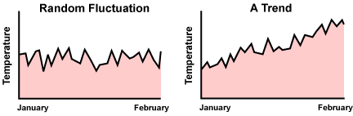
Trends
Random Fluctuation vs. A Trend
(http://evolution.berkeley.edu/evolibrary/article/evo_54)

Slide 3
Does Not Always Have a Direction
Misconception’s (higher organisms)
Simplicity vs. Complexity (rate of production)
Examples: Malaria and Mycoplasma
These parasites have dispensed of traits

Slide 4
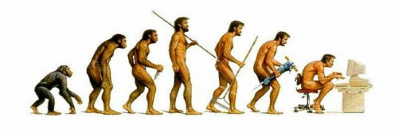

Slide 5
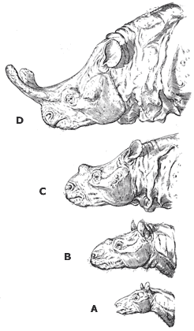
Towards Complexity
We also see that organisms evolve to become more complex
Typically through co-evolution (evolutionary arms race)

Slide 6
Evolution: A response to survival
http://upload.wikimedia.org/wikipedia/commons/3/3b/Evolution_of_complexity.svg

Slide 7
Active Vs. Passive
Evolution can be passive or active
Active- evolutionary self-organization
Passive- a response to a greater amount of biodiversity

Slide 8
What do I think this means?
We find that this has proven troublesome in Artifical life.
We find this in Thomas Rays Tierra. With the absence of the fitness function. Like many other computer models the model at large begins to loop or ceases to evolve.
How do we produce true “open-ended evolution” or rather can we make sense of evolution?

Slide 9
Works Citied
Artiﬁcial life: organization, adaptation and complexity from the bottom up Review TRENDS in Cognitive Sciences Vol.7 No.11 November 2003 505. Mark A. Bedau.
http://evolution.berkeley.edu/evolibrary/article/evo_54
Ray, T. S. 1991, "Evolution and optimization of digital organisms", in Billingsley K.R. et al. (eds), Scientific Excellence in Supercomputing: The IBM 1990 Contest Prize Papers, Athens, GA, 30602: The Baldwin Press, The University of Georgia. Publication date: December 1991, pp. 489–531.
http://en.wikipedia.org/wiki/File:Evolution_of_complexity.svg Tim Vicks

