Slide 1
Hebb’s Theory
The implications of his theory, and their application to Artificial Life

Slide 2
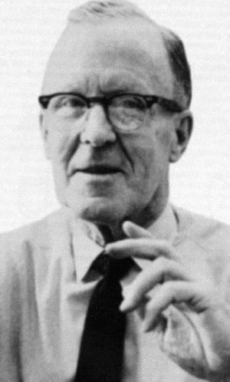
Donald O Hebb
The man
Associative Learning
Hebbian Plasticity
Artificial Life
Applications
Wrote The Organization of Behavior in 1949
“When an axon of cell A is near enough to excite cell B and repeatedly or persistently takes part in firing it, some growth process or metabolic change takes place in one or both cells such that A's efficiency, as one of the cells firing B, is increased” (Hebb 1949)

Slide 3
In Other Words
The man
Associative Learning
Hebbian Plasticity
Artificial Life
Applications
Neurons that fire together wire together

Slide 4
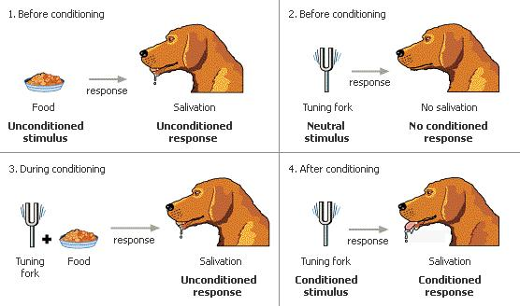
Classical Conditioning
The man
Associative Learning
Hebbian Plasticity
Artificial Life
Applications
Img From: http://www.skewsme.com/behavior.html

Slide 5
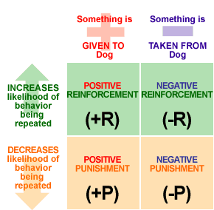
Operant Conditioning
The man
Associative Learning
Hebbian Plasticity
Artificial Life
Applications
Img From: http://malinut.com/img/ocquad.gif

Slide 6
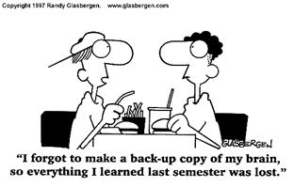
What about long term memory?
The man
Associative Learning
Hebbian Plasticity
Artificial Life
Applications
From: http://www.cdtl.nus.edu.sg/examprep/imgs/randy2.jpg

Slide 7
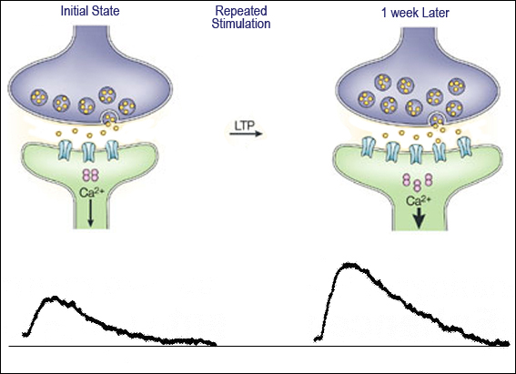
Long-term Potentiation
The man
Associative Learning
Hebbian Plasticity
Artificial Life
Applications
from: http://employees.csbsju.edu/ltennison/PSYC340/LTP.jpg

Slide 8
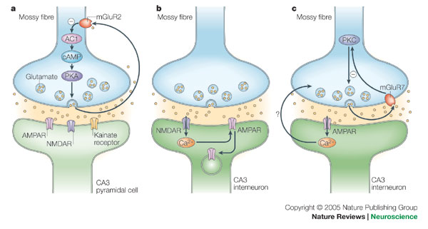
Long-term Depression
The man
Associative Learning
Hebbian Plasticity
Artificial Life
Applications
From http://www.nature.com/nrn/journal/v6/n11/images/nrn1786-f7.jpg

Slide 9
Bienenstock, Cooper and Munro (BCM) model
The man
Associative Learning
Hebbian Plasticity
Artificial Life
Applications
“neuron possesses a synaptic modification threshold”
“the value of [modification threshold] is not fixed but instead increases according to a non- linear function with the average output of the cell.”
Jedlicka P - Synaptic plasticity, metaplasticity and bcm theory

Slide 10
Bienenstock, Cooper and Munro (BCM) model
The man
Associative Learning
Hebbian Plasticity
Artificial Life
Applications
Sliding modification threshold

Slide 11
Hebbian plasticity
The man
Associative Learning
Hebbian Plasticity
Artificial Life
Applications
“..must be augmented by global processes that regulate overall levels of neuronal and network activity”
Synaptic plasticity: taming the beast L. F. Abbott and Sacha B. Nelson

Slide 12
Hebbian plasticity
The man
Associative Learning
Hebbian Plasticity
Artificial Life
Applications
“…over time Hebbian plasticity has come to mean any long-lasting form of synaptic modification (strengthening or weakening) that is synapse specific and depends on correlations between pre- and postsynaptic firing”
Synaptic plasticity: taming the beast L. F. Abbott and Sacha B. Nelson

Slide 13
Hebbian plasticity
The man
Associative Learning
Hebbian Plasticity
Artificial Life
Applications
Synaptic scaling
Spike-timing dependent plasticity
Synaptic redistribution
Synaptic plasticity: taming the beast L. F. Abbott and Sacha B. Nelson

Slide 14
Implications
The man
Associative Learning
Hebbian Plasticity
Artificial Life
Applications
Framework for building and understanding how information islands accumulate knowledge

Slide 15
The man
Associative Learning
Hebbian Plasticity
Artificial Life
Applications
Applications
Cocktail Problem
Imagery
Fuzzy Cognitive Maps
Adaptive Interactions
Robotics

Slide 16

Summaries
Hebbian Learning
Oja's_rule
BCM_theory
Long-term_potentiation

Slide 17
Biblography
Igor, Antonov, Antonova, Irina, Kandel , Eric R., and Hawkins, Robert D. (2003). Activity-Dependent Presynaptic Facilitation and Hebbian LTP Are Both Required and Interact during Classical Conditioning in Aplysia
Abbott , L. F. and Nelson, Sacha B(2000). Synaptic plasticity: taming the beast https://www.stanford.edu/group/brainsinsilicon/documents/AbbotPlasticityReview.pdf
Bienenstock, Elie L.; Leon Cooper, Paul Munro (January 1982). Theory for the development of neuron selectivity: orientation specificity and binocular interaction in visual http://www.physics.brown.edu/physics/researchpages/Ibns/Cooper%20Pubs/070_TheoryDevelopment_82.pdf
Hyvärinen, A. and Oja, E. (1998). Independent component analysis by general nonlinear Hebbian-like learning rules.
Hyvärinen, Aapo and Oja, Erkki (2000) Independent Component Analysis :Algorithms and Applications
Jedlicka P (2002) Synaptic plasticity, metaplasticity and bcm theory
Xiangfeng, Luo, Wei, Xiao, and Zhang, Jun (2010) Guided Game-Based Learning Using Fuzzy Cognitive Maps

