Slide 1
Music and Artificial Life
Applications of Artificial Life Methods in the Study of Music and Sound
Informatics I-586 – Artificial Life as an approach to Artificial Intelligence
Scott McCaulay

Slide 2
Why is this interesting?
Music (like language) is a complex, emergent system, a good match for the types of tools used in Artificial Life
Music is an interesting phenomenon in human evolution, it’s universality is unexplained in terms of a specific functional need
Music is not a uniquely human phenomenon, many other animals produce what we consider music

Slide 3
Where to Look
Computer Music Journal
Published by MIT Press, quarterly since 1977
Artificial Life
Also published by MIT Press, quarterly since 1993
ECAL – European Conference on Artificial Life
Have held multiple workshops on Music and Artificial Life
Artificial Life Models for Musical Applications (ALMMA)
Music-AL Workshops
International Conference on Music Information Retrieval
Annual conference since 2001, Alife is not the primary focus but has hosted Alife presentations

Slide 4
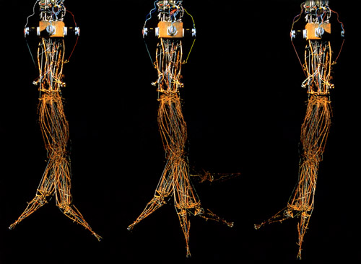
Areas of Interest
Sound Synthesis
Music Composition
Origins and Evolution of Music
Robotics

Slide 5
Audio Synthesis
Using Cellular Automata
Miranda, E.R. (1995). Granular Synthesis of Sounds by Means of a Cellular Automaton
Using Genetic Algorithms
Horner, A., Beauchamp, J., Haken, L. (1993). Genetic Algorithms and Their Application to FM Matching Synthesis.
When, K. (1998). Using Ideas from Natural Selection to Evolve Synthesized Sounds.

Slide 6
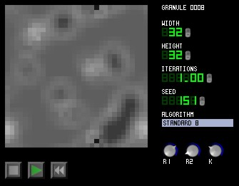
Chaosynth
CA-based granular synthesis program developed by Eduardo Reck Miranda (University of Plymouth)
2D grid of cells evolve over time, influenced by states of neighboring cells, active cells contribute information to the sound being produced

Slide 7

Music Composition
Based on cellular automata
Grid of cells containing some musical information or rule, cells are activated based on status of neighboring cells
Based on genetic algorithms
Iterative application of some scoring or ranking mechanism, with subsequent selection, recombination and mutation

Slide 8
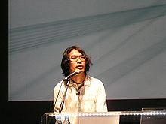
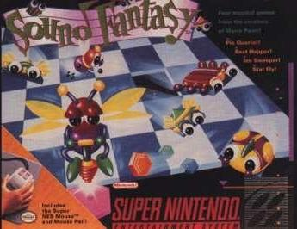
Toshio Iwai
Artist and game designer
Music Insects (1992)
Insect-like creatures moving over a two dimensional grid. The movements of the insects are translated into sound. By appropriate placement of patches and choice of behavioral parameters of the insects (e.g., their speed and timbre), different musical performances can be created.
Video games Sound Fantasy, SimTunes and Electroplankton all involve music composition based on the actions of agents selected by the player

Slide 9
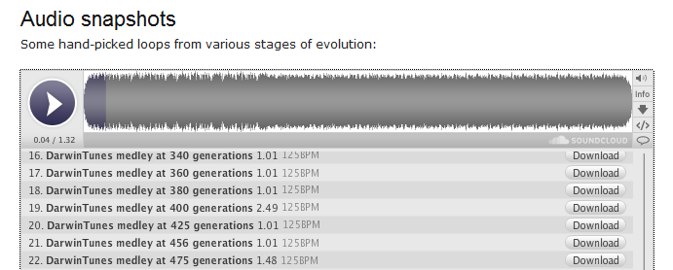
DarwinTunes.org
Developed at Imperial College London
Dr. Bob Macallum (Bioinformatics)
Dr. Armand Leroi (Evolutionary Biology)
Uses genetic algorithms to evolve music. Fitness is determined by listeners ratings.

Slide 10
Origins and Evolution of Music
Examine questions about how musical styles and tunings could develop in a population
Miranda, E.R. (1999). The Artificial Life Route to the Origins of Music
Aucouturier, J.J. (2008). The Hypothesis of Self-Organization for Musical Tuning Systems

Slide 11
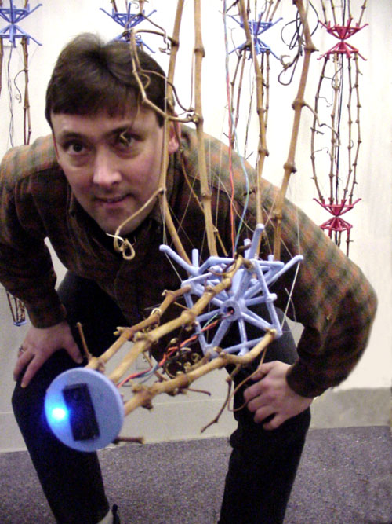
Robotics
Ken Rinaldo - Directs the Art and Technology program at The Ohio State University
Works at “the intersection of art and biology”. Research in interactive robotics, biological art, artificial life, interspecies communication…
Produces interactive robotic art that incorporates elements of music and language

Slide 12
Questions? Comments?

