Slide 1
BALANCED WORKFORCE
Final presentation in Design of Governance in Socio-Technical Information Systems
University of Neuchatel, 27.05.2024
Melody Amaizu Martin Stojkovski Professor: Alain Sandoz
Ariton Verush Assistant: Andreas Athanasopoulos

Slide 2
INTRODUCTION TO BALANCED WORKFORCE
Overview
Companies struggle to adapt manpower quickly to changing demands.
Recruitment and training of new employees is time-consuming and costly.
Challenges
Operational inefficiencies during periods of high demand. Companies who struggle to find employees for a specific need and lack workforce in their branches.
Financial inefficiency due to idle workforce. Some companies struggle with overcapacity, which leads to employee insufficient work-time and lack of having tasks or active projects to work on – further reflecting on their annual/hourly salary.
Solution
Balancing workforce needs between companies through temporary employee exchanges. Companies who need employees for a specific job, skill, tool or any other reason, can search for companies who loan their employees about the same needs for a specific period of time.

Slide 3
PROJECT REQUIREMENTS
Technology Connector
Digital marketplace tool for listing and requesting temporary team members.
Requires Information and Communication Technologies(ICT) for platform development, security, and data privacy.
Governance Framework
Policies are mandatory to be followed for leasing terms, financial arrangements, contracts signed according to the laws and responsibilities of each side involved.
Performance Mechanisms
Systems for evaluating performance and facilitating knowledge transfer. Collective feedback of employees about their experience during lease time.
Cultural and Ethical Considerations
Addressing corporate culture, achieving employee's loyalty, and shutting down discrimination while being loaned.

Slide 4

STAKEHOLDERS INVOLVED
Companies (Lessor)
Lease out underutilized employees to reduce costs and provide growth opportunities.
Companies (Lessee)
Temporary need for additional workforce to fill skill gaps or increase production capacity.
Employees (Resources)
Interests include compensation, job security, and professional development.
IT Departments/Technology Providers
Responsible for developing and maintaining the digital connector tool.

Slide 5
OPERATIONAL PROCESS
Company 1 (Lessor) and Company 2 (Lessee)
Use a Docker image to host the web application within their environments.
Platform
Accessed through a specific port tunneled by the Docker image for security.
Central Server
Hosts a database with non-personal data about employee availability.
Chat System
Facilitates secure communication between companies.
Contract Management System
Integrated for generating, signing, and storing leasing contracts.

Slide 6
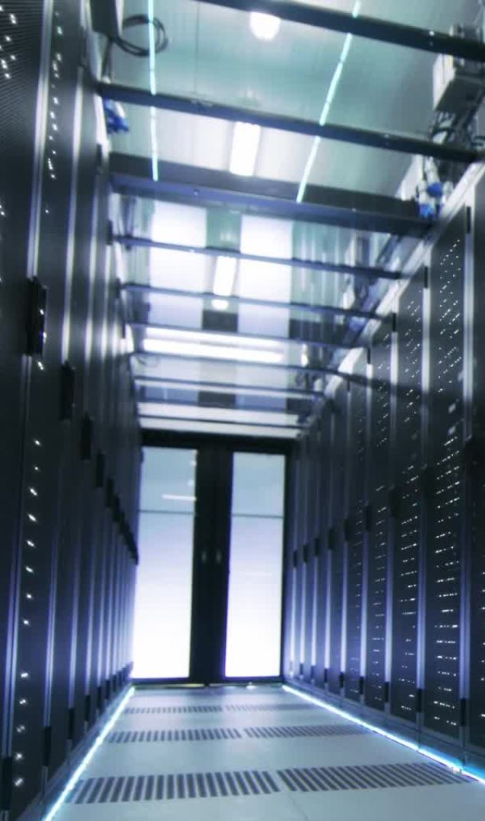
INFRASTRUCTURE SETUP
Server-based Companies
Install Docker image on server infrastructure with secure access configurations.
Laptop/Desktop-based Companies
Docker image can be installed on individual devices with SSH tunneling and DDNS for accessibility.
Security Measures
Employ robust configurations including SSL/TLS and secured authentication methods.

Slide 7

EMPLOYEE'S USER PROFILE, WAY OF ACCESS AND RIGHTS
User Profile Management
Information Sharing: Employees can control which personal information is shared with potential lessee companies. They can choose to anonymize certain details while making essential qualifications and experience visible.
Profile Updates: Employees can update their profiles regularly to reflect their latest skills, projects, and certifications. Changes are synced with the employer’s internal HR system and the platform’s central database.
Access and Authentication
Login Credentials: Employees receive secure login credentials from their employer to access the platform. These credentials ensure that only authorized users can access and update their profiles.
Web Platform Access: Employees log in via a secure web interface, which provides access to their profiles, leasing opportunities, and other platform features.

Slide 8

EMPLOYEE VERIFICATION AND LISTING
Employee Initiation
Employees express interest in being leased out or respond to internal postings.
Employer Verification
Employer verifies employee eligibility and willingness to participate.
Profile Listing
Verified profiles are listed internally and then synchronized with a central database.

Slide 9

INTEGRATION AND PLATFORM DEVELOPMENT
Integration Capabilities
Compatibility with existing HR and ERP systems.
Pre-built connectors for popular systems (SAP, Oracle, Microsoft Dynamics).
Custom integration support and development kit.
Third-Party Developer Usage
Open Developer Platform: Tiered API access, developer portal, and support.
Plugin and Extension Development: Encouraging enhancements and niche integrations.
Innovation and Feedback Loop: Regular updates based on community feedback.

Slide 10
TALENT MATCHING AND AGREEMENT
Discovery of Talent by C2
Company 2 reviews available listings and selects potential candidates.
Interest Expression
C2 expresses interest through the platform, initiating secure communication.
Negotiation and Agreement
Secure chat opens for negotiation, contract terms are drafted, reviewed, and signed.
Direct Employee Engagement
C2 engages with the employee to finalize terms and start the assignment.
Documentation and Traceability
All terms, agreements, and communications are documented and stored securely.

Slide 11

BUSINESS MODEL OVERVIEW
Objective
Maximize revenue while providing scalable, secure, and efficient solutions
Revenue Components
Licensing Fees
Subscription Services
Installation Services
Community Contributions
Target Audience
Small businesses to large corporations

Slide 12
LICENSING FEES AND SUBSCRIPTION SERVICES
LICENSING FEES
-Initial Licensing Fee:
One-time fee for installing and running the Docker container.
-Renewal Fees:
Annual fee for updates and support, ensuring continuous platform improvements and security updates.
SUBSCRIPTION SERVICES
-Standard Subscription:
Access to basic functionalities, regular updates, and standard customer support.
-Premium Subscription:
Advanced features, enhanced analytics, priority support, early access to new features.
-Scalability:
Plans tailored to different company sizes and needs.

Slide 13
ADDITIONAL REVENUE STREAMS
Installation Services
On-site Installation: Technicians install and configure the Docker container.
Remote Setup: Virtual assistance for installation and configuration.
Training and Onboarding: Sessions for staff to effectively use the platform.
Community Contributions
Marketplace Fees: Percentage of sales from developer plugins.
Certification Fees: Ensuring third-party plugins meet compatibility and security standards.

Slide 14
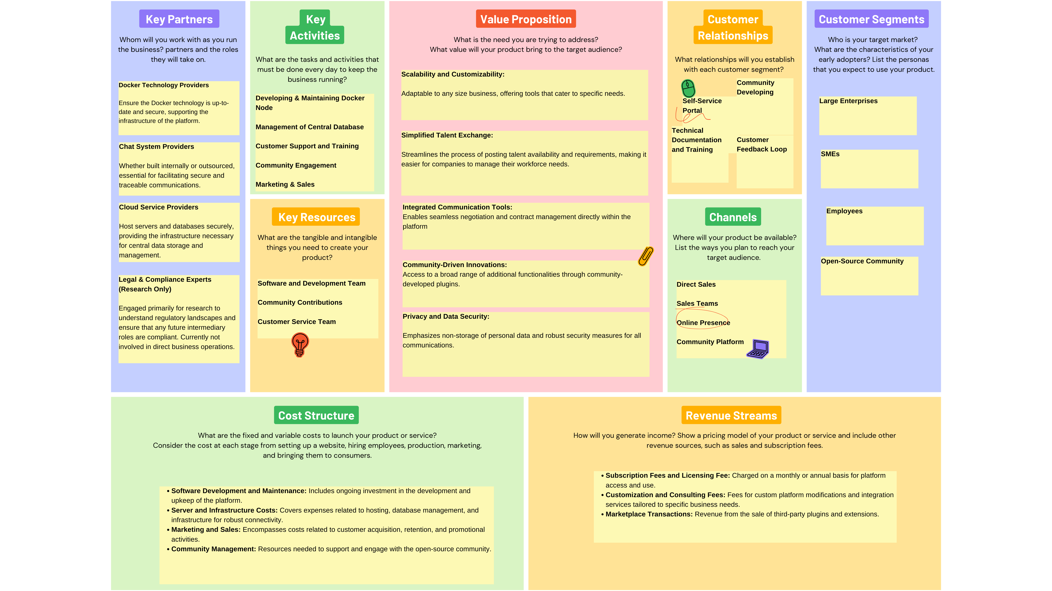
BUSINESS MODEL CANVAS

Slide 15
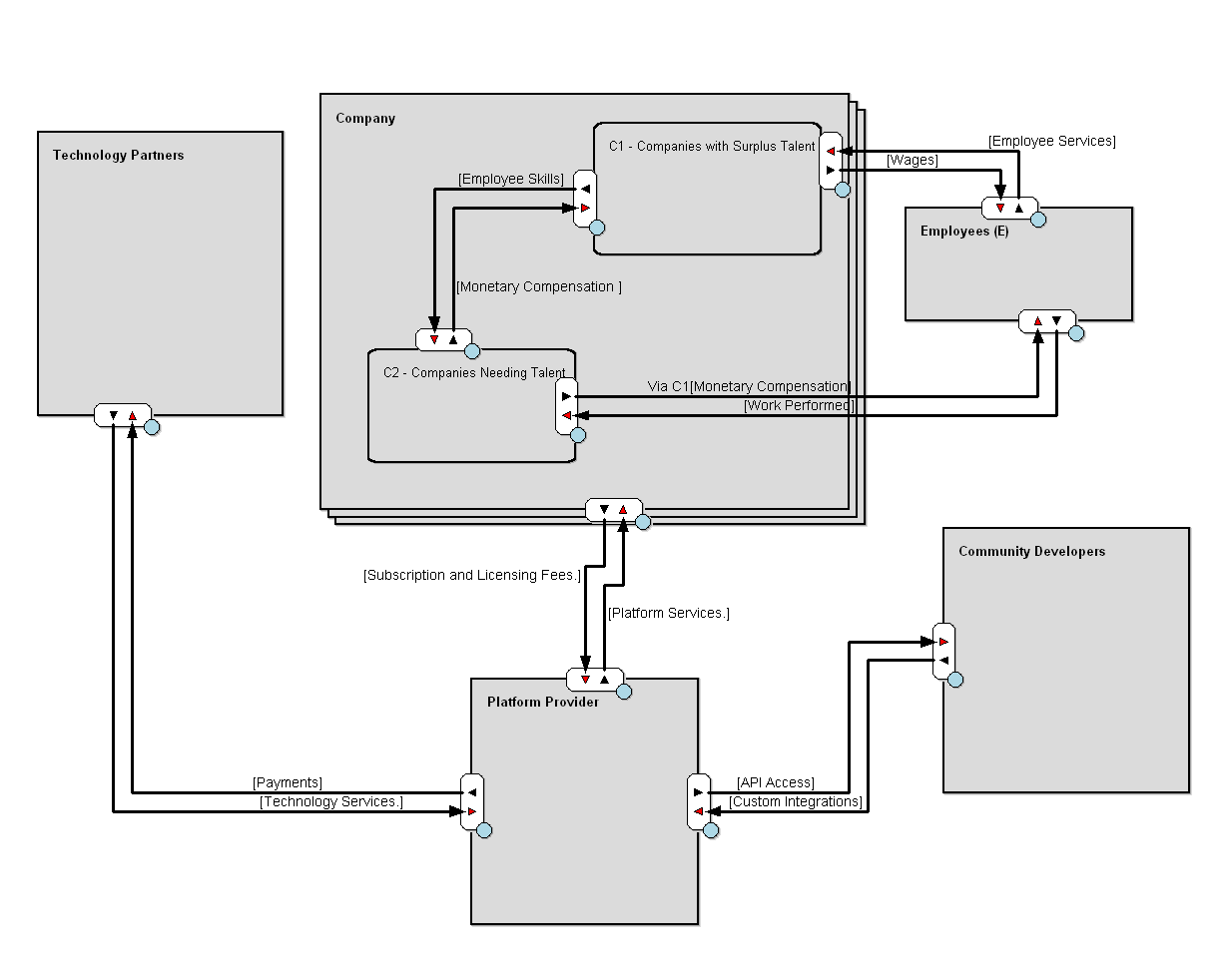
E3VALUE EXCHANGE MODEL

Slide 16
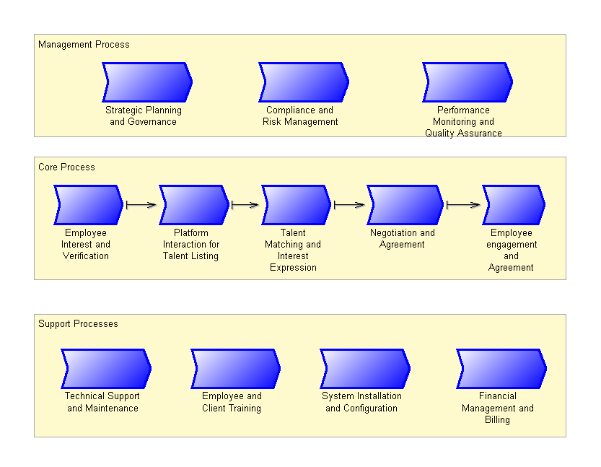
BUSINESS PROCESS LANDSCAPE

Slide 17
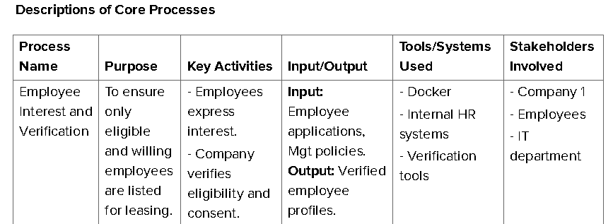
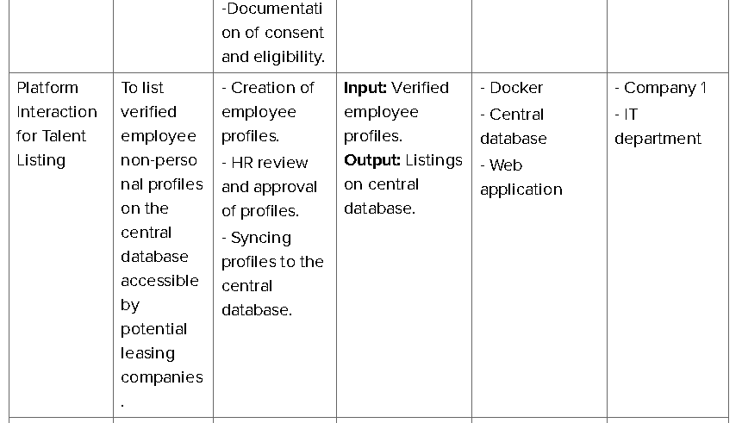

Slide 18
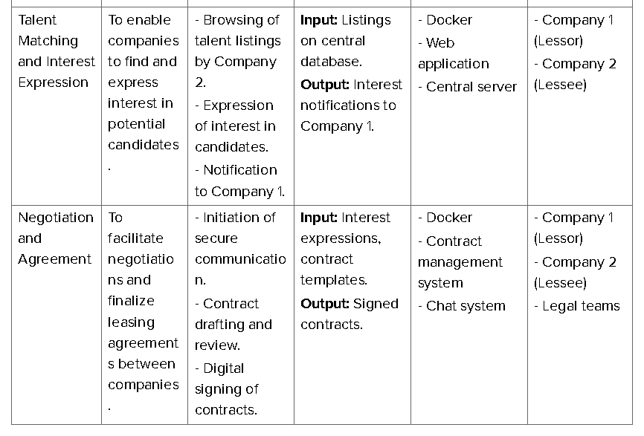
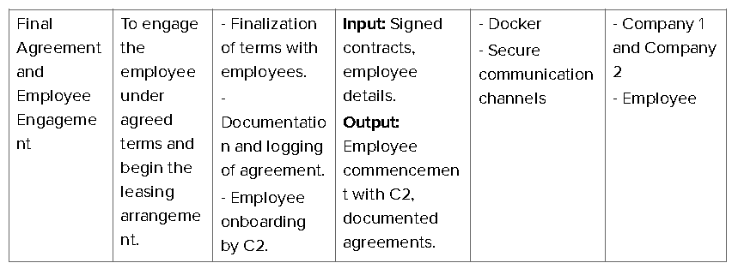

Slide 19
BUSINESS PERSPECTIVE ON T2 TRANSACTION – PART 1
Impact on Business Model
Revenue Generation
T2 drives transaction volume on the platform.
Successful matches increase perceived value of subscription plans.
User Engagement and Retention
Efficient matching capabilities enhance satisfaction and retention.
Quick and accurate matches make the platform indispensable.
Data Utilization and Value Proposition
Leverages data from T1 phase to match employees with opportunities.
Demonstrates value proposition to C1 and C2, enhancing competitive edge.

Slide 20
Impact on Operational Processes
Scalability
T2 tests platform's ability to handle large data volumes and interactions.
Influences infrastructure investment decisions.
Security and Compliance
Ensures robust security and compliance with data protection regulations.
Protects sensitive employee information during data exchange.
Integration and Flexibility
Seamless integration with existing HR and ERP systems.
Influences API design and integration capabilities.
BUSINESS PERSPECTIVE ON T2 TRANSACTION – PART 2

Slide 21

ARCHIMATE ARCHITECTURE
Introduction to ArchiMate
ArchiMate is an open and independent modeling language for enterprise architecture.
Supported by the Open Group, it provides tools for describing, analyzing, and visualizing relationships among business domains.
Usefulness for Balanced Workforce Platform
Aligns technological infrastructure and business goals.
Ensures clarity and consistency across project documentation.
Facilitates communication with stakeholders.

Slide 22
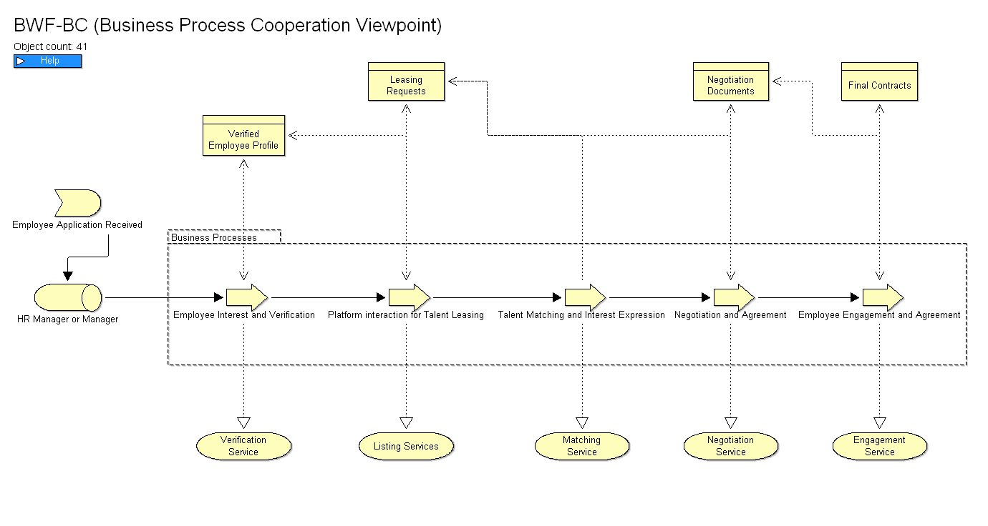
BUSINESS PROCESS COOPERATION VIEWPOINT

Slide 23
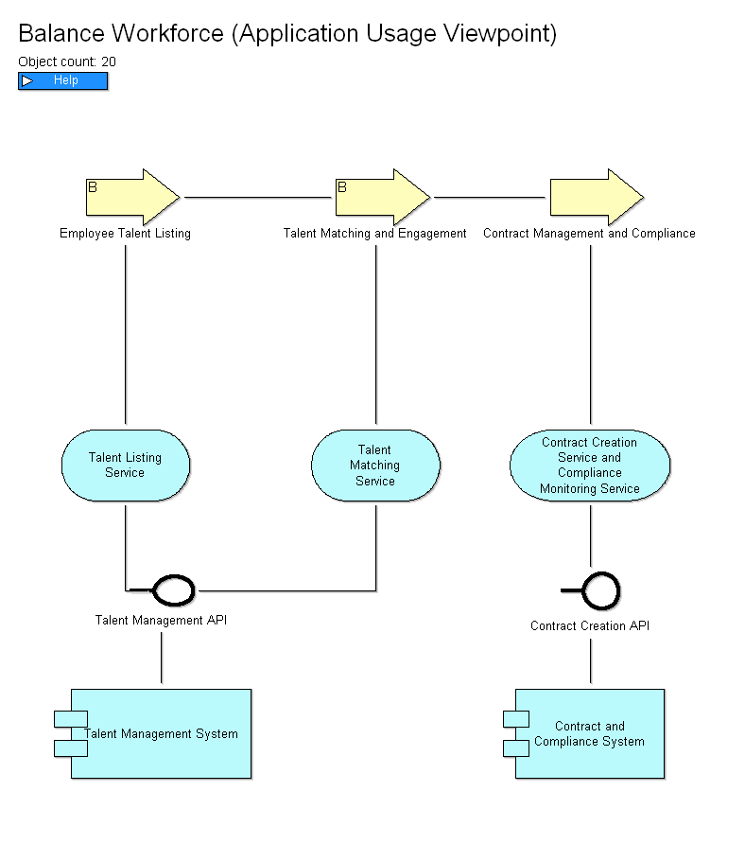
APPLICATION USAGE VIEWPOINT

Slide 24

OVERVIEW OF THE ARCHITECTURE
KEY COMPONENTS
Docker Image/Container (Node)
Web Platform: Primary user interface.
Database: Stores non-personal employee data, leasing requests, transaction logs.
Logger: Logs all transactions and actions on the platform.
API Layer: Communicates with external systems and connectors.
Authentication Module: Manages user authentication and authorization.
Company 1 (Lessor) Infrastructure
Docker Node: Hosts web platform and database locally.
Internal HR System: Manages employee data and profiles.
Company 2 (Lessee) Infrastructure
Docker Node: Facilitates access to the platform and data exchange.
Internal HR System: Manages leased employees.

Slide 25
Central Server
Registration and Licensing System: Manages licenses and subscriptions.
Central Database: Aggregates non-personal data on employee availability and leasing requests.
Communication Hub: Facilitates secure communication between nodes.
Employee Interface
Mobile/Web App: Allows employee interaction with the platform.
Local Database (SQLite): Stores employee credentials and minimal data locally.
External Connectors and Plugins
API Integration: For third-party custom connectors and plugins.
Marketplace: For purchasing or downloading plugins.

Slide 26
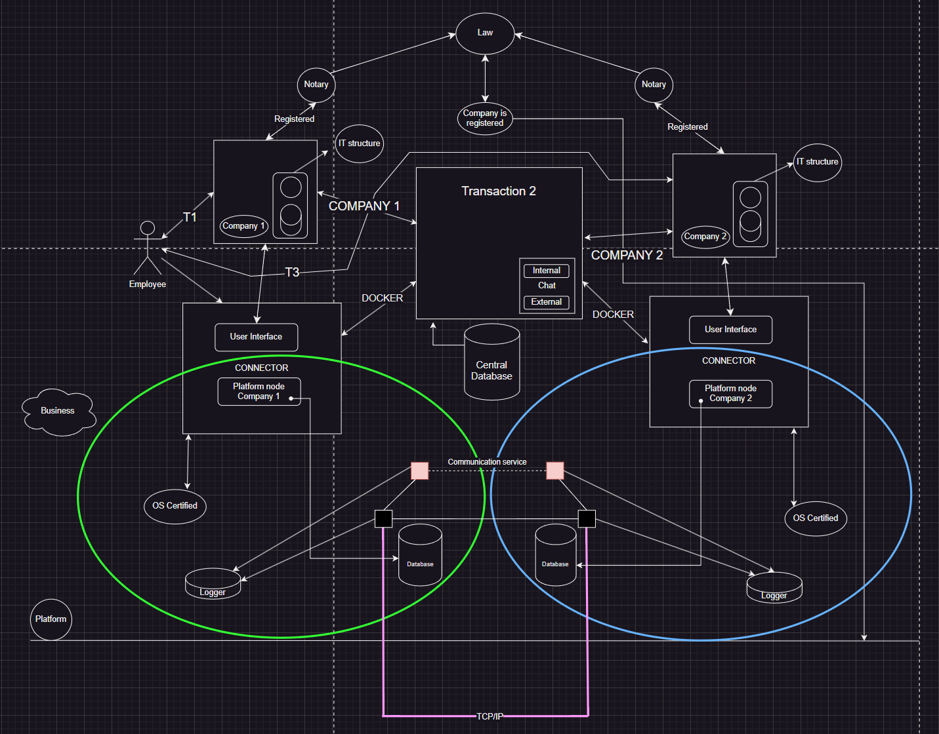

Slide 27

CONCEPTUAL DATA FLOW ACROSS COMPONENTS
Employee Interest and Verification (T1)
Employees express interest via mobile/web app.
Verified by Company 1's HR system.
Profiles stored in local Docker node database.
Approved profiles synchronized with central database (non-personal data only).
Talent Matching and Interest Expression (T2)
Company 2 browses talent listings via Docker node.
Interest expressions logged and notifications sent to Company 1.
Secure channels established for negotiations and agreement finalization.
Negotiation and Agreement (T2 Continued)
Contracts drafted, reviewed, and signed within the platform.
Interactions logged and stored securely.
Employee Engagement (T3)
Company 2 manages onboarding.
Performance and feedback monitored and recorded.

Slide 28
DETAILED ARCHITECTURE OF T2 TRANSACTION(PART 1)
Browsing and Interest Expression
Company 2 Docker Node: Accesses platform and browses profiles.
API Requests: Sent to central server to retrieve profiles.
Central Database: Returns profiles (non-personal data only).
Interest Expression
Company 2: Selects profile and expresses interest.
API Request: Logs interest in central database.
Notification Service: Notifies Company 1 of expressed interest.

Slide 29
DETAILED ARCHITECTURE OF T2 TRANSACTION(PART 2)
Secure Communication
Initiation of Communication: Establishes secure channel between Company 1 and Company 2.
Data Exchange: Discusses employee details and terms, all logged.
Contract Negotiation and Signing
Contract Drafting: Drafts created and reviewed within platform.
Digital Signatures: Contracts signed digitally and stored securely.
Transaction Logging: All interactions and agreements logged in central and local databases.

Slide 30
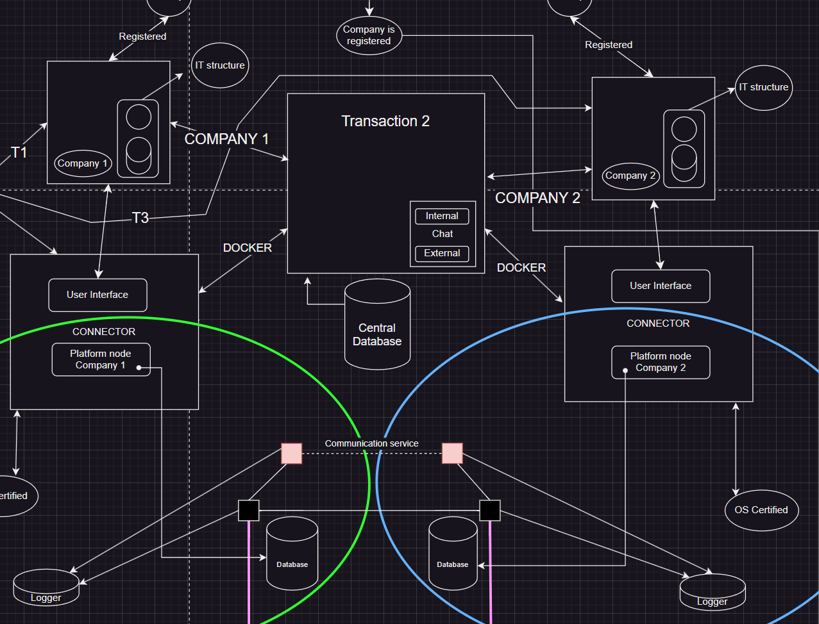

Slide 31

POTENTIAL CHALLENGES – LEGAL ISSUES
Labor Laws and Regulations
Complex Compliance: Adhering to local and international labor laws.
Employment Standards: Ensuring worker rights and benefits entitlements.
Data Privacy and Protection
Regulatory Compliance: Following data protection laws like GDPR and CCPA.
Anonymization Risks: Ensuring anonymized data cannot be re-identified.
Contractual Agreements
Legal Soundness: Ensuring all contracts reflect agreed terms and avoid disputes.
Intellectual Property Rights
Ownership Issues: Addressing IP rights for work created during leasing.

Slide 32

POTENTIAL CHALLENGES – ETHICAL ISSUES
Employee Consent and Autonomy
Informed Consent: Ensuring employees understand and agree to be listed.
Transparency and Fair Treatment
Bias Prevention: Ensuring fair and unbiased selection of employees.
Conflict of Interest
Competitor Leasing: Preventing conflicts when leasing to competitors.
Impact on Company Culture
Employee Morale: Mitigating negative effects on company culture.

Slide 33

POTENTIAL CHALLENGES – OPERATIONAL ISSUES
Quality Control
Skill and Performance: Ensuring leased employees meet standards.
Dispute Resolution
Complex Handling: Managing disputes between companies and employees.
Platform Security
Continuous Monitoring: Protecting sensitive data from breaches.
Scalability and Reliability
Managing Growth: Handling increased transactions and maintaining reliability.

Slide 34
FUTURE PLANS – DECENTRALIZED CONTRACT SIGNING
Objective
Enhance security, transparency, and efficiency by decentralizing contract signing using blockchain technology and smart contracts.
Blockchain Integration
Immutable Ledger: Utilize blockchain to store all contract-related transactions in an immutable and transparent ledger.
Smart Contracts: Implement smart contracts to automate and enforce the terms of leasing agreements without the need for intermediaries.
Digital Signing Process
Contract Creation: Contracts are created and stored on the blockchain.
Smart Contract Execution: Smart contracts execute predefined conditions, ensuring that once conditions are met, the contract is automatically enforced.
Digital Signatures: Companies digitally sign the contracts using cryptographic keys, ensuring authenticity and security.

Slide 35
FUTURE PLANS – STORING TRANSACTIONS WITH BLOCKCHAINS
Process Flow
Smart Contract Deployment: The smart contract is deployed, encoding the terms of the agreement.
Transaction Initiation: When a leasing agreement is reached, the transaction is initiated on the blockchain.
Execution and Storage: Once the conditions of the contract are met, the smart contract executes the transaction, which is then recorded on the blockchain.
Monitoring and Verification: Continuous monitoring of the blockchain ensures that all transactions are verified and remain tamper-proof.

Slide 36

CONCLUSION
The Balanced Workforce Leasing Platform represents a significant innovation in workforce management, offering a secure, scalable, and efficient solution for talent leasing. With a robust business model encompassing licensing fees, subscription services, and community contributions, it provides substantial value to businesses. Our Docker-based architecture ensures seamless integration and robust data management, while the future plans to incorporate blockchain technology for decentralized, secure digital contract signing promise enhanced transparency and efficiency. Committed to addressing legal, ethical, and operational challenges, we aim to continually evolve the platform to meet the dynamic needs of businesses and employees, driving innovation and growth in workforce management.

Slide 37

THANK YOU😃 ANY QUESTIONS?

