Slide 1
SPORTIFY HUB
DEPENDANT ON USER’S FREE TIME / PREFERENCES / PREVIOUS ACTIVITIES
Mid-term presentation in Fuzzy Sets and Systems II
12.04.2024, University of Fribourg Martin Stojkovski and Ariton Verush

Slide 2
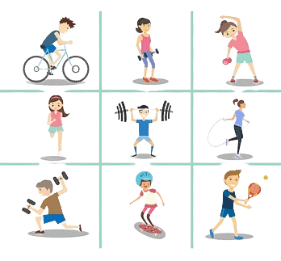
INTRODUCTION
"Sportify Hub" is going to be a comprehensive platform designed to meet the varied needs of sports enthusiasts, athletes, and fitness enjoyers alike. Whether you're seeking connections with like-minded individuals, exploring new sports and activities, or tracking your progress and achievements, Sportify Hub provides a centralized hub for all things sports-related. With community challenges, Sportify Hub aims to inspire, motivate, and empower users to lead active and healthy lifestyles.

Slide 3
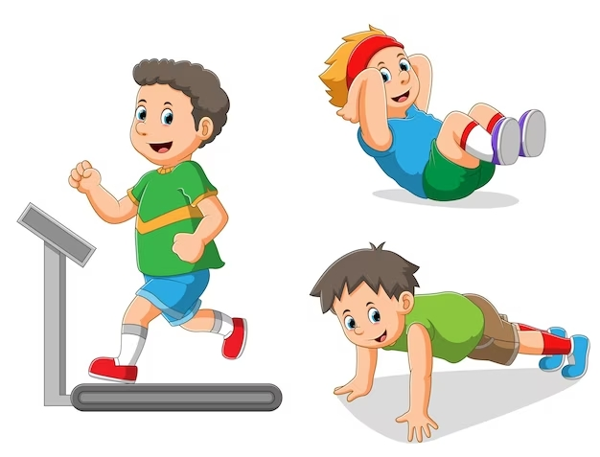
GOALS
Our plan is to cultivate a supportive community where users, dependent on their free time, preferences, and previous activities, can track their progress, set fitness goals, and participate in challenges, all while accessing expert advice and diverse sports content to stay motivated and engaged. Join the Sportify community and discover endless opportunities to explore, engage, and succeed in your sporting journey.

Slide 4
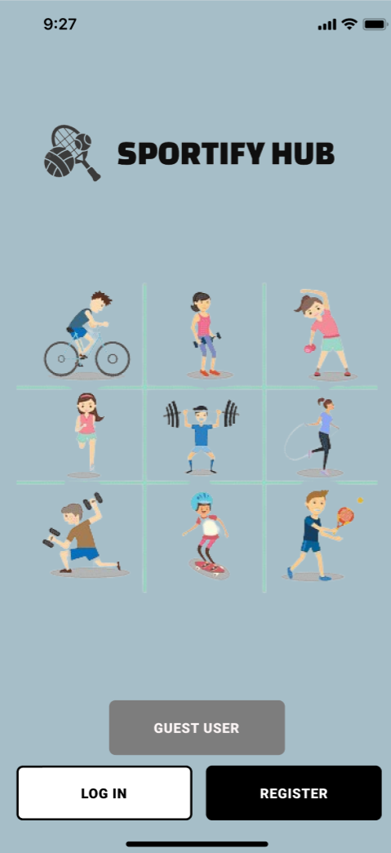
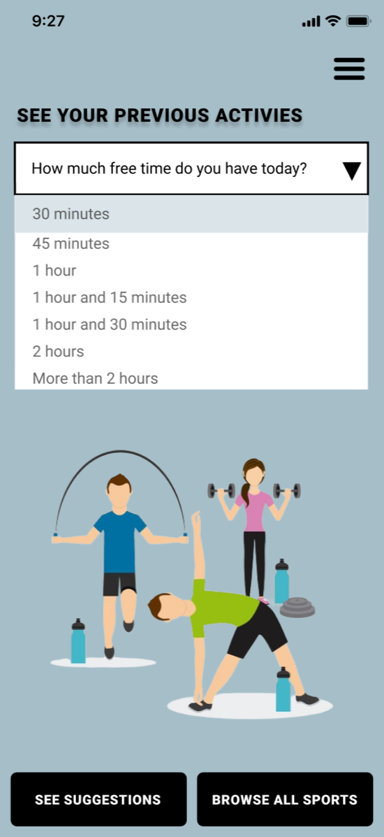
THE PROTOTYPE
Link to our prototype:
SPORTIFY HUB

Slide 5
OUR CATEGORIES
Team Sports:
Football: Played between two teams to score goals by kicking the ball into the opposing team's net.
Basketball: Involves two teams competing to score points by shooting a ball through the opponent's hoop.
Handball: Precise throws, and strategic teamwork, where players aim to score goals by throwing a ball into the opponent's net.
Volleyball: Players use their hands or arms to hit a ball over a net and score points by grounding it in the opponent's court.
Individual Sports:
Running: Includes various disciplines such as sprinting, long-distance running, and hurdling.
Swimming: Involves various strokes (e.g., freestyle, breaststroke, butterfly) swum in pools or open water.
Golf: Players use clubs to hit a ball into a series of holes on a course in as few strokes as possible.
Boxing: A combat sport where participants throw punches at each other to score points or achieve a knockout.

Slide 6
Combat Sports:
Martial Arts: Includes disciplines such as karate, judo, taekwondo, and Brazilian jiu-jitsu, where participants engage in combat using various techniques and strategies.
Wrestling: Involves grappling techniques to gain control over an opponent and pin them to the ground.
Mixed Martial Arts (MMA): Combines techniques from various martial arts disciplines, including striking and grappling, in standing and ground positions.
Racquet Sports:
Badminton: Played with racquets and a shuttlecock, where players hit the shuttlecock over a net.
Squash: Involves hitting a ball against a wall within a defined court using a racquet.
Ping Pong: Players use paddles to hit a lightweight ball back and forth over a table divided by a net.
Tennis: Played between two individuals or teams, where players use racquets to hit a ball over a net into the opponent's court.
Adventure Sports:
Hiking: lets you explore nature, relax, and recharge while walking through beautiful outdoor scenery and trails.
Rock Climbing: Participants climb natural rock formations or artificial climbing walls using ropes and specialized equipment.
Surfing: Riding waves on a surfboard in the ocean.
Skydiving: Involves jumping from an aircraft with a parachute and freefalling before deploying the parachute to slow descent

Slide 7
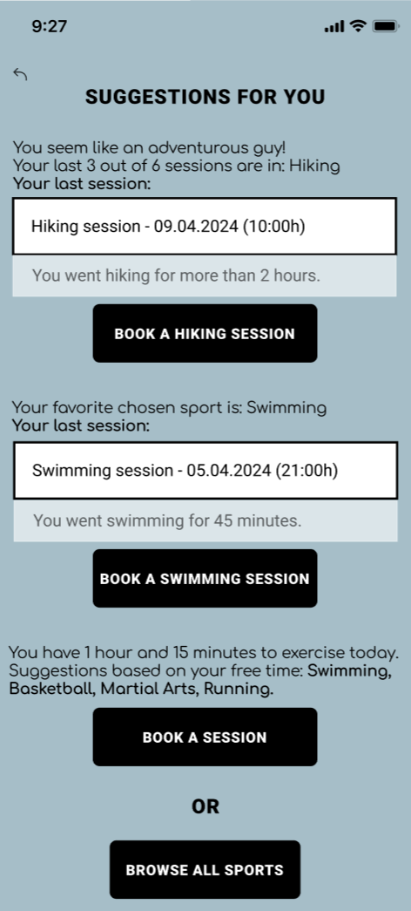
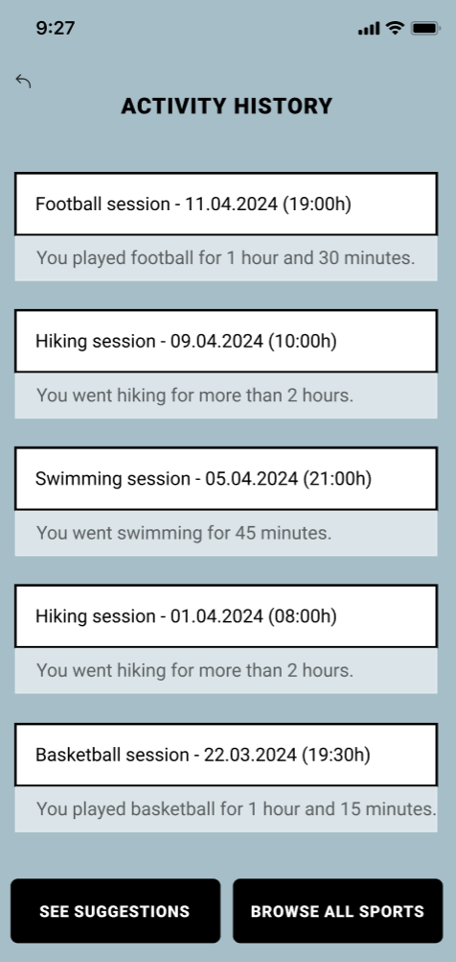

Slide 8
ASK US ANYTHING
Session 1
Luca: Is the user able to rate the sport after having a session, so he can get better recommendations?
Michele: What if the user wants to play a team sport with his friends? Can they book a session together?
Tobias: Does the user have the option to recommend a sport to similar users? Can he choose more favorite sports while registering on the platform?
Session 2
Pierre: To get better recommendations, the logic in the whole projects needs to look a bit more fuzzy. Does the user get any reward after completing his sessions?
Jiaxin: Do you have a streak for days in a row exercised in your platform? Can the user see how much calories is he going to burn after completing a session, before booking one?

Slide 9
SPORTIFY HUB’S RESPONSES
Answer 1: Right now the user can’t rate the sport after having a session. It will definitely lead to better recommendations if he is able to rate the sessions that he enjoyed.
Answer 2: Regarding the team sports booking, they can actually play all together if they only have the exact number of players required for the given sport. We can maybe improve that in a way too.
Answer 3: The user doesn’t have the option to recommend a sport to a similar user, and that can be a nice improvement on our platform. Choosing more favorite sports can also lead to better recommendations for the user.
Answer 4: The user doesn’t get any reward after completing a session right now, and that is a nice idea that we can add on our improvements list.
Answer 5: We don’t have a day-streak counter, but it will be a nice feature for improved motivation.

Slide 10

WHERE SHOULD WE IMPROVE?
From session 1:
Users should be able to rate sports after sessions. They also need to get better recommendations, according to their ratings of previous experiences, as well as recommend sports to similar users. Regarding the team sports, we are planning to add one more option on the platform.
From session 2:
Those who are serious about their goal, need to get more motivation by claiming rewards after completing a session or having a day-streak.
Also, a bit more fuzzy logic should be implemented in the whole idea.

Slide 11

WHAT SHOULD BE EXCLUDED? WHAT IS INSUFFICIENT?
Do not give a lot of recommendations
While aiming to give a better view to the variety of sports is good, having too broad of a scope might reduce the platform's effectiveness. It's important to focus on specific target goals or preferences to ensure a strong community foundation before expanding.
Simple progress tracking and goal setting
Building a supportive community requires active engagement and interaction among users. Simply providing a platform for tracking progress and setting goals may not be enough to foster meaningful connections. Implementing features such as forums, group challenges, or live events can encourage community participation.

Slide 12
CONCLUSION
In conclusion, while Sportify Hub holds promise as a comprehensive platform for sports enthusiasts, addressing potential challenges is crucial. By refining its focus, prioritizing user experience and community engagement, and ensuring data security, Sportify Hub can maximize its appeal and become a better community for users to thrive in their sporting journey. Join us as we advance through Sportify Hub.

Slide 13
Any questions?

