Slide 1
Influence government, platform power and the patchwork profile
Exploring the appropriation of targeted advertising infrastructures for government behavior change campaigns
Mid-term presentation in Design of Governance in Socio-technical systems
15.04.2024, University of Neuchatel Ariton Verush

Slide 2
Abstract
This research explores the intersection of power, governance, and digital advertising platforms, particularly focusing on the implications for state power and public communication strategies in the UK. It delves into how digital infrastructures shape government communication tactics, especially through targeted advertising, and investigates the dynamics between commercial platforms like Meta and governmental bodies. The study aims to understand how these platforms influence public perceptions, policy dissemination, and the behavioral thinking, drawing insights from empirical analyses of digital advertising campaigns conducted by various public sector entities.

Slide 3
Introduction
Reflect on a decade marked by intensive exploration and analysis of the business models, infrastructures, and wielded power of internet giants.
Navigate through the shifting landscape of the Big Tech economy, encountering an opposition of technological upheaval and intensified state oversight.
Delve into critical perspectives that dissect the commercial exploitation of digital infrastructures, ranging from data capitalism to surveillance capitalism, and their subsequent utilization for political agendas and combating misinformation.

Slide 4
Government Communications and Behavioral Governance
Explore the historical backdrop of government efforts to shape public attitudes and behaviors within their own populations.
Journey through post-1945 initiatives in the United Kingdom and beyond, aimed at formalizing public information and leveraging emerging communication theories.
Discover the evolution of marketing science adapted for social issues, emphasizing the fusion of commercial strategies with policy objectives, particularly in realms such as public health and safety.

Slide 5
Evolution of Communication Channels
Focus on the mechanisms of communication employed by governments, spanning from traditional mediums like leaflets and print media to modern-day digital platforms.
Examine the challenges encountered by governments in utilizing paid advertising, from assessing social outcomes to engaging with marginalized communities.
Uncover the recent integration of design and behavioral theories into government strategies, emphasizing concepts like nudge theory and choice architectures to shape citizen behavior.

Slide 6
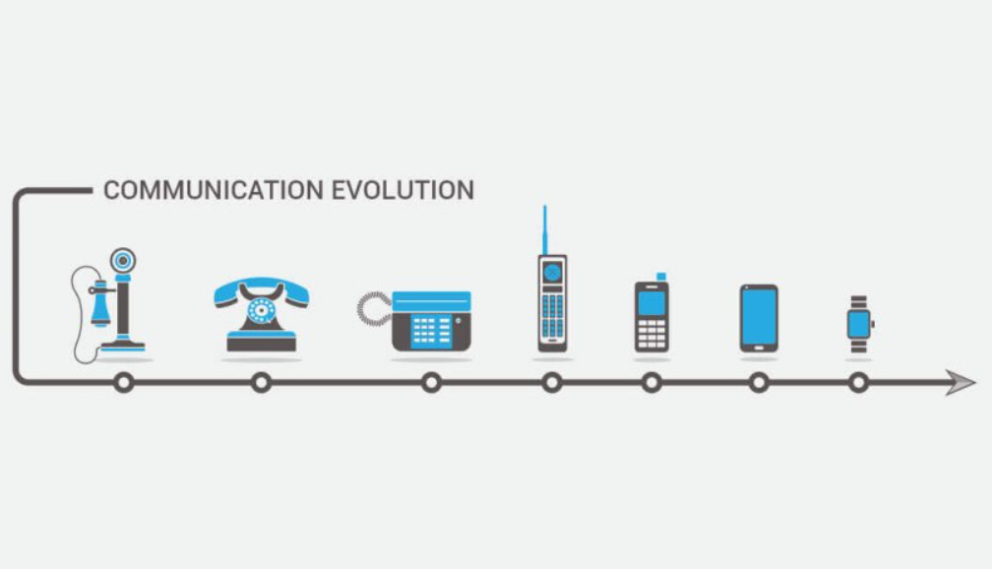

Slide 7
Social Media and Advertising Ecosystem
Witness the evolution of government communication strategies as they adapt to the ever-changing landscape of digital platforms.
Uncover the symbiotic relationship between media businesses and third-party advertisers, aiming to capture user attention and influence behaviors.
Explore the distinct mechanisms of information control and influence facilitated by internet platforms, from paid communications to algorithmically driven content promotion.

Slide 8

Targeted Advertising on Meta Platforms
Investigate into the intricacies of advertising on Meta's properties, including Facebook and Instagram, within the context of the broader digital advertising landscape.
Discover the sophisticated categorization methods employed by Meta, leveraging user demographics, interests, behaviors, and real-time location data.
Examine the ethical and regulatory implications of data-driven targeted advertising, including concerns related to misinformation, privacy, and competition.

Slide 9
Power and Justice in Datafication
Explore the profound implications of datafication on power dynamics and justice within contemporary society.
Have a look at the role of classification processes in rendering populations visible and legible to powerful actors, enabling social sorting and risk assignment.
Reflect on how infrastructural systems enforce particular epistemic frames and distribute power unequally, drawing parallels with Foucauldian frameworks of power assertion and categorization.

Slide 10
Platform Economy and State Power
Analyze the intricate relationship between platform economies and state power, focusing on the ability of platforms to delocalize power and enact their discursive visions.
Investigate the pivotal role of platforms like Meta in shaping Internet infrastructure and controlling the passage of information and communication.
Consider the evolving dynamics of government advertising within platform ecosystems, navigating complex regulatory landscapes and negotiating the balance between public policy objectives and commercial interests.

Slide 11

Research Questions - Exploring the Intersection of Government Communications and Digital Advertising
Unveil the potential of digital advertising platforms in granting the state novel capabilities for targeted communication and influence.
Investigate the concept of "influence government" as an emerging mode of power within U.K. governance, blending strategic marketing practices, behaviorist government frameworks, and digital advertising infrastructures.

Slide 12
Pose key research questions to guide the exploration:
To what extent are government bodies utilizing Meta advertising, and what themes do their campaigns emphasize?
How are public sector entities leveraging targeted advertising tools to reach specific segments of the population?
What modes of government power do these campaigns represent, considering both their targeting strategies and content?
How do the material features of the platform shape government actions in this space, including available categories, defaults, policies, and rationalities?

Slide 13
The Meta Ad Library: Infrastructure and Methods
Historical context: Policy changes driven by concerns over the political impact of targeted advertising, leading to the introduction of transparency measures by major platforms like Facebook, Twitter, and Google.
Meta's response: Implementation of registration requirements for advertisers, validation of government agencies, and ongoing efforts to expand the scope of registered entities.
Use of Meta's advertising services by government bodies, encompassing messaging tools like WhatsApp, Pages, and paid advertising for citizen engagement and policy goals.
Regulatory framework governing advertising behavior, including sector-specific regulations for electoral, political, and social ads.

Slide 14

Data Analysis Method
Methodology Overview: Monthly sweeps from Jan to Jun 2023 curated a dataset of 15,325 adverts from 363 advertisers.
Analysis Approach: Qualitative analysis avoids misleading quantitative claims, utilizing case studies to compare targeting strategies.
Variable Collection: Administrative, audience, and targeting data variables inform the analysis.
Team Collaboration: Interdisciplinary collaboration ensures thorough data processing and qualitative examination.

Slide 15

Insights from Meta Dataset
Overview:
Analysis of 15,325 UK government adverts over 2 years from diverse entities.
Variety of strategies observed, from traditional to sophisticated digital targeting.
Communication Goals:
Goals include information transmission, propaganda, information gathering, narrative shaping, behavior change, and territory enforcement.
Topic Diversity:
Wide range of topics covered, with concentrations in health, law enforcement, and online safety.
Strategic Priorities:
Campaigns align with strategic priorities, leveraging digital platforms for targeted interventions.

Slide 16
Six Main Targeting Approaches
Demographic Targeting: Utilizes age and gender segmentation for broad national campaigns.
Location-Based Targeting: Segments audiences by geographic areas, such as cities or postcode districts.
Basic Interest-Based Targeting: Targets specific demographic communities, like parents or the unemployed, using interest categories.
Patchwork Profiles - Interests and Behaviors: Combines interest sub-categories to create complex profiles when direct sensitive category targeting is disallowed.
Patchwork Profiles - Locations: Uses location data, like postcode, to approximate protected categories such as ethnicity.

Slide 17
Some examples of targeting
Demographic Targeting: Campaign targeting young adult men in England and Wales for Violence Against Women and Girls.
Location-Based Targeting: Heat banks campaign in Manchester targeting elderly people in specific areas.
Interest-Based Targeting: Campaign encouraging complaints about sub-standard social housing targeted at parents who are unemployed.

Slide 18
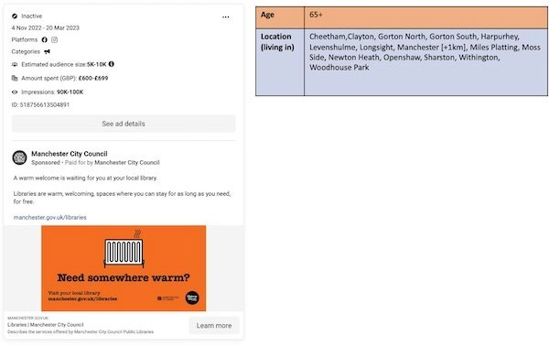

Slide 19

(Re)constructing Muslim Communities through Meta
Objective: Examine how the state reconstructs social groups, like Muslim communities, despite Meta's policy against direct religious targeting.
Comparison of Targeting Profiles:
U.K. vs. Scottish Government: Different approaches; U.K. focuses on diaspora identities, while Scotland targets solely Muslim audience.
Local Councils: Diverse strategies addressing theology, culture, and vaccine hesitancy.
National Health Service (NHS): NHS campaigns integrate Muslim identity within broader healthcare contexts.

Slide 20
Conclusion
In summary, this research sheds light on how governments utilize targeted ads to exert influence over citizens on digital platforms. While showcasing diverse governance models, the study underscores the importance of data transparency and accountability. Despite sophisticated targeting techniques, the effectiveness of these ads remains uncertain. Overall, governments aim to assert control over the digital landscape through these systems.

