Slide 1

Design of governance in socio-technical information systems
Individual mid-term presentation
29.04.2024, University of Neuchatel Ariton Verush

Slide 2

Introduction to shared workforce
In today's dynamic market, companies face challenges in balancing their workforce needs. The project explores the concept of sharing employees between companies to address fluctuations in demand and workforce situations. By leveraging a digital marketplace, companies can efficiently exchange skilled workers, even among competitors, benefiting both employers and employees.

Slide 3
ESSENTIAL REQUIREMENTS
Technology Connector: Develop a digital marketplace tool for efficient employee exchange.
Governance Framework: Establish policies and agreements to ensure fair and secure transactions.
Performance and Feedback Mechanisms: Implement systems for evaluating employee performance and facilitating knowledge transfer.
Cultural and Ethical Considerations: Address potential challenges related to corporate culture, confidentiality, and employee welfare.

Slide 4
STAKEHOLDERS
Understanding the stakeholders involved is crucial:
Companies (Lessor)
Companies (Lessee)
Employees
IT Departments/Technology Providers

Slide 5

THe components
Company 1 (Lessor): Initiates and verifies employee interest.
Company 2 (Lessee): Identifies suitable candidates.
Platform: Facilitates secure communication.
Connectors: Enables transaction flow and ensures data privacy.
Database: Stores transactional data securely.

Slide 6
The process flow
Employee Interest and Verification: Employees express interest; Company 1 verifies.
Platform Interaction: Data transmitted securely; Company 2 searches for candidates.
Transaction and Direct Communication: Company 2 expresses interest; terms transmitted securely; direct communication for finalization.
Transaction Logging: All interactions and transactions logged for accountability.

Slide 7

DIGITAL CONTRACTS?
Smart Contracts: Utilize blockchain technology for secure, automated agreements.
Transparency: Ensure transparency and immutability in contract execution.
Digital Signatures: Implement digital signatures for authentication and compliance, streamlining the contract process and ensuring legality.

Slide 8
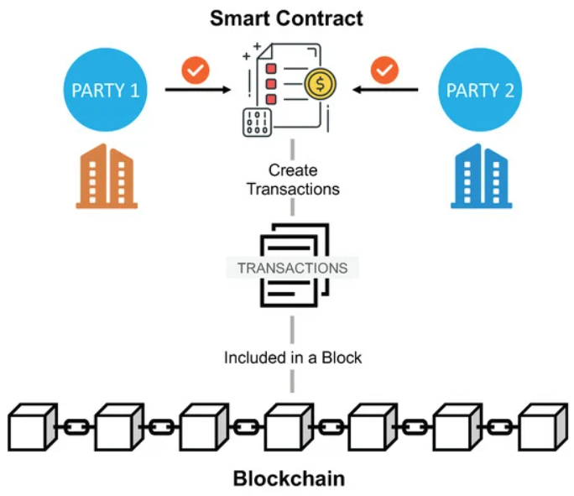

Slide 9

Where should we improve?
UML Use-Case diagrams
UML Activity diagrams
Process Landscape (Company Map)
Improvements in the architecture (draw.io diagram)
Think and agree about how contracts should be implemented, all while respecting the laws and ensuring data privacy and protection
Define how should workers get their payments

Slide 10
POSSIBLE ISSUES
Legal Issues: Ensuring compliance with labor laws, data privacy regulations, and contractual agreements can be complex, especially across different jurisdictions. Legal expertise is essential to navigate these challenges effectively.
Ethical Concerns: Addressing employee consent, transparency, and fair treatment is crucial to uphold ethical standards. Additionally, potential conflicts of interest and impacts on company culture must be carefully managed.
Operational Challenges: Technical issues in system integration, quality control of leased employees, and dispute resolution processes can arise. Platform security and scalability are also critical considerations for smooth project operations.

Slide 11
LAW REGULATIONS
Legal Compliance: Ensuring adherence to labor laws and regulations is paramount in our project. This includes compliance with employment standards, worker rights, and benefits entitlements, as well as data privacy regulations such as GDPR or CCPA.
Contractual Agreements: The project involves multiple contractual layers between ERP providers, leasing companies, and employees. These contracts must be legally sound and reflect agreed-upon terms to avoid disputes and liability issues.
Intellectual Property Rights: Addressing ownership of intellectual property created during the lease period is crucial. Clear provisions in leasing agreements can mitigate potential conflicts regarding the ownership of created assets.
Project Alignment with Laws: Our project design prioritizes compliance with legal regulations at every stage. From the development of governance frameworks to the implementation of digital contracts, we ensure that all aspects of the project meet legal standards and obligations.

Slide 12

CONCLUSION
Our shared workforce project presents an innovative solution to the challenges of modern workforce management. By prioritizing technology and collaboration, we aim to revolutionize how companies address fluctuations in demand and idle workforce situations. While we acknowledge potential challenges, we are committed to proactively addressing them and continuously improving our project.

