Slide 1
ETHICAL CONSIDERATIONS IN SOCIAL COMPUTING: BALANCING PRIVACY, TRANSPARENCY, AND SOCIAL GOOD
Final presentation for the Seminar in Social Computing
29.05.2024
Martin Stojkovski Professor: Edy Portmann
Ariton Verush Assistant: Narek Andreasyan
Place: University of Bern Place: University of Fribourg

Slide 2
Abstract
In today's digital age, social computing technologies have changed how we interact and communicate. However, they also raise important ethical issues. This presentation explores these ethical concerns, focusing on fair treatment and discrimination against loaned employees. We will look at different viewpoints and introduce an Ethical Decision-Making Framework to ensure fair treatment of employees in shared workforce arrangements.

Slide 3
Introduction to Social Computing Ethics
Universality of Social Computing: High and low work demand in companies are common in modern life.
Balancing Innovation with Ethics: Technological advancements for workers must be aligned with the protection of user rights and values.
Workforce Dynamics: The increasing trend of companies sharing employees brings new ethical challenges, particularly concerning the treatment of loaned employees.
Recent Ethical Issues: Highlight the urgency of addressing ethical concerns in social computing, especially in workforce management.

Slide 4
Elaborating on the pains
Discrimination Against Loaned Employees:
Unequal Treatment: Loaned employees often face bias and unequal treatment compared to permanent staff.
Job Security: Uncertainty about job stability and career advancement for loaned employees.
Privacy Concerns:
Data Handling: Sensitive employee information may be shared between companies without proper consent.
Surveillance: Increased monitoring of loaned employees to assess performance.
Transparency Challenges:
Opaque Policies: Lack of clear policies on the terms and conditions of loan agreements.
Decision-Making: Intransparency in how decisions regarding loaned employees are made and communicated.

Slide 5
Ethical Decision-Making Framework for a Balanced Workforce
The framework will contain the following points:
Identifying Ethical Principles
Understanding and addressing bias
Implementing Inclusive Practices
Monitoring and Evaluation

Slide 6
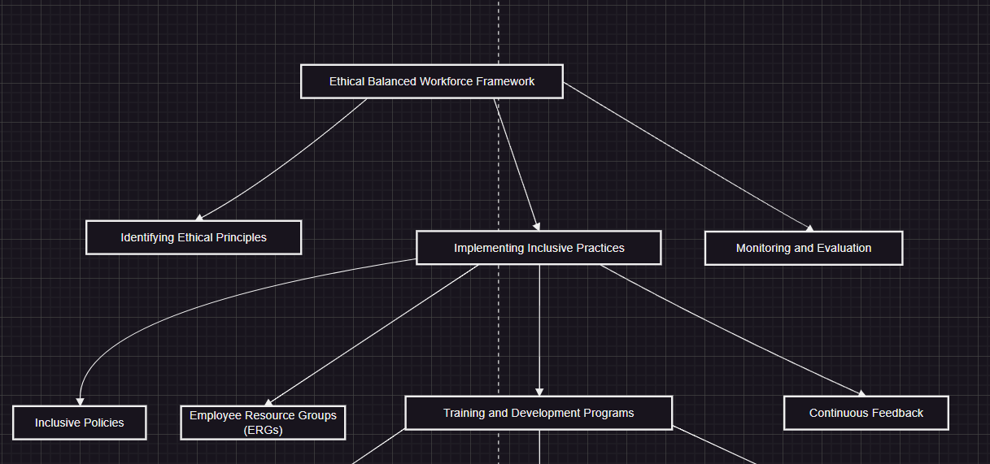
Flowchart of the framework

Slide 7
Developing Inclusive Policies
Inclusive Policies: Develop and enforce policies that promote diversity and prevent discrimination.
Anti-Discrimination Policies: Specific rules and regulations that explicitly prohibit discriminatory practices.
Equal Opportunity Policies: Ensure equal opportunities in hiring, promotion, and professional development.

Slide 8
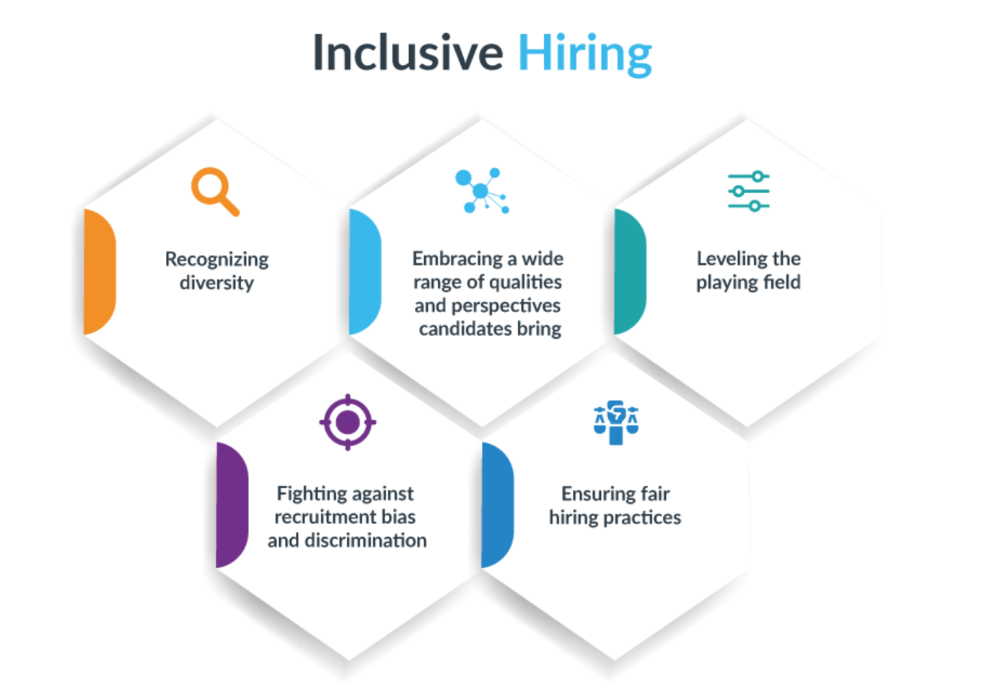

Slide 9
Supporting Employee Resource Groups (ERGs)
Employee Resource Groups (ERGs): Support groups providing platforms for employees from diverse backgrounds to share experiences and advocate for change.
Benefits of ERGs: Enhance employee engagement, provide support networks, and drive cultural change within the organization.
Establishing ERGs: Steps include identifying needs, gaining leadership support, and defining goals and structures.

Slide 10
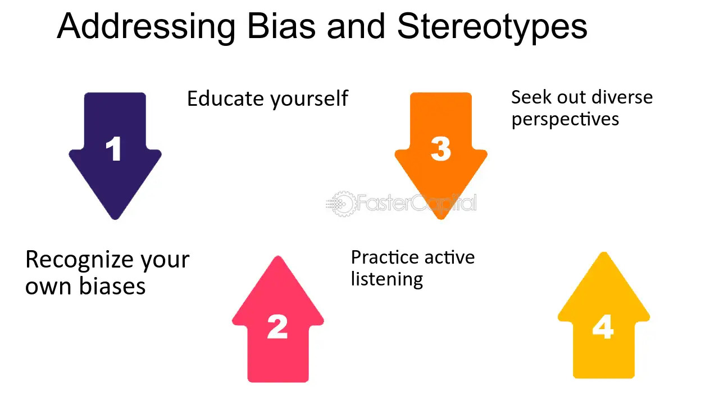

Slide 11
Training and Development Programs
Diversity Training Programs: Regular training sessions that utilize fuzzy logic principles to adaptively educate employees on diversity, equity, and inclusion, allowing for a nuanced understanding and flexible responses to varied employee backgrounds and perspectives.
Leadership Development: Specific programs designed using fuzzy systems to dynamically promote inclusive leadership and decision-making, by adjusting to the fuzzy variables of individual leadership styles and the organizational climate.
Skill Development Workshops: Workshops incorporating fuzzy logic to focus on enhancing skills such as cultural competence and bias recognition, with training modules that can be flexibly modified based on the fuzzy input of participant feedback and situational context

Slide 12
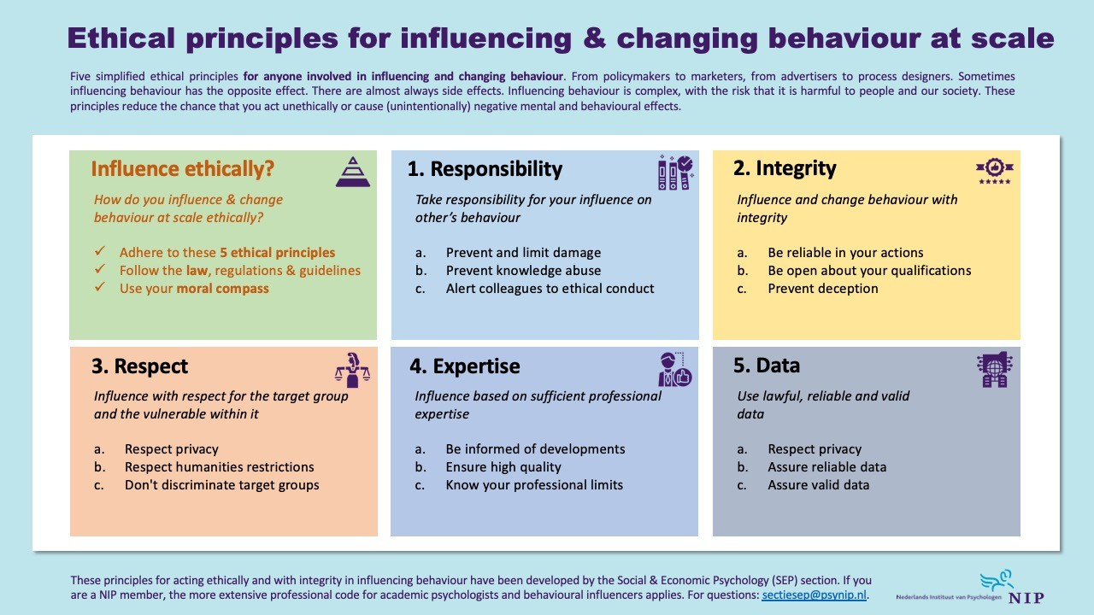

Slide 13
Providing Continuous Feedback
Continuous Feedback Mechanisms: Establish channels for regular feedback from employees on inclusivity and diversity initiatives.
Anonymous Surveys: Conduct surveys to gather honest feedback without fear of repercussions.
Feedback Loops: Implement processes to act on feedback, make improvements, and communicate changes back to employees.

Slide 14
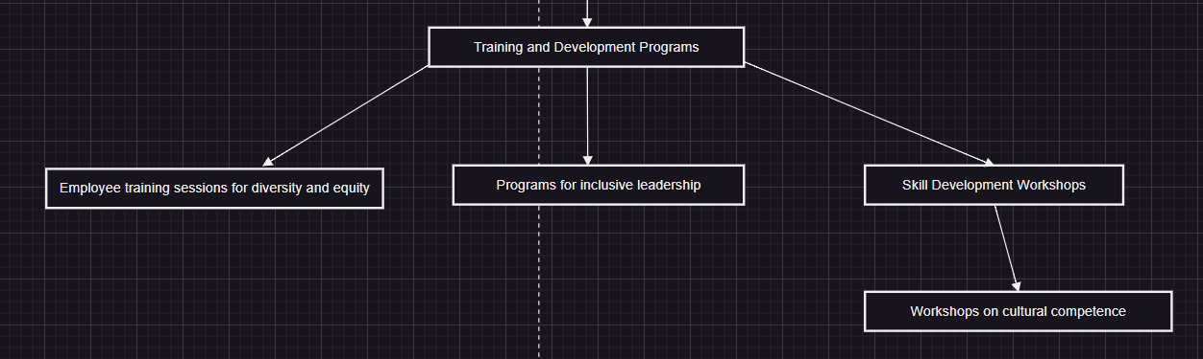
Training and Development Programs

Slide 15
Evaluation
Question: Can the little company have an idea which employees are available?
Answer: Yes, so the framework will know if the profile is presented in such good way than it will be accepted and available on the platform for other companies.
Question: What if the employees didn’t do a good job? Can the little company give a feedback?
Answer: Well, in that case the other company can for sure can give any feedback, but if is in the discriminative way the framework will exclude it from the platform.
Question: Would you implement a base salary for the loaned employees?
Answer: Yeah definitely it will be based by their rank and the salary will remain the same, so there will no place for discriminations.

Slide 16
CONCLUSION
Ethical Issues Key for fair and inclusive workforce management.
Ethical Practices Use tech for the greater good, respecting rights.
Fair Treatment Ensure respect and fairness for all employees.

Slide 17
KEYWORDS
Social computing
Ethical considerations
Privacy
Transparency
Balanced workforce
Loaned employees
Fair treatment
Human-centered design
Participatory design
Collaboration
Data protection

Slide 18
REFERENCES
https://www.linkedin.com/pulse/ethical-principles-influencing-changing-behaviour-scale-bart-schutz
https://fastercapital.com/topics/addressing-bias-and-stereotypes.html
https://www.aihr.com/blog/inclusive-hiring/

Slide 19


