Slide 1
Decentralized auctions
Final presentation - Digitalization and Information Systems
Wednesday, 29.05.2024
Professor D-r: Hans-Georg Fill
Martin Stojkovski and Ariton Verush Assistants: Simon Curty and Marcel Bühlmann

Slide 2
E3value model
Updates that has been done
the actions are located in the smart contract
change of the color for the part that is outside of the blockchain
the value objects of the value transfers

Slide 3
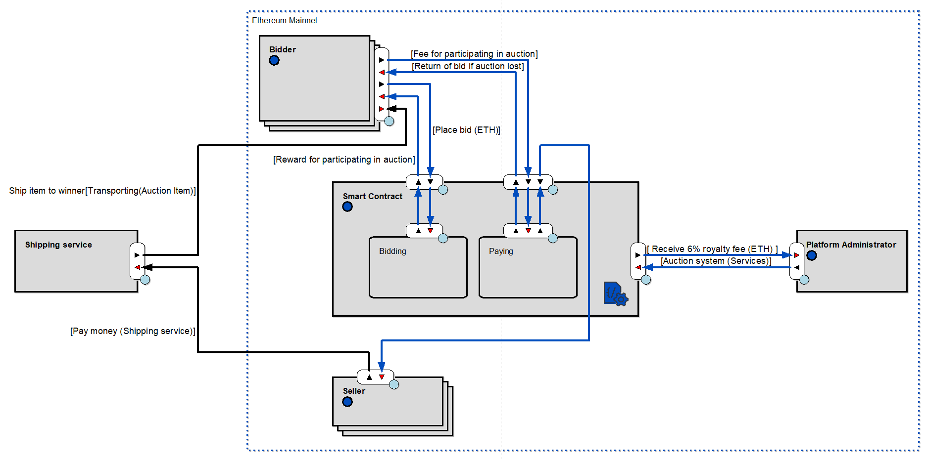

Slide 4
BPMN diagram
Updates that has been done
inserted into pool, each actor
imported the smart contract part between the two actors
changed the returning bid amount and receiving items from shipping service to an exclusive gateway with one ending

Slide 5
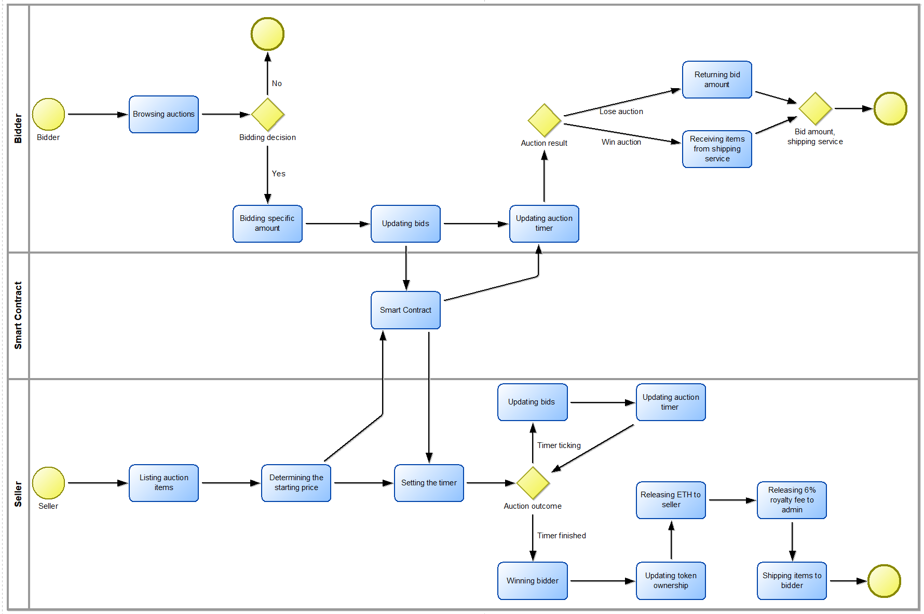

Slide 6
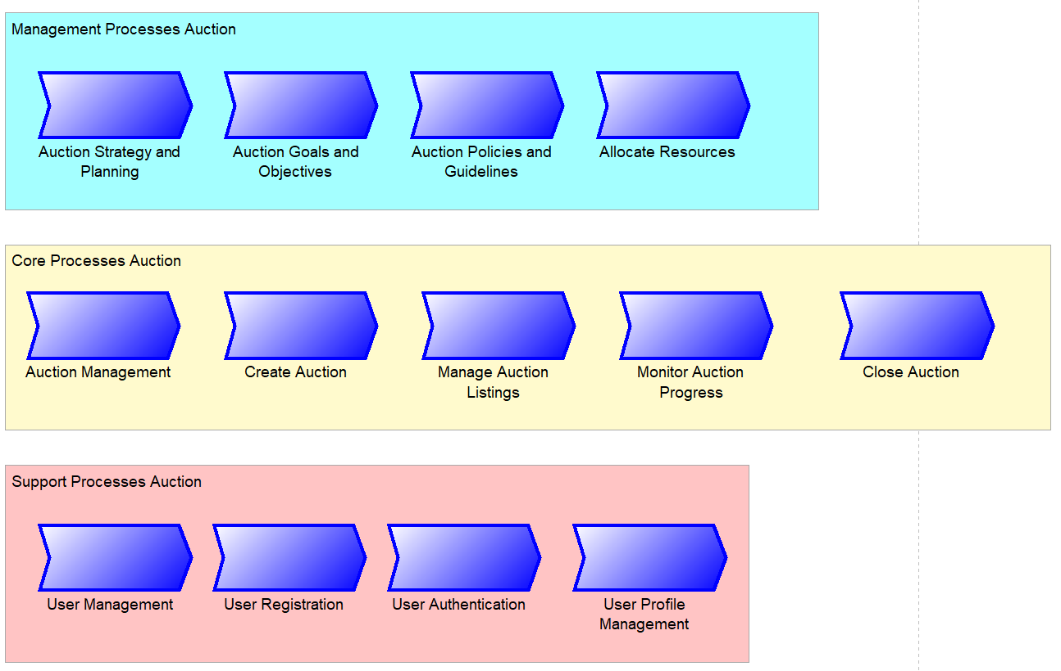
Process Landscape

Slide 7
Use-case diagram
Updates that has been done
deleted the ETH function
deleted the connection with sellers receiving ETH from auction
deleted the connection browse auctions and the function ETH
merged bidder and seller to user actor

Slide 8
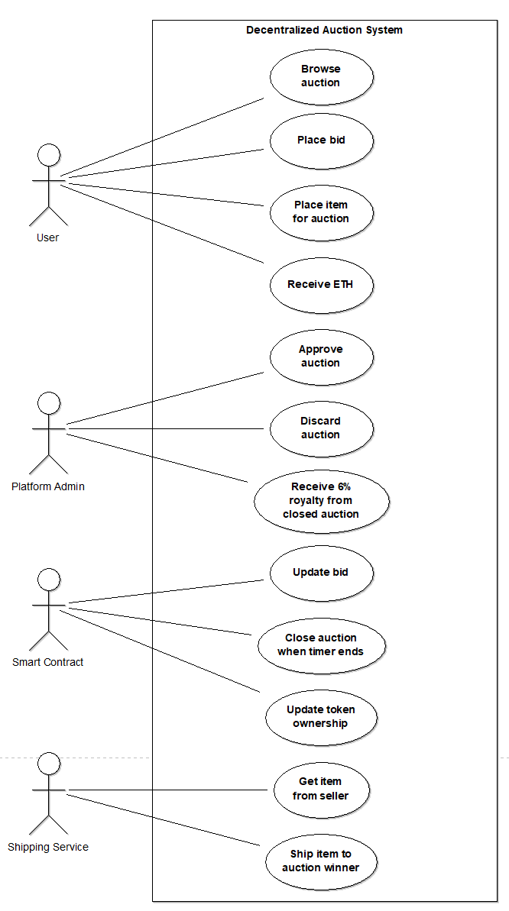

Slide 9
ArchiMate diagram
Updates that has been made
added the business part and connected with application
added the application part and connected with technology

Slide 10
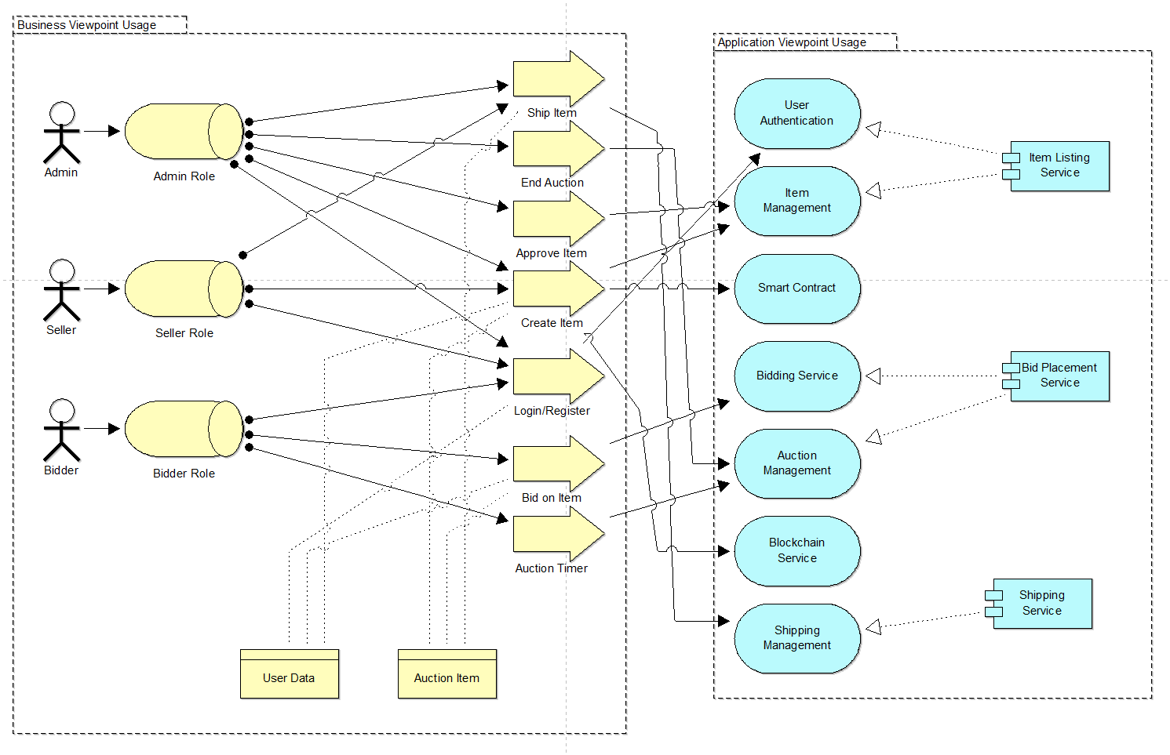

Slide 11
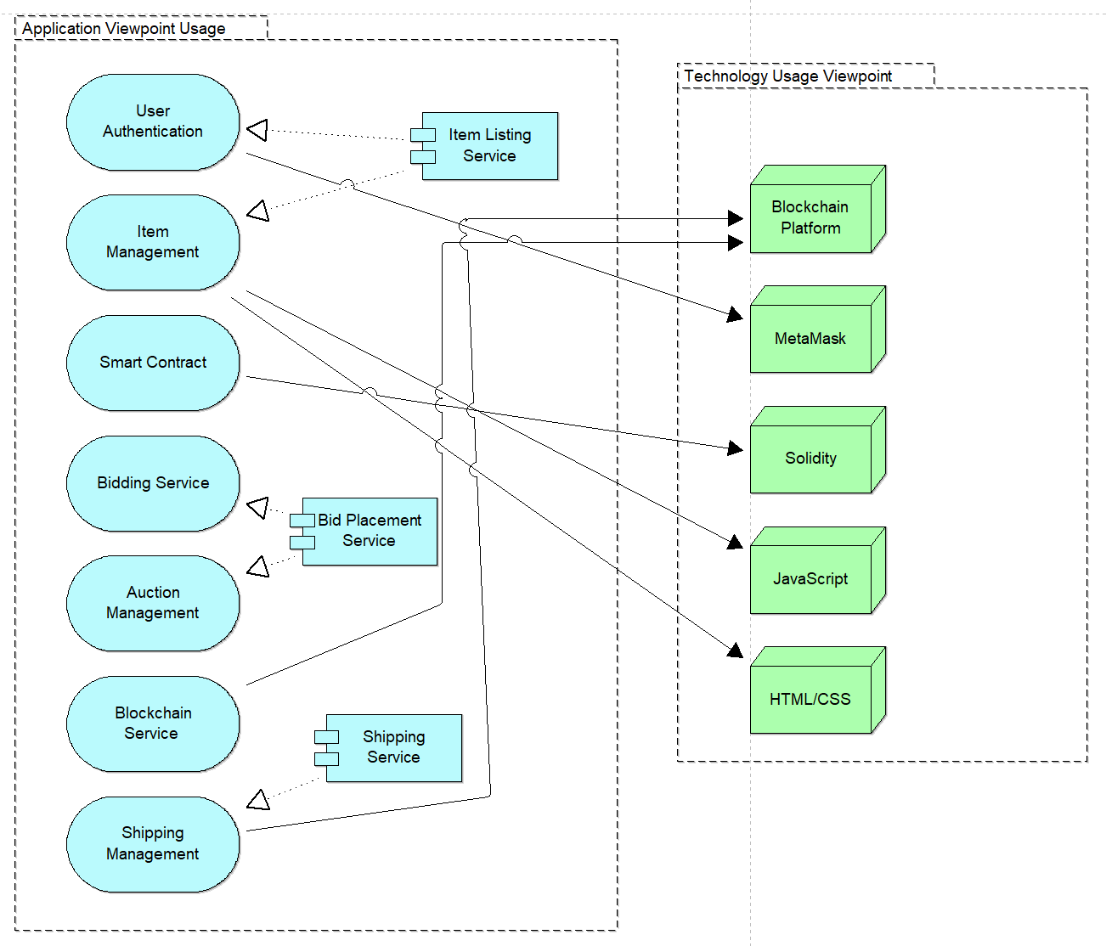

Slide 12
Class diagram
Updates has been made
merged the two tables into one User
changed and added more functions

Slide 13
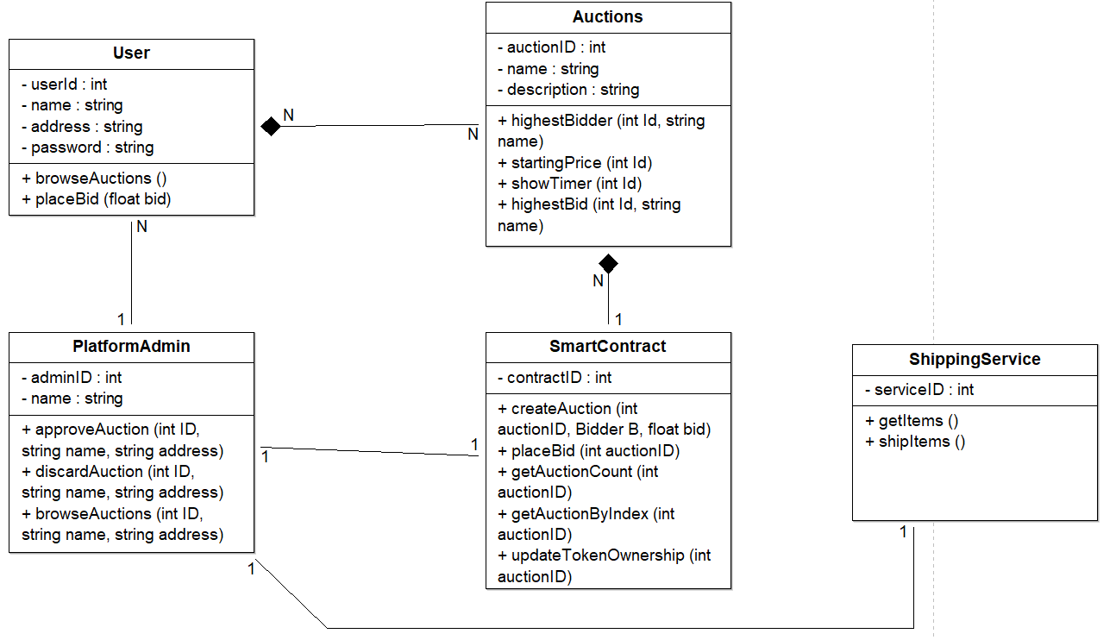

Slide 14
Sequence diagram
Updates has been made
naming convention
gates for the processes where they start and end
notification for the admin and approval

Slide 15
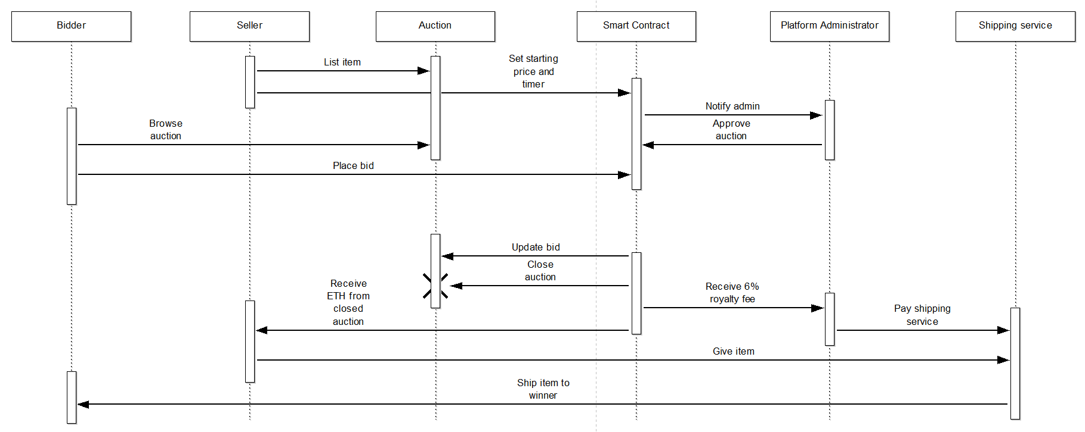

Slide 16
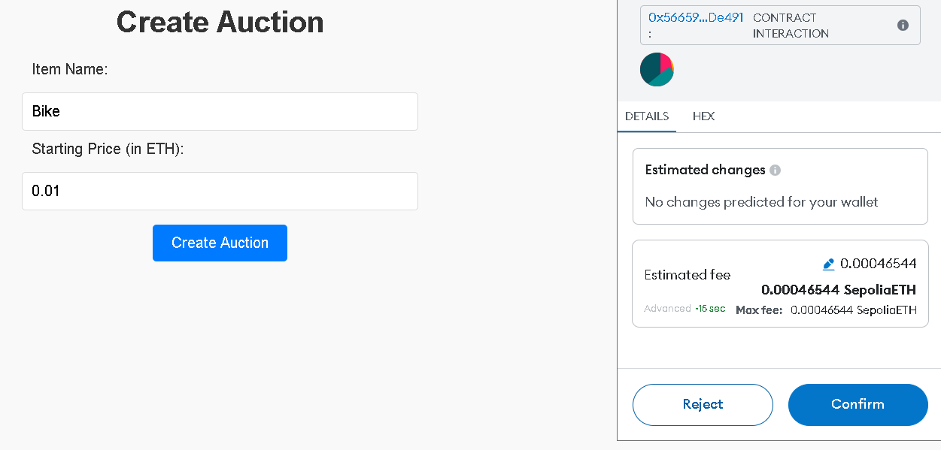
Prototype

Slide 17
Conlcusion
This shows how using blockchain technology can make auctions better. By using smart contracts, the auction process becomes more transparent, secure, and efficient. Decentralizing the auctions means there's less need for middlemen, which lowers costs and reduces potential unfairness. Every transaction is permanent and can be checked, which builds more trust among users. These improvements make auction platforms more modern, user-friendly, and reliable for people everywhere.

Slide 18
THANK YOU 😀
ANY QUESTIONS?

