Slide 1
SDG 11 · SUSTAINABLE CITIES SDG 13 · CLIMATE ACTION
AI-Powered Civic Grievance Triage
& Flood-Risk Early-Warning System
Classifying civic complaints and detecting early flood risk across Indian cities — from a photo, a message, or both.
Aritra Dey
B.Tech, Computer Science & Engineering — MCKV Institute of Engineering
1M1B AI for Sustainability Virtual Internship — in collaboration with IBM SkillsBuild & AICTE

Slide 2


THE PROBLEM
Cities react to floods. They rarely see them coming.
Residents report civic issues — broken streetlights, uncollected garbage, blocked drains — through channels that get sorted manually. It's slow, and it misses patterns. Flood risk in low-lying wards is usually only recognized after a street has already flooded, even though the warning signs are visible beforehand: a cluster of waterlogging complaints, rising rainfall, a drain reported blocked twice in a week.
SDG 11
Sustainable Cities
& Communities
Primary SDG
SDG 13
PROBLEM STATEMENT
Climate Action
“How might we use AI to triage civic complaints and detect early flood/waterlogging risk, so that city departments respond faster and residents get advance warning before an area floods?”
Secondary SDG
2

Slide 3


WHO IT'S FOR & WHY AI
Two audiences, one blind spot
Who's Affected
Why AI Is Needed
Residents of low-lying, drainage-poor wards across Indian cities — the first to feel a flood and the last to be warned.
Individually, complaint text, photos, and rainfall numbers are just noise.
AI classifies and routes complaints instantly — from text or a photo — and turns a cluster of waterlogging reports plus rising rainfall in one ward into an early flood signal no single complaint reveals on its own.
Municipal departments that currently sort complaints manually, with no signal that tells them where flooding is building up.
This is decision support — AI surfaces the signal; people still make the call.
3

Slide 4






AI SOLUTION OVERVIEW
From a single report to a city-wide early warning
Report
Classify
Route & Alert
Combine
Score & Flag
Resident submits text,
a photo, or both
Prompt-engineered AI reads
it — category + urgency
Sent to the right dept.,
logged as a priority alert
Flood-related reports +
recent rainfall, per ward
Explainable risk score —
high-risk wards flagged live
One rule always wins: fire, exposed live wires (especially near water), gas leaks, or structural collapse are classified as Emergency/Life-Threatening with High urgency — no matter what else is in the text or image. Life-safety signals are never allowed to be silently downgraded by a routine keyword.
4

Slide 5
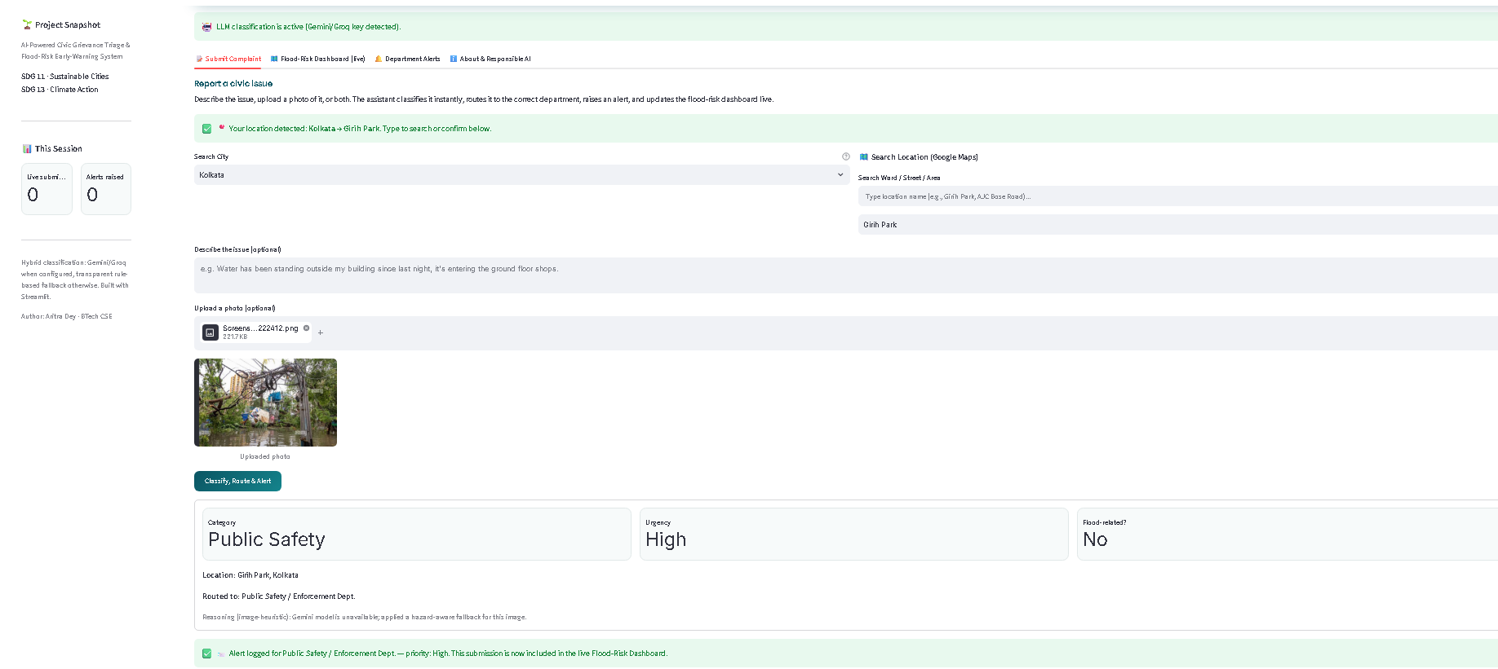


LIVE PROTOTYPE
Report an issue — classified and routed instantly
What this demonstrates
Multimodal input
Text, photo, or both — Gemini Vision classifies the image directly.
Instant routing
Classified and sent to the correct department the moment it's submitted.
Live alerting
Every submission raises a timestamped, priority-tagged alert.
5

Slide 6
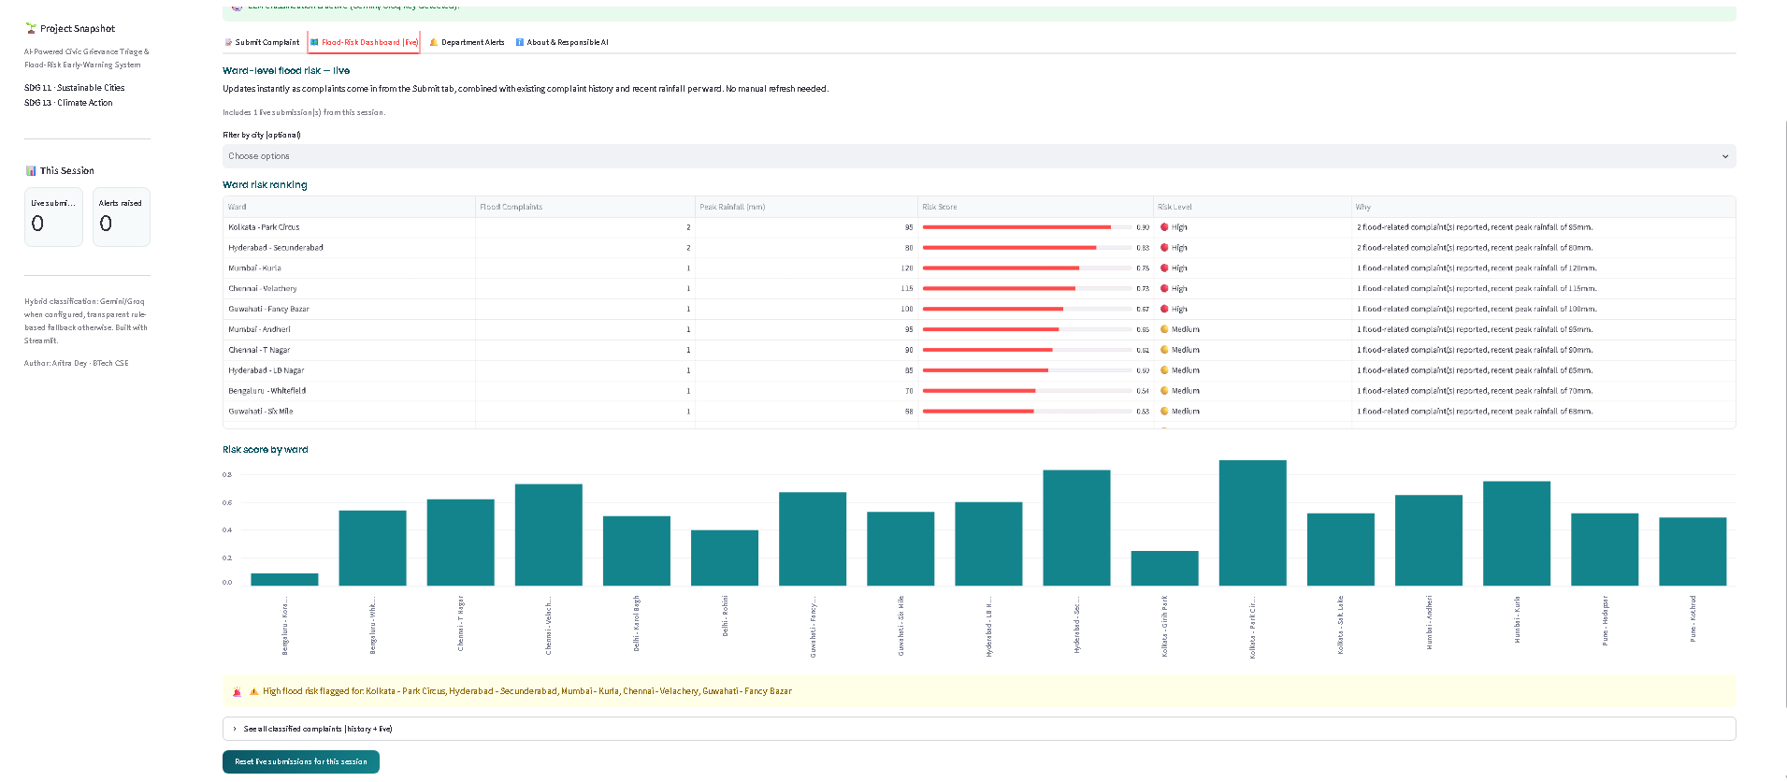
LIVE PROTOTYPE
Ward-level flood risk — updates the moment a report comes in
8 cities · 16 wards — every complaint is classified once, cached, then combined live with rainfall data and any new submissions. No manual refresh.
6

Slide 7
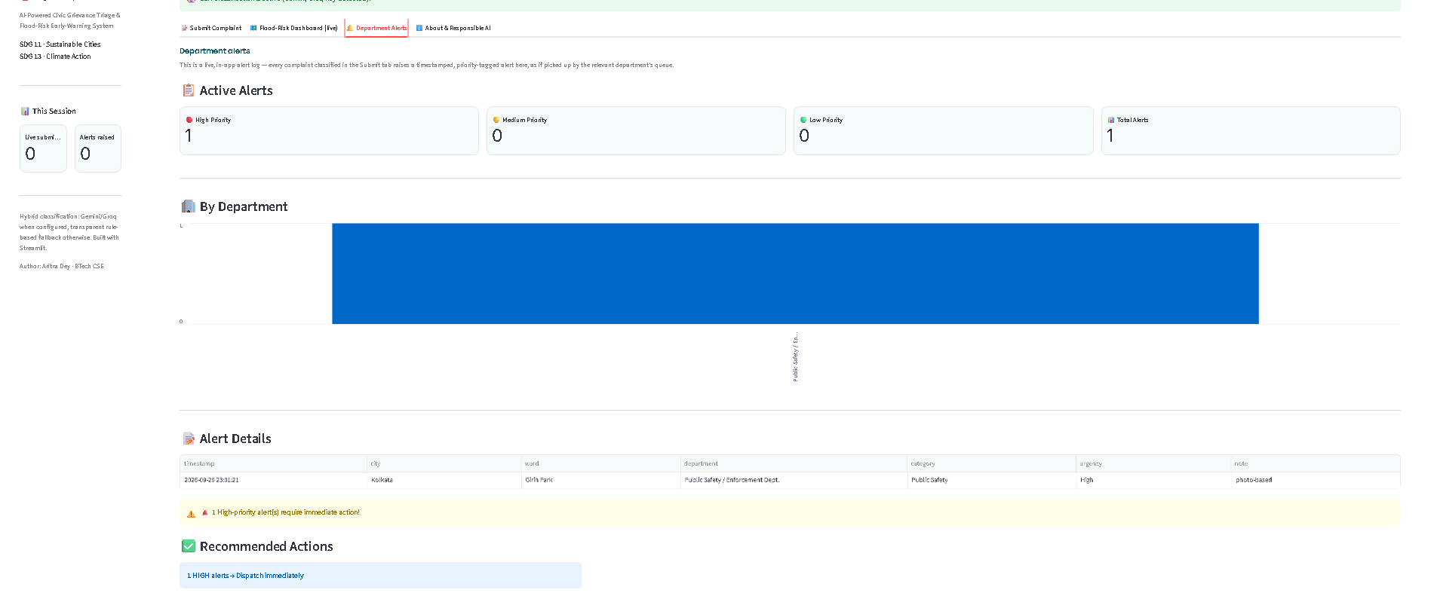
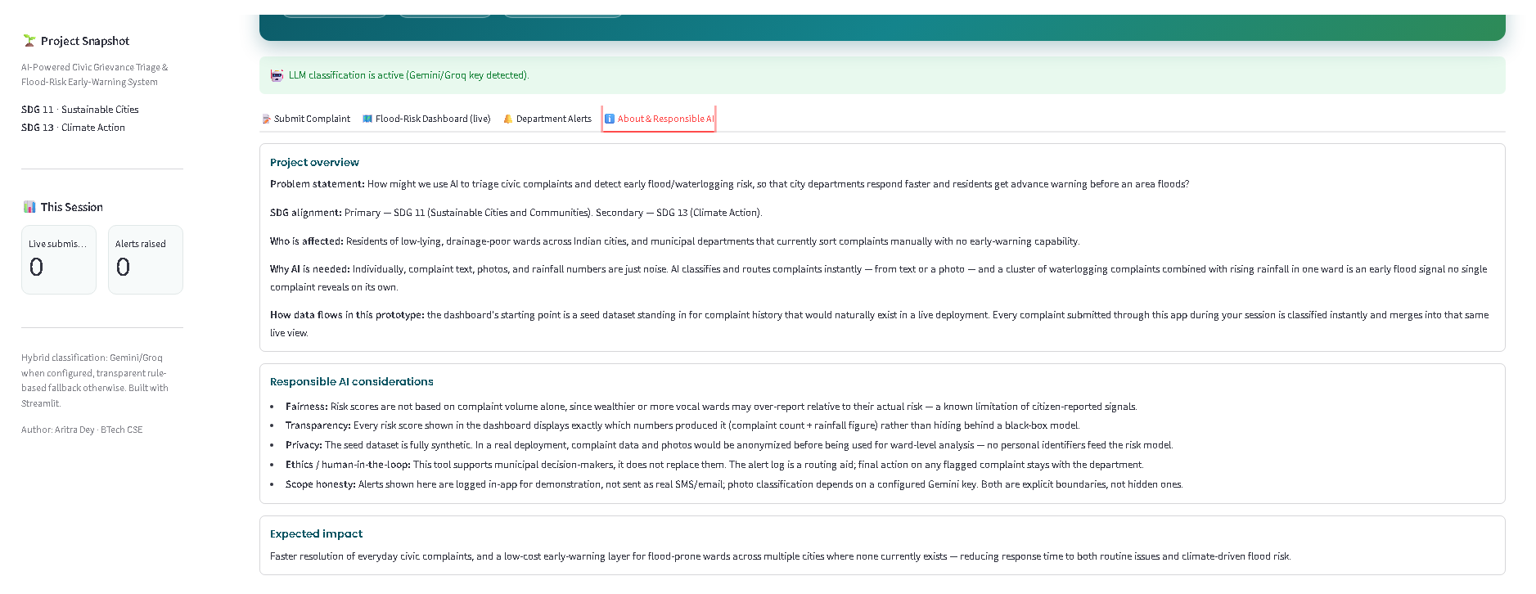
LIVE PROTOTYPE
Department alerts, and the reasoning behind every score
Alert log — in-app, timestamped, department-routed
Every score shows its own reasoning — in-app, not hidden
7

Slide 8




RESPONSIBLE AI
Built to be checked, not just trusted
Fairness
Transparency
Risk scores aren't based on complaint volume alone — wealthier or more vocal wards may over-report relative to their real risk. A known limitation of citizen-reported signals, stated plainly.
Every risk score shows exactly which numbers produced it — complaint count and peak rainfall — rather than hiding behind a black-box model.
Privacy
Human-in-the-loop
All demo data is fully synthetic. A real deployment would anonymize complaints and photos before any ward-level analysis — no personal identifiers feed the model.
The system supports department decision-makers; it does not replace them. The alert log is a routing aid — final action always stays with people.
8

Slide 9
EXPECTED IMPACT
What changes, and what's honestly still ahead
Faster resolution of everyday civic complaints, and a low-cost early-warning layer for flood-prone wards across multiple cities where none exists today — cutting response time to both routine issues and climate-driven flood risk.
SCOPE, STATED UP FRONT
All demo data is synthetic — seed complaints and rainfall figures stand in for real deployment history.
Alerts are logged in-app, not sent as SMS/email — a documented next step, not a hidden gap.
The risk score is an explainable heuristic — not a trained predictive model — by design, so it stays auditable.
Runs on Gemini/Groq today, not IBM Granite/watsonx — the hybrid-provider design isolates the LLM call behind one interface, so swapping providers is a config change, not a rebuild.
9

Slide 10
Thank you
AI-Powered Civic Grievance Triage & Flood-Risk Early-Warning System
Aritra Dey · B.Tech CSE, MCKV Institute of Engineering
1M1B AI for Sustainability Virtual Internship — IBM SkillsBuild & AICTE

