Slide 1
STUDENT PERFORMANCE
PREDICTION
Student Name: Aritra Mondal
Roll No: BWU/BCA/24/117
Subject Name: Machine Learning
Subject Code: BCA57205(P)

Slide 2
Introduction
PROJECT OVERVIEW
Student performance is influenced by multiple academic and behavioural factors, including attendance, previous marks, assignments, study habits and participation.
Educational institutions often review these factors manually to understand student progress.
This project applies supervised machine learning to estimate a student's final examination marks from seven input features.
A Random Forest Regressor is trained on historical student data and used to predict marks for a new student.
2

Slide 3
Problem Statement
It can be difficult to estimate a student's likely final marks early and consistently by considering several performance-related factors together.
Current challenge
Need
Project response
Manual assessment can be time-consuming and may not reveal complex relationships among student factors.
A data-driven method that learns patterns from previous student records.
Build a regression model to predict final marks from student information.
3

Slide 4
Objectives
WHAT THE PROJECT AIMS TO ACHIEVE
Prepare a student performance dataset by checking and cleaning missing and duplicate records.
Identify relevant input features and define final marks as the prediction target.
Train a Random Forest Regression model using an 80:20 train-test split.
Evaluate predictions using MAE, MSE, RMSE and R² metrics.
Study feature importance and visualize relationships and prediction performance.
Save the trained model and allow users to enter new student details for prediction.
4

Slide 5
Scope of the Project
COVERAGE, USERS AND LIMITATIONS
Coverage
Potential users
Current limitations
Predicts a numerical final-marks estimate using seven features from a structured CSV dataset.
Students, teachers, academic mentors and educational analysts exploring performance patterns.
Depends on dataset quality and representativeness; no live institutional database or automated intervention is included.
5

Slide 6
Literature Review / Existing System
CONTEXT AND COMPARISON
Manual academic review
Traditional statistical methods
Tree-based machine learning
Teachers examine attendance, assignments and previous results. It is useful but can be labour-intensive and subjective.
Simple averages or linear models can provide baselines, but may not capture complex non-linear relationships.
Decision trees and ensemble methods can learn interactions from tabular data, but require careful validation.
Gap addressed by this project
Combines multiple student-related features in one predictive model.
Uses a Random Forest ensemble and reports standard regression evaluation metrics.
Provides feature-importance output and visual graphs for interpretation.
Note: Add specific research papers or local institutional systems reviewed, if used, to strengthen this section.
6

Slide 7
Proposed System
THE SOLUTION
A Python-based machine learning pipeline that learns from historical student records and estimates final marks for newly entered student data.
Data preparation
Model development
Prediction & output
Load CSV, inspect missing values, remove duplicate rows and drop incomplete records.
Split the data, train a 200-tree Random Forest Regressor and evaluate test predictions.
Accept new student inputs, predict marks, assign a performance band and save the model.
7

Slide 8
Project Methodology
DEVELOPMENT APPROACH AND TECHNOLOGY STACK
Programming language
Data processing
Machine learning
Python
Pandas and NumPy-compatible tabular workflow
Scikit-learn: train_test_split and RandomForestRegressor
Visualization
Model persistence
Data storage
Matplotlib and Seaborn
Joblib serializes the trained model to a .pkl file
CSV file: student_performance.csv
8

Slide 9
Project Internal Structure
SYSTEM ARCHITECTURE
CSV Dataset
Data Cleaning
Feature Selection
Train / Test Split
Random Forest
Evaluation Metrics
Feature Importance
Saved Model + Prediction
The training pipeline produces evaluation outputs and a reusable model; the saved model is then used to predict marks for new student inputs.
9

Slide 10
Project Internal Structure
MODULE-WISE BREAKDOWN AND FEATURE SET
01 Data loading
02 Data cleaning
Reads dataset/student_performance.csv using Pandas.
Reports null counts, removes duplicates and drops missing rows.
03 Model training
04 Evaluation
Selects seven features and splits data into 80% train and 20% test.
Calculates MAE, MSE, RMSE and R² on test data.
05 Visualization
06 Prediction
Creates correlation heatmap, feature-importance chart and actual-vs-predicted scatter plot.
Accepts seven values, predicts marks and maps the result to a category.
10

Slide 11
Implementation
CORE CODE AND PREDICTION LOGIC
Model training
Performance classification
model = RandomForestRegressor(\n n_estimators=200,\n random_state=42\n)\nmodel.fit(X_train, y_train)\npredictions = model.predict(X_test)
if marks >= 90:
category = "Excellent"
elif marks >= 75:
category = "Good"
elif marks >= 60:
category = "Average"
elif marks >= 40:
category = "Below Average"
11

Slide 12
Testing and Results
RANDOM FOREST REGRESSION • HELD-OUT TEST RESULTS
Metric | What it measures | Your result
MAE | Average absolute prediction error | 6.385
MSE | Mean squared prediction error | 65.040
RMSE | Error in marks' original unit | 8.065
R² | Variance explained by the model | 0.378
Test cases
Valid numeric student inputs
Non-numeric input should be rejected
Prediction remains within 0–100
Model file is created and reloadable
12

Slide 13
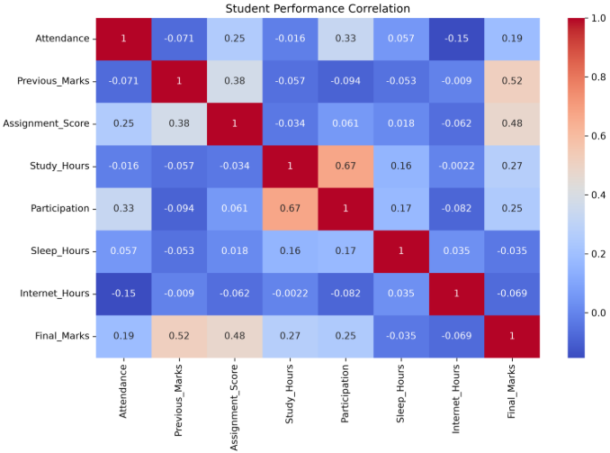
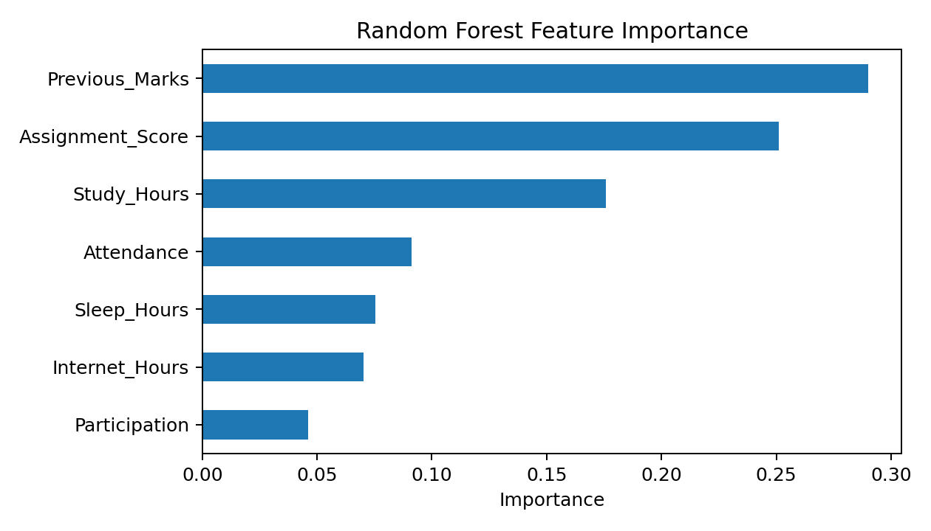
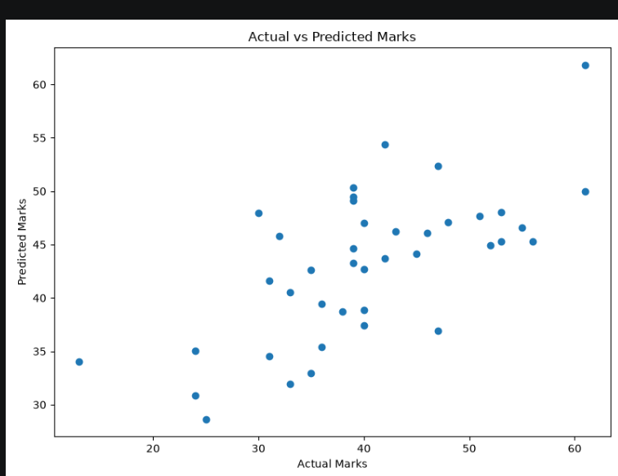
Visual Results from the Dataset
CORRELATION • FEATURE IMPORTANCE • PREDICTION COMPARISON

Slide 14
Conclusion
PROJECT SUMMARY
Developed a complete Python workflow for student final-marks prediction using supervised machine learning.
Prepared data, trained a Random Forest Regressor and evaluated it with four standard regression metrics.
Generated visual analysis of feature relationships, feature importance and actual versus predicted marks.
Saved the trained model and implemented terminal-based prediction for new student records.
The system demonstrates how historical academic data can support analysis and early academic guidance.
13

Slide 15
Future Scope
POSSIBLE ENHANCEMENTS
Web application
More algorithms
Better validation
Build a Flask or Streamlit interface so users can submit student details through a browser.
Compare Random Forest with Linear Regression, Decision Tree, Gradient Boosting and other models.
Add cross-validation, hyperparameter tuning and a larger, more representative dataset.
Database integration
Explainability
Responsible use
Store student records and prediction history in a database with access controls.
Add SHAP or other explanation methods to help interpret individual predictions.
Check bias, protect student privacy and keep predictions as decision-support rather than final judgement.
14

Slide 16
References
DOCUMENTATION AND LEARNING RESOURCES
Scikit-learn documentation: RandomForestRegressor — https://scikit-learn.org/stable/modules/generated/sklearn.ensemble.RandomForestRegressor.html
Scikit-learn documentation: Model evaluation — https://scikit-learn.org/stable/modules/model_evaluation.html
Pandas documentation — https://pandas.pydata.org/docs/
Matplotlib documentation — https://matplotlib.org/stable/
Seaborn documentation — https://seaborn.pydata.org/
Joblib documentation — https://joblib.readthedocs.io/
Project dataset: student_performance.csv [add dataset source / author / access date].
15

Slide 17
THANK YOU

