Slide 1
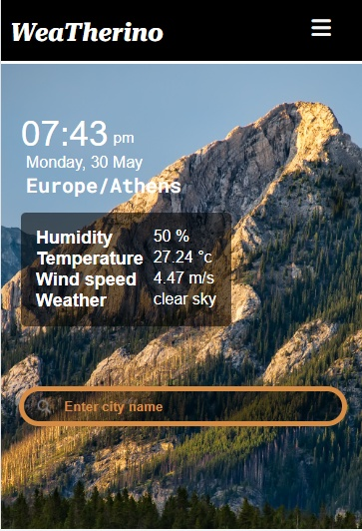

WeaTherino
- a weather forecasting website
Presented by -
Supervised by -
Himangshu Ghosh, Rejaul karim,
Sourav Roy Dalai,
Soumita Ganguly, Aritra Paul,
Somnath Das
Mr. Prem Kumar Jha
B.SC (Hons.)
Department of Computer Science
Siliguri College
Affiliated to -
University of North Bengal

Slide 2
Acknowledgement
Project Supervisor, Mr. Prem Kumar Jha, for his enthusiasm, patience, insightful comments, helpful information, practical advice and unceasing ideas.
Our Head of the department of Computer Science and Application Mr. Dipak Kumar Sarkar, for permitting in laying the first stone of success and providing the lab facilities.
Honorable principal Dr. Sujit Ghosh, for his support and encouragement.
B.Sc(Hons) Computer Science
Page - 1

Slide 3
Contents
Introduction
Table (II) Section
Objectives
Safety Section
Working Logic
About Section
Menu & Header Section
Contact Section
Explain some messages
Future Scope
Table (I) Section
Conclusion
B.Sc(Hons) Computer Science
Page - 2

Slide 4
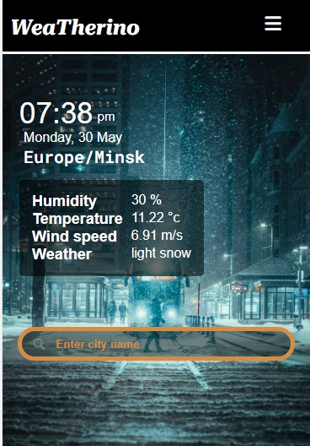
Introduction
User can get weather data by enter a city name or by providing the GPS coordinate
This application very useful for students who want various data related to weather
User can contact with us easily through contact page of this application
Various types of safety information are also provided here.
B.Sc(Hons) Computer Science
Page - 3

Slide 5
Objectives
Useful for various weather operations
Easy availability of information
Time saving application
Economically feasible for users
Specially designed for students who need various weather information
B.Sc(Hons) Computer Science
Page - 4

Slide 6
Working Logic
There are two different tasks at the core of this project -
User request analysis
Returning the appropriate response
Openweathermap
API
Display Fetched data
Request
Response
GPS
WeaTherino
User
City name
B.Sc(Hons) Computer Science
Page - 5

Slide 7
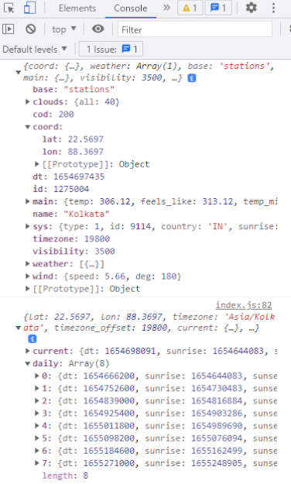
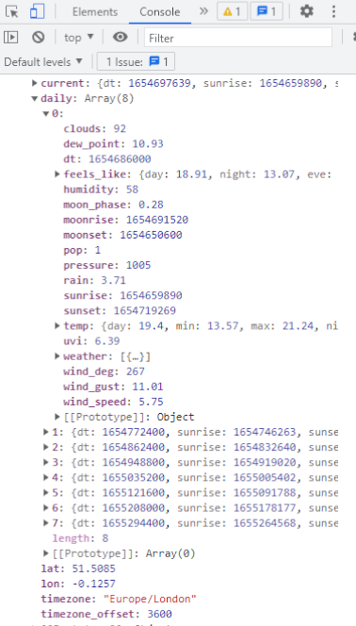
fetch(`https://api.openweathermap.org/data/2.5/onecall?lat= ${latitude} &lon= ${longitude} &exclude=hourly,minutely&units=metric&appid= ${API_KEY} `)
fetch(`https://api.openweathermap.org/data/2.5/weather?q= `+inputValue.value+` &appid= ${API_KEY} `)
Response
process-data
Openweathermap
API
Request
Display
Get-coordinate
Response
City-name
Request
Response
User
WeaTherino
Latitude, Longitude
Request
GPS
Getdata
B.Sc(Hons) Computer Science
Page - 6

Slide 8

Menu bar & Header Section
navigation elements – site_name, home, about, contact us and gps-search button
if user input a name which is not available then the site displays the nearest location’s data according to the entered name
header elements – brief description about weather ; a search field
background image change according to the weather condition
B.Sc(Hons) Computer Science
Page - 7

Slide 9
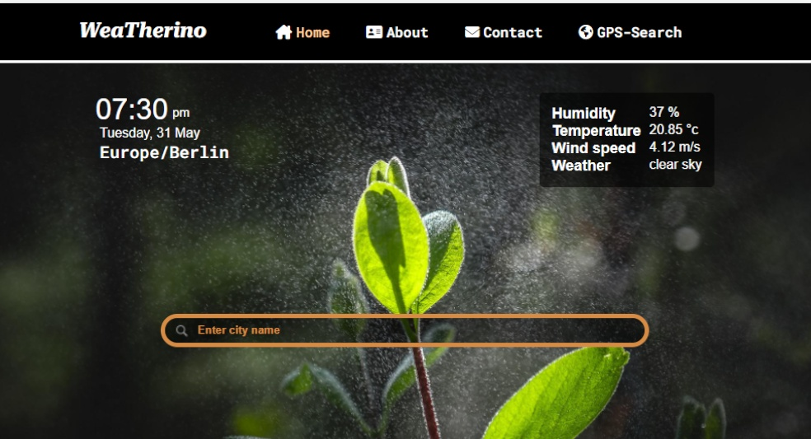
Desktop View

Slide 10
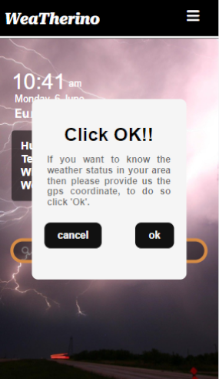
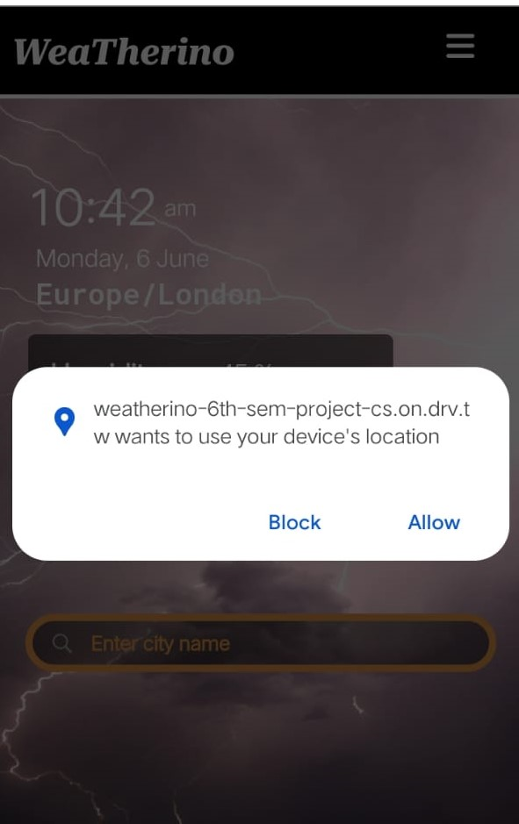
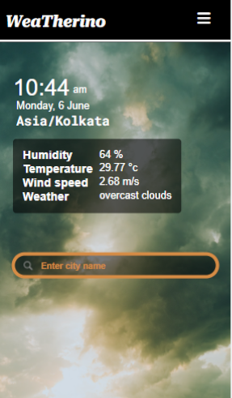
Messages
B.Sc(Hons) Computer Science
Page - 8

Slide 11
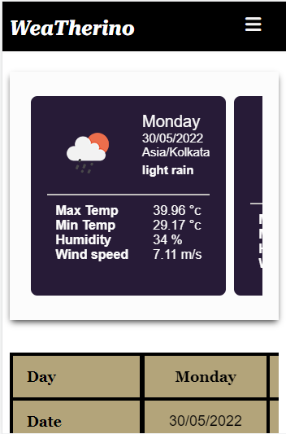
Table (I) Section
display brief description of 7 days weather condition with icon according to the weather status
can be slide towards right or left direction to view the weather of 7 days
B.Sc(Hons) Computer Science
Page - 9

Slide 12
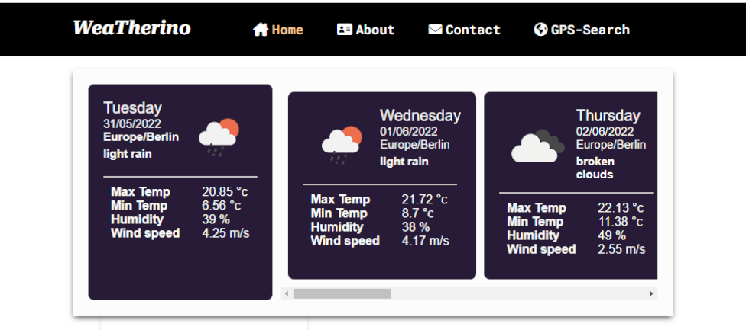
Desktop View

Slide 13
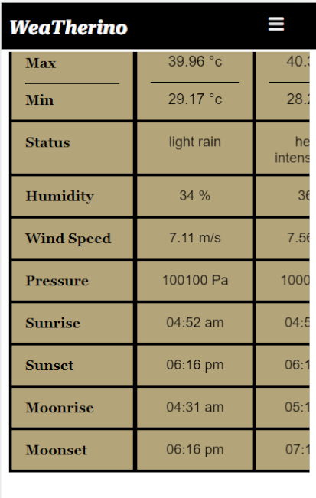
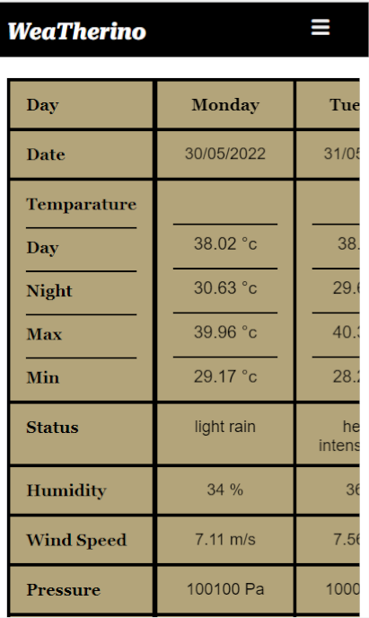
Table (II) Section
display detail description of 7 days weather condition
can be slide towards right or left direction to view the weather of 7 days
This section specially designed for students who need data of various weather components for education purpose
B.Sc(Hons) Computer Science
Page - 10

Slide 14
Desktop View

Slide 15
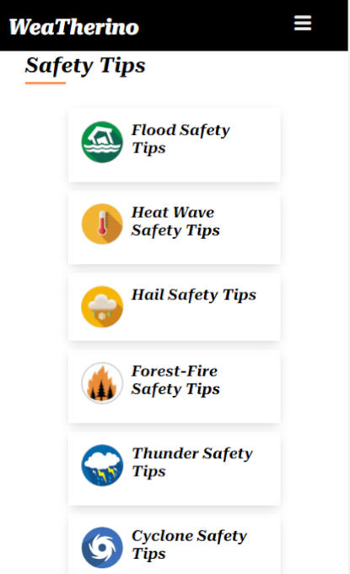
Safety Tips Section
We have included safety precautions about 6 disastrous weather events i.e. Flood, Heat wave, Hailstorm, Forest Fire, Thunderstorm and Cyclone
In every page we share some safety precaution and prevention tips
B.Sc(Hons) Computer Science
Page - 11

Slide 16
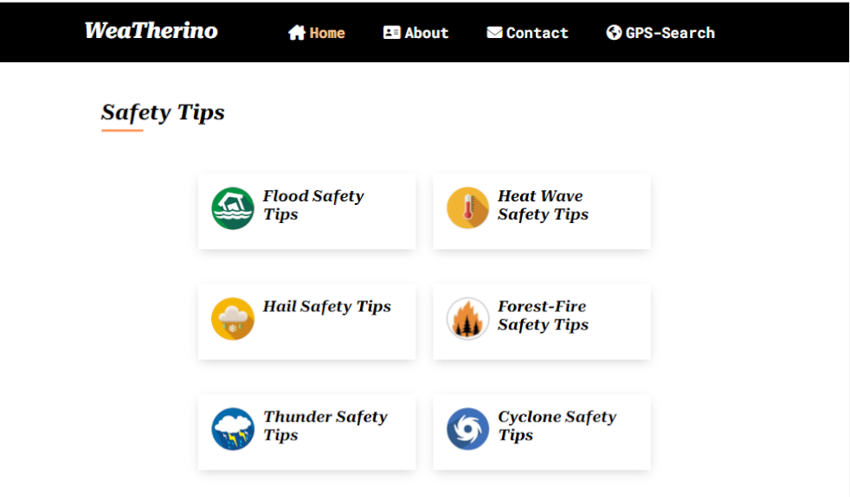
Desktop View

Slide 17
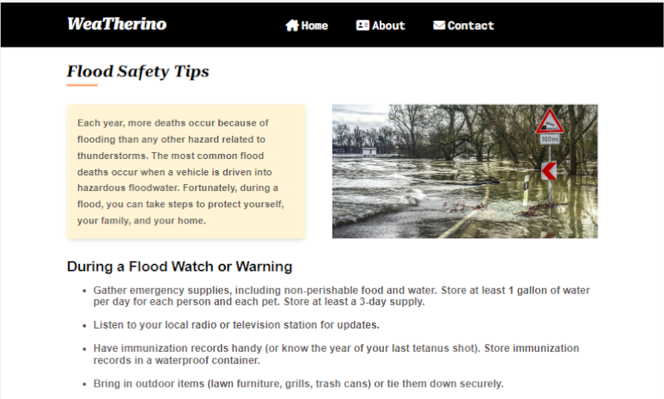
Safety Page View
B.Sc(Hons) Computer Science
Page - 12

Slide 18
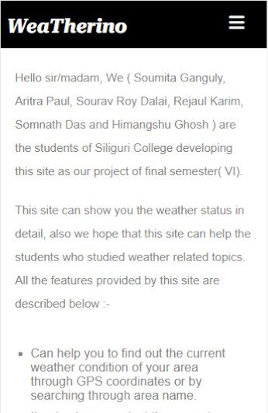
About Page
Here we explain briefly about our website
We have also explain how a user can get information in very easy language so anyone can easily understand it.
B.Sc(Hons) Computer Science
Page - 13

Slide 19
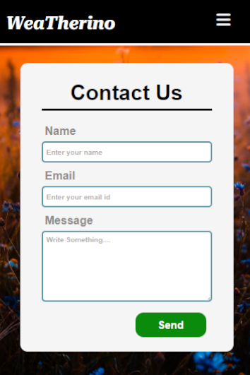
Contact Page
Through this page a user can easily contact with us
To contact with us we just ask a name and a valid email id so it is very secure user don’t need to enter any valuable personal information except email id.
B.Sc(Hons) Computer Science
Page - 14

Slide 20
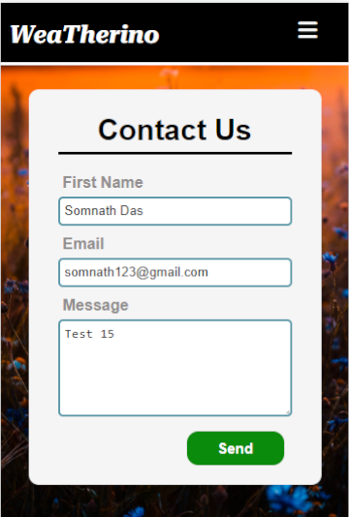
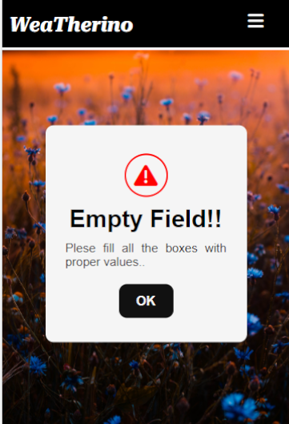
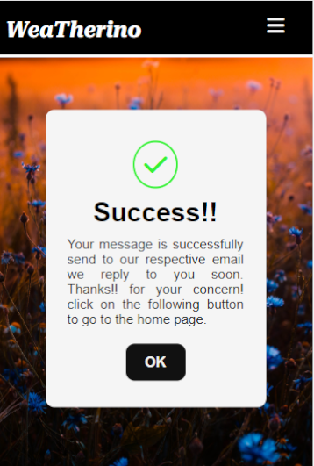
B.Sc(Hons) Computer Science
Page - 15

Slide 21
Future Scope
Try to launch this application in regional languages such as Bengali, Nepali, Hindi etc.
Try to make this application more user-friendly
Get data directly from government
Add some graphs about different weather components
Cerate a database to handle the user information
B.Sc(Hons) Computer Science
Page - 16

Slide 22
Conclusion
The design and development of this application will significantly useful for normal users as well as students. The application is Economically, Technically and Operationally Feasible.
It is user friendly, so that every user can handle it with ease.
The application is developed such that it will not use much of RAM and memory space
This application provides detail information with the use of interactive images
This application also provide various safety tips
B.Sc(Hons) Computer Science
Page - 17

Slide 23

Thank You!!

