Slide 1




Braille English
Translator
Presented by Team Seaslug

Slide 2
TEAM MEMBERS
Aritra
MCS202304
Nandini
MDS202335
Sreeja
MDS202350
Satyaki
MDS202344

Slide 3
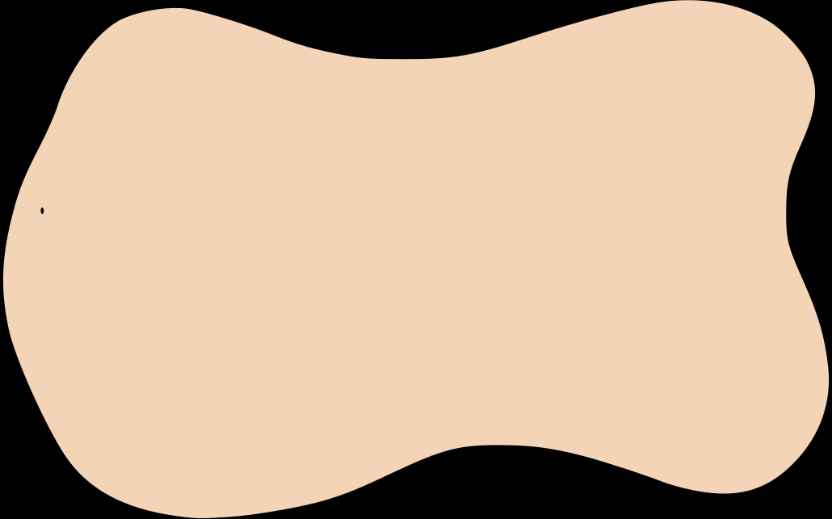
Project Aim
To bridge the communication gap between visually impaired individuals and the broader community by developing a seamless translator that converts between Braille and English, both in the text and image formats.

Slide 4
What is Braille?
Braille is a tactile writing system used by people with visual impairments to read and write through touch.
It consists of raised dots arranged in patterns that represent letters, numbers, punctuation, and even abbreviations.
Each Braille character is made up of a cell of six dots, arranged in two vertical columns of three dots each.

Slide 5
Motivation
Most of educational, professional, and everyday materials like newspaper are written in English.
To make these accessible to the visually impaired people, a quick translator might help a lot.
Apart from that, caregivers should be able to read and assess work written in Braille without knowing Braille at all.
Moreover, if Braille books or documents can be converted to English on the fly , we can further convert that to audio to facilitate quicker learning.

Slide 6

Our Approach
The project provides 4 apis for these tasks :
Braille text -> English text
English text -> Braille text
Braille image -> English text
English text image -> Braille text
Each of them facilitates instantaneous image or text processing returning the response in no time.

Slide 7
Project
Demo

Slide 8
Project Workflow
The server is written in python and used Flask framework which acts as the backend for the application, handling HTTP requests and responses.
All the routes we have seen, upon request, render a dynamic template that uses Jinja engine.
The routes, under the hood, call the utility functions which help us with translation and optical character recognition.
Then the intended results are wrapped in the http response and sent back.

Slide 9
Tools Used
YOLO (You Only Look Once) is a popular object detection model designed to identify and locate objects within images.
We have fine-tuned a YOLO model to detect and classify the Braille dots as the english words.
We have used the latest yolo11m.pt model to perform this task. (m stands for medium).
Then the fine-tuned last.pt is used to annotate the images and return the detected Braille.
EasyOCR is an open-source OCR library designed for extracting text from image.
In this project, EasyOCR is used as a direct dependency to extract English text from an image.
One of the main advantages of EasyOCR over traditional CNN is that it returns detected words instead of the letters, therefore saving us the time to write algorithms that converts the letters, spaces and punctuations to words.

Slide 10
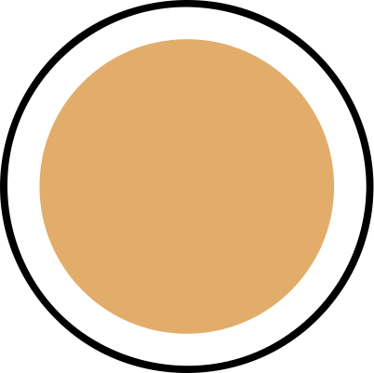
Yolo Dataset
Angelina Braille Character Dataset
Kaggle Braille Character Dataset
Braille Detection Dataset

Slide 11
Training the YOLO model
We have written a Kaggle notebook to fine-tune the YOLO model.
To train a YOLO model, we needed to structure the dataset, a training data for YOLO consists of an image and a corresponding txt file of the exact same base name with the detection coordinates and labels in it.
Moreover, the images and labels for train, test and val should be clubbed in the corresponding train, test and val folder .
All the settings and paths can be configured writing a config.yaml file.
To train a YOLO model, all we have to do is to pass the number of epochs (300 for us) and the config file path .
You can find the notebook here and the validation results in the next tab.

Slide 12
Key Features
Translation
Convert braille to text and text to braille with an advanced and robust translation tool. Use the handy braille keyboard to learn braille.
Image Processing
Process both Braille and text images effortlessly. Convert braille images to text or text images to braille with accuracy.

Slide 13
Braille Text Translation
Braille-to-text translator converts Braille code input (via keyboard or pasted strings) into readable text. It uses mappings to translate Braille patterns to English, handling capitalization and numbers, and displays the output clearly.

Slide 14
Text Braille Translation
Text-to-Braille translator converts English text into Braille by mapping each character to its corresponding Braille symbol. It supports letters, numbers, punctuation, and special symbols, displaying the translated Braille in a dedicated output area for easy use. (doesn’t support contractions)

Slide 15
Text-Image Braille
This functionality processes images containing text and converts the text into Braille. It uses EasyOCR to detect and extract text from the input image. The extracted text is then translated into braille using predefined character-to-braille mappings. The output is a Braille representation of the text from the image.

Slide 16
Braille-Image Text
This functionality processes images containing braille and converts the braille patterns into readable text. It uses fine-tuned YOLO11 for detecting Braille patterns within the image. The YOLO model directly returns the English letters for each of the Braille pattern detected. We then translate the text to Braille text and return as output.

Slide 17
Containerization
We containerized our application using Dockerfile.
The docker image installs the required libraries to run opencv models and then install the necessary python packages.
Then the image copies the server and run the server in production mode using waitress .
We also pushed the docker image to Docker Hub to make it publicly accessible.

Slide 18
Pytest suite
We have written lots of unit tests and integration tests using pytest framework to make sure that every function and endpoint works as intended and the new code doesn’t introduce any regression bugs.
We have also written a pre-push hook to run these tests before pushing to remote to make sure that everything works as intended in the production.

Slide 19
GitHub Workflow
Finally, we have set up a GitHub workflow to monitor the code quality and coverage.
When we push the code to the remote repository, the workflow runs the pytest and creates the code-coverage file.
We also have setup codecov to automatically compare the current and the old coverage.
The coverage report for the repo can be accessed here.

Slide 20

Deployment
The application can be run locally by running the script index , which will run the server in dev mode on 5000 .
A Dockerfile is provided to containerize the application . This will run the server in production mode on 10000 .
Alternatively, the built image is also available on the DockerHub here and can be pulled to run directly .
Apart from that, the docker image is deployed publicly on Hugging Face space and Render .

Slide 21
Future Works
Adding the functionality to directly convert the Braille images to audio.
Adding support for Braille contractions.
Implementing more robust algorithms for braille texts.
Finding a better dataset for training the YOLO model and a way to merge the datasets for extensive training
Considering support for different Braille formats (e.g., Double-Sided Braille).

Slide 22
GitHub
Repo

Slide 23
THANK YOU

