Slide 1
AEGISINSPECT / P20
AegisInspect: Autonomous Multimodal Drone Infrastructure Inspection with 3D Defect Localization and Reporting
Robotics/computer-vision infrastructure inspection combining deep-learning defect detection with classical localization, 3D geometry, mapping, persistence and deterministic reporting.
WORKING DRAFT
Evidence-bound. No Stop C or full-autonomy claim.
AEGISINSPECT | WORKING DRAFT | EVIDENCE-BOUND PRESENTATION SOURCE
01
Notes:
WORKING DRAFT
Assembly source: docs/presentation/assembly/slide_content.md
Assembly SHA-256: 76829ec39dff392479c4db9b50683b24143c96080f5eeef56148a6cf06412415
Title and capability boundary derived from assembly source.

Slide 2
AEGISINSPECT / P20
Inspection Problem and Objective
IMPLEMENTED / EVIDENCE-DRIVEN
Infrastructure inspection requires repeatable visual review and traceable defect documentation. AegisInspect keeps each subsystem claim tied to its evidence.
- Acquire RGB, depth, IMU and LiDAR observations
- Detect structural defects and project observations into 3D
- Persist records for human review and deterministic reporting
- Evaluate detector, localization and spatial outputs reproducibly
Boundary: this deck does not claim a validated full autonomous mission.
AEGISINSPECT | WORKING DRAFT | EVIDENCE-BOUND PRESENTATION SOURCE
02
Notes:
WORKING DRAFT
Assembly source: docs/presentation/assembly/slide_content.md
Assembly SHA-256: 76829ec39dff392479c4db9b50683b24143c96080f5eeef56148a6cf06412415
Assembly sections 1-2.

Slide 3
AEGISINSPECT / P20
Evidence-Bound System Architecture
IMPLEMENTED / SYSTEM CHAIN
CAMERA
/ DETECTOR
>
DEPTH
>
CAMERA
XYZ
>
LOCALIZATION
/ MAP RELATION
>
MAP XYZ
/ P15
>
P16
PERSISTENCE
>
P17
REPORT
DEMONSTRATED
MEASURED
PENDING
P16/P17 real handoff
P19 localization
P19 3D + Workstream 04
verified persistence, dashboard and report
no frozen accuracy PASS/FAIL threshold
controlled correspondence / low-light evaluation
AEGISINSPECT | WORKING DRAFT | EVIDENCE-BOUND PRESENTATION SOURCE
03
Notes:
WORKING DRAFT
Assembly source: docs/presentation/assembly/slide_content.md
Assembly SHA-256: 76829ec39dff392479c4db9b50683b24143c96080f5eeef56148a6cf06412415
Assembly section 3.

Slide 4
AEGISINSPECT / P20
GYU-DET Dataset and Defect Classes
SUPPORTED / DATA FOUNDATION
SUPERVISED IMAGES
ANNOTATIONS
HELD-OUT TEST
TEST INSTANCES
10,398
48,392
1,053
5,886
GYU-DET V3 baseline-v1
6 defect classes
images
GT instances
- Crack
- Breakage
- Honeycombing
- Hole
- Exposed Reinforcement
- Seepage
Dataset counts are data-foundation facts, not detector-performance metrics.
AEGISINSPECT | WORKING DRAFT | EVIDENCE-BOUND PRESENTATION SOURCE
04
Notes:
WORKING DRAFT
Assembly source: docs/presentation/assembly/slide_content.md
Assembly SHA-256: 76829ec39dff392479c4db9b50683b24143c96080f5eeef56148a6cf06412415
Assembly section 4.

Slide 5
AEGISINSPECT / P20
DET-FINAL-v1 Held-Out Detection Evidence
SUPPORTED / REAL HELD-OUT
DET-FINAL-v1 / YOLO26s
mAP50
mAP50-95
MEAN CLASS F1
0.29669431228680787
0.17480040543737643
0.3556245448108634
held-out GYU test
held-out GYU test
validation-selected threshold
- 1,053 test images; 5,886 instances
- Validation-selected operating threshold: 0.18618618618618618
- Macro precision: 0.37674095487474335
- Macro recall: 0.37432339044543
mAP is a detection metric, not generic or drone accuracy. The operating threshold was selected using validation data, not the test set.
AEGISINSPECT | WORKING DRAFT | EVIDENCE-BOUND PRESENTATION SOURCE
05
Notes:
WORKING DRAFT
Assembly source: docs/presentation/assembly/slide_content.md
Assembly SHA-256: 76829ec39dff392479c4db9b50683b24143c96080f5eeef56148a6cf06412415
Assembly sections 5-6.

Slide 6
AEGISINSPECT / P20
Localization and Simulation Architecture
SUPPORTED / SIMULATION RUNTIME
- ROS 2 Lyrical and Gazebo Sim 10.5.0
- RGB, CameraInfo, IMU, 3D LiDAR, depth, simulation clock and TF
- Accepted LiDAR ICP runtime acceptance: PASS
- Localization accuracy is MEASURED against simulation ground truth
RUNTIME ACCEPTANCE
ACCURACY STATUS
PASS
MEASURED
LiDAR ICP runtime
not PASS / FAIL classified
No frozen localization-accuracy pass/fail threshold exists.
AEGISINSPECT | WORKING DRAFT | EVIDENCE-BOUND PRESENTATION SOURCE
06
Notes:
WORKING DRAFT
Assembly source: docs/presentation/assembly/slide_content.md
Assembly SHA-256: 76829ec39dff392479c4db9b50683b24143c96080f5eeef56148a6cf06412415
Assembly sections 8 and insertable P19 status.

Slide 7
AEGISINSPECT / P20
Simulated Depth and Camera-Frame XYZ
SUPPORTED / SIMULATION RUNTIME
DEPTH CONTRACT
DEPTH VALIDATION
PROJECTION VALIDATION
RESULT FRAME
32FC1
103 tests
196 tests
camera_optical_frame
metres / camera_optical_frame
0 errors, failures or skips
0 errors, failures or skips
runtime-validated service
Depth and projection are supported in simulation. Camera-frame XYZ alone does not establish real-world depth accuracy, map-frame defect localization, or global localization accuracy.
AEGISINSPECT | WORKING DRAFT | EVIDENCE-BOUND PRESENTATION SOURCE
07
Notes:
WORKING DRAFT
Assembly source: docs/presentation/assembly/slide_content.md
Assembly SHA-256: 76829ec39dff392479c4db9b50683b24143c96080f5eeef56148a6cf06412415
Assembly sections 9-10.

Slide 8
AEGISINSPECT / P20
Map-Frame Defect Localization / P15
DEMONSTRATED / VERIFIED REAL HANDOFF
- Detection / track
- Robust depth
- Camera XYZ
- Pose transform
- Map XYZ
- Temporal aggregation
- Persistent defect record
Accepted mapped-defect lineage
P15D-10627c5f-3f84-5c64-ab2d-3e574b6e97ee
map XYZ: (3.9000027127470087, -0.09877989958311785, 0.0032930137079122536)
Timestamp: 1970-01-01T00:00:21.813000Z
P19 3D evaluation remains pending a controlled experiment with accepted explicit GT-to-mapped-defect correspondence.
AEGISINSPECT | WORKING DRAFT | EVIDENCE-BOUND PRESENTATION SOURCE
08
Notes:
WORKING DRAFT
Assembly source: docs/presentation/assembly/slide_content.md
Assembly SHA-256: 76829ec39dff392479c4db9b50683b24143c96080f5eeef56148a6cf06412415
Assembly section 11 and verified P16/P17 lineage.

Slide 9
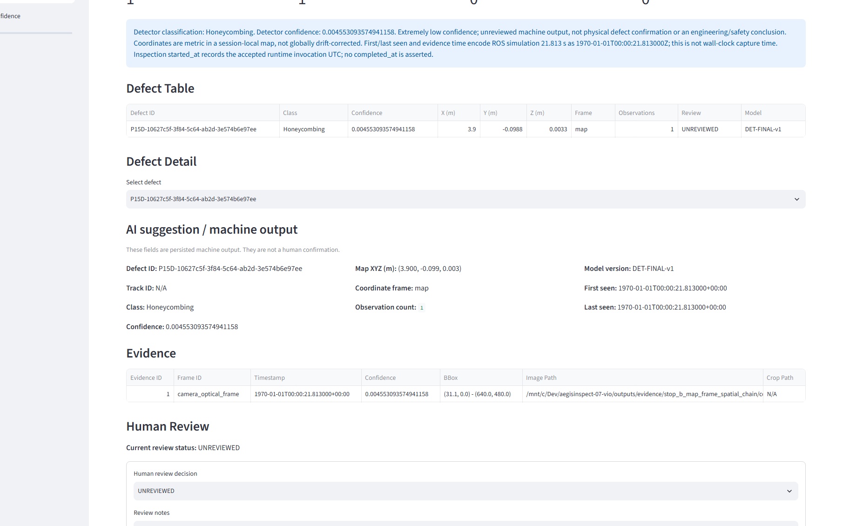
AEGISINSPECT / P20
P16 Persistence and Dashboard Review
DEMONSTRATED / VERIFIED REAL HANDOFF
REVIEW
UNREVIEWED
accepted review state
Detector classification: Honeycombing
Confidence: 0.004553093574941158
Observation count: 1
Model: DET-FINAL-v1
Extremely-low-confidence, unreviewed machine output used to demonstrate system lineage.
AEGISINSPECT | WORKING DRAFT | EVIDENCE-BOUND PRESENTATION SOURCE
09
Notes:
WORKING DRAFT
Assembly source: docs/presentation/assembly/slide_content.md
Assembly SHA-256: 76829ec39dff392479c4db9b50683b24143c96080f5eeef56148a6cf06412415
Verified dashboard_overview.png; P16/P17 package hash inventory 29/29.

Slide 10
AEGISINSPECT / P20
P17 Deterministic Reporting
DEMONSTRATED / VERIFIED REAL HANDOFF
DETERMINISTIC REPORT EXCERPT
REPORT VERIFICATION
HASH-VERIFIED
Inspection ID: 2026091901
Defect ID: P15D-10627c5f-3f84-5c64-ab2d-3e574b6e97ee
Class: Honeycombing
Confidence: 0.004553093574941158
Coordinate frame: map
Review Status: UNREVIEWED
Model Version: DET-FINAL-v1
deterministic P17 report
The report preserves persisted and mapped evidence without inferring severity, dimensions, repair action or structural safety.
AEGISINSPECT | WORKING DRAFT | EVIDENCE-BOUND PRESENTATION SOURCE
10
Notes:
WORKING DRAFT
Assembly source: docs/presentation/assembly/slide_content.md
Assembly SHA-256: 76829ec39dff392479c4db9b50683b24143c96080f5eeef56148a6cf06412415
Verified inspection_2026091901.md and P17 report SHA-256.

Slide 11
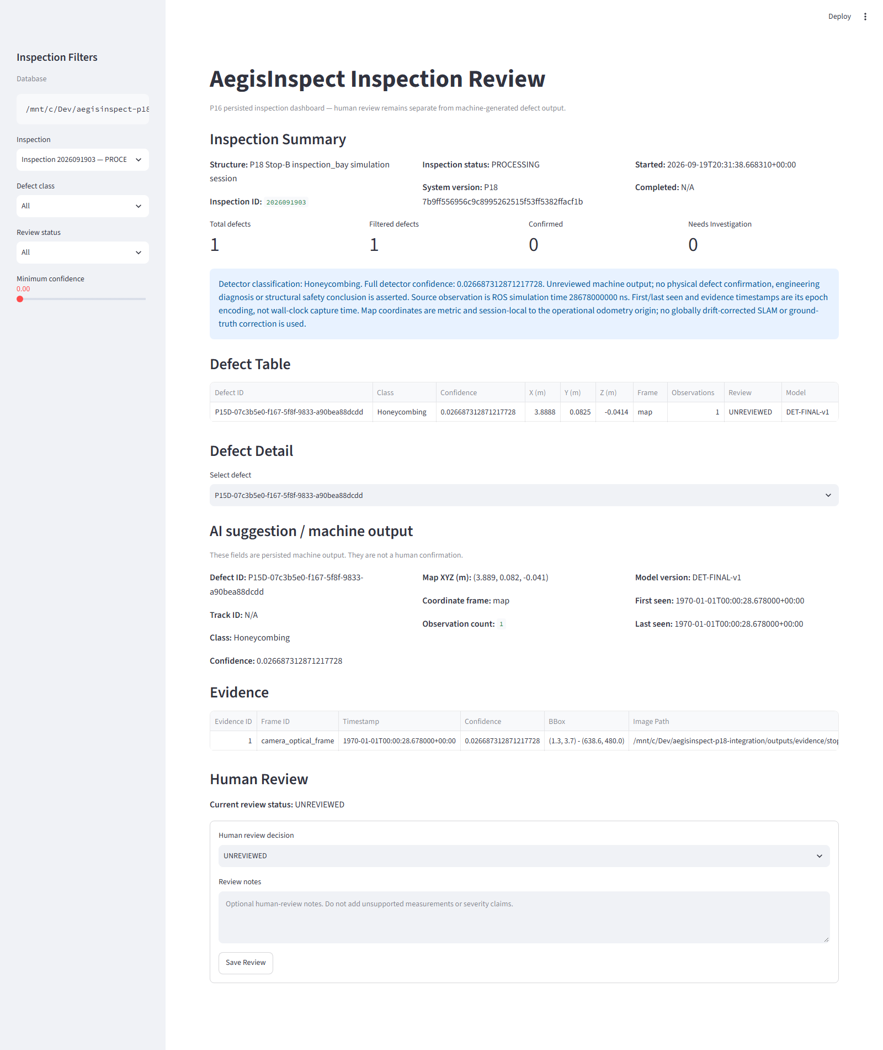
AEGISINSPECT / P20
P18 Integrated-System Demonstration
DEMONSTRATED / VERIFIED PACKAGE
DASHBOARD COMPLETION
PASS
real browser screenshot
The first integrated retry validated the same-observation data chain, but its browser capture was absent. The separate dashboard-evidence completion package supplies the accepted real dashboard capture.
This demonstrates integrated runtime and dashboard evidence; it does not establish full autonomy or production readiness.
AEGISINSPECT | WORKING DRAFT | EVIDENCE-BOUND PRESENTATION SOURCE
11
Notes:
WORKING DRAFT
Assembly source: docs/presentation/assembly/slide_content.md
Assembly SHA-256: 76829ec39dff392479c4db9b50683b24143c96080f5eeef56148a6cf06412415
Verified P18 dashboard-completion package; first retry limitation retained.

Slide 12
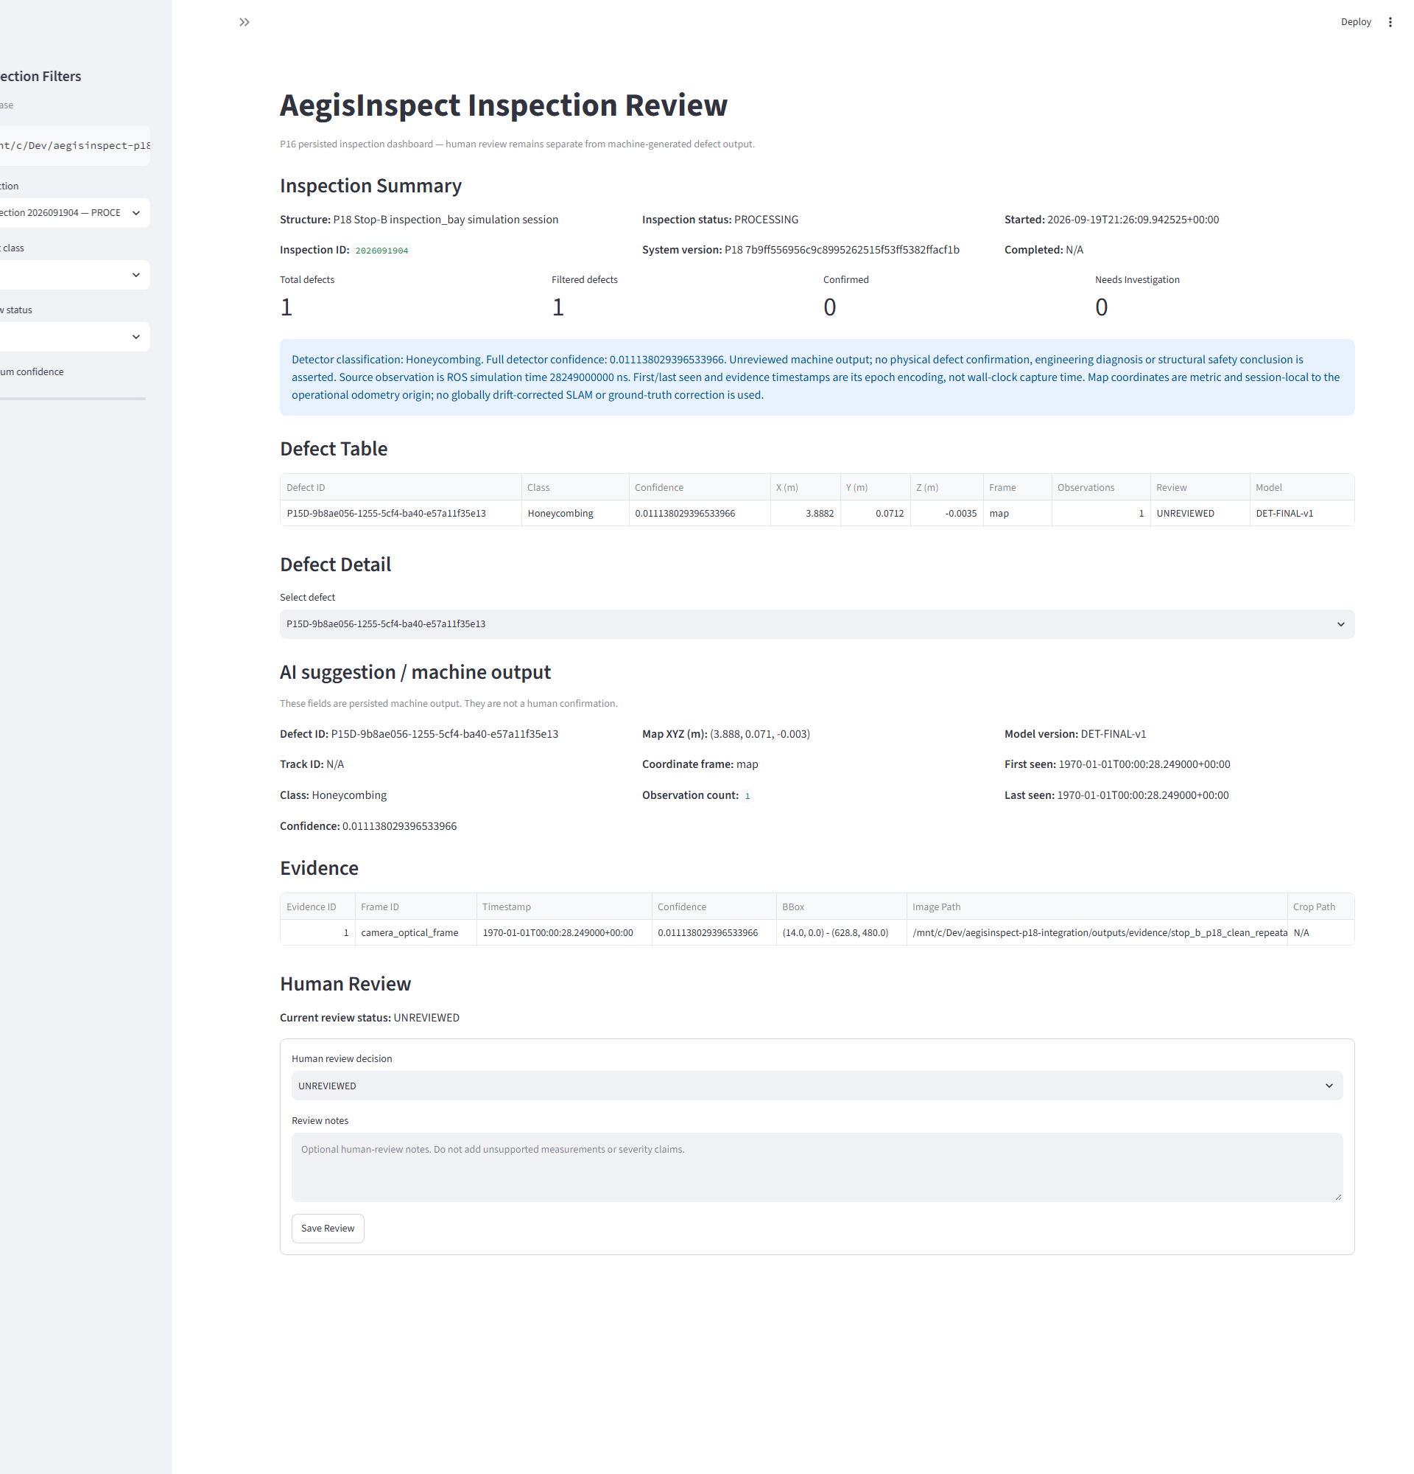
AEGISINSPECT / P20
P18 Clean Repeatability
DEMONSTRATED / VERIFIED PACKAGE
CLEAN REPEATABILITY
PASS
accepted execution identity
The clean repeatability package records a new detection and mapped-defect identity, P16 PASS, browser screenshots PASS and P17 PASS under unchanged source and configuration.
P19 3D correspondence and Workstream 04 evidence remain pending.
AEGISINSPECT | WORKING DRAFT | EVIDENCE-BOUND PRESENTATION SOURCE
12
Notes:
WORKING DRAFT
Assembly source: docs/presentation/assembly/slide_content.md
Assembly SHA-256: 76829ec39dff392479c4db9b50683b24143c96080f5eeef56148a6cf06412415
Verified clean-repeatability package.

Slide 13
AEGISINSPECT / P20
P19 Localization Evaluation
MEASURED / FROZEN METHODOLOGY
ATE TRANSLATION RMSE
RPE TRANSLATION RMSE
RPE ROTATION RMSE
0.595396782192 m
0.340604743330 m
1.707265244063 deg
76 matched samples; interval 3-18 s
delta 1 s +/- 50 ms
44 pairs
Ground-truth bracket maximum 50 ms; linear translation interpolation; quaternion SLERP; SE(3) no-scale alignment; scale = 1.
Runtime acceptance: PASS. Localization accuracy: MEASURED. No frozen localization-accuracy pass/fail threshold exists.
AEGISINSPECT | WORKING DRAFT | EVIDENCE-BOUND PRESENTATION SOURCE
13
Notes:
WORKING DRAFT
Assembly source: docs/presentation/assembly/slide_content.md
Assembly SHA-256: 76829ec39dff392479c4db9b50683b24143c96080f5eeef56148a6cf06412415
Accepted P19 metrics represented in assembly source.

Slide 14
AEGISINSPECT / P20
P19 3D Evaluation Status
PENDING / CONTROLLED CORRESPONDENCE
P19 3D correspondence - pending controlled experiment
GT defect ID: pending
Mapped defect ID: pending
Reserved evidence visual
Insert only after accepted correspondence evidence arrives.
Estimated XYZ: pending
Ground-truth XYZ: pending
Euclidean 3D error: pending
Correspondence provenance: pending
No 3D metric or result classification is populated before accepted explicit correspondence.
AEGISINSPECT | WORKING DRAFT | EVIDENCE-BOUND PRESENTATION SOURCE
14
Notes:
WORKING DRAFT
Assembly source: docs/presentation/assembly/slide_content.md
Assembly SHA-256: 76829ec39dff392479c4db9b50683b24143c96080f5eeef56148a6cf06412415
Assembly P19 3D pending boundary and late-evidence slot.

Slide 15
AEGISINSPECT / P20
Workstream 04: Low-Light Robustness
PENDING / ARMOURY RESULTS
AWAITING ACCEPTED WORKSTREAM 04 RESULTS
RAW series reserved
Accepted detector metric
(mAP50-95 if accepted)
Additional series
only if accepted
No points, bars, curves, or performance values are shown before accepted results.
L0
L1
L2
L3
L4
Illumination level
AEGISINSPECT | WORKING DRAFT | EVIDENCE-BOUND PRESENTATION SOURCE
15
Notes:
WORKING DRAFT
Assembly source: docs/presentation/assembly/slide_content.md
Assembly SHA-256: 76829ec39dff392479c4db9b50683b24143c96080f5eeef56148a6cf06412415
Assembly Workstream 04 pending statement and late-evidence slot.

Slide 16
AEGISINSPECT / P20
Evidence, Provenance and Reproducibility
DEMONSTRATED / HASH-BOUND
- Git preservation provenance: canonical P17 preservation state
- Runtime evidence provenance: recovered P16/P17 ZIP, DB and report
- P19 localization evidence preservation commit
- Full hashes retained in the verified P20 evidence package
P16/P17 PACKAGE
29 / 29 PASS
verified package hash inventory
Concise identifiers
P17 Git: eb4013fa...bbfe488f
P16/P17 ZIP: df3f87f0...9f313ec2
P19 evidence: 4c7bd79a...9a4d78a
AEGISINSPECT | WORKING DRAFT | EVIDENCE-BOUND PRESENTATION SOURCE
16
Notes:
WORKING DRAFT
Assembly source: docs/presentation/assembly/slide_content.md
Assembly SHA-256: 76829ec39dff392479c4db9b50683b24143c96080f5eeef56148a6cf06412415
Assembly section 18 and verified P16/P17 package.

Slide 17
AEGISINSPECT / P20
Limitations and Evidence Boundaries
REQUIRED LIMITATIONS
- Held-out detector mAP remains modest; metrics are not generic accuracy
- Accepted P16/P17 example is extremely-low-confidence, unreviewed machine output
- P19 localization is measured, not threshold-classified as accurate
- P19 3D requires explicit correspondence
- P18 demonstrates runtime, dashboard-completion and repeatability evidence; Workstream 04 results are pending
- Stop C / full autonomy is not demonstrated
AEGISINSPECT | WORKING DRAFT | EVIDENCE-BOUND PRESENTATION SOURCE
17
Notes:
WORKING DRAFT
Assembly source: docs/presentation/assembly/slide_content.md
Assembly SHA-256: 76829ec39dff392479c4db9b50683b24143c96080f5eeef56148a6cf06412415
Assembly section 15.

Slide 18
AEGISINSPECT / P20
Current Demonstrated Capability
WORKING DRAFT / EVIDENCE-BOUND
AegisInspect demonstrates a robotics/computer-vision inspection pipeline combining deep-learning structural-defect detection, depth and 3D projection, localization/map-frame processing, mapped-defect persistence, dashboard review, deterministic reporting and measured localization evaluation.
Next accepted inputs: explicit P19 3D correspondence; Workstream 04 low-light results.
Implemented is not the same as measured. Pending results remain visible.
AEGISINSPECT | WORKING DRAFT | EVIDENCE-BOUND PRESENTATION SOURCE
18
Notes:
WORKING DRAFT
Assembly source: docs/presentation/assembly/slide_content.md
Assembly SHA-256: 76829ec39dff392479c4db9b50683b24143c96080f5eeef56148a6cf06412415
Assembly section 17.

