Slide 1



STARTIFY
(Empowering entrepreneurship by connecting innovators)
TechHubBharat
TEAM MEMBERS
Aritra Chakraborty – Team Leader
Abhishek Kr. Pandey
Tushar Solanki
Anish Gupta

Slide 2
Abstract
The core idea of our project is that we are trying to solve the problems faced by budding Entrepreneurs by connecting them with top VCs, Business coaches, Finance Leaders, in a single web and app platform to help each other in building India as the modern Entrepreneurship capital. India having a strong demographical dividend on factors like Less median age, large workforce, lower dependency ratio it has a huge potential to climb up the ladders to be the next superpower. We as a team TechHub Bharat want to elevate the Startup India concept to the next level by leveraging the power of modern Tech stack and AI/ML. We as a team do believe that technology is the way which can bring change and revolutionize the entrepreneurial Landscape of our country.

Slide 3
Problem Statement
Startup activity has increased by 45% in comparison to FY2022, but only 15%
of these ventures manage to secure venture capital funding as well as building a robust marketing and sales pipeline with robust financial analysis indicating a substantial gap in resources and support. Our tech-focused ecosystem aims to bridge this divide by connecting new startups with established venture capitalists, successful business leaders, experienced coaches, and financial experts to build, grow,
run, buy/sell a business.
One of the leading causes of startup failure is a lack of mentorship and funding, contributing to an estimated 70% failure rate within the first three years. From Times Of India (TOI) Report “95% startups fail due to lack of mentors”

Slide 4
Proposed Solution
Startify creates a synergistic ecosystem designed to connect startups
with venture capitalists, business coaches, and finance leaders through AI-driven suggestions. The web & app platform optimizes deal flow, enhancing funding prospects for entrepreneurs. Real-time chat functionality fosters seamless communication, enabling dynamic networking and rapid information exchange. Users can see and follow the posts made by the other fellow users they follow in our platform regarding their business and work-culture. Our subscription model provides stable cash flow, allowing for continuous platform improvements. Startify's focus on value creation through strategic partnerships and knowledge transfer positions it as a pivotal resource for startups aiming to scale and secure investment. Our platform intends to solve the problem for startups to grow and scale by providing them quality networks and business partnership opportunities.

Slide 5
Tech Stack Used
While building Startify the technologies and tech stack used are:
Frontend:
HTML, CSS, JS, Tailwind CSS, React.js
Backend:
Django, Django REST Frameworks (REST APIs), Chat Socket, SQLite Database/MYSQL, Joblib.
AI/ML:
Classification and Regression based ML Models – for suggestions and AI backed features, Jupyter Notebook, Image Processing (by OpenCV), NLP – for not suitable/harmful text content detection in platform.

Slide 6
Target Audience
The target audience of startup-focused social media platforms typically includes:- Entrepreneurs and founders looking for resources, support, and networking opportunities- Investors seeking promising startup ventures to invest in- Professionals interested in joining startup teams or providing services to startups (e.g., developers, marketers, designers)- Startup enthusiasts and individuals interested in entrepreneurship and innovation- Incubators, accelerators, and startup support organizations offering guidance and resources- Potential customers or users of startup products or services, depending on the platform's focus
Th

Slide 7
Future Scope
1. Enhanced Networking: Improved algorithms for connecting startup founders, investors, and mentors.
2. AI-Driven Insights: Machine learning for personalized mentorship and investment recommendations.
3. Cross-Platform Integration: Integration with productivity and project management tools for seamless workflow.
4. Global Collaboration: Tools that enable real-time global collaboration among startups.
5. Diverse Resource Libraries: Expanding access to startup-focused resources and educational content.
6. Gamification and Incentives: Incorporating elements to encourage engagement and innovation.
7. Blockchain and Security: Secure data and transaction systems for funding and collaborations.

Slide 8
Uniqueness
(Optional)
Personalized Startup specific social platform
Mentorship and guidance on AI suggestions
Easy UI/UX of the software
Plethora of startup related resources
Lower Cost in comparison to other platforms
Specialized Chat feature for interest oriented people and business partners

Slide 9
Competitor Analysis
The main competitors of our platform and their demerit is:
1. Slack:-
1. Slack is too expensive to use by Forbes Report
2. By Platform Report it lacks personal connections
3. Slack has a difficult UI/UX for users
2. LinkedIn:-
1. Difficult to find Specialized Industry Expertise
2. It adheres to be a generalized Networking platform
3. Very Limited Startup-Specific Resources
:

Slide 10
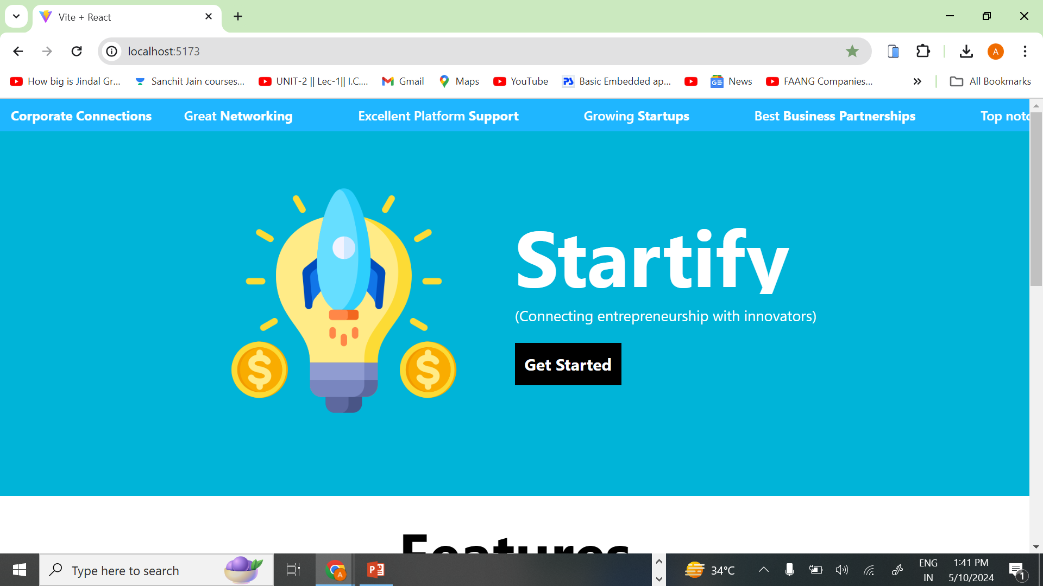
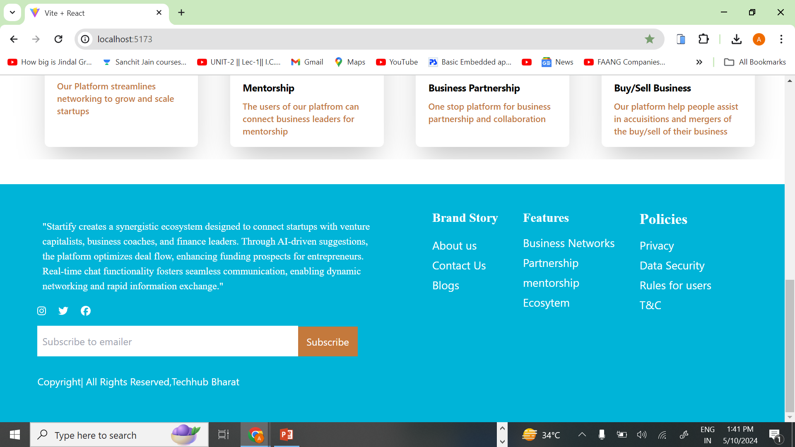
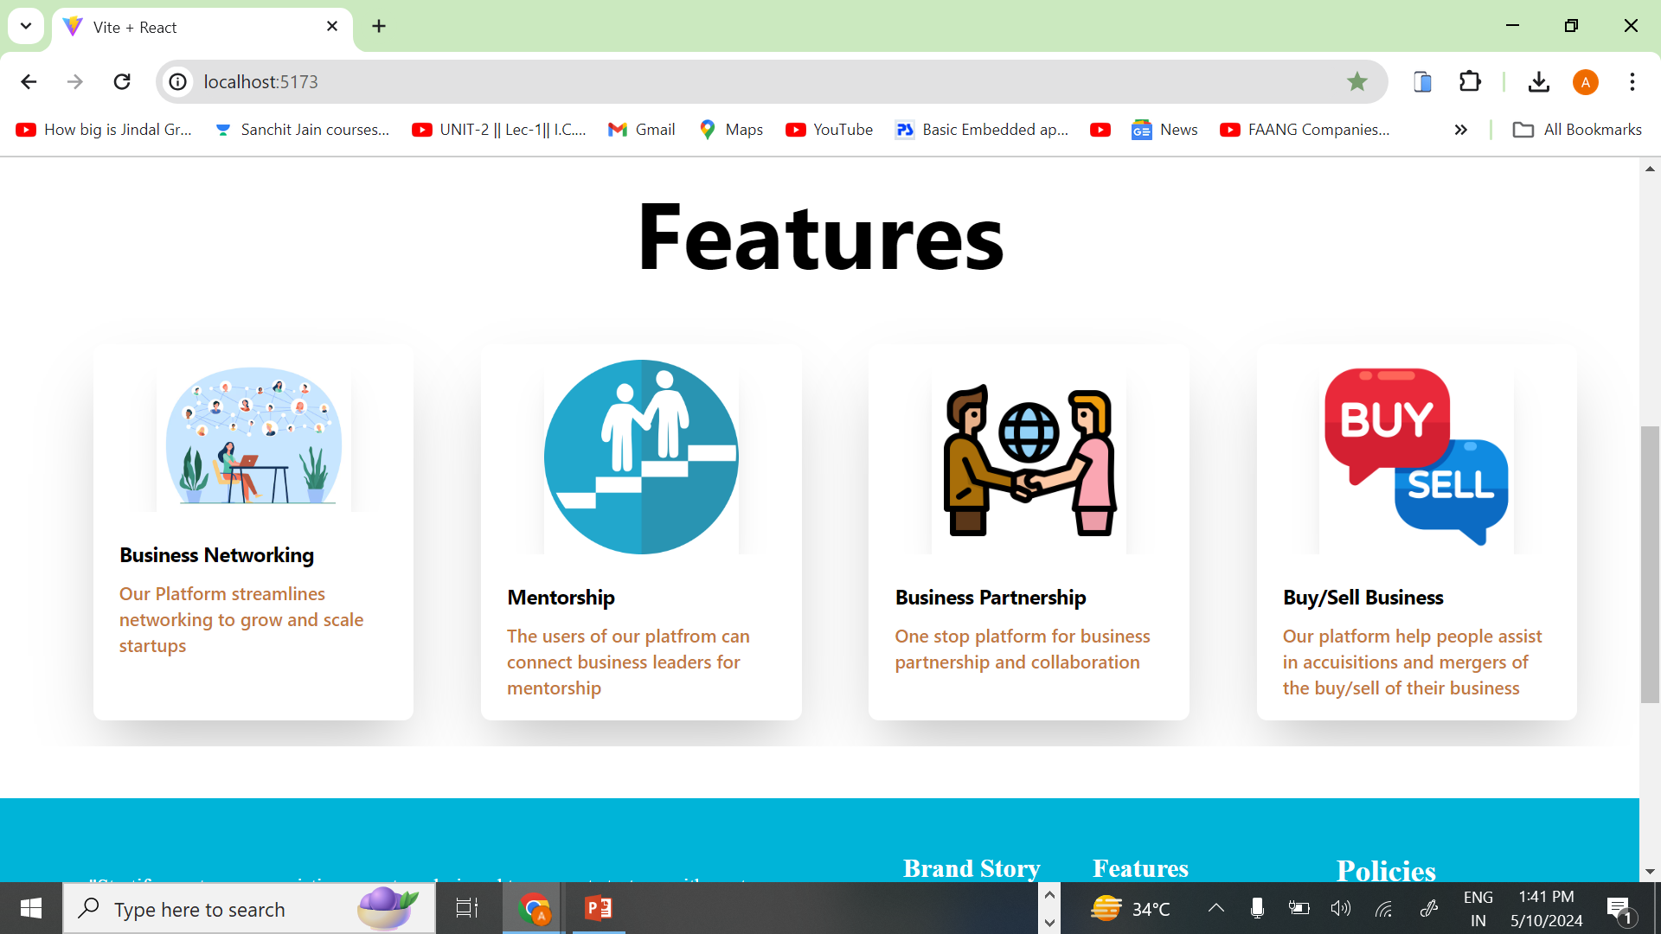
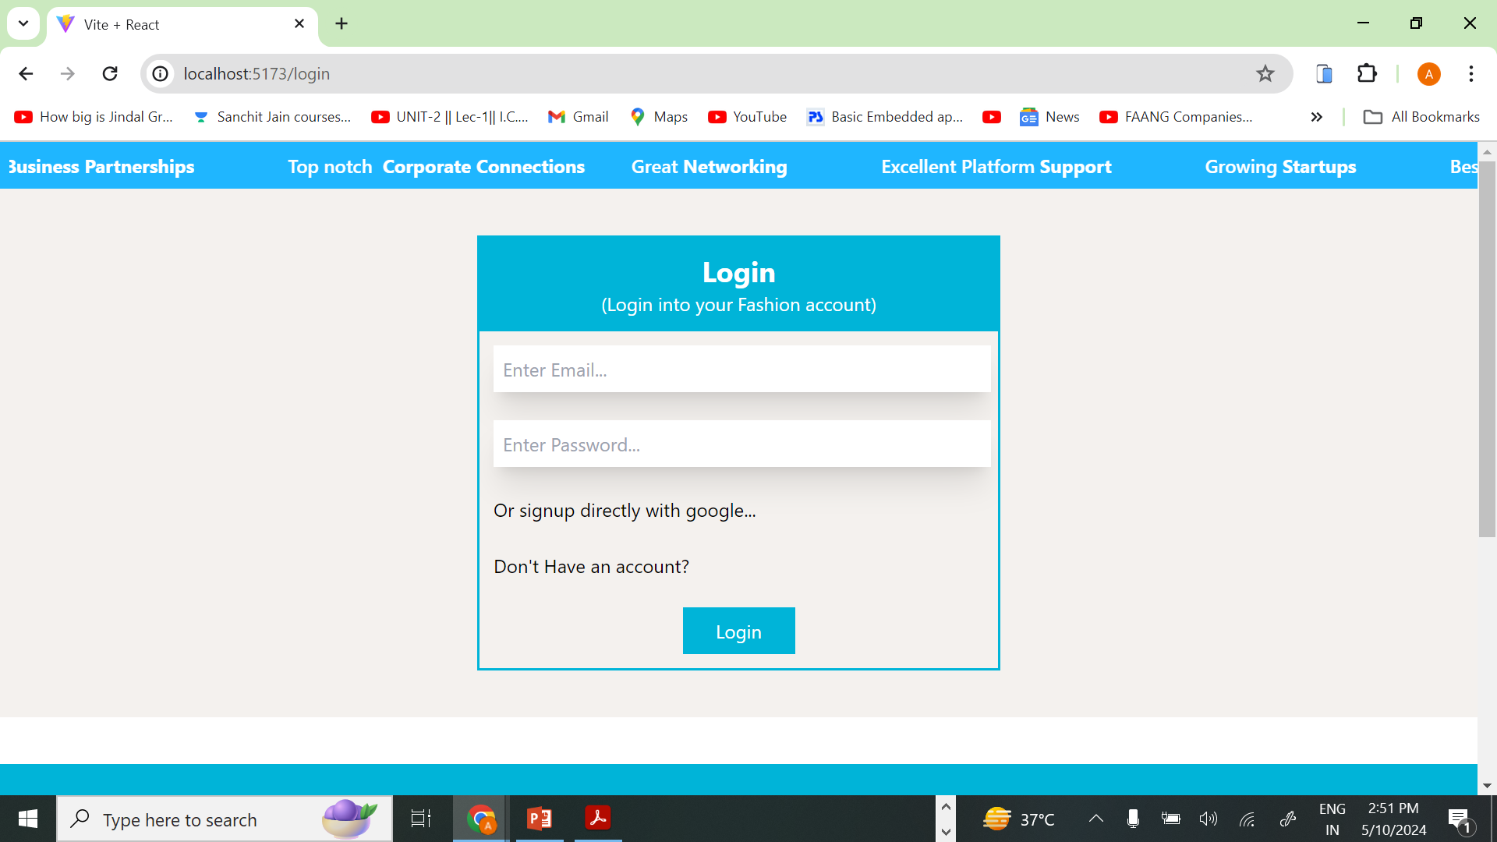
Screenshots/Images
(Optional)

Slide 11
Conclusion
Given the unique challenges and requirements of the startup ecosystem, utilizing a startup-focused social media platform can lead to more meaningful connections, relevant resources, and supportive communities. While LinkedIn and similar platforms have their place in professional networking, startup founders seeking mentorship, guidance, and a thriving ecosystem may find more value in platforms designed with their specific needs in mind. Ultimately, the choice of platform should align with the goals and stage of development of the startup, ensuring it provides the right balance of resources, community, and collaborative tools with Startify.

