Slide 1
DNA & RNA
Nature's Code — How Life Stores, Copies & Reads Information
Nucleotides
Nitrogenous Bases
DNA & RNA
Replication & Transcription
Central Dogma & PCR
BB 101 · Tutorial 2

Slide 2
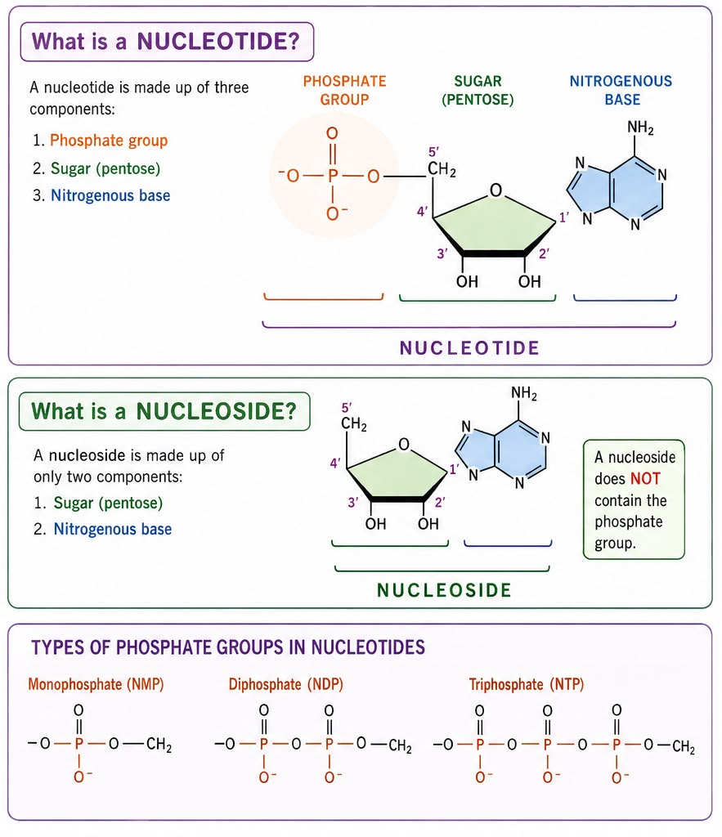
BUILDING BLOCKS
Structure of Nucleotides
A nucleotide has three parts:
1. Phosphate group
The connector — links one nucleotide to the next.
2. Sugar (pentose)
Ribose (RNA) or deoxyribose (DNA) — the backbone.
3. Nitrogenous base
A, T, G, C, or U — the actual information.
Nucleoside vs Nucleotide
A nucleoside is sugar + base only — no phosphate, not yet linked into a chain. Add the phosphate and it becomes a nucleotide, ready to join the strand. NMP / NDP / NTP just mean 1, 2, or 3 phosphates attached.
2

Slide 3
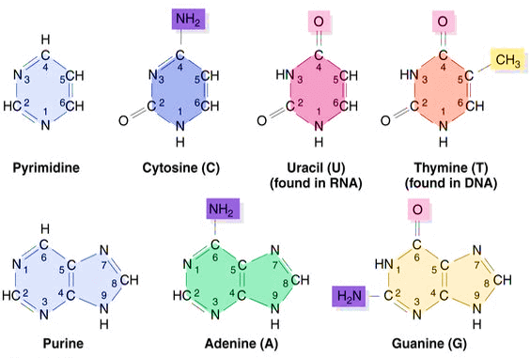
BUILDING BLOCKS
Structure of Nitrogenous Bases
Purines vs Pyrimidines
A & G = purines, two rings, “big.” C, T, U = pyrimidines, one ring, “small.” Big always pairs with small — that’s what keeps the DNA ladder a constant width.
Pairing Rule
A — T (or A—U in RNA), 2 hydrogen bonds G — C, 3 hydrogen bonds — slightly stronger
Why It Matters Later
G-C rich DNA needs more heat to melt apart than A-T rich DNA — directly relevant to PCR’s temperatures, later in this deck.
3

Slide 4
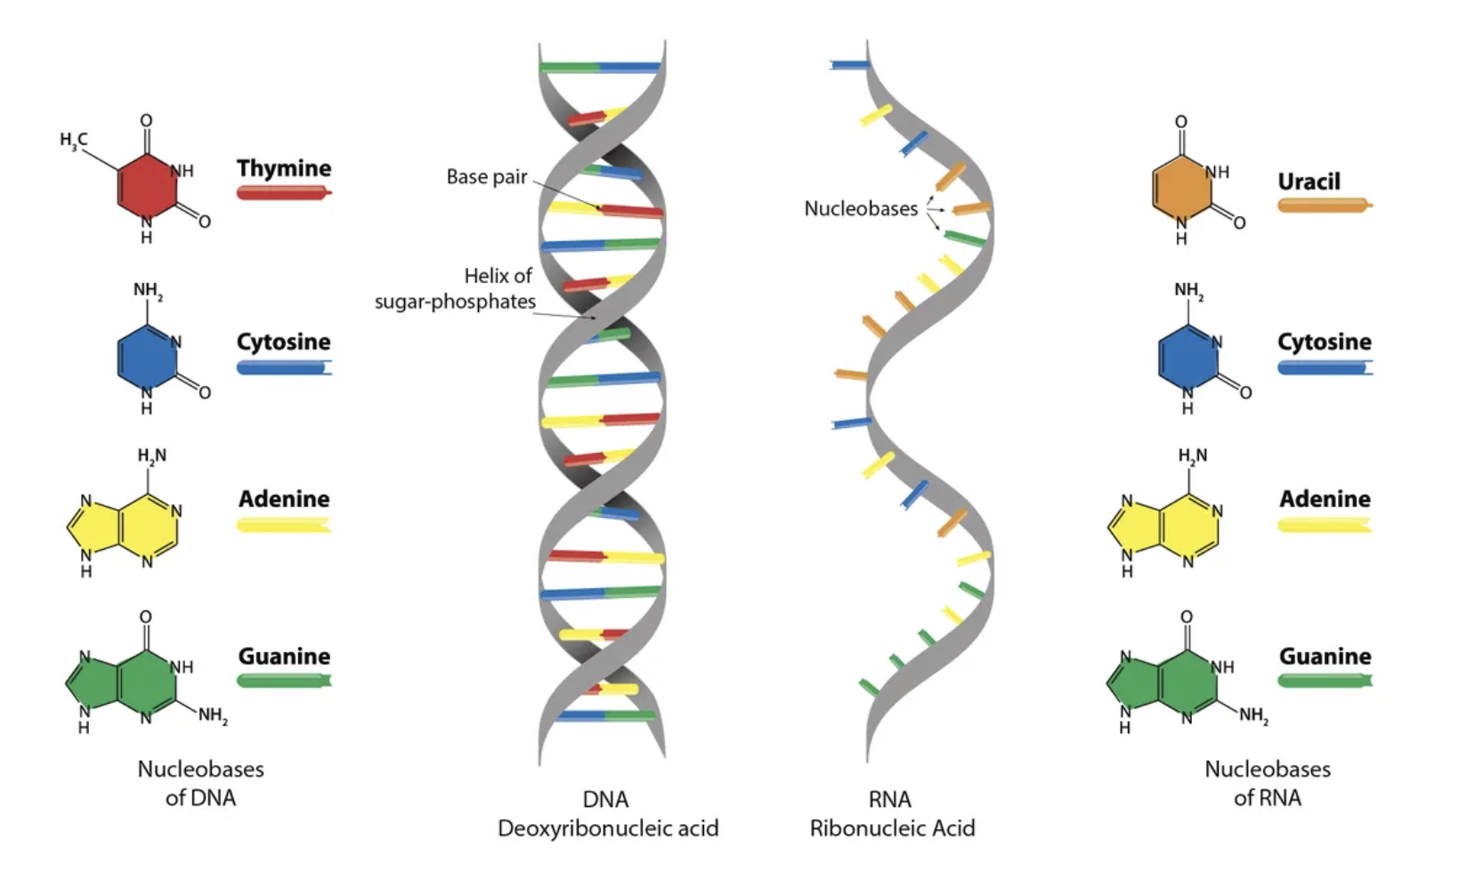
STRUCTURE
DNA & RNA: Structure of the Code
DNA
Double-stranded helix
Millions of bases long
Deoxyribose sugar — very stable
Stays in the nucleus — the archive
RNA
Single-stranded
A few thousand bases long
Ribose sugar — less stable, reactive
Made, used, then discarded
DNA is built to last. RNA is built to be disposable. Every difference above exists for that one reason.
4

Slide 5
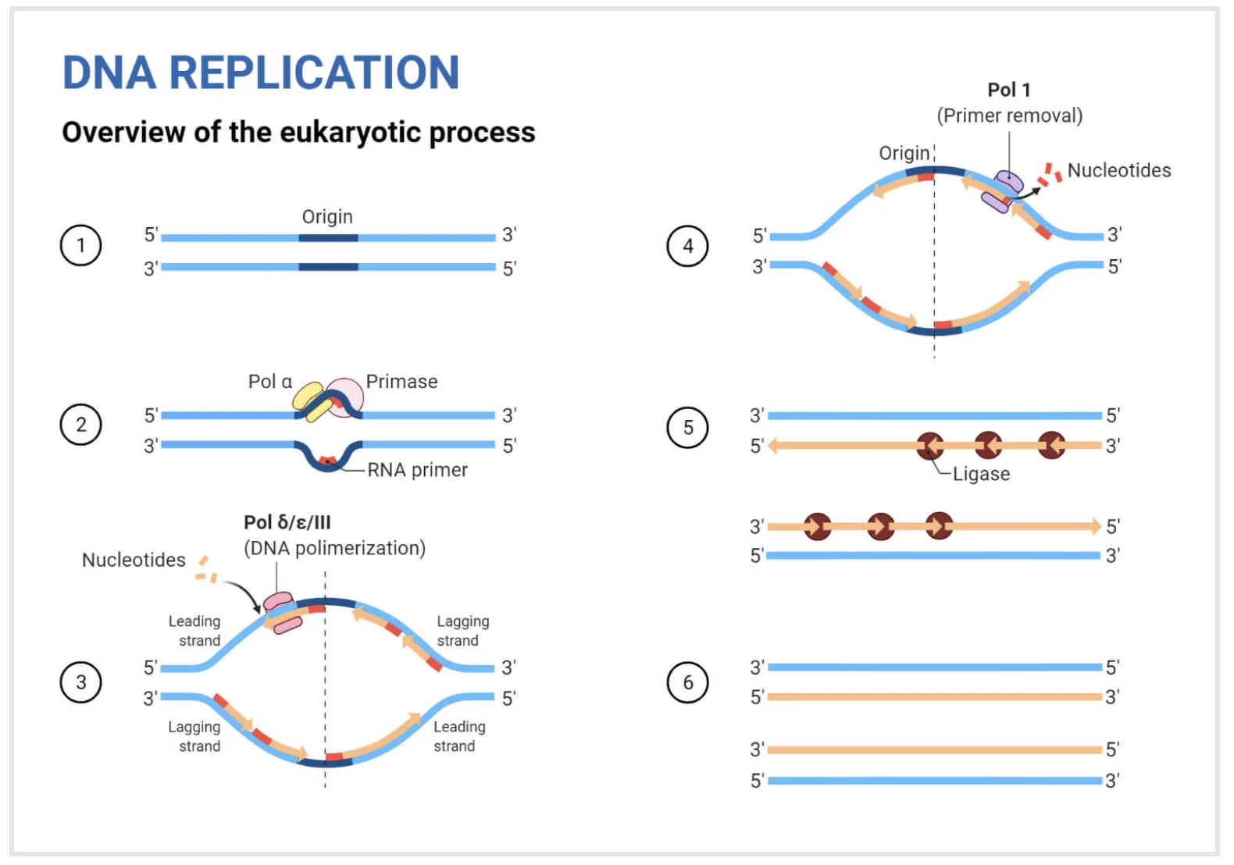
COPYING THE CODE
Replication & Transcription: Two Ways to Copy
DNA → DNA · Replication
Semiconservative — each new duplex keeps one parental strand.
DNA polymerase reads 3'→5', builds new strand 5'→3'.
Leading strand: continuous. Lagging strand: short Okazaki fragments, sealed by ligase.
DNA → RNA · Transcription
Copies out one gene only — not the whole genome.
RNA polymerase reads the template, builds mRNA 5'→3'.
mRNA transcript (5'…AUG…3') carries the code to the ribosome.
Reference: the full replication mechanism (not required to memorize step-by-step today).
5

Slide 6
READING THE CODE
Codons & the Central Dogma
Transcription
Translation
DNA (template)
mRNA (codon)
Protein
3'–T A C–5'
5'–A U G–3'
Met (Start)
tRNA (anticodon)
reads the codon, delivers the matching amino acid
3'–U A C–5'
Translation runs mRNA → Protein directly. tRNA is a helper that reads the codon and hands over an amino acid — not an intermediate product.
The Code Is Degenerate
The Wobble Position
61 sense codons specify only 20 amino acids — most amino acids have more than one codon.
Strict pairing governs codon positions 1 & 2. Position 3 tolerates a looser match — e.g. a G on the tRNA pairing with U on the mRNA. Result: one tRNA can recognize more than one codon, so fewer than 61 tRNA types are needed.
Amino acid | Codons (mRNA)
Leucine (Leu) | UUA · UUG · CUU · CUC · CUA · CUG
Serine (Ser) | UCU · UCC · UCA · UCG · AGU · AGC
Methionine (Met) | AUG (also the start codon)
Tryptophan (Trp) | UGG (only one codon)
C
U
U
codon
G
A
G
anticodon (wobble)

Slide 7
THE COPY-PASTE TOOL
PCR: The Polymerase Chain Reaction
1
2
3
Denaturation
Annealing
Extension
~95 °C
50–65 °C
~72 °C
Heat breaks H-bonds; dsDNA separates into two single strands.
Short primers bind complementary sequences flanking the target.
Taq polymerase adds dNTPs 5'→3', synthesizing new strands.
Repeat 25–35 times — every molecule made becomes a template for the next cycle.
What's in the tube
Copy number ≈ 2ⁿ
Template DNA
Forward & reverse primers
Taq DNA polymerase
dNTPs
Mg²⁺ buffer
n = number of cycles
35
≈ 3.4 × 10¹⁰ copies
from a single template molecule — enough to detect DNA present only in trace amounts.
cycles
7

Slide 8
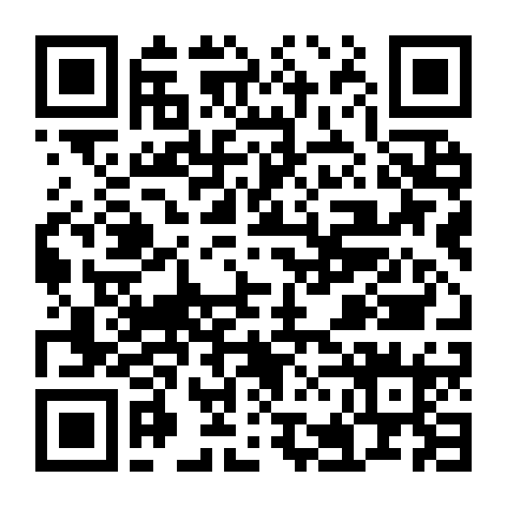
Go Deeper: DNA & RNA Right Now
Scan for 12 current articles on gene editing, RNA medicine, DNA storage, and more
https://claude.ai/code/artifact/667ab17c-f452-4b89-8df7-2286ee64214f

