Slide 1
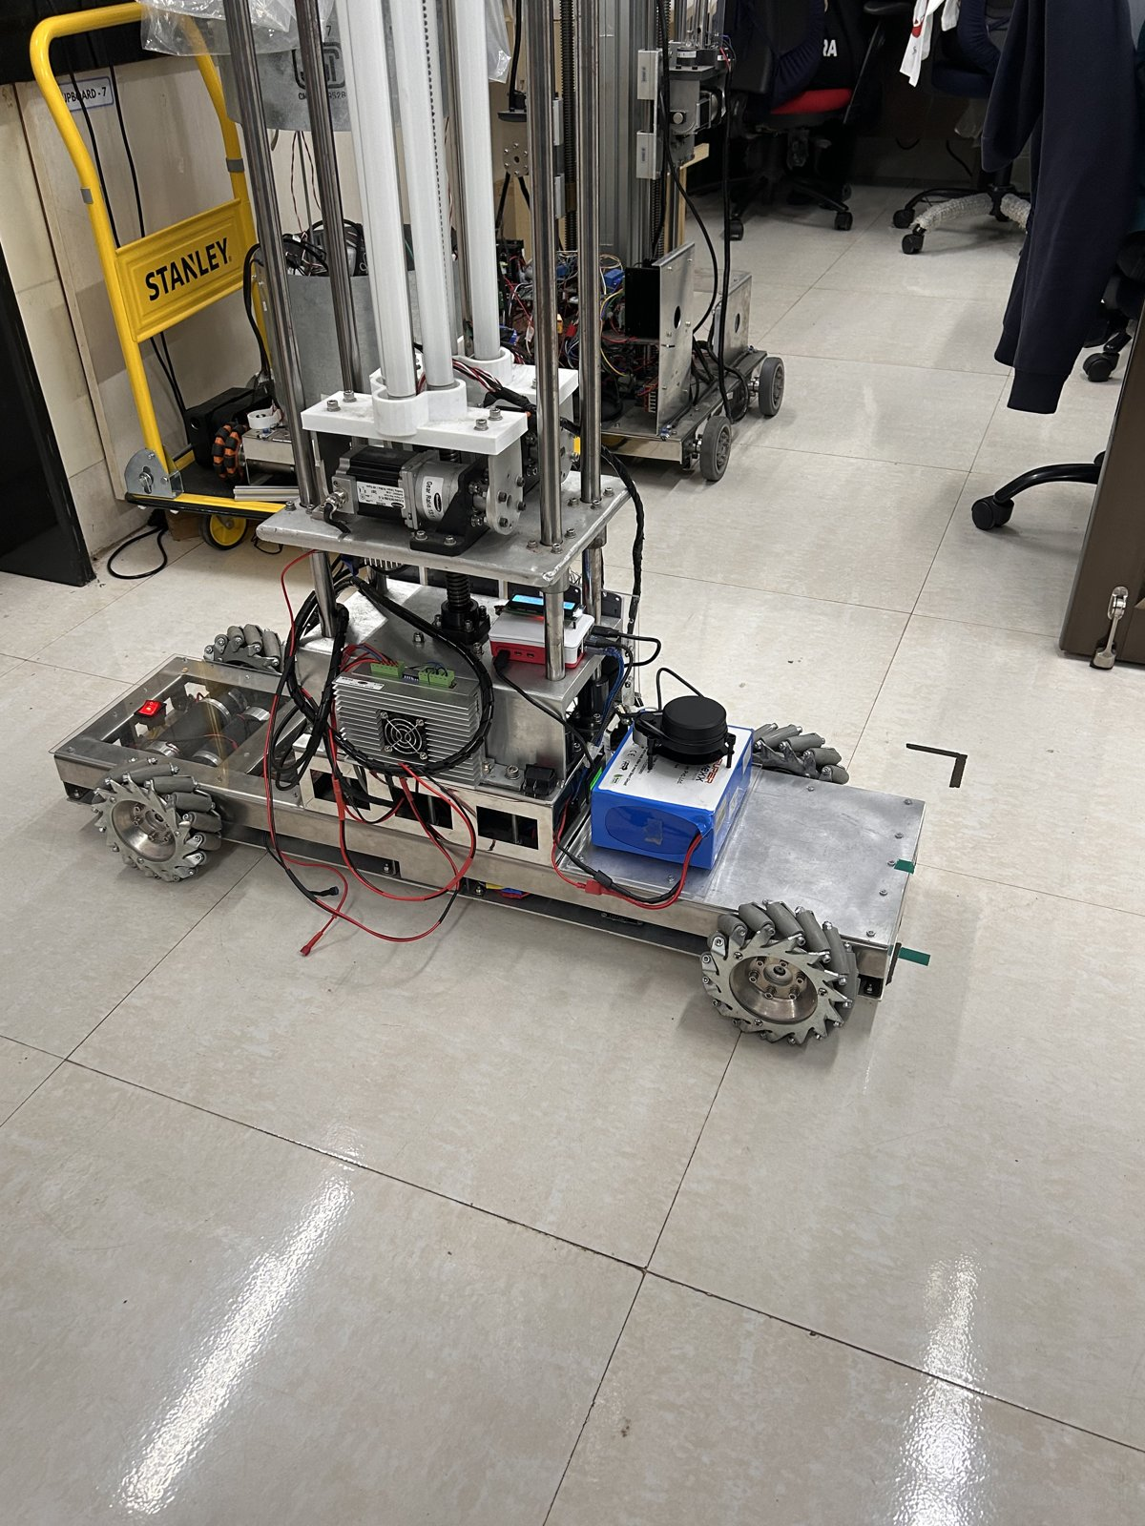
Annual Progress Seminar · Year 1
NarrowAisleBot
An asymmetric mecanum platform for autonomous operation in narrow aisles
Aritra Das
Roll 25D0074
Department of Biosciences and Bioengineering, IIT Bombay
Supervisor: Prof. Ambarish Kunwar
September 2026
Notes:
An omnidirectional cargo platform for narrow aisles, built and instrumented over the first year. This talk covers the electronics, firmware, software and mechanical work; the biological application sits outside it. The photograph is the platform as it stood on 11 August: long chassis, four mecanum wheels at unequal radii, the mast, the LiDAR on the battery, the Pi and the motor driver.

Slide 2
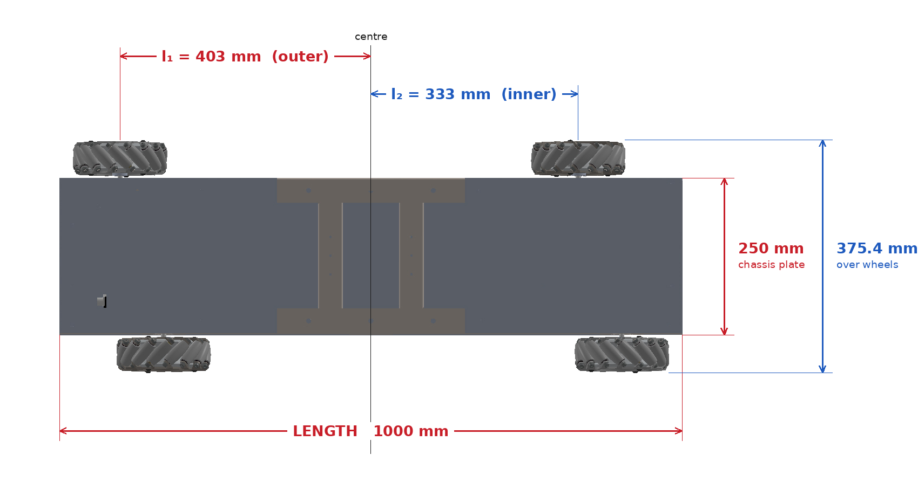
The geometry, and why it is asymmetric
Wheels are not at the corners
A conventional mecanum base puts all four wheels the same distance from the centre. This one does not. The outer pair sits at 403 mm, the inner pair at 333 mm, with a half-track of 158 mm.
Each wheel earns its own term
That 70 mm offset gives the outer wheels a yaw coefficient of 0.561 m and the inner wheels 0.491 m, so the inverse kinematics cannot be the textbook one. Footprint 1.00 x 0.36 m, mass 45.5 kg, wheel radius 76.2 mm.
Plan view to scale, and the yaw coefficient each wheel earns from its own position.
2
Notes:
The aisle sets the width, so the wheels could not go where the textbook puts them. Front-right and rear-left ended up 403 mm from centre, front-left and rear-right 333 mm. The consequence is that every wheel has a different lever arm on yaw, so the standard mecanum matrix does not apply and had to be re-derived for this chassis.

Slide 3
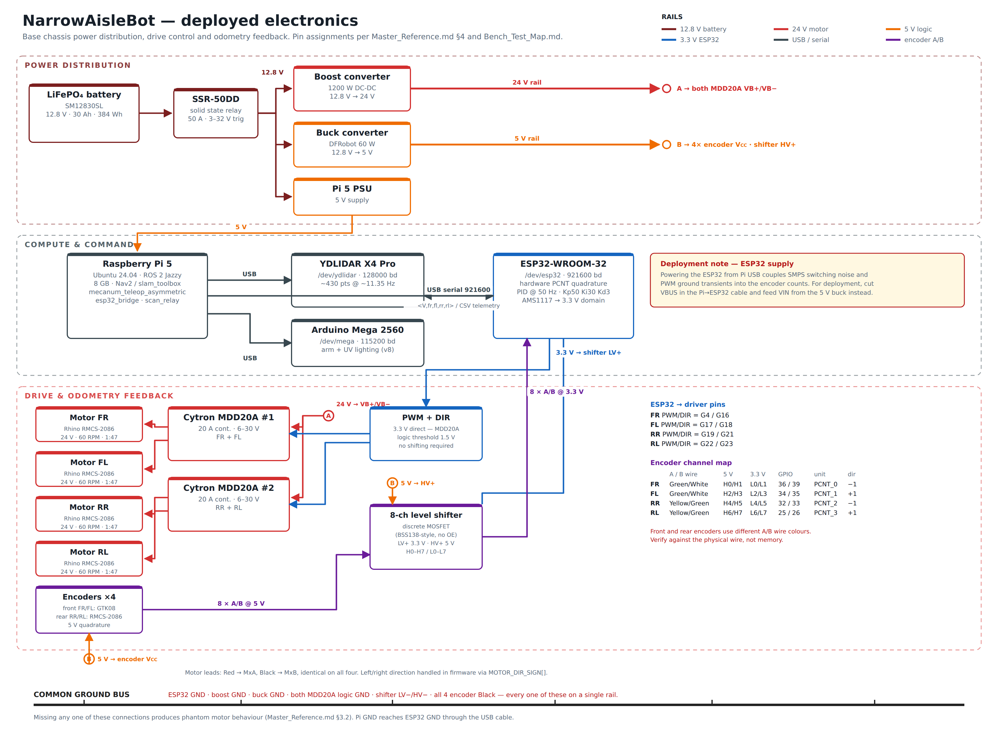
What was built
Three processors, one rule
The split is by real-time capability, not by software preference. A Raspberry Pi 5 runs ROS 2 for planning and perception. An ESP32 runs the 100 Hz velocity loop with hardware quadrature decoding. An Arduino Mega drives the cargo arm and the staged UV-C tubes.
Sensing and command path
A YDLIDAR X4 Pro feeds SLAM. Nav2 plans, MPPI tracks, and a priority multiplexer keeps the manual joystick above the autonomous stream, so a person can always take the robot back.
The real deployed-electronics diagram: power distribution, compute and command, drive and odometry feedback.
3
Notes:
Nothing here was chosen for novelty. The ESP32 exists because a 100 Hz deterministic loop cannot live on a Linux scheduler; the Arduino exists because the arm and the lamps need their own timing and must survive a Pi reboot. The multiplexer is a safety decision: manual command always outranks autonomous command.

Slide 4
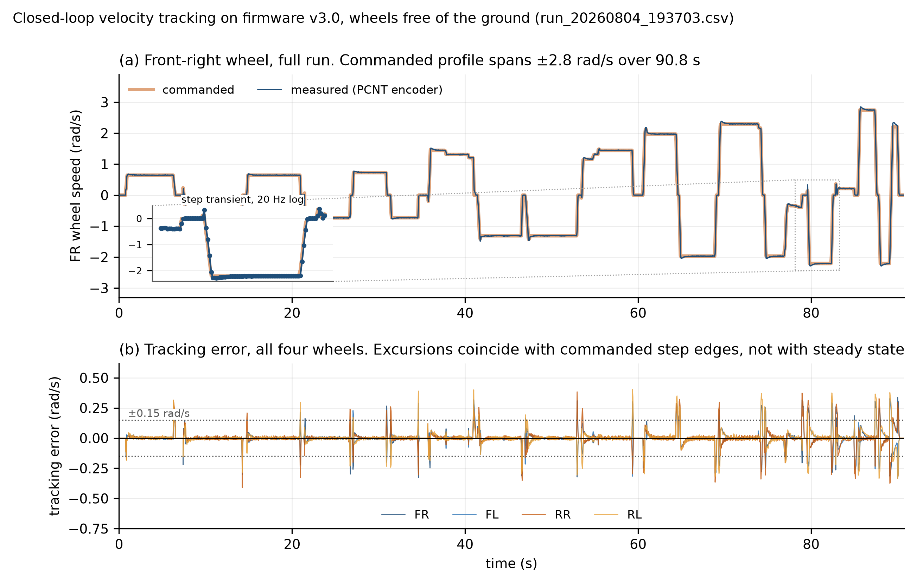
Control, in air and on the floor
Open loop failed measurably
At equal duty cycle, one diagonal pair ran 11 to 13 percent faster than the other. That mismatch is what produced the strafing stutter. It was never a tuning problem; it was an unmeasured plant.
Closed loop, then measured
Tracking error is 1.2 to 1.4 percent of peak with the wheels free, and 3.4 to 4.0 percent under the real chassis weight. Not one run contained a saturated sample, so the loop still has headroom.
Closed-loop velocity tracking, wheels free, 1816 samples.
4
Notes:
The stutter was visible long before it was explained. Characterising the four motors open-loop at a fixed PWM turned a driving complaint into a number: an 11 to 13 percent split inside one diagonal pair. The loop is a 100 Hz PID with two feedforward terms, one proportional to commanded speed and one static term for stiction. Zero saturation matters because it means the errors quoted are the controller’s, not the motor’s ceiling.

Slide 5
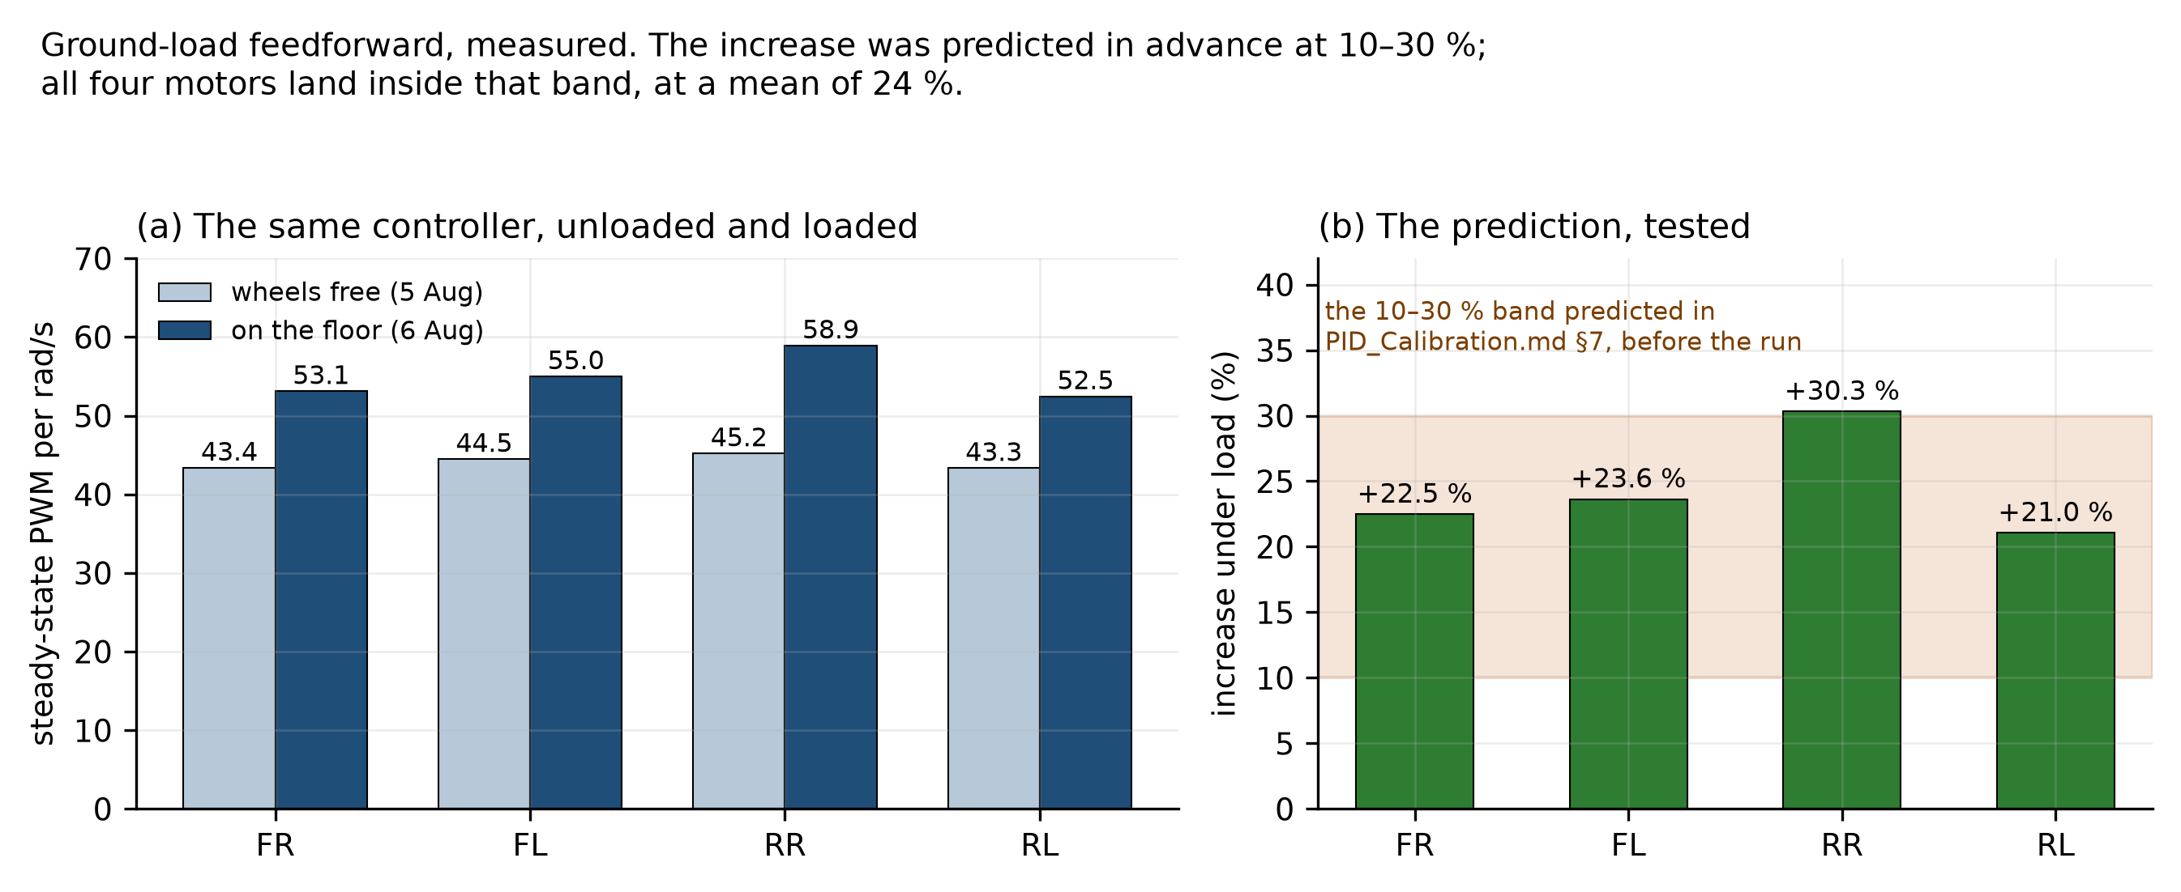
A prediction, then a test
Written down beforehand
Before any floor test existed, the calibration notes recorded that ground contact should raise feedforward demand by 10 to 30 percent. The number was committed in advance, not fitted afterwards.
What the floor returned
Mean increase 24 percent. Front-right 22.5, front-left 23.6, rear-right 30.3, rear-left 21.0. All four sit inside the predicted band.
Steady-state PWM per rad/s, unloaded against loaded, computed from the raw logs.
5
Notes:
This is the one place in the year where a number was written down before the experiment that could refute it, so it is worth a slide of its own. The quantity is steady-state PWM per rad/s: how much drive each motor needs to hold a given wheel speed. Unloaded against loaded, the same four motors, the same firmware. If a reviewer asks why 30.3 percent on the rear right is not a concern: it is inside the band, and the rear right also carries the mast.

Slide 6
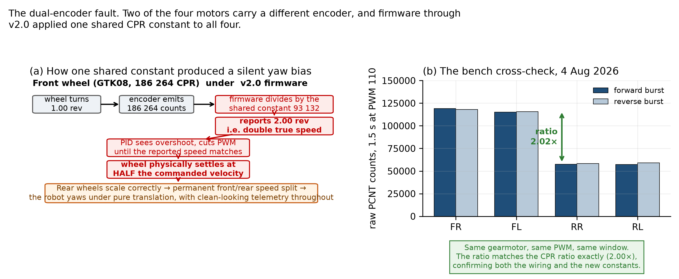
The fault that defined the year
One constant, two encoders
A single counts-per-revolution constant was applied to two different encoder types. The front wheels reported twice their true speed, so the controller obediently ran them at half the commanded velocity.
Why it stayed hidden
There was no error and no warning. Every tracking plot looked clean, because the loop was closing correctly on the wrong number. It surfaced only when front and rear were compared on one command.
The failure mechanism, and the bench cross-check that detected it.
6
Notes:
This is the fault class the year kept returning to: a silent unit or convention error that every self-check passes. The controller was doing exactly what it was told. The instrumentation was lying, so the diagnostics were confirming the lie. That is why the audit rule became measure the input before tuning the estimator. Same family: the shared axis convention, the mirrored scan, the frame published in the wrong rotation.

Slide 7
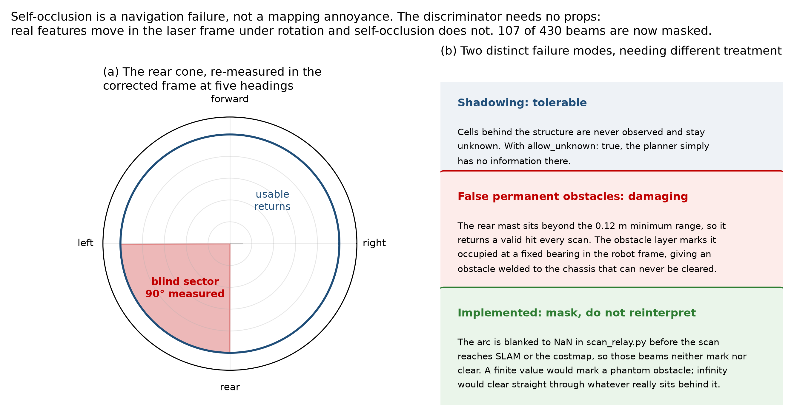
Perception: what the robot cannot see
The mast is in the way
The rear mast blocks a 90 degree wedge of the scan. It was re-measured at five independent headings, and it does not move with the robot’s heading. It is structural, not incidental.
A phantom welded to the base
The blocked returns land beyond the sensor minimum range, so they read as a genuine hit on every sweep. 107 of 430 beams are now masked as invalid before the scan reaches SLAM.
The rear cone, re-measured in the corrected frame at five headings.
7
Notes:
The distinction that matters: a blind spot inside the minimum range is discarded automatically. This one is not. It is far enough out to look like a real wall that follows the robot everywhere. Five headings were used precisely to separate a chassis-fixed obstruction from something in the room. The wedge stayed put. Masking is a mitigation, not a fix; the honest version is that a quarter of the scan is gone.

Slide 8
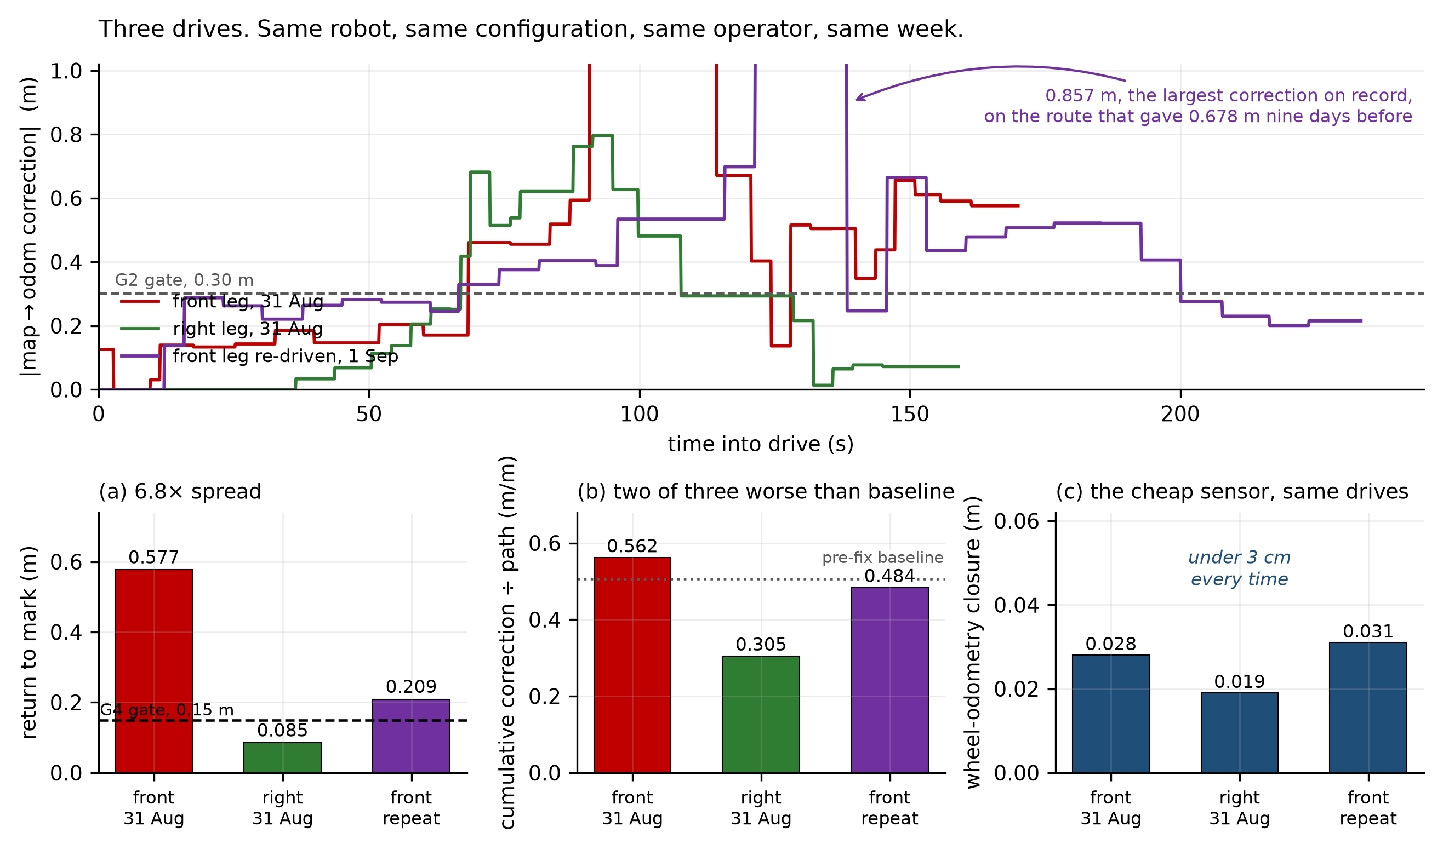
The symptom: maps that would not close
Every map folded
Return to the same physical mark came out at 0.577 m, 0.085 m and 0.209 m: a spread of 6.8 times on a task meant to repeat.
The base was not at fault
Wheel odometry closed under 3 cm on all three of those drives. Whatever folded the map was being added above the odometry, not inside it. That narrowed the search to one layer.
Three drives, same robot, same deployed configuration, same week.
8
Notes:
A 6.8 times spread is the point, not the worst value. An estimator that fails consistently can be corrected; one that fails differently every run cannot be trusted at all. The odometry cross-check is what made this tractable. If the wheels close to 3 cm and the map does not, the fault is not mechanical and not in the drive layer.

Slide 9
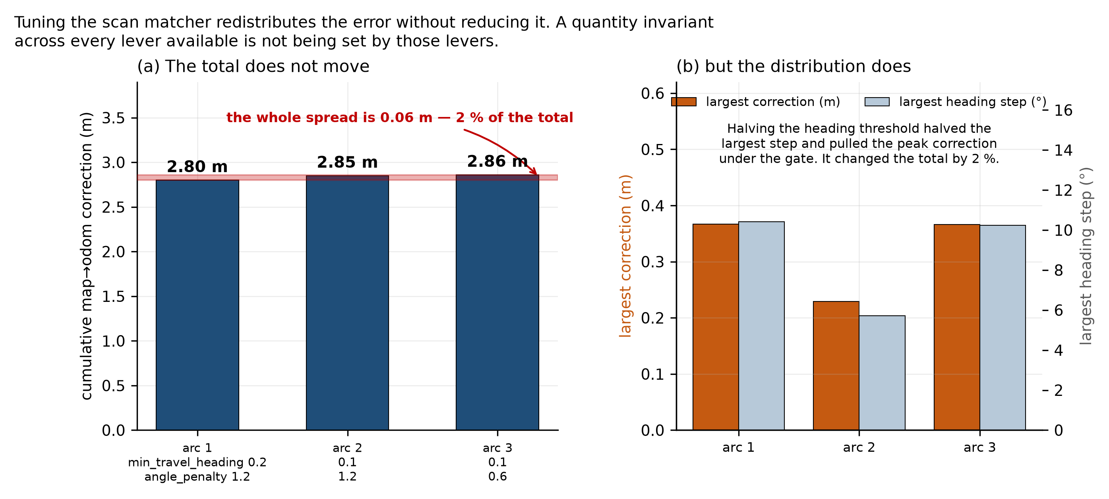
The result that decided the diagnosis
Three parameter sets
Cumulative pose correction: 2.80 m, 2.85 m, 2.86 m. Every scan-matching lever available was pulled between them. The total moved by 2 percent.
What invariance means
Tuning moved where the error appeared, never how much of it there was. A quantity that will not move when every lever is pulled is not set by those levers. So the search moved upstream, to the sensor.
The same tight arc driven three times on three parameter sets.
9
Notes:
This is the strongest single result of the year, and the one to slow down on. The experiment was designed to be refutable: if the correction total had moved with tuning, the problem would have been tuning. It did not move. Two percent across three parameter sets is inside run-to-run noise. That converts an open-ended tuning exercise into a closed argument about where the error enters, and it is what justified spending the following weeks measuring the LiDAR instead of the algorithm.

Slide 10
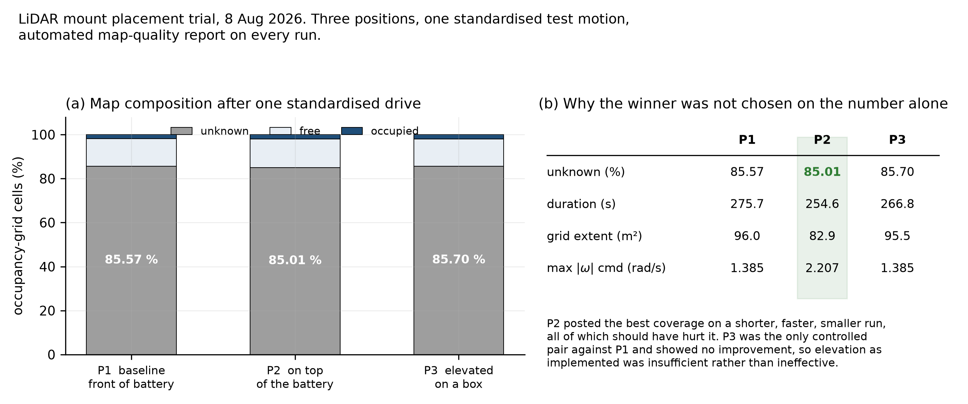
Measuring the input, not the algorithm
First look at the scan
After a year of tuning the estimator, nobody had measured what it was being fed. With the robot stationary, 74.8 to 78 percent of rays flip between valid and invalid from one scan to the next.
A different cloud each sweep
Only 47.4 percent of beams are valid at any instant. The matcher is asked to align two clouds that do not share most of their points. The unit is a triangulation scanner meeting its own specification; the specification is not adequate here.
Placement trials: three mount positions on one standardised metric.
10
Notes:
This is the measurement the invariance result pointed to, and it took one afternoon once the question was right. The robot is not moving. Nothing in the room is moving. Three quarters of the beams still change state between consecutive sweeps. Be careful with the conclusion: the sensor is not broken. It is a low-cost triangulation unit performing within its datasheet. The mistake was expecting datasheet behaviour to be sufficient for pose-graph SLAM in a corridor.

Slide 11
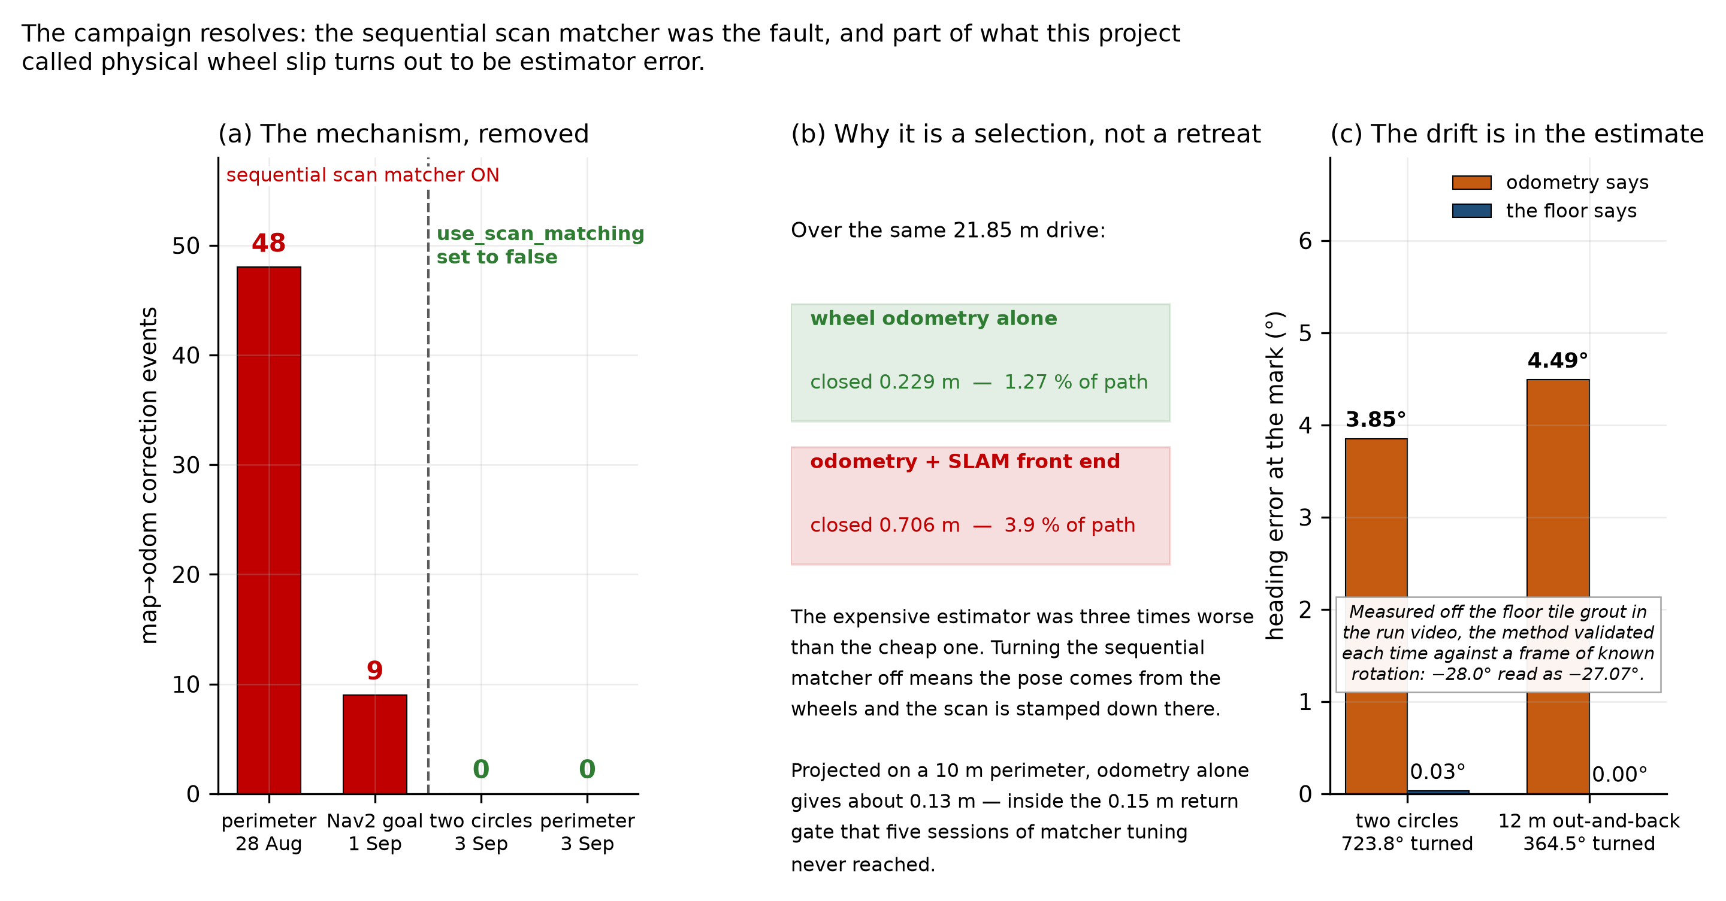
Choosing between two measured estimators
Measured, then chosen
Over one 21.85 m drive, wheel odometry alone closed the loop to 0.229 m; odometry corrected by SLAM closed to 0.706 m. The correction was making the estimate worse, so it was removed.
What removal produced
Zero corrections across 698 seconds and 18.5 m, on two different routes. Photogrammetry against the floor grout shows the reported heading drift is largely estimator error rather than wheel slip.
The mechanism removed, and why disabling it is a selection rather than a workaround.
11
Notes:
Disabling the sequential scan matcher is not a workaround dressed up as a result. It is a selection between two estimators that were both measured on the same drive, and the worse one was dropped. The photogrammetry cross-check matters because it rules out the obvious objection: that the wheels were slipping and odometry only looked better. Tile grout gives an independent ground truth. What this does not give is loop closure. Without a scan matcher there is no correction at all, which is fine for a straight run and not fine for a full map.

Slide 12
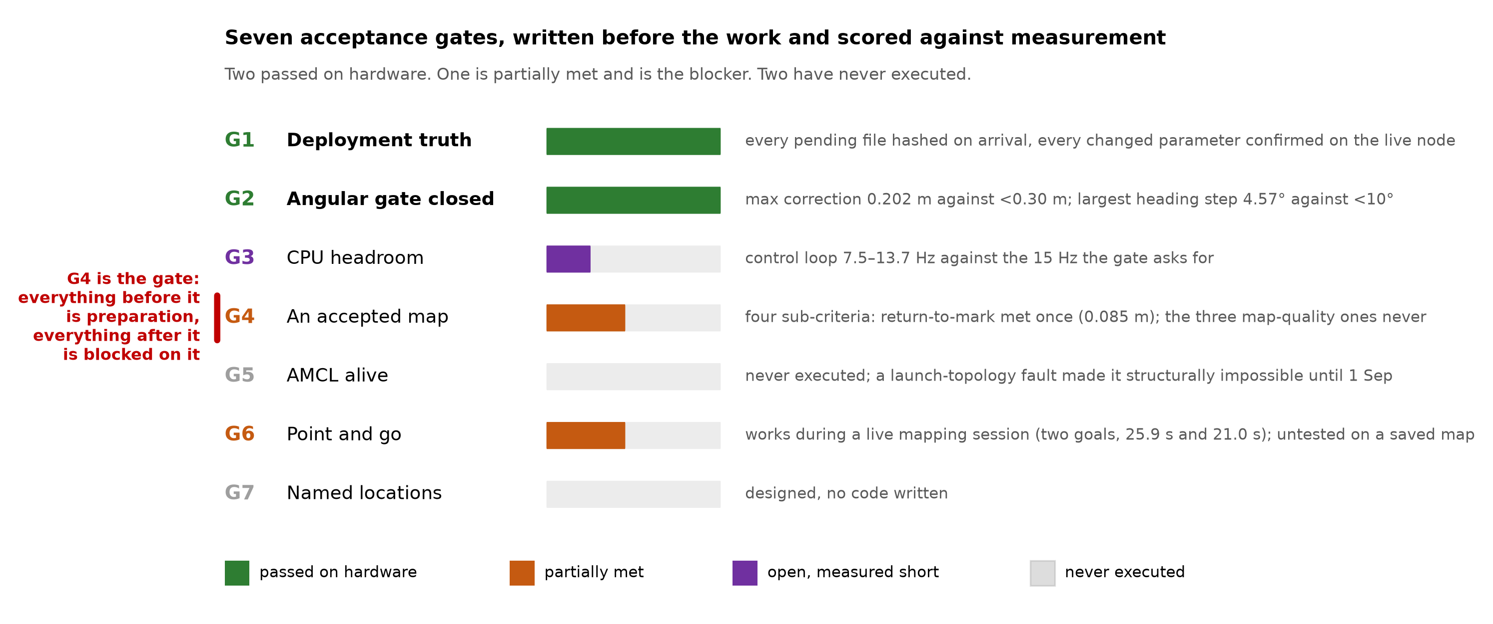
Autonomous navigation: where it stands
What has run
The first autonomous forward-and-return round trip ran on 14 August. Operator-tapped goals inside a live mapping session were reached in 21 to 26 seconds, with the full Nav2 stack in the loop.
What is still blocked
DWB was replaced with MPPI on a source-level argument: its rotation-to-goal test compares translation against exact zero, so rotation-only goals fail by construction. Navigation on a saved map waits on a commissioning map that does not yet exist.
Seven acceptance gates, written before the work and scored against it.
12
Notes:
Be precise about the claim: goals were reached inside a live mapping session, not on a saved map. That is a real result and a limited one. The DWB change is worth a sentence because it was decided by reading the controller’s source rather than by tuning against it. A bit-exact comparison against zero translation means a rotation-only goal can never satisfy the test. The blocker is not code. It is that no map good enough to localise against has been produced yet, which is exactly what the previous four slides were about.

Slide 13
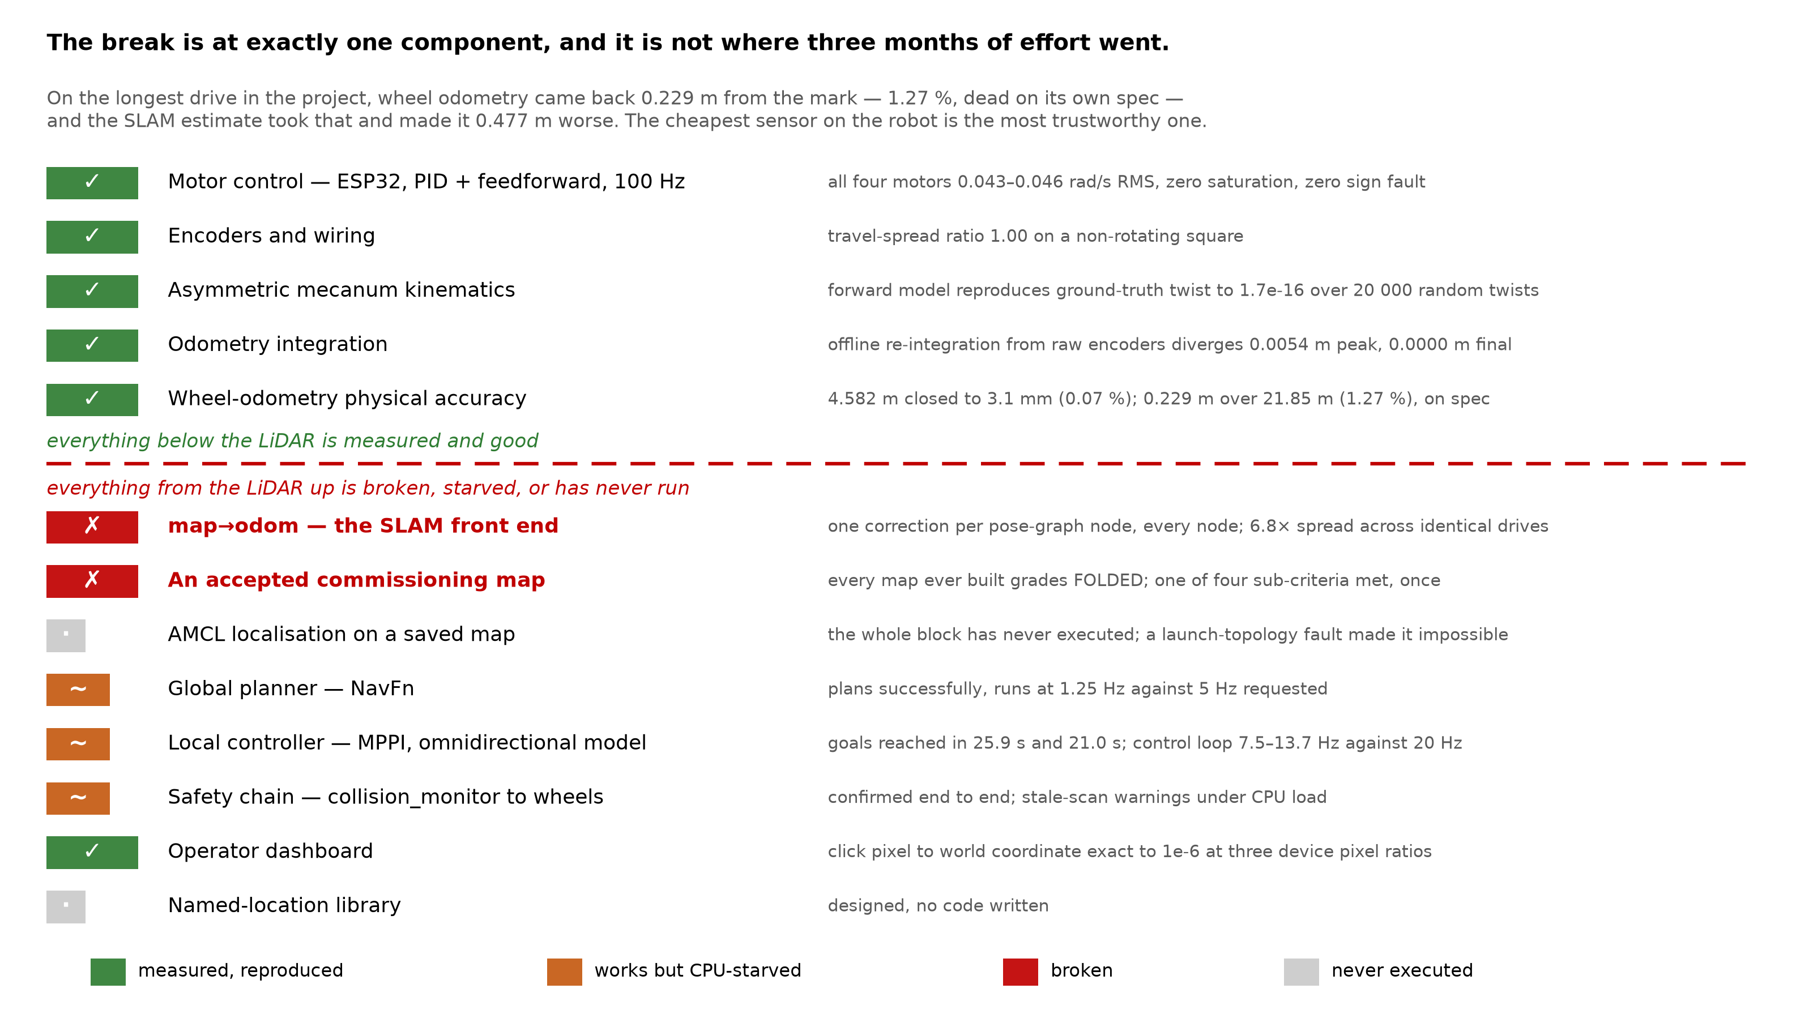
An honest audit of the stack
Where the line falls
Everything below the LiDAR is measured and reproducible. Everything from the LiDAR up is broken, starved of CPU, or has never been run. 82 defects were root-caused this year across eight categories.
Rules that came out of it
A value in the repository is not a value on the robot. Never fix an axis complaint in the display. Measure the input before tuning the estimator. Write the prediction down before running the test.
The layer-by-layer audit. The break is at exactly one component.
13
Notes:
The point of grading the stack layer by layer is that the break is at exactly one component, not spread across the design. That is a good position to be in going into year two. Every claim in the report carries an evidence grade: measured, single observation, hypothesis, retracted, or never run. Several earlier conclusions are marked retracted, and they are left in rather than quietly removed. The four rules are not slogans; each one is the generalisation of a specific defect that cost weeks.

Slide 14
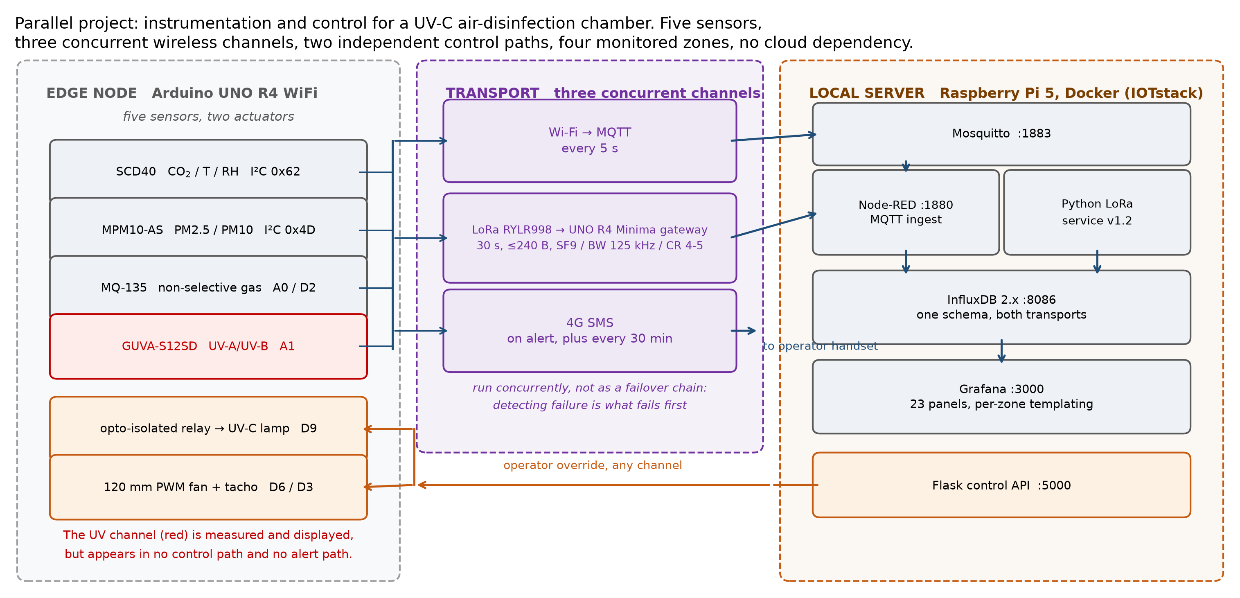
Parallel project: UVGI instrumentation
What it does
Instrumentation and control for a UV-C air-disinfection unit, under a departmental TIH-IoT activity. Five sensors, three concurrent wireless channels, two control paths, four zones, and no cloud dependency.
Reported with its limits
The UV channel is measured but sits in no control or alert path. The trigger signal has no causal relationship to pathogen load; the correction is a carbon-dioxide-derived occupancy proxy.
Five sensors, three concurrent wireless channels, two independent control paths.
14
Notes:
This is the second project, not a second thesis. Keep it to two minutes. The engineering that is worth showing is the redundancy: three wireless channels running concurrently and two independent control paths, so a network failure does not leave the lamps in an unknown state. It is presented with the same self-audit as the robot, which is why the limitations are on the slide rather than in the questions. The honest position is that the current trigger is an occupancy proxy, and dose-based control is year four.

Slide 15
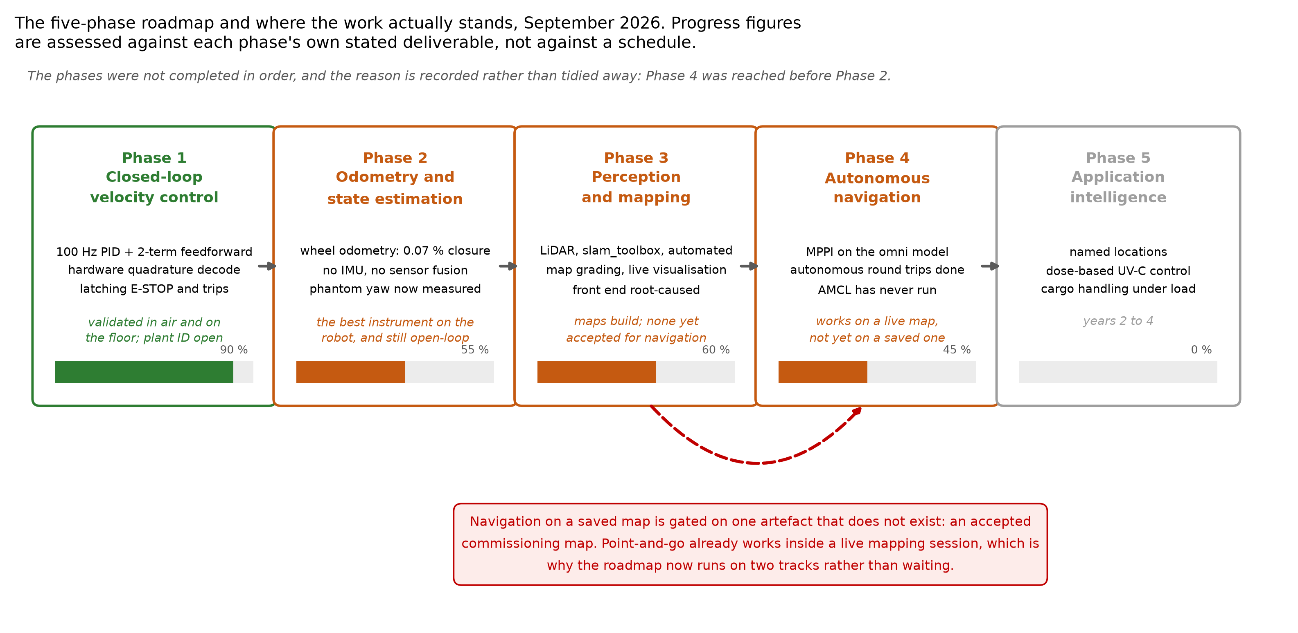
Research gaps, and the plan for years 2 to 4
Two gaps worth the time
The asymmetry has never been compared against a matched symmetric baseline, so its cost and benefit are both unquantified. And what sensing corridor-width localisation actually requires is now a measured question rather than an assumption.
The sequence from here
Year 2: inertial sensing, a commissioning map, localisation on a saved map, a sensor comparison. Year 3: the geometry comparison, per-wheel slip, control under cargo load. Year 4: dose-based UV-C control, whole-system evaluation, writing up.
The five-phase roadmap and current standing.
15
Notes:
The first gap is the one that justifies the platform: nobody has shown what a non-collinear mecanum base costs or buys against a symmetric one on the same task, and this robot is the instrument for asking that. The second gap only became a research question because of this year’s measurements. Before, sensor choice was an assumption; now it is a quantity with a number attached. Year two is deliberately unglamorous. An inertial sensor and one good commissioning map unblock everything above them.

Slide 16
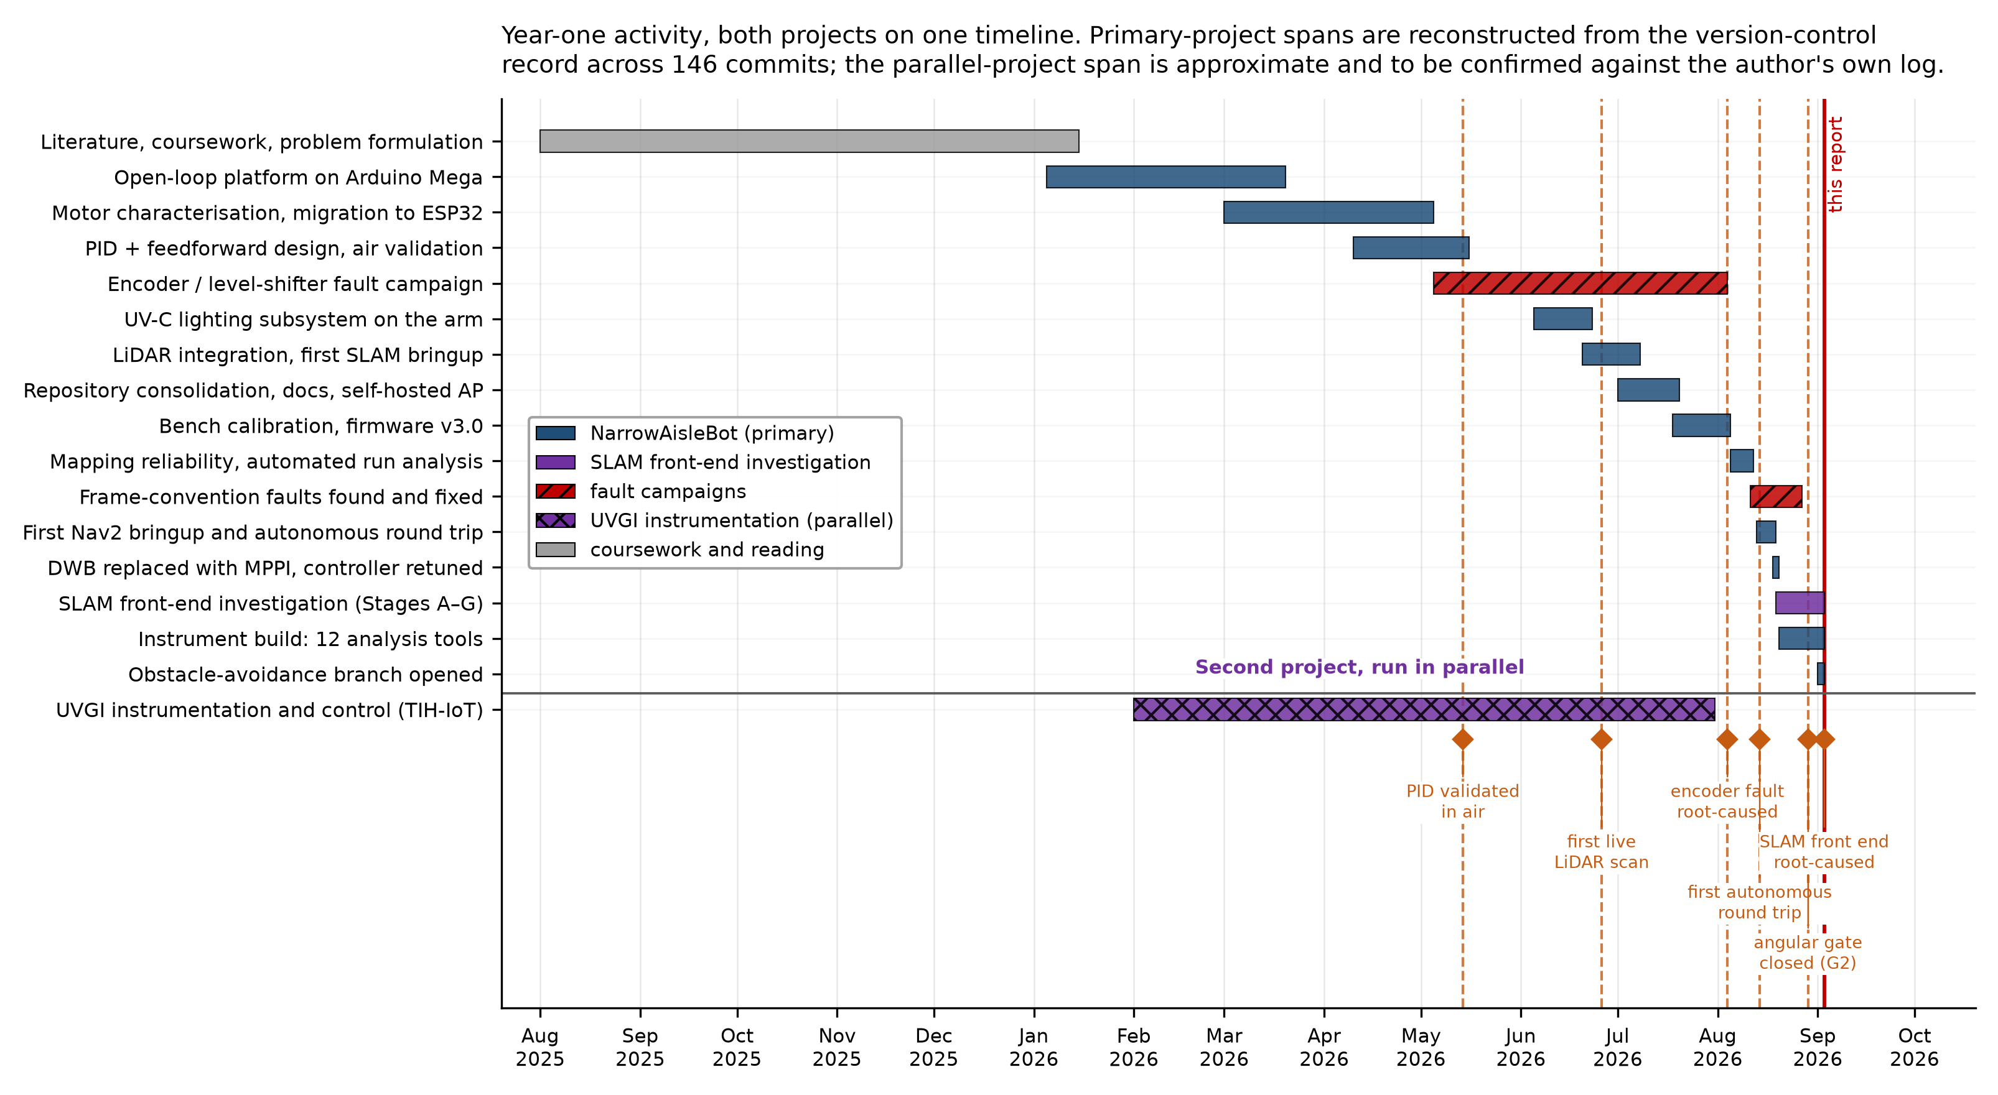
Thank you
Questions
Supervisor
Prof. Ambarish Kunwar
Department
Biosciences and Bioengineering, IIT Bombay
Roll number
25D0074
Both projects on one timeline, reconstructed from 146 commits.
Notes:
Questions. Likely ones and where the answer is: - Why not just buy a better LiDAR? Cost, and the sensor comparison is year two work item four. - Is disabling the scan matcher not giving up on SLAM? No: two estimators were measured on the same drive and the worse one was dropped. Slide 11. - Why an asymmetric base at all? The aisle width. And quantifying what it costs is research gap one. - How do you know odometry is not just hiding slip? Photogrammetry against the floor grout. Slide 11. The timeline on the right is both projects reconstructed from 146 commits, if a date is queried.

