Slide 1


Genre Classification From News Title
Present by –
A R I T R A
M U K H E R J E E
Aritra Mukherjee

Slide 2
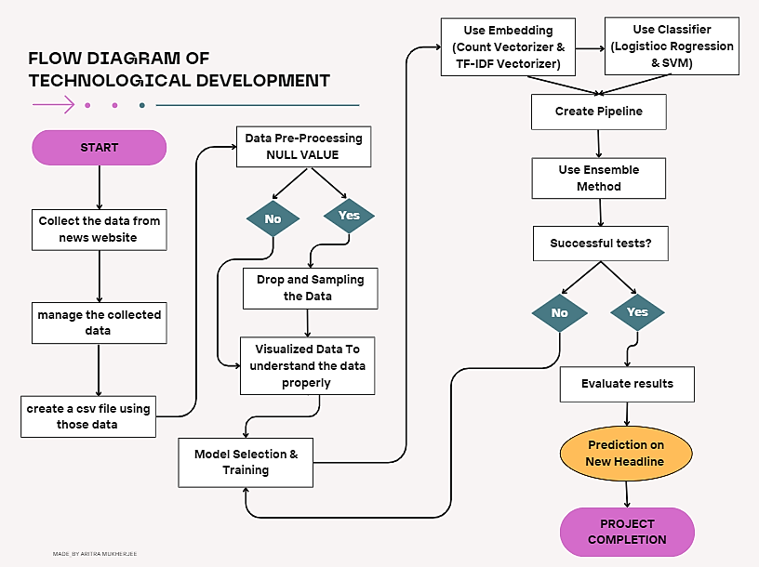
Flow
Diagram

Slide 3
Workflow Steps Details
Step | Description
1. Data Collection | Gather raw data from various sources e.g., databases, APIs.
2. Data Preparation | Clean, transform, and organize data, handle missing values.
3. Prepare CSV File | Format the data into a Comma Separated Values format.
4. Load the Data Set | Import the prepared data into the modeling environment.
5. Read the Data Set | Verify data integrity and understand its structure.
6. Preprocess Data | Transform data for analysis, handle scaling, encoding, etc.
7. Divide Data into Train and Test Sets | Split data for training and evaluation of models.
8. Create Pipeline using Embedding and Classifier | Construct a data processing and model building pipeline.
9. Create Ensemble Model | Combine multiple models to improve prediction accuracy.
10. Prediction on New Headline | Utilize the model to predict outcomes on new data.

Slide 4

Steps Learning for Genre Classification
1
Data Collection
2
Data Pre-Processing
3
Model Training
4
Prediction

Slide 5

Data Collection
For News Data, Use “TIMES OF INDIA”
For Collecting the Data , Use Web Scraping Method
Use “Beautifull Soup library”

Slide 6
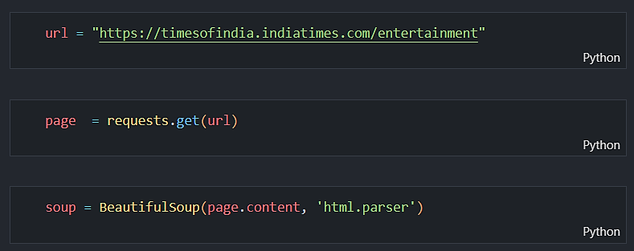
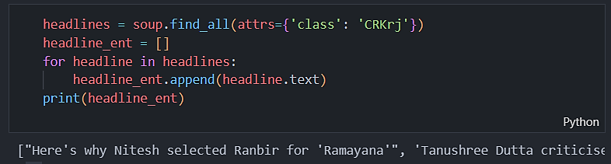
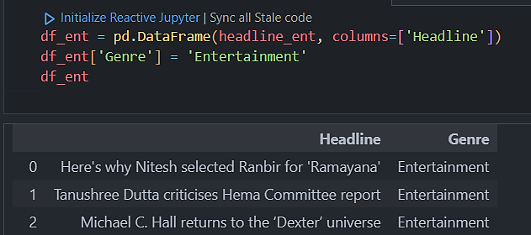

Code of Web Scraping
Aritra Mukherjee

Slide 7
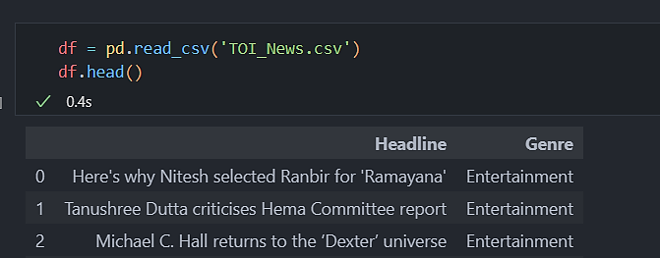
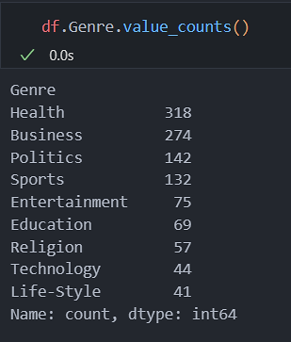
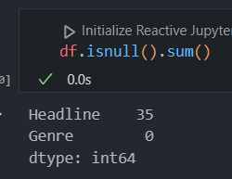
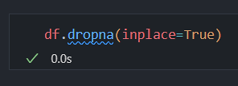
Data Preprocessing
Read The Data
Check The Genre Category
Check For The Null Value
Drop The Null Value

Slide 8
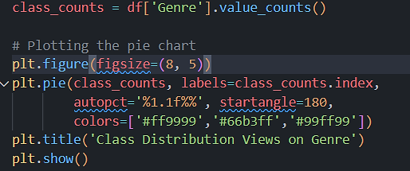
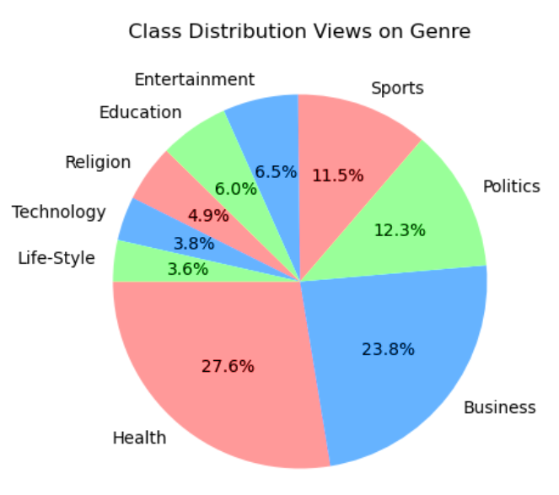
Data Visualization

Slide 9
Model Selection
Embeddings
Count Vectorizer
TF-IDF Vectorizer
Classifiers
Logistic Regression
Support Vector Machines (SVM)

Slide 10
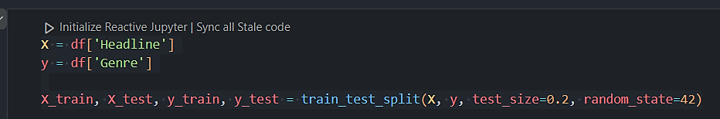
Model Training
Splitting The Data into training and Testing

Slide 11
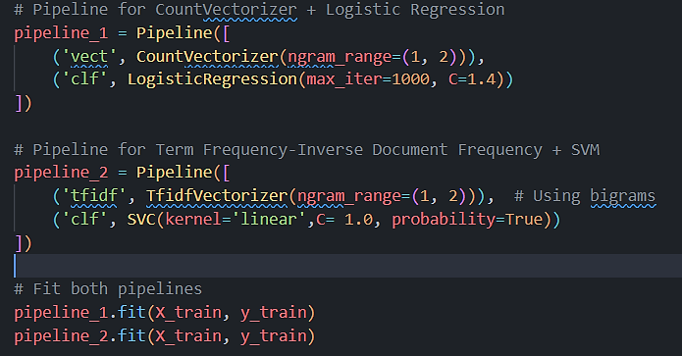
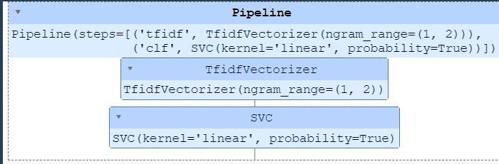
Create Pipeline
Pipeline for
Count Vectorizer + Logistic Regression
Pipeline for TF-IDF + SVM
Fit those Pipeline
Pipeline

Slide 12
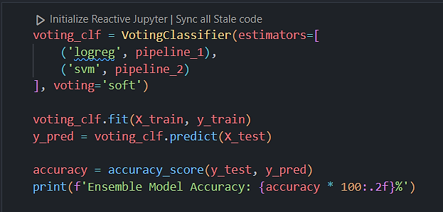
Ensemble Method
Voting Mechanism
A majority vote or weighted average of predictions from
individual models is used to determine the final genre prediction.

Slide 13

Model Evaluation
Metric
Description
Accuracy
Percentage of correctly classified articles.

Slide 14

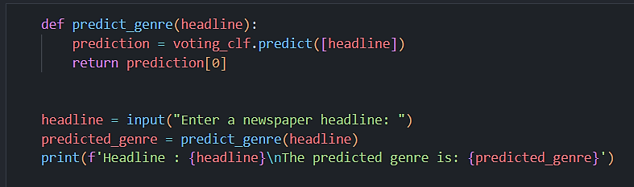


Prediction on a New News Headline
User Input
A user enters a news article title into the system.
Genre Prediction
The trained machine learning model predicts the genre of the news article.
Output
The system displays the predicted genre.

Slide 15
Conclusion
This project successfully developed a text classification model by combining advanced feature extraction techniques and ensemble learning, significantly improving prediction accuracy for genre classification of newspaper headlines.

