Slide 1
Airline Safety
Aritzi Piedras Silva
DSC 640

Slide 2
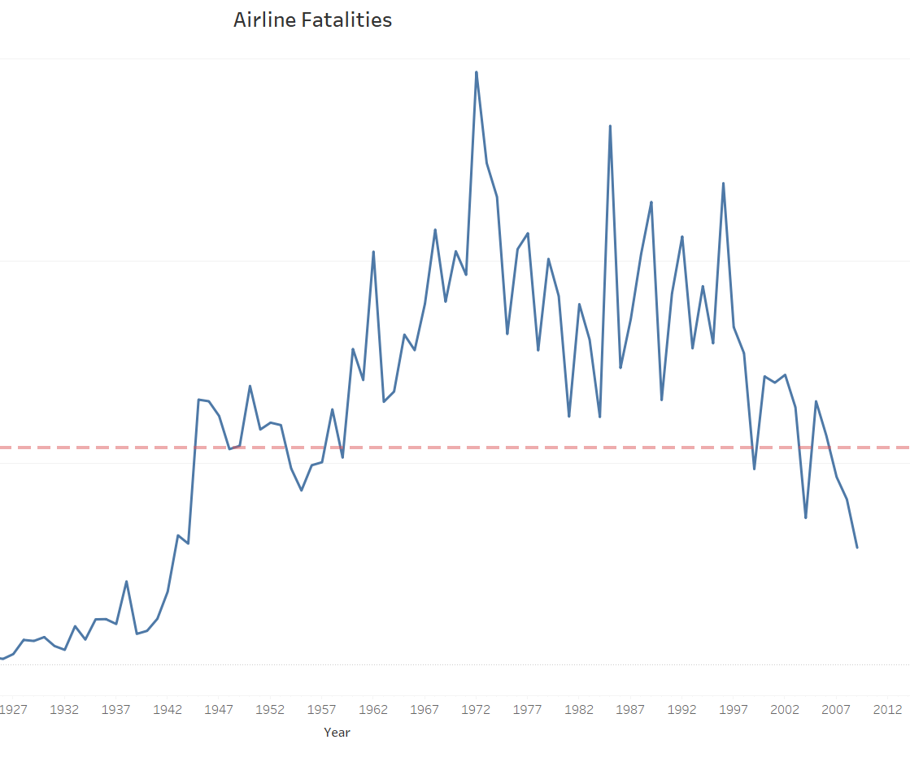
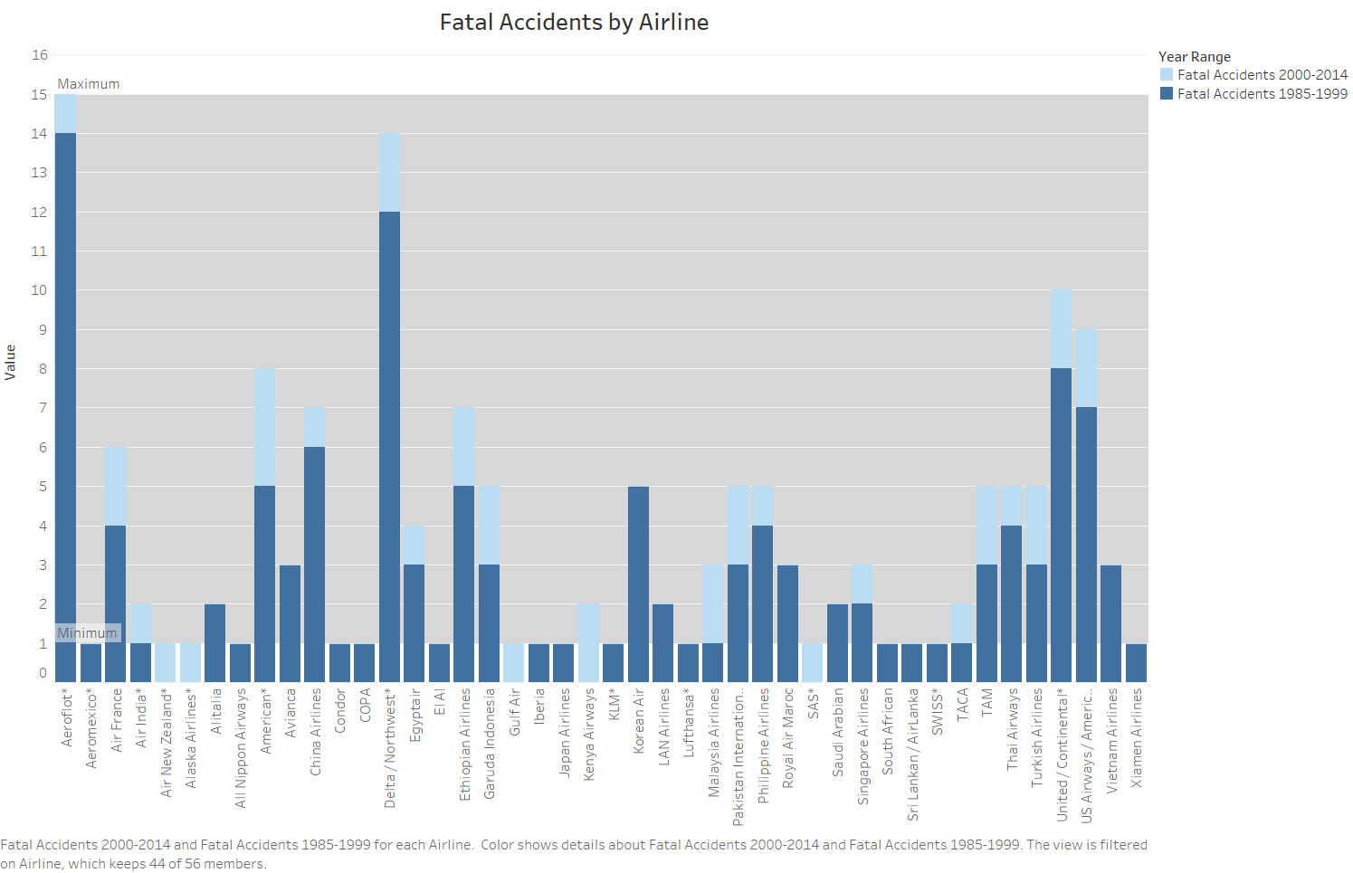
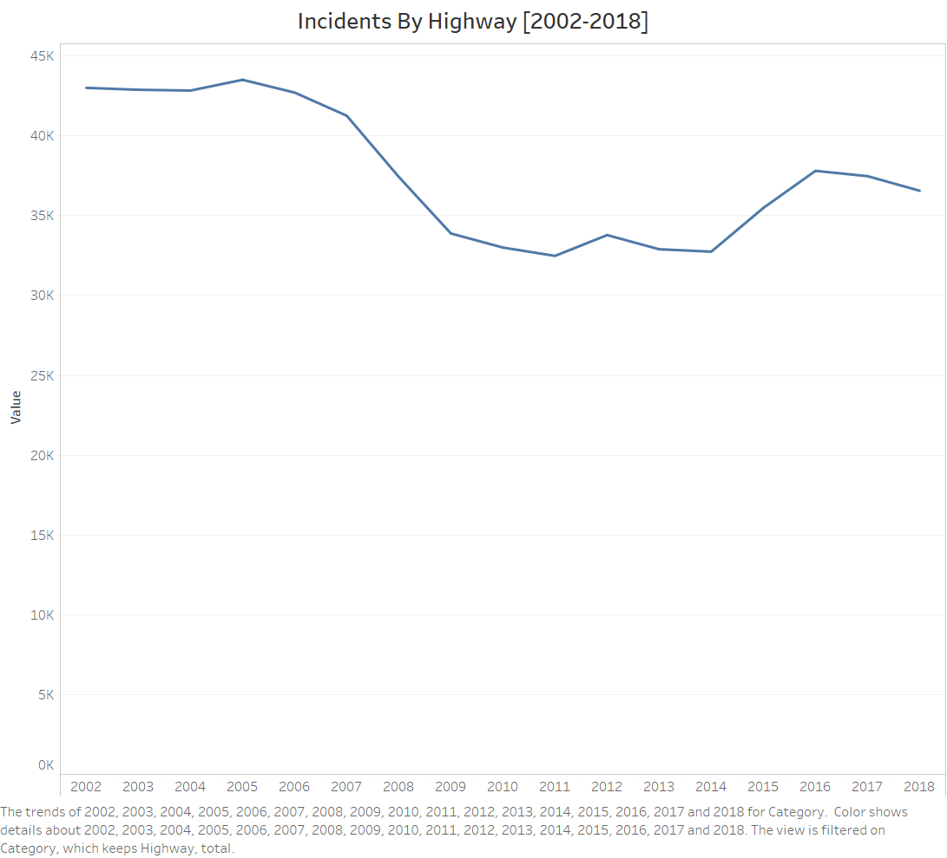
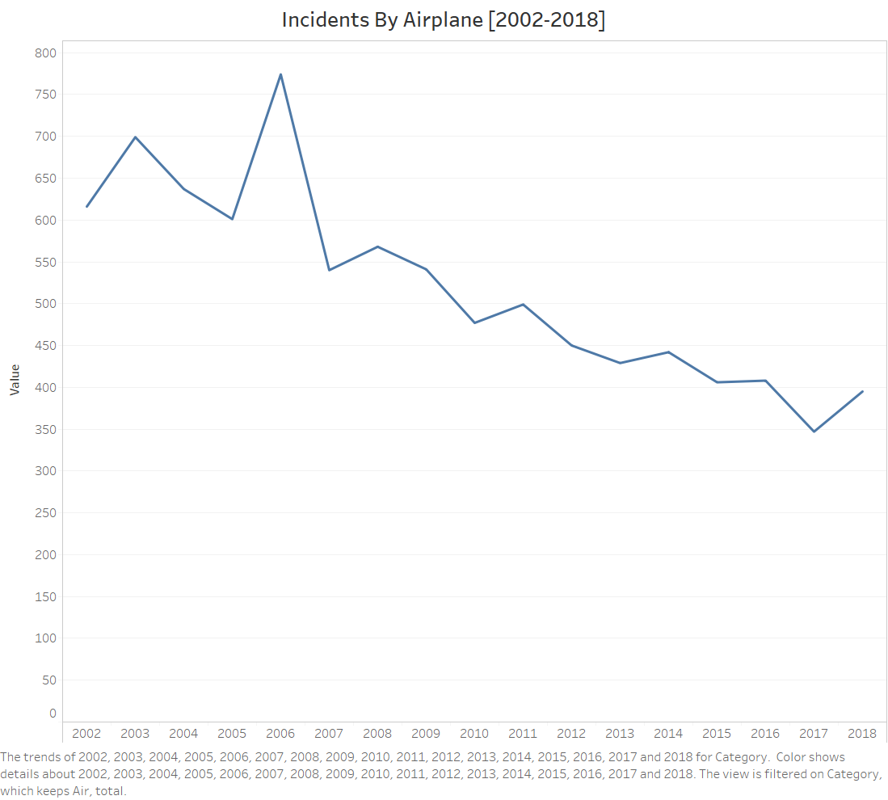
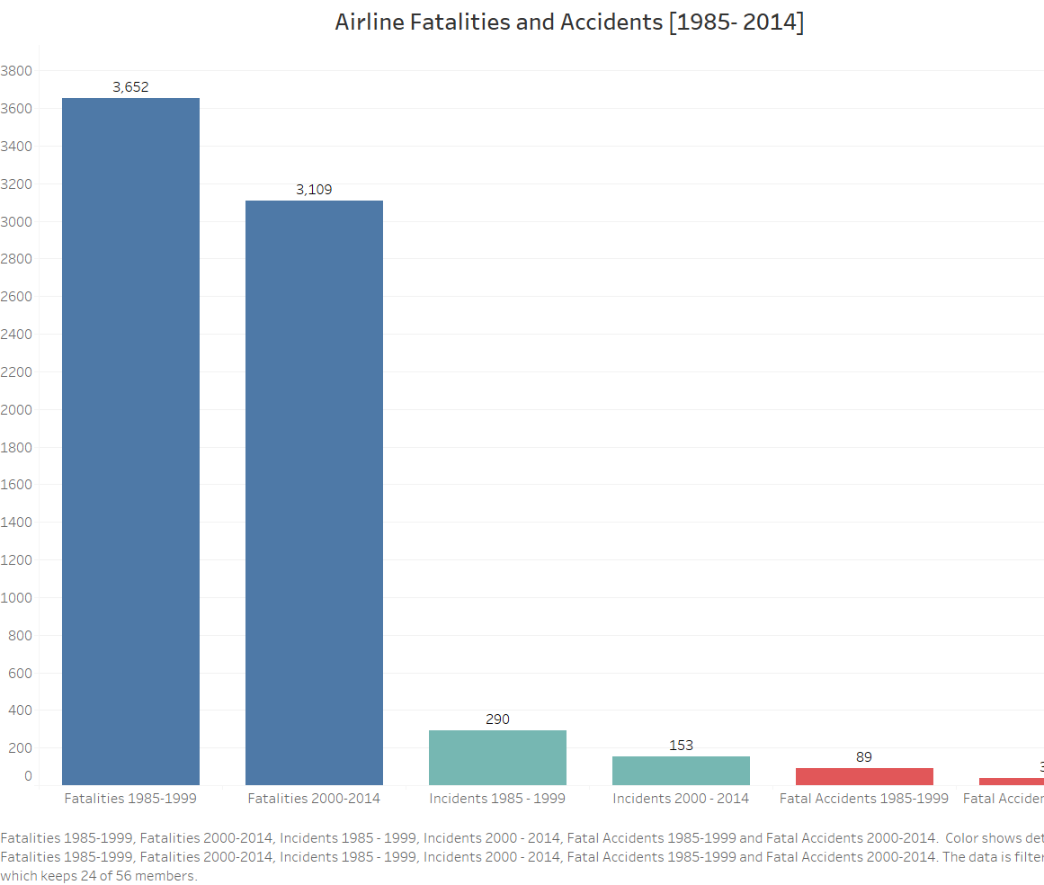
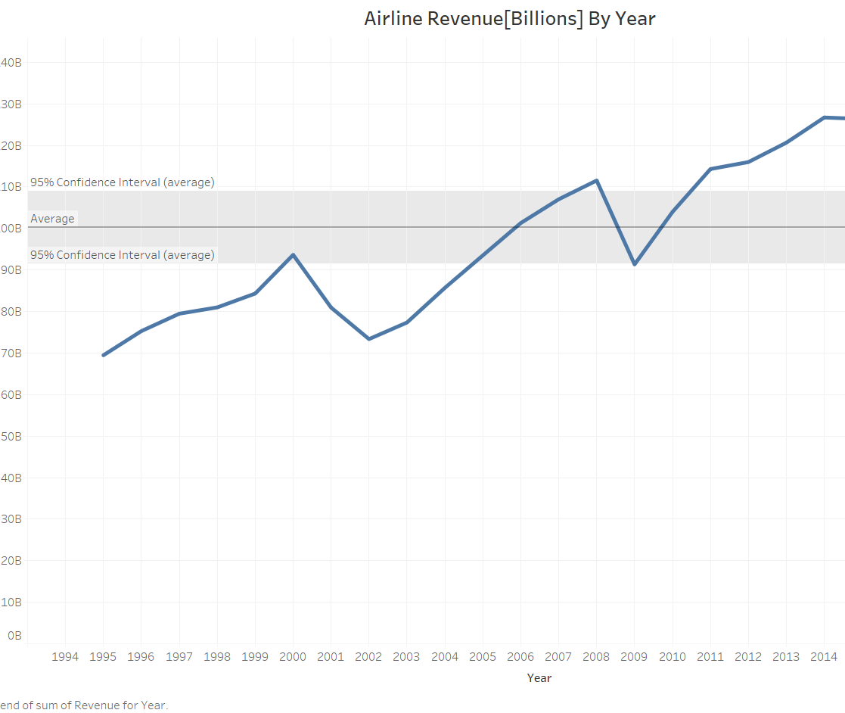

Slide 3
Airline Safety
For some people airplane is the only way they can get to their destination. However, public distrust continues to grow as the news outlets pushes a propaganda of misleading information regarding what was once seen as the safest way to travel. After looking at data from FiveThirtyEight, incidents have decreased since 2000 by nearly 42% while accidents have decreased by 50%. Additionally, with a data source found on The United States Department of Transportation Statistics, total highway fatalities from 2002 to 2018 average to around 37 thousand fatalities while airplane fatalities with that year range average to only 500.
Although the media and news outlets continue to spread negative information regarding airline safety, they fail to share that the airplane industry continues to grow. There was a drop in revenue between the year 2001 to 2002 – this drop could have represented the terrorist attack that the United States had faced. This US tragedy nearly forced airlines to file for bankruptcy. However, by 2003 things quickly changed and people began to board airlines causing an all time high in revenue by 2018. Airlines producing a high revenue has led airline companies to make a positive contribution to the US unemployment rates.
Based on the fact that airplane accidents and incidents have significantly decreased since the early 2000s. It is safe to argue that flying in today’s day and age is safer than ever.

Slide 4
Reference Page
Airline Safety. (2018). Retrieved from https://github.com/fivethirtyeight/data/tree/master/airline-safety
Airplane Crashes Since 1908. (2016). Retrieved from https://www.kaggle.com/saurograndi/airplane-crashes-since-1908/version/4#Airplane_Crashes_and_Fatalities_Since_1908.csv
System Total Operating Revenue. (n.d.). Retrieved from http://web.mit.edu/airlinedata/www/Revenue&Related.html
Statistics | Bureau of Aircraft Accidents Archives (baaa-acro.com)
CNN Money.(2001). Retrieved from https://money.cnn.com/2001/09/21/news/toll_transportation/

