Slide 1

Airline Industry Safety
Executive Summary
Aritzi Piedras-Silva

Slide 2
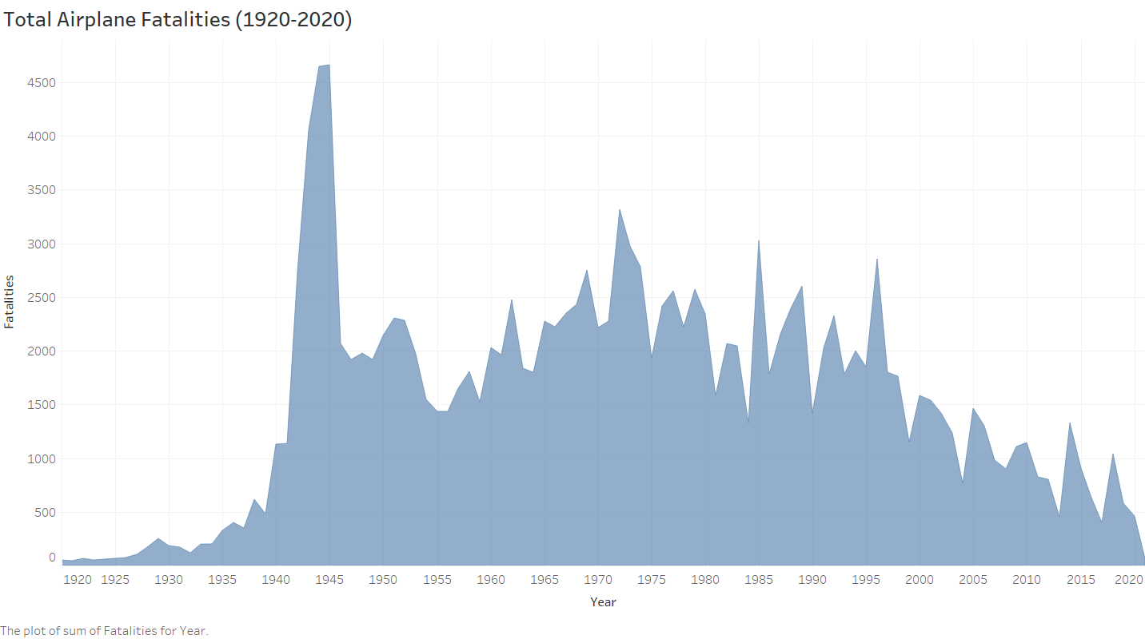
Fatalities in the past 100 years.
-Since 1990, the number of totally fatalities has continuously decreased. Even with 2001 nation’s terrorist attack – the overall fatalities dropped by nearly 50%.

Slide 3
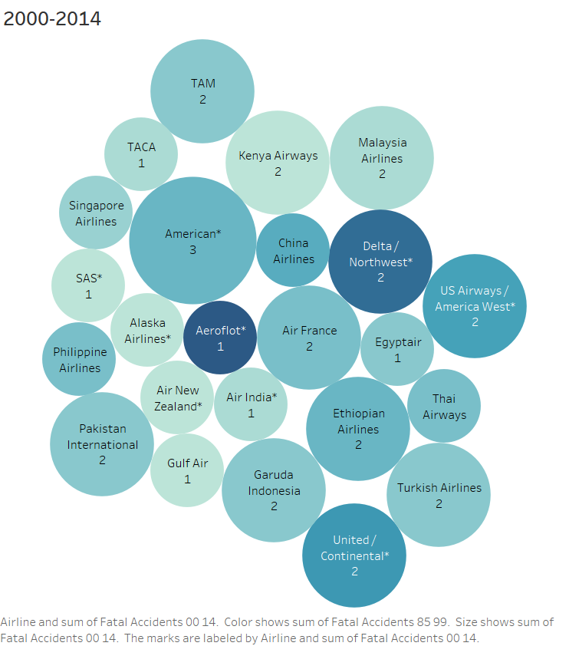
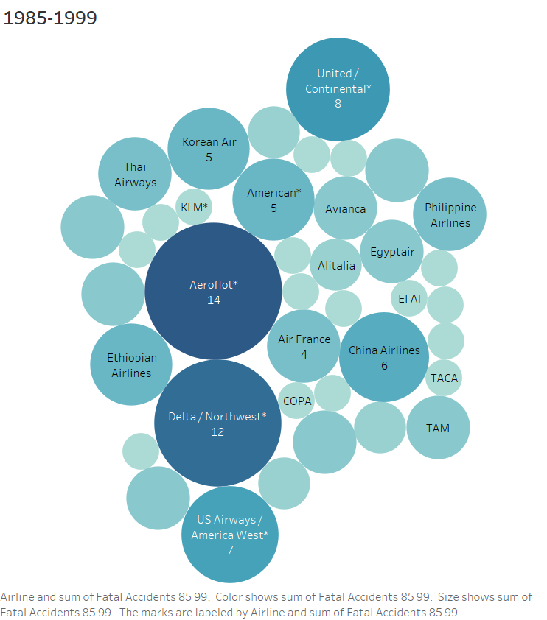
Airline Fatalities
- Airline fatalities reduced Fatal Accident by a huge portion such as Aeroflot. Between 1985 and 1999 Aeroflot reported a total of 14 fatal accident while in 2000 and 2014, Aeroflot reported a total of 1 fatal accident in the 14-year span.

Slide 4
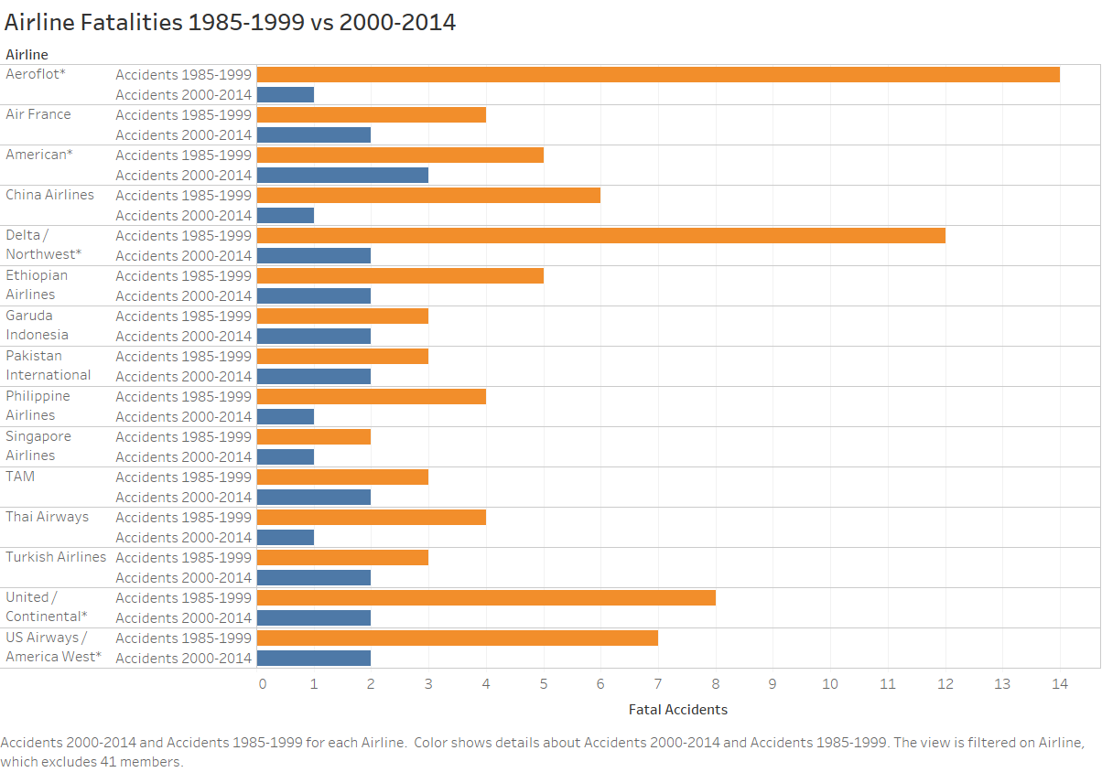
Fatalities by Airline Changes
- Pivoting from the previous visualization. In this image we can see how each airline has decreased by more than 50% once we enter the 2000s. Aeroflot, Delta and United airline have shown how their numbers have decreased suggesting that better safety regulations were implemented.

Slide 5
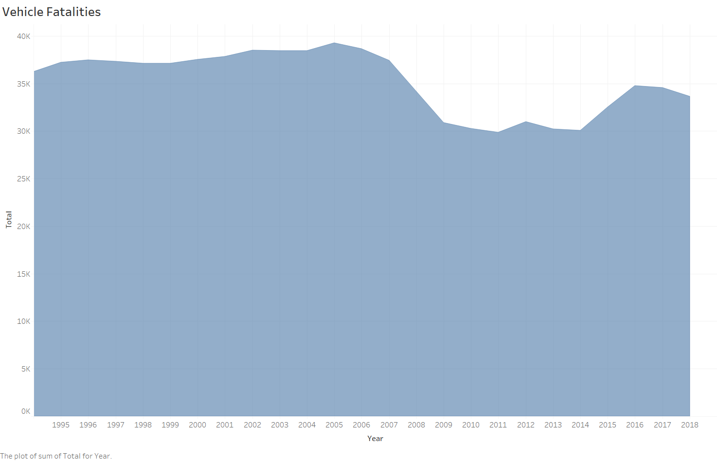
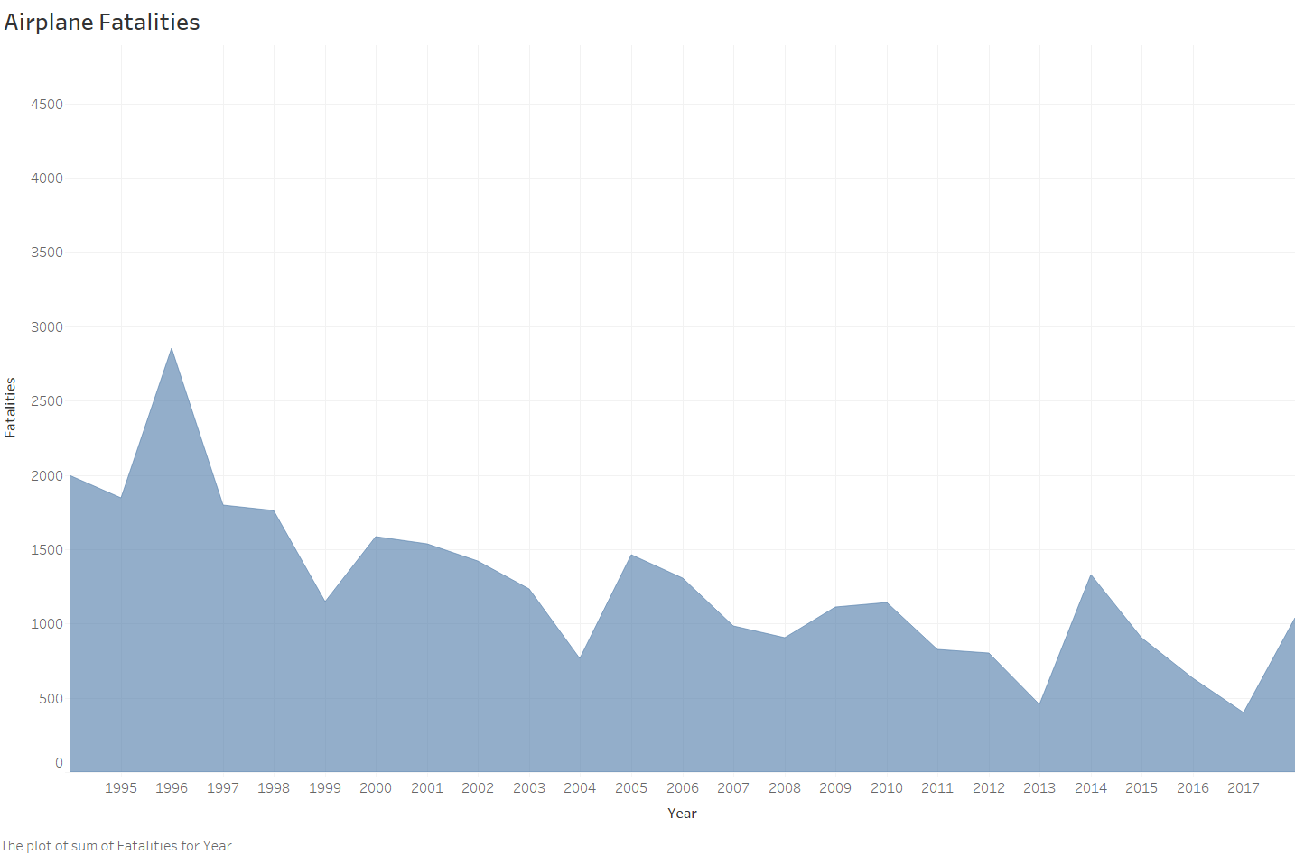
Vehicle vs Airplane Fatalities [1994-2018]
Even before the significant changes that the airline industry had implemented to their services decrease the number of total fatalities. Vehicle fatalities have been at a steady trend rate.
Airline travel seems to still be one of the safest ways of travel.

Slide 6
Wrap Up
Goal of visualizations is to find out why there are reports of increased accidents in the air travel industry being shared to the public by news outlets.
Overall, airline industry fatalities have decreased over all since the beginning of the 2000s.
Comparing airline versus vehicle incidents – there has always been more vehicle incidents without a significant change of improvement. While the airline industry has showing improvement in the last 20 years.

Slide 7
Reference
Airline Safety. (2018). Retrieved from https://github.com/fivethirtyeight/data/tree/master/airline-safety
Airplane Crashes Since 1908. (2016). Retrieved from https://www.kaggle.com/saurograndi/airplane-crashes-since-1908/version/4#Airplane_Crashes_and_Fatalities_Since_1908.csv
NHTSA. Fatal Crashes,1994-2018. Retrieved from FARS Encyclopedia: Trends - General (dot.gov)

