Slide 1
FINAL PACKAGE
LEGAL OOD PROTOCOL
SUBMISSION_1
Submission surface
Our solution trains the GPT2-large model on the provided training data, with a twist:
We synthesize self-built novel additional family data for further training for our model
These results come from training on 12 families, testing on 3 unseen families:
nextstep.csv
completion.csv
anomaly.csv
0.722
0.999
0.847
15
outputs/gpt_large_train12
OOD3 Top-1
OOD3 Top-5
OOD3 MRR
Families
n-gram fallback
family-wise avg
family-wise avg
family-wise avg
12 train / 3 test
SUBMISSION_1 | Industrial AI Infineon | May 31, 2026

Slide 2
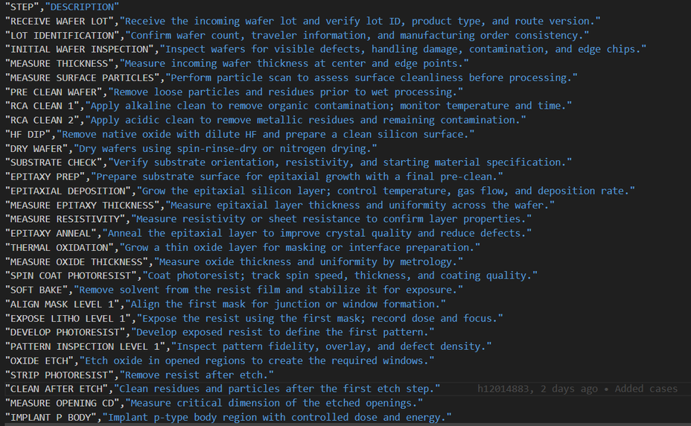
The Data Problem
With most model solutions, performance drops when tested on unseen families
It is hard to distinguish if models learn the process grammar or if they memorization the grammar of the families
All baseline performance scores are not satisfactory for semiconductor chip production

Slide 3
Score exactly where the jury scores
Each official task has a generated CSV, a legal source path, and an auditable local proof.
Jury task
Submitted file
What it scores
SUBMISSION_1 proof
Risk
1. Next step
nextstep.csv
Top-1 / Top-3 / Top-5 / MRR
GPT large OOD3 Top-1 0.722
Low
2. Completion
completion.csv
Normalized edit distance plus exact/token/block
Same checkpoint, official IDs
Medium
3. Anomaly
anomaly.csv
Validity, score, violated rule name
Rule validator, official rule strings
Low
Legality
repo evidence
No hidden eval training
Official eval only used for inference
Low
Reproducibility
REPORT + README
Run path and dependencies
Checkpoint + n-gram fallback
Low
SUBMISSION_1 | Industrial AI Infineon | May 31, 2026

Slide 4
Why this branch ranks first
The best winning chance is the strongest legal OOD result that also ships clean official-format artifacts.
SUBMISSION_1 GPT large
0.722
Selection logic
15 families; train 12; test 3; final CSVs and checkpoint present
Higher OOD confidence than inherited single-family proxy
Prior GPT self-eval path
0.705
No eval_input_anomaly training leakage
Strong self-eval, but weaker OOD framing than SUBMISSION_1
Single-family OOD proxy
0.582
Official IDs generated from participant files
Useful single-family stress test; less robust than OOD3 average
Checkpoint included; fallback remains runnable
N-gram fallback
0.662
Dependency-free safety baseline; not the primary winning path
Counterargument handled: if the hidden OOD family differs from our synthetic families, the 3-family average is still a better proxy than optimizing on known-format self-eval alone.
SUBMISSION_1 | Industrial AI Infineon | May 31, 2026

Slide 5
OOD protocol is explicit and judge-aligned
SUBMISSION_1 tests whether the model learned process grammar, not just known family routes.
15 total families
12 train families
mosfet, igbt, ic
+ scfam01-09
3 held-out OOD families
scfam10, scfam11, scfam12
Report family-wise average
Why this matters
Legal boundary
A hidden fourth family rewards transfer. The local score must therefore penalize family memorization before the final submission is frozen.
Official eval_input_valid.csv and eval_input_anomaly.csv are used only to produce final CSVs, not as training data.
SUBMISSION_1 | Industrial AI Infineon | May 31, 2026

Slide 6
System design stays simple enough to trust
The model improves sequence predictions; the validator owns hard rule compliance.
Training CSVs
15-family manifest
Step tokenizer
one process step = one token
GPT large
21.47M parameters
Ranked next steps
completion beam
Official CSVs
root + final_submission
Fallback path
Safety path
Trigram n-gram runs without torch and can regenerate official-shaped CSVs from a clean checkout.
GPT runner refuses random-init submissions unless explicitly overridden, preventing silent bad CSVs.
SUBMISSION_1 | Industrial AI Infineon | May 31, 2026

Slide 7
Evidence: GPT beats the safe baseline on OOD3
The measured lift is on the train-12/test-3 protocol, not on the final hidden eval files.
Top-1
n-gram 0.662
GPT 0.720
Top-3
n-gram 0.937
GPT 0.981
Top-5
n-gram 0.976
GPT 0.999
MRR
n-gram 0.799
GPT 0.847
+0.058 Top-1 lift vs n-gram
Family-wise OOD3 average: Top-1 0.7216, Top-5 0.9989, MRR 0.8474
SUBMISSION_1 | Industrial AI Infineon | May 31, 2026

Slide 8
Blockers closed before final polish
The package now fails closed on format, legality, and checkpoint availability.
OK
Official IDs
Root CSVs use valid_0001... and anomaly_... copied through from participant inputs.
Final files
Checkpoint present
nextstep.csv
OK
outputs/gpt_large_train12 contains config, generation config, and model.safetensors.
completion.csv
Required docs
anomaly.csv
OK
REPORT.md, README.md, LICENSE, requirements.txt are present at repo root.
OK
Legal usage
Official eval inputs are used only for final inference; not for training.
OK
Fallback
n-gram official bundle remains available if checkpoint transfer fails.
SUBMISSION_1 | Industrial AI Infineon | May 31, 2026

