Slide 1

Trend Analysis
By
G.Arivazhagan
MBT7

Slide 2
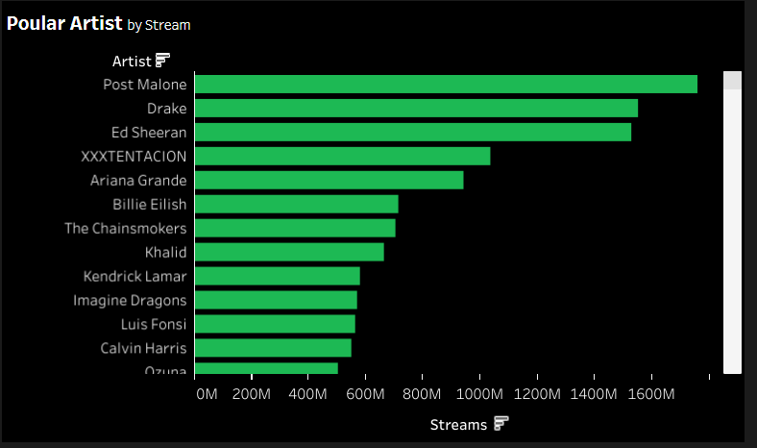
Top Artist
Identify the popular artists in each country.
Create playlists featuring these artists.
Promote these playlists to the audience in their specific countries.
Collaborate with these artists to release official albums with us.
Use these artists in our ads to promote Spotify.

Slide 3
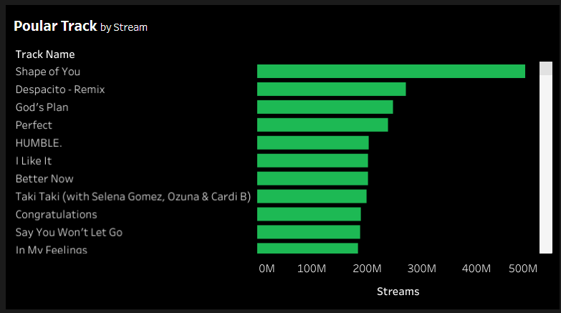
Top Tracks
Identify the popular Tracks that are trending in the market
Create playlists featuring these Tracks.
Promote these playlists to the audience in their specific countries.
Hire influencers to create content promoting these songs with a Spotify watermark and a shoutout from them.

Slide 4
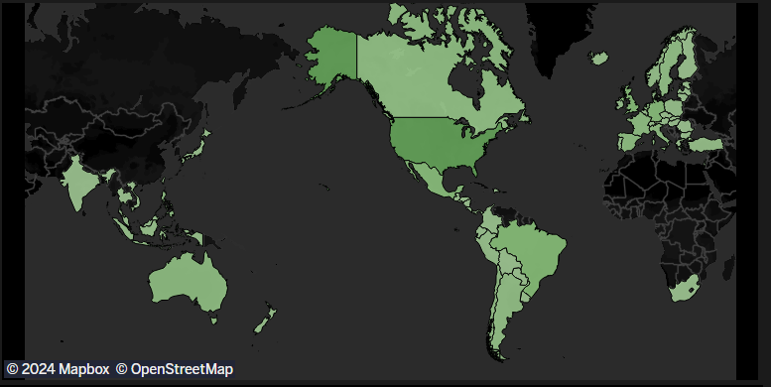
Top Countries
We can use the Popular Countries data Where we have most of our users
Identify Special events based on these popular countries and run Campaigns tailored to it
We can promote/recommend songs based their local Languages, festivities
We can sponsor discounts during these times as limited time deals

Slide 5
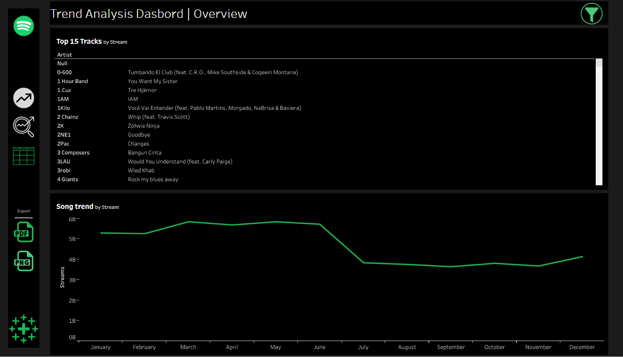
Trends
Utilize ongoing trends to recommend songs to users.
Create an playlist full of new and trending songs.
Newly released songs have a high chance of going viral, so adopting new releases and creating playlists will attract new users to try Spotify.
Let the user know we are always in the top of the trend via ad creatives and promotion

Slide 6
Thank You
By
G.Arivazhagan
MBT7

