Slide 1

SERBA DINAMIK SDN. BHD.
IMAT
INCIDENT MATRIX ANALYSIS TOOL
Think Globally…..Act Locally…..
www.e-serbadk.com

Slide 2

IMAT
INTRODUCTION
This software is used for plant’s that involves in the manufacturing sectors
The software will be used to Analysis all the incident happening in the plant
The software will help to Safety department in the plant
www.e-serbadk.com

Slide 3
IMAT
FLOW OF THE SOFTWARE
The software can able to capture all the data related to the incident that happening in the plant
The location of the incident, the date and time of the incident, the department, the plant, the description of the incident is captured in the system as a basic information of the incident
The finding of the incident, the recommendation of the incident, the status, Job Safety Analysis and Incident analysis
The software can able to provide the no of incident happen in the plant, the finding and recommendation as a lesson learn from the incident
The report’s are generated as per department, location, month and year
The bar and pie graph are provided as per month and year
www.e-serbadk.com

Slide 4
IMAT
BENEFITS OF THE SOFTWARE
The software is used to storage all the incident happening in the plant
It can able to do comparison of incident for the current year to the previous year
All the report for analysis incident can be generated in few minutes.
www.e-serbadk.com

Slide 5
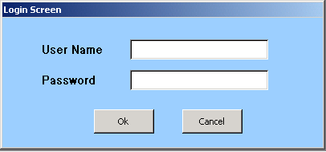
IMAT
LOGIN SCREEN
Login is categories on User ID as
1. Admin User
2. Data Entry User
3. Verify User
www.e-serbadk.com

Slide 6
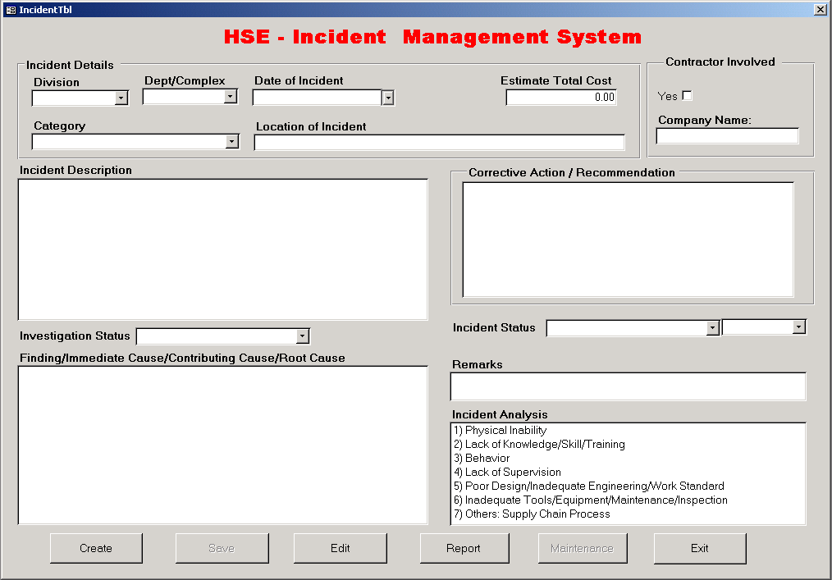
IMAT
Create a New Incident
Save the Incident
Go to Edit Screen
Go to Report Screen
Go to Maintenance
Exit
www.e-serbadk.com

Slide 7
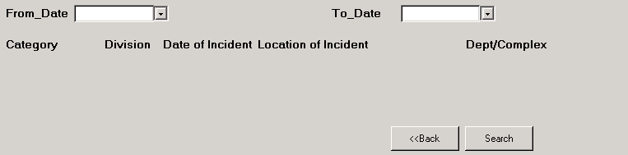
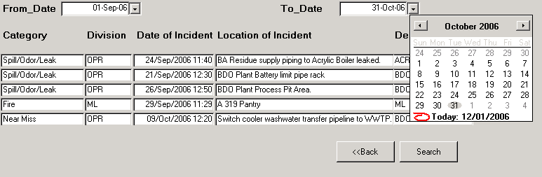
IMAT
Click to select the date
Click to search Incident
Double click the category to view the detail of the related incident
www.e-serbadk.com

Slide 8
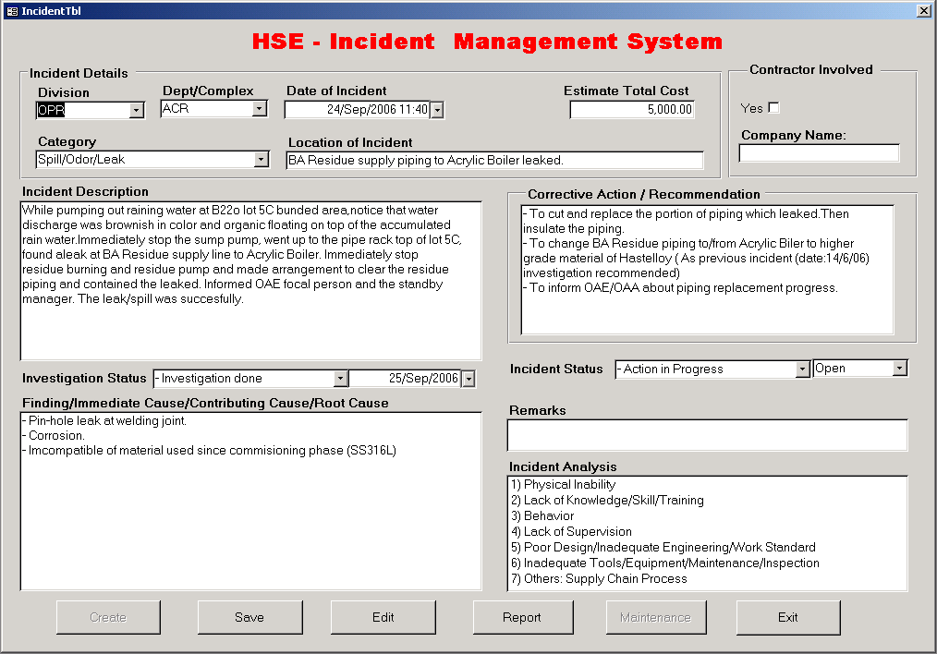
IMAT
Save Edited Incidents
www.e-serbadk.com

Slide 9
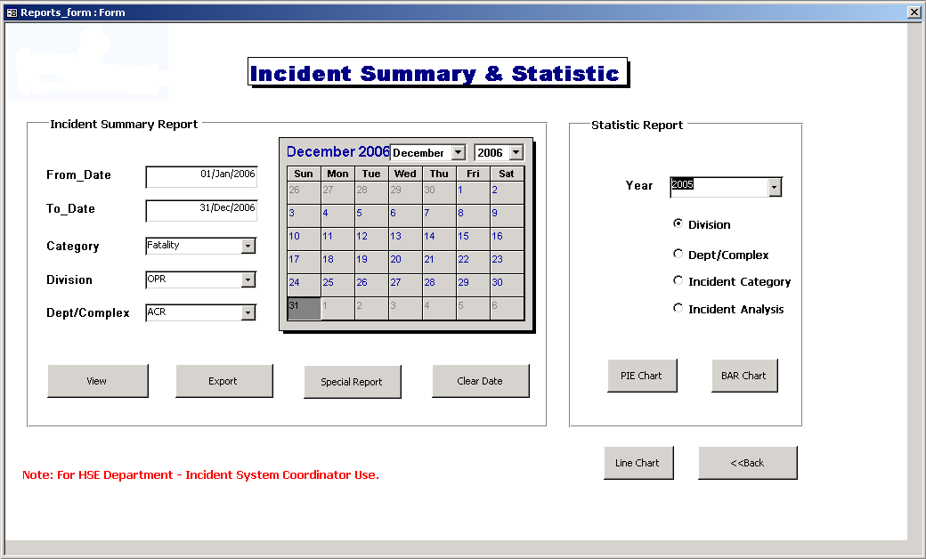
IMAT
REPORT SELECTION SCREEN
www.e-serbadk.com

Slide 10
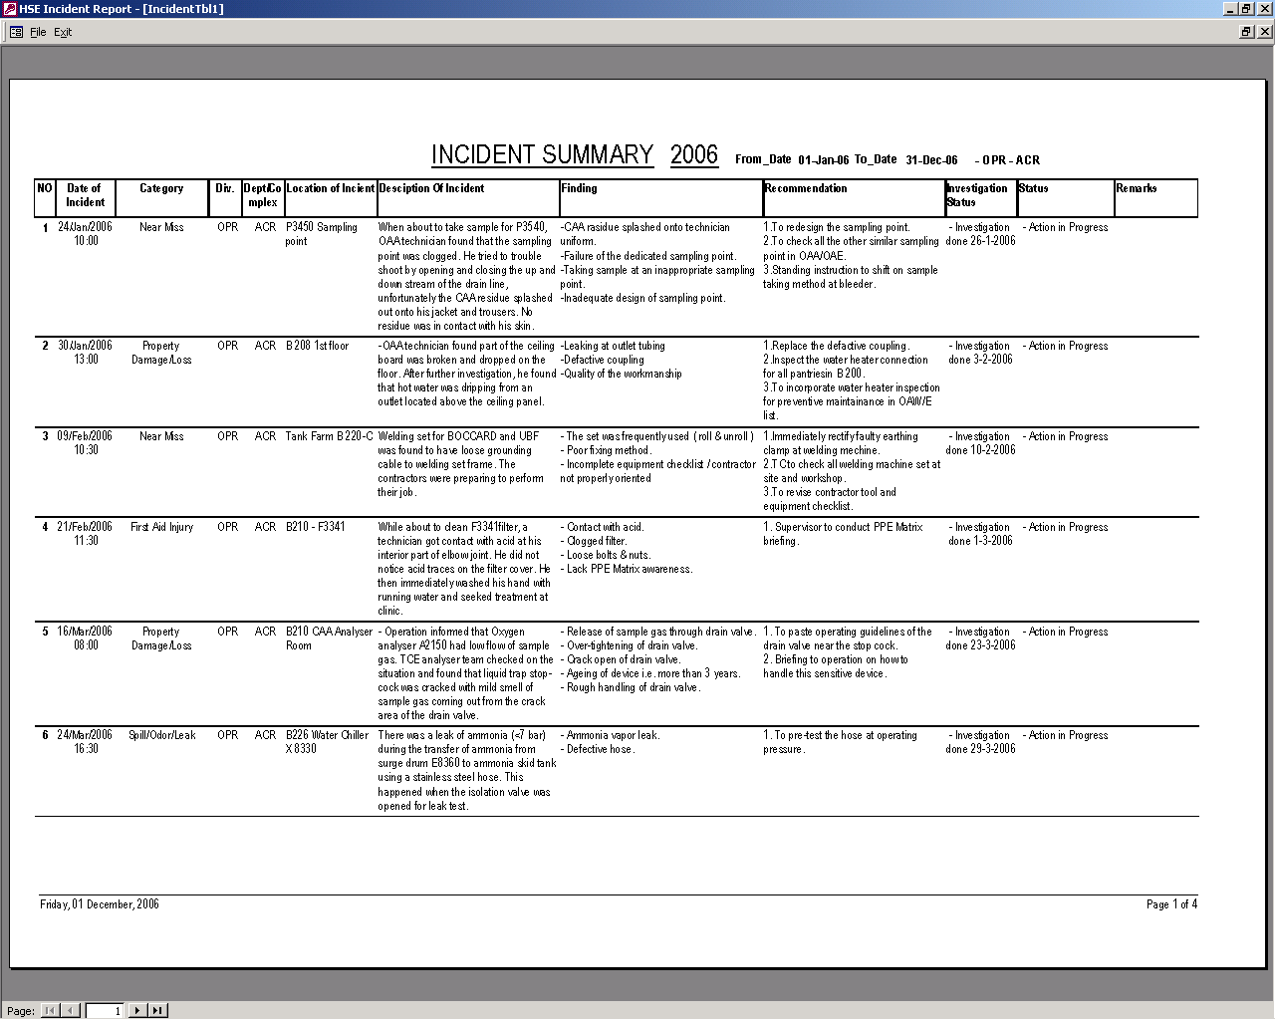
IMAT
REPORT SCREEN
www.e-serbadk.com

Slide 11
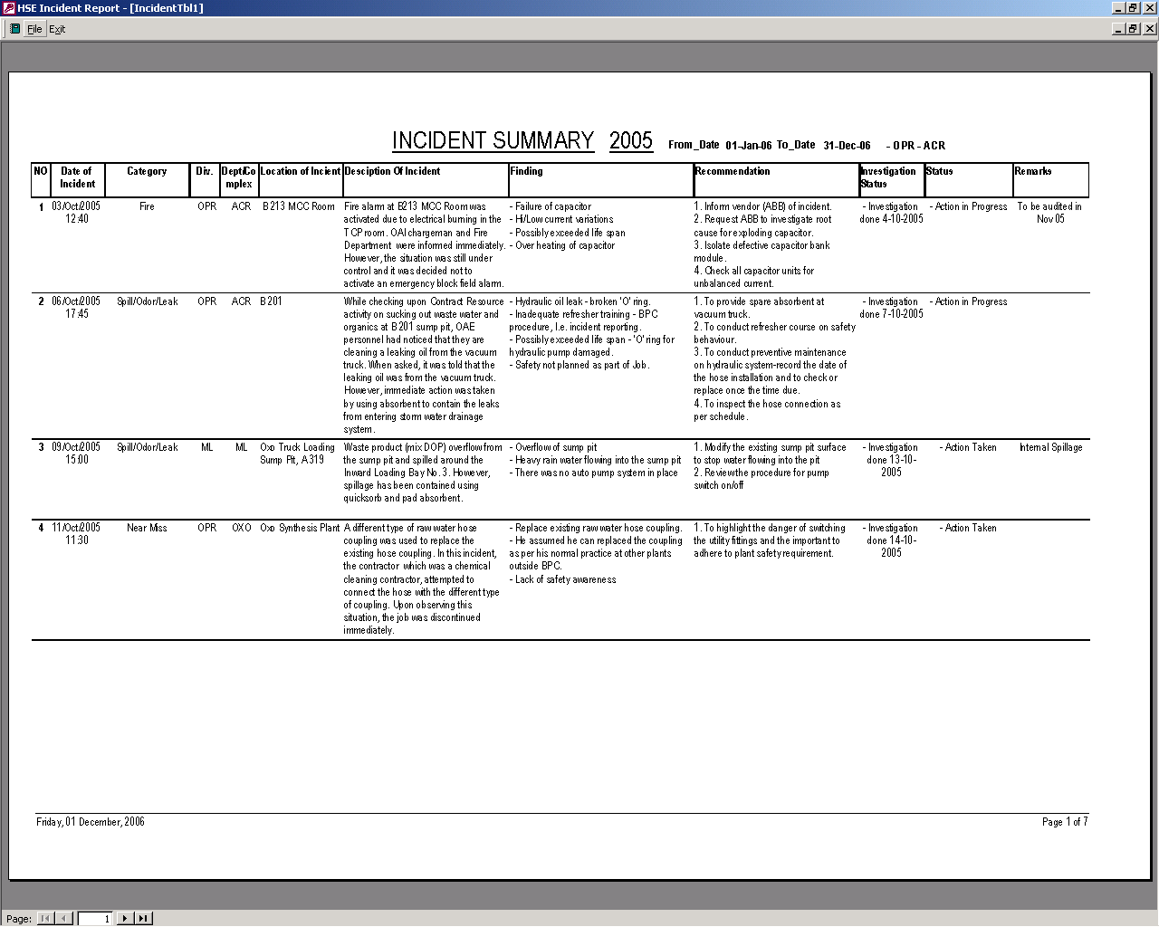
IMAT
SPECIAL REPORT SCREEN
www.e-serbadk.com

Slide 12
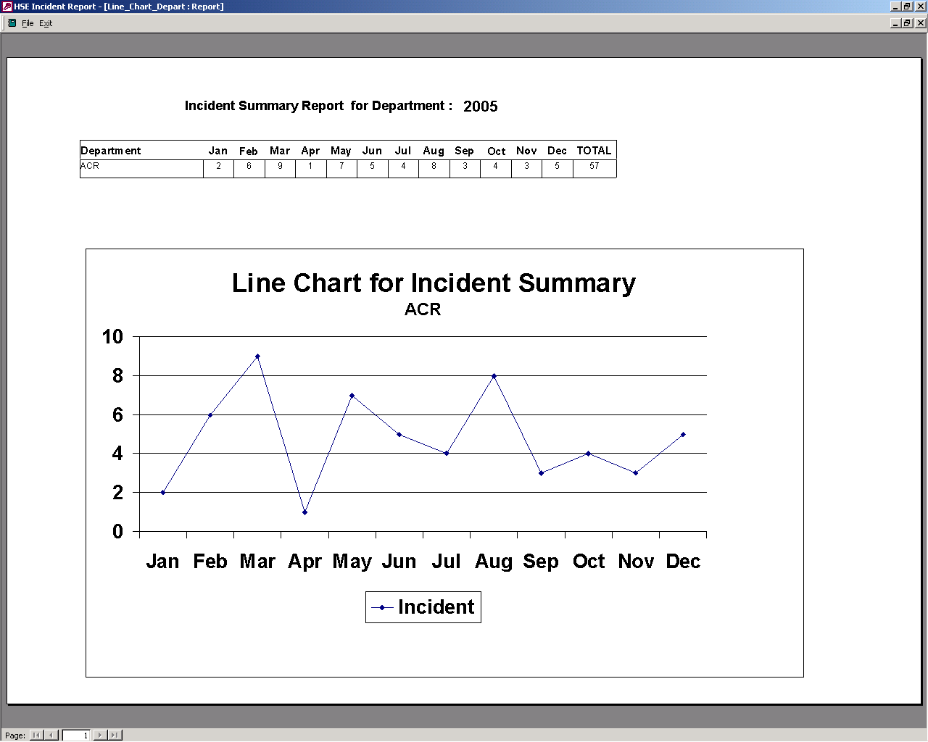
IMAT
LINE CHART REPORT SCREEN
www.e-serbadk.com

Slide 13
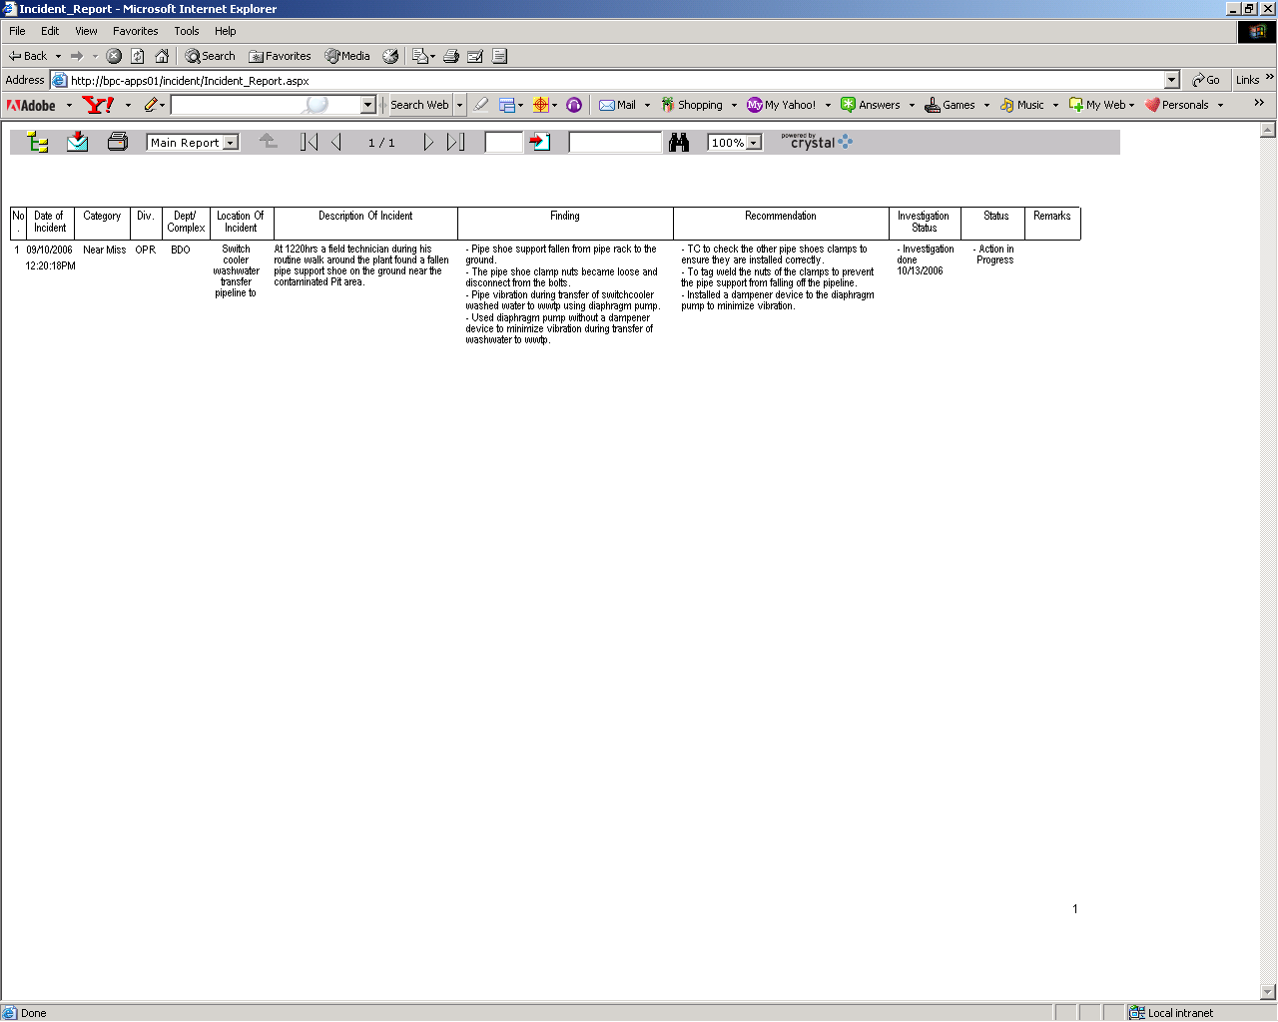
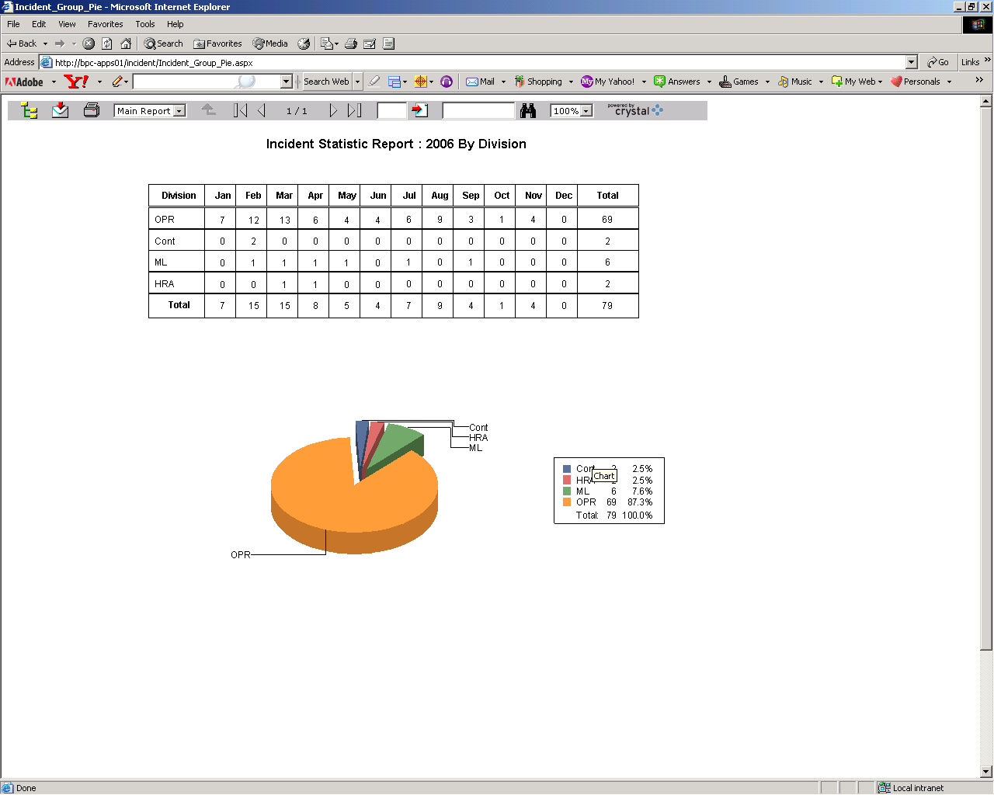
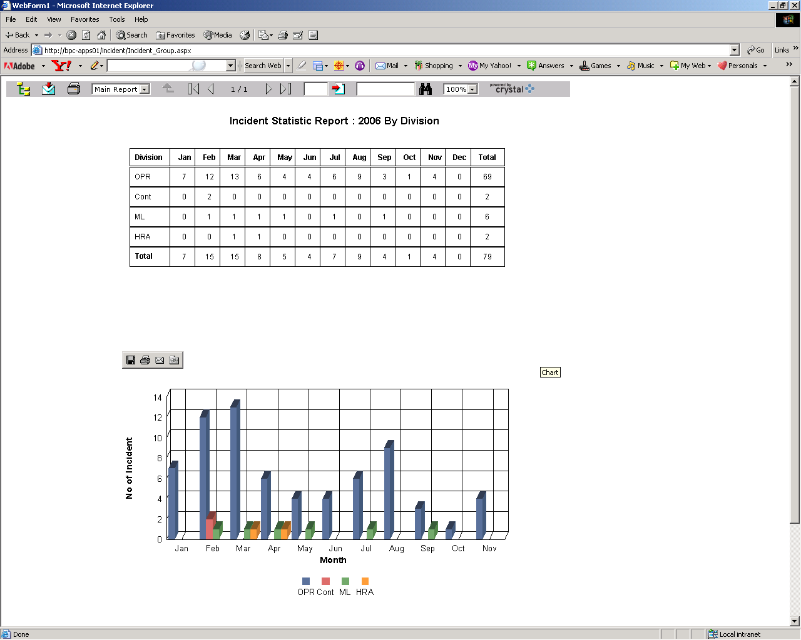
IMAT
USER REPORT SCREEN
www.e-serbadk.com

Slide 14
THANK YOU
E-MAIL: kschin@e-serbadk.com
WEBSITE: www.e-serbadk.com
www.e-serbadk.com

