Slide 1

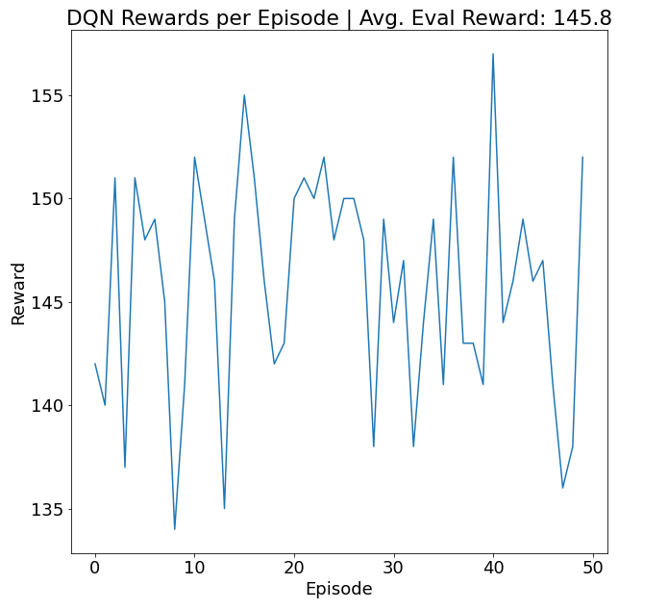
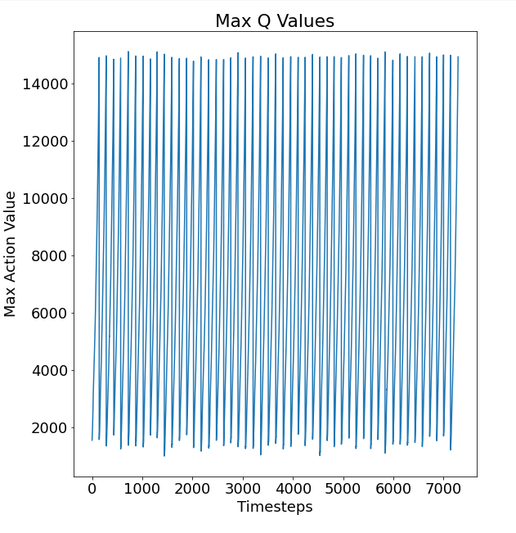
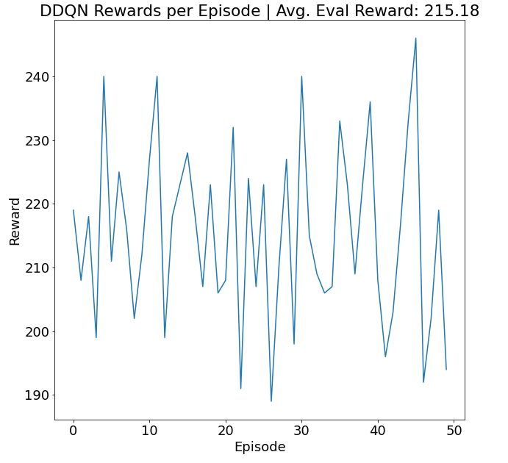
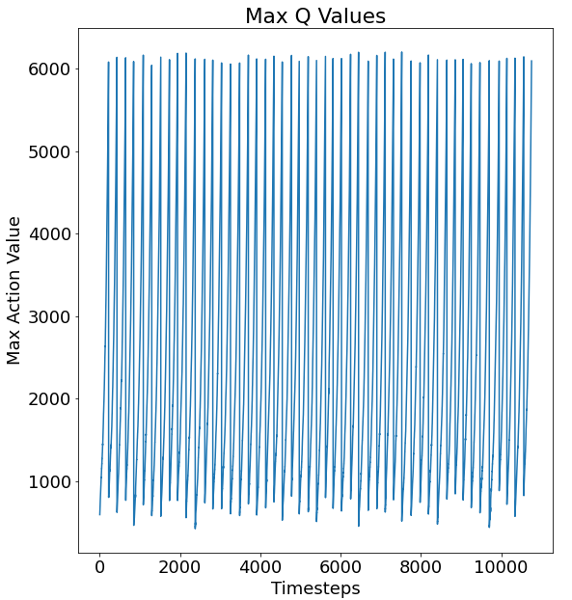
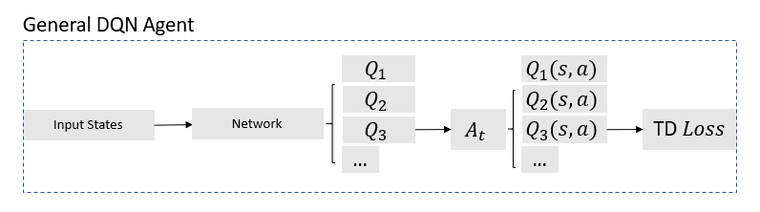
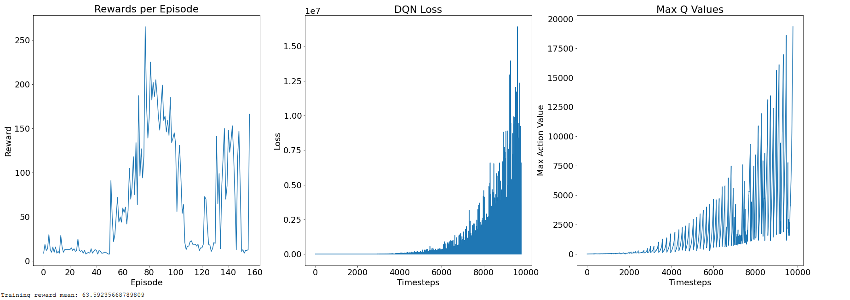
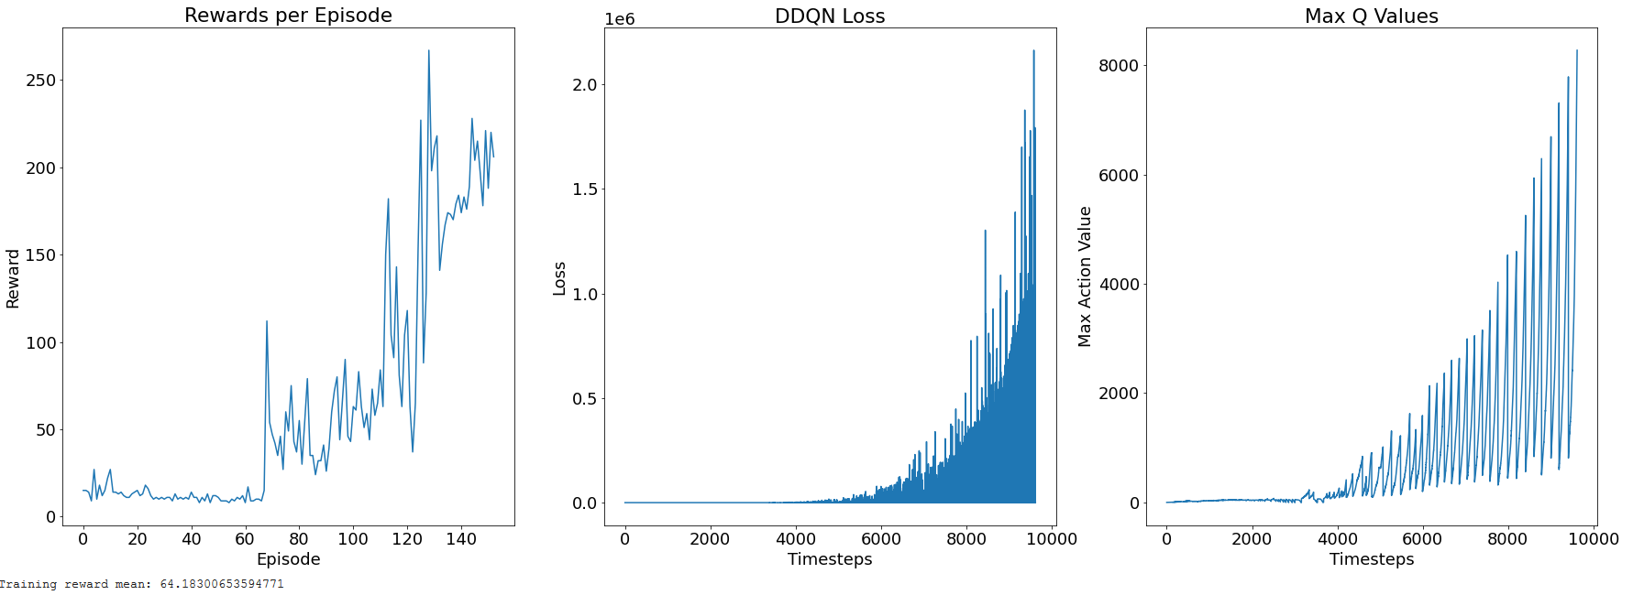
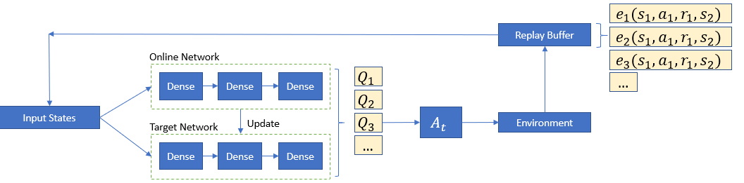
Double DQN for Overestimation Reduction in Games
Akhil Avula, Calvin Chang, Daniel Truong
ECE 239AS Reinforcement Learning, MS in Signals and Systems
Our group is in the process of re-implementing the proposed methods in van Hasselt et al.[2]to investigate how DDQN and DQN play different roles in overestimation. This will be achieved through simulation in an Atari game setting from gym.openai Brockman et al.[1]. In an attempt to improve the methods proposed in van Hasselt et al.[2], we propose two ideas to bring out new results: adjusting the hyper parameters or simulating in new environments. To evaluate the performance of the agents, DDQN and DQN will be pitted against each other, visualized through graphs and tables.
1. Introduction:
3. Results
For this project, algorithms are adapted from"Deep Reinforcement Learning with Double Q-learning" from van Hasselt et al.[2]which proposes a solution called "Double DQN" to prevent overestimating values. The methods from van Hasselt et al.[2]report that Double DQN leads to better policies in video game environments than the DQN method. The DQN and Double DQN algorithm have mostly been replicated and while introducing a variation in the algorithms presented in van Hasselt et al.[2 ]to further investigate the issue of overestimation.
To compare the two algorithms, Opengym AI’s cartpole environment was used to evaluate the performance of the two agents after using the same hyperparameters.
DQN Cartpole Evaluation Results
DDQN Cartpole Evaluation Results
Why does DQN overestimate?
Overestimation is a substantial flaw in the broad spectrum of Q-Learning methods. These overestimated results are from a positive bias that is introduced because Q-learning uses the maximum action value as an approximation for the maximum expected action value.
Overestimation combined with bootstrapping propagates the wrong relative information about which states are more valuable than others, degrading the quality of the learned policies
DQN Cartpole Training Results
DDQN Cartpole Training Results
2. Methods
To improve overestimation double DQN was implemented. Pytorch was used to implement a three layer network double DQN. Below is a block diagram of our model. The network is interchangeable depending on the observation space. In this cases it is composed of linear layers. For environments with observations with images, the network was composed of convolutional layers.
4. Discussion and Next steps
The DDQN not only performs better in the evaluation stage, but appears to be more stable in the training phase than the DQN. Comparing the plots of the max Q values for each algorithm during the evaluation stage, DDQN hovers from 1000-6000 while DQN hovers between 2000 to 14000. The overestimation of the DQN is shown here, which leads to worse performance than the DDQN. Another interesting result is that during the training phase, the overestimation of reward of DQN was followed by a strong dip in reward which can be linked the inaccurate Q value estimations.
This project can be taken further by training and evaluating both algorithms on more environments which have a similar learning difficulty to Cartpole, such as Pong, Lunar Lander, etc. Also, there are plans to tune the hyperparameters of the DDQN to show the potential benefit over DQN.
Notes:
For our project, we are recreating RL algorithms to reduce overestimation in games. The goal is to improve the performance of agents in a given game environment, namely Atari. DQN (Deep q network) has been largely used in the past, but with our paper, double DQN along with other techniques are introduced to reduce the overesitmation of DQN, giving better results.

Slide 2
Why does DQN overestimate?
Overestimation is a substantial flaw in the broad spectrum of Q-Learning methods. These overestimated results are from a positive bias that is introduced because Q-learning uses the maximum action value as an approximation for the maximum expected action value.
Overestimation combined with bootstrapping propagates the wrong relative information about which states are more valuable than others, degrading the quality of the learned policies
Notes:
Dqn overestimates, because it uses a max function to approximate the maximum expected action value
Below you can see a general block diagram for a DQN agent.

Slide 3
2. Methods
To improve overestimation double DQN was implemented. Pytorch was used to implement a double DQN. Below is a block diagram of our model. The network is composed of three layers that are interchangeable depending on the observation space. In this cases, it is composed of linear layers. For environments with observations that are images, the network was composed of convolutional layers.
Notes:
To improve overestimation we implemented a double DQN agent in pytorch. This alleviates overestimation, because the idea of Double Q-learning is to reduce overestimations by decomposing the max operation in the target- into action selection and action evaluation.
Below is a block diagram of our implemented agent.

Slide 4
3. Results
To compare the two algorithms, Opengym AI’s cartpole environment was used to evaluate the performance of the two agents after using the same hyperparameters.
DQN Cartpole Evaluation Results
DDQN Cartpole Evaluation Results
DQN Cartpole Training Results
DDQN Cartpole Training Results
Notes:
DQN evaluation results compare with DDQN evaluation results

Slide 5
Double DQN for Overestimation Reduction in Games
Akhil Avula, Calvin Chang, Daniel Truong
ECE 239AS Reinforcement Learning, MS in Signals and Systems
Our group is in the process of re-implementing the proposed methods in van Hasselt et al.[2]to investigate how DDQN and DQN play different roles in overestimation. This will be achieved through simulation in an Atari game setting from gym.openai Brockman et al.[1]. In an attempt to improve the methods proposed in van Hasselt et al.[2], we propose two ideas to bring out new results: adjusting the hyper parameters or simulating in new environments. To evaluate the performance of the agents, DDQN and DQN will be pitted against each other, visualized through graphs and tables.
1. Introduction:
3. Results
For this project, algorithms are adapted from"Deep Reinforcement Learning with Double Q-learning" from van Hasselt et al.[2]which proposes a solution called "Double DQN" to prevent overestimating values. The methods from van Hasselt et al.[2]report that Double DQN leads to better policies in video game environments than the DQN method. The DQN and Double DQN algorithm have mostly been replicated and while introducing a variation in the algorithms presented in van Hasselt et al.[2 ]to further investigate the issue of overestimation.
To compare the two algorithms, Opengym AI’s cartpole environment was used to evaluate the performance of the two agents after using the same hyperparameters.
DQN Cartpole Evaluation Results
DDQN Cartpole Evaluation Results
Why does DQN overestimate?
Overestimation is a substantial flaw in the broad spectrum of Q-Learning methods. These overestimated results are from a positive bias that is introduced because Q-learning uses the maximum action value as an approximation for the maximum expected action value.
Overestimation combined with bootstrapping propagates the wrong relative information about which states are more valuable than others, degrading the quality of the learned policies
DQN Cartpole Training Results
DDQN Cartpole Training Results
2. Methods
To improve overestimation double DQN was implemented. Pytorch was used to implement a three layer network double DQN. Below is a block diagram of our model. The network is interchangeable depending on the observation space. In this cases it is composed of linear layers.
4. Discussion and Next steps
The DDQN not only performs better in the evaluation stage, but appears to be more stable in the training phase than the DQN. Comparing the plots of the max Q values for each algorithm during the evaluation stage, DDQN hovers from 1000-6000 while DQN hovers between 2000 to 14000. The overestimation of the DQN is shown here, which leads to worse performance than the DDQN. Another interesting result is that during the training phase, the overestimation of reward of DQN was followed by a strong dip in reward which can be linked the inaccurate Q value estimations.
This project can be taken further by training and evaluating both algorithms on more environments which have a similar learning difficulty to Cartpole, such as Pong, Lunar Lander, etc. Also, there are plans to tune the hyperparameters of the DDQN to show the potential benefit over DQN.

