Slide 1
My Talk
Zengyanyu

Slide 2
Introduction
This is some text
As is this

Slide 3
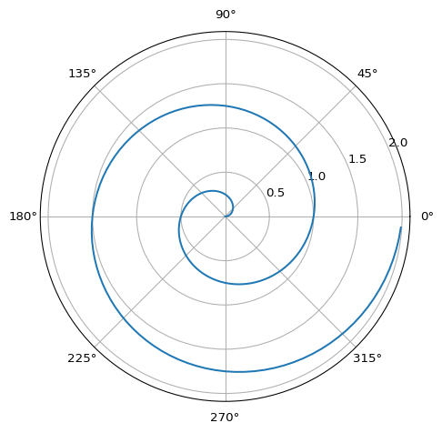
Here Are Some Code Outputs

