Slide 1


Laravel 11
Migarasi

Slide 2
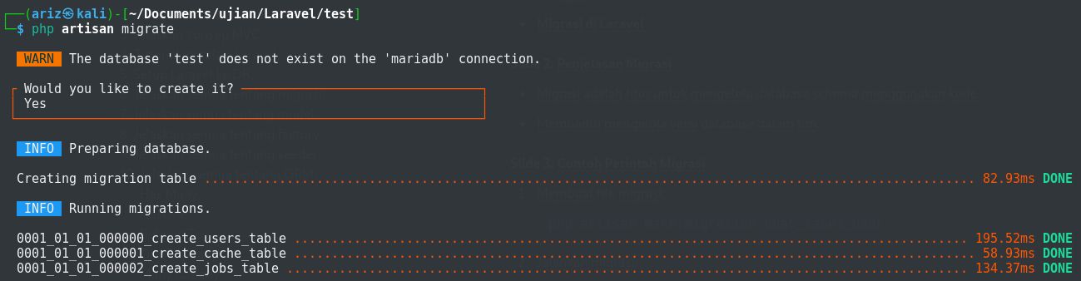
Migrasi Laravel
>> php artisan migrate

Slide 3
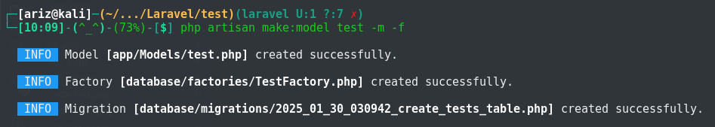
Membuat Model
>> php artisan make:model NamaModel -m -f

Slide 4
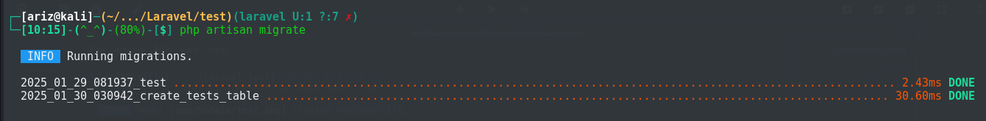
Migrate
>> php artisan migrate

Slide 5
Laravel 11
Model

