Slide 1
Progress Report 7 12-5-2021
“Real-Time Localization of Emergency Responders in Dynamic Lightning environments with a pocket-sized LiDAR enhanced RGB-Camera.”

Slide 2
Progress Report 6
Outcomes of last meeting
Results
ORB-slam3,LOAM,SSL-slam, LIC-Fusion
Challenge
Plans for next weeks

Slide 3
Outcomes of last meeting
Mathematics
Go back to the fundamentals of signal analysis
Using an UKF instead of an EKF saves time on tuning the initial covariance matrix.
Report Layout
Use the recommended layout of the grading rubric for your literature report
Use colors and symbols to exemplify figures
Planning
Use a gain factor when planning tasks, use the actual time spent on a task as feedback to adjust this factor when necessary
Plan from the bottom up

Slide 4
Next meeting?

Slide 5
Where is room for improvement?
Plan more from the bottom up,
The tasks I wanted to do were to long and therefore planning didn’t work -> I now plan my days in Hourly blocks.

Slide 6
What went well?
Diversify my days
Switching occasionally from literature to doing some programming or recap of lectures made me more productive and happy

Slide 7
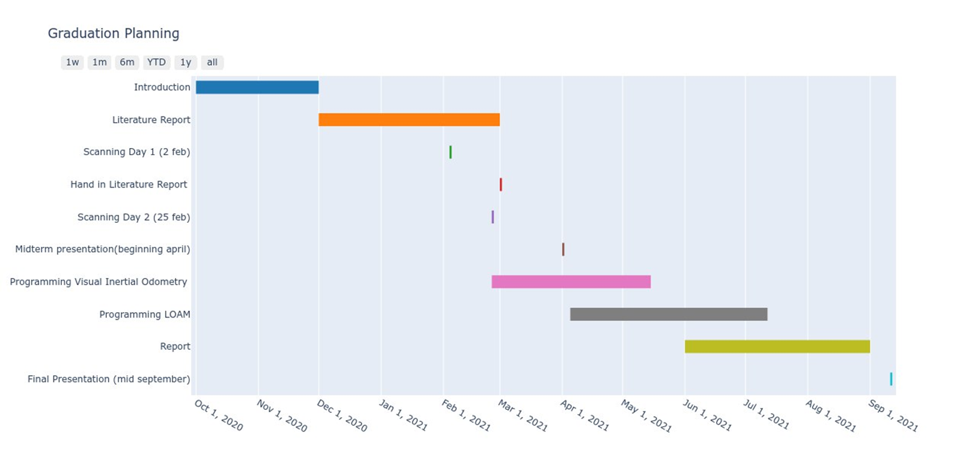
Plan for the next weeks

Slide 8
Results Week 1
Progress meeting

Slide 9
Results Week 2
Meet with Joost Jeschke
Presentation in GEO ict practice meeting
Study at TU
Ask Oleg to do midterm in CSI meeting in April

Slide 10
Results Week 3

Slide 11
Results Week 4

Slide 12
Results Week 5
Progress Meeting Wednesday 16:30

