Slide 1
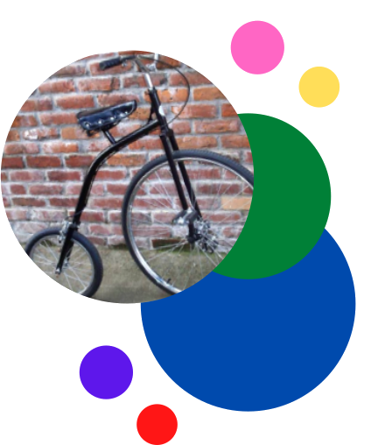
Adults
$24.99
Kids (8+)
$19.95

Slide 2
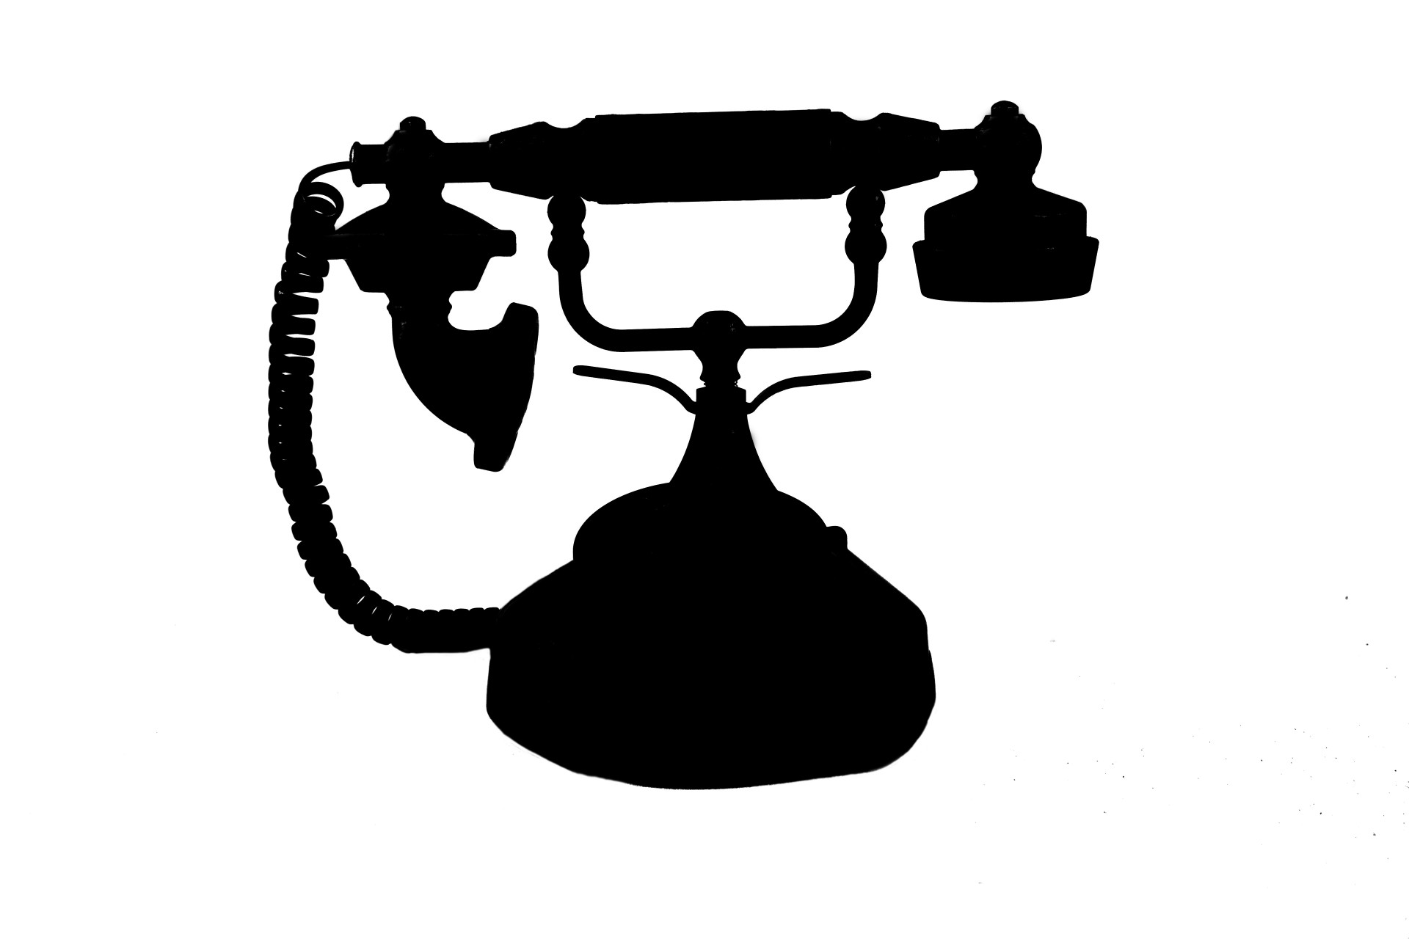

Slide 3


Slide 4
The Bikeadelic
Penny Farthing Ride

Slide 5
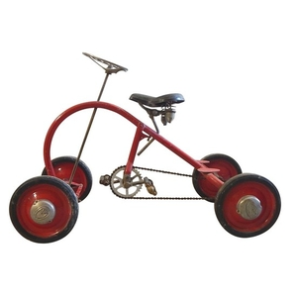

Slide 6
