Slide 2
NETFLIX Clone
Submitted to:
Department of Computer Science and Engineering

Slide 3
Supervised by: Prof. Gajendra Chauhan
Arjav Jain

Slide 4
Project Presentation Outline
Introduction
Description
Website Structure
Technology used
Working
User Interface
Conclusions

Slide 5
Introduction
Our endeavor, titled "Netflix Clone," is a web-based application crafted to emulate the visual interface of the widely-used streaming platform, Netflix. The objective is to establish an engaging and easily navigable platform, enabling users to browse content seamlessly and register for an account.

Slide 6
Description
The Netflix Clone presents a streamlined rendition of Netflix's homepage, showcasing a "Get Started" button and an email input field for user registration. The intended solution seeks to offer users a recognizable interface for exploring and enjoying content, with a particular emphasis on simplifying the signup process.

Slide 7
Website Structure
Components:
Main Navigation Bar
Featured Content Section
Categories and Genres
Sections:
Home
Footer(contact)
Sign In / Sign Up

Slide 8
Objectives
Develop an intuitive front-end that mirrors Netflix's layout for a user-friendly experience.
Incorporate a smooth email registration system to enhance user onboarding.
Acquire practical expertise in both web development and the management of databases throughout the implementation process.

Slide 9
Technology Used
Front-end: HTML, CSS
Back-end: PHP
Database: MySQL
Server: XAMPP
The chosen technologies were selected for their simplicity, ease of integration, and compatibility with web development requirements.

Slide 10
Working
Homepage Layout:
The homepage features a "Get Started" button.
An email input field is provided for user registration.
Database Integration:
PHP scripts handle user input and interact with the MySQL database.
User email addresses are stored securely in the database.
XAMPP Server:
XAMPP is utilized to run the Apache server for PHP execution.
MySQL database is managed using phpMyAdmin.
User Interaction:
Users click the "Get Started“ and “Sign-in” button and enter their email address.
PHP scripts validate and store the email in the database.

Slide 11
User Interface
Design Elements:
Consistent color scheme and branding.
User-friendly layouts.
Showcase of key pages (home, sign-in, sign-up).

Slide 12
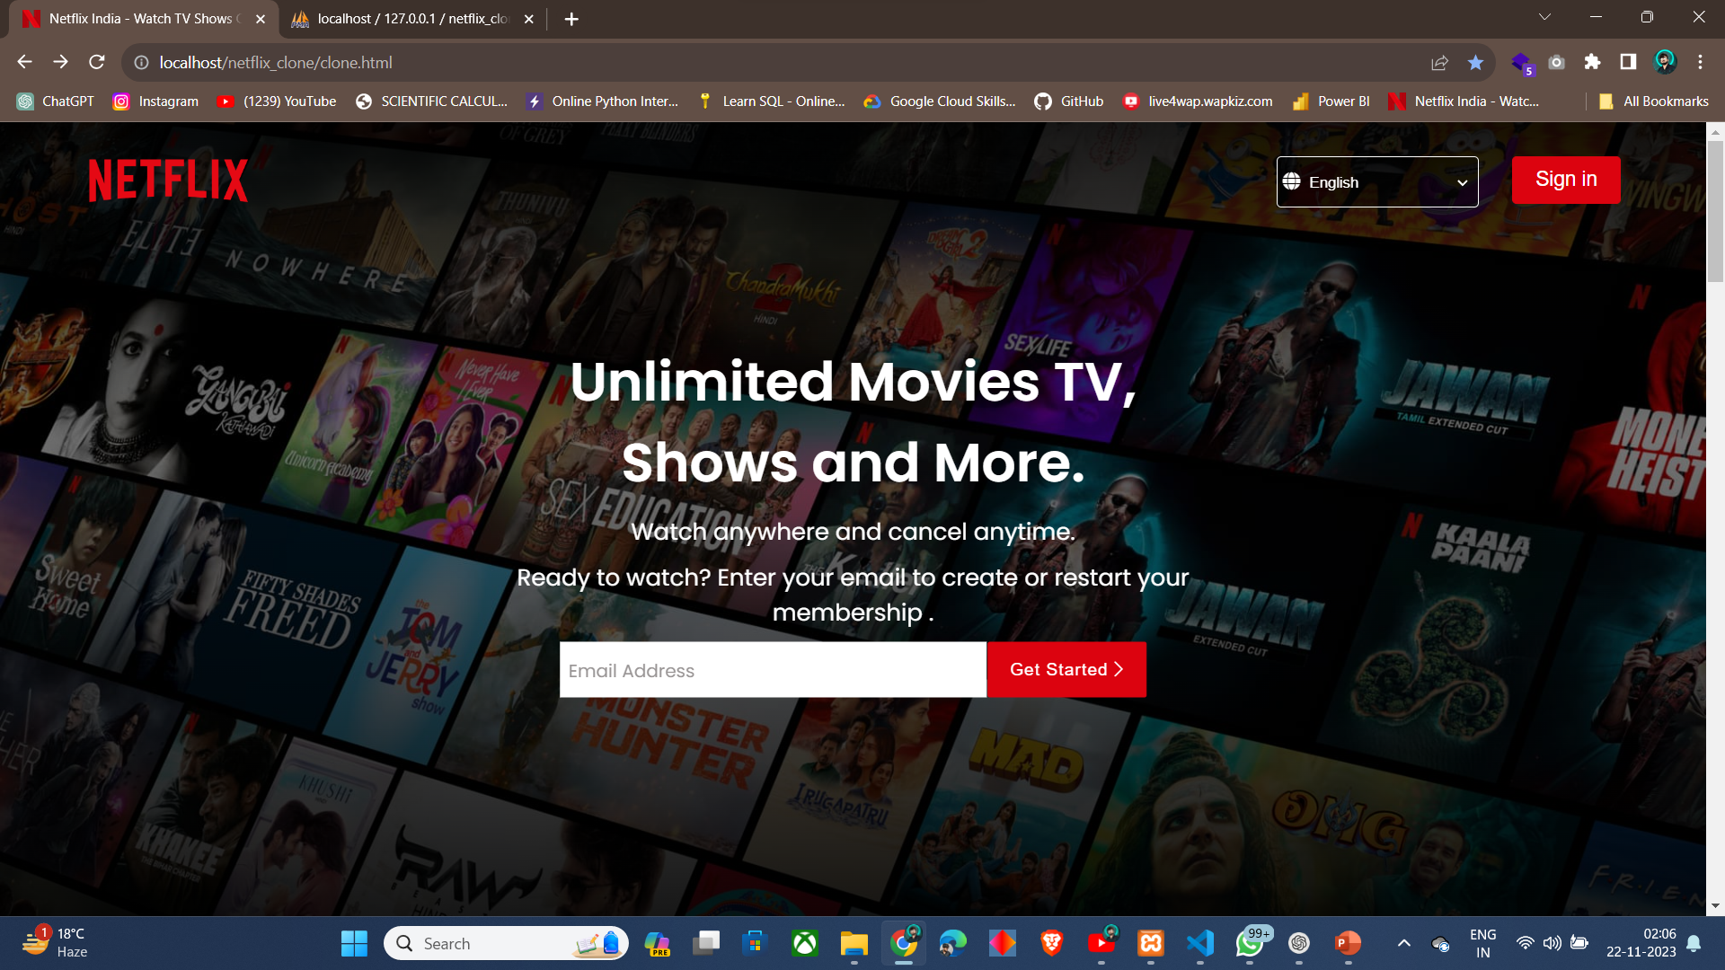
User Interface

Slide 13
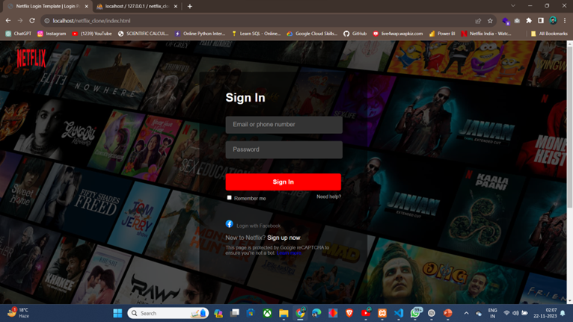
User Interface

Slide 14
Conclusion
In summary, the Netflix Clone project effectively attains its goals by delivering a practical front-end that closely mirrors Netflix's interface and incorporating a streamlined user registration process. The project employs a stack of web development technologies and showcases the seamless integration of PHP with a MySQL database. Despite its simplified nature, the project serves as a valuable learning opportunity in the realms of web development and server management.

Slide 15
Q&A

Slide 16
THANKS

