Slide 1
EC Project
Title: WaveForm Generation Using Op-Amps
Team:
Arji Jethin Naga Sai Eswar (***********)
Ayush Singh (***********)
Aluru Bala Karthikeya (***********)
Notes:
EC Project
Devarakaggalahalli, Harohalli Kanakapura
Road, Dt, Ramanagara, Karnataka 562112
School of Engineering
Title: Applications of OP-AMP
Class: B9
Team:
Arji Jethin Naga Sai Eswar (23UGENG0321)
Ayush Singh (23UGENG0821)
Aluru Bala Karthikeya (23UGENG0050)

Slide 2
Contents:
Introduction
Methodology
Circuit Diagram
Results/Outcomes
References
Notes:
Content:
Introduction
Methodology
Circuit Diagram
Results/Outcomes
References

Slide 3
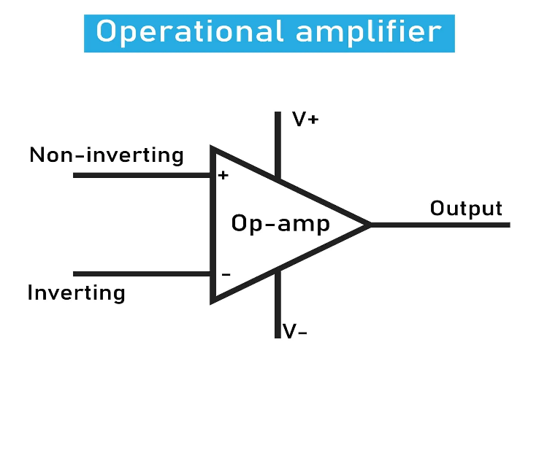
Introduction:
An operational amplifier, often referred to as an op-amp, is a versatile and widely used analog electronic component. It is a type of voltage amplifier with very high gain and differential inputs. Op-amps are designed to amplify the voltage difference between two input terminals and provide a high-gain output voltage. The symbol for an op-amp typically consists of two input terminals (inverting and non-inverting), an output terminal, and power supply connections. The triangle shape represents the amplifier, and the arrow indicates the direction of signal flow. Op-amps find applications in various electronic circuits, including amplifiers, filters, oscillators, comparators, voltage regulators, and more. They are fundamental to analog electronics and are an integral part of countless electronic devices. In summary, operational amplifiers are fundamental building blocks in electronics, providing high gain and versatile functionality.
Their use in both open-loop and closed-loop configurations makes them indispensable in a wide range of applications,
from basic amplification to complex signal processing circuits. Understanding the characteristics and configurations of op-amps is
essential for anyone working in the field of electronics. Op-amps typically require dual power supplies, providing positive and
negative voltage rails. However, some applications may use single-supply op-amps with a ground reference and a positive voltage
supply. Op-amps are utilized in oscillator circuits, like the Wien Bridge or RC Phase Shift configurations, to generate stable and
controlled oscillations, enabling precise manipulation of frequency and amplitude. These op-amp-generated waveforms find
applications in diverse fields, from audio signal processing and frequency standardization to instrumentation and signal modulation
showcasing the fundamental importance of op-amps in shaping electronic signals.

Slide 4
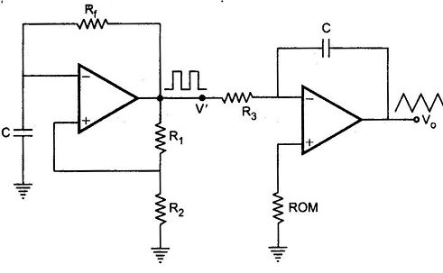
Methodology:
1) Triangular wave generation using operational amplifiers:
1. Component selection: pick an op-amp, resistors, capacitors, and a square wave source.
2. Integrator setup: connect a capacitor in the op-amp's feedback loop and a resistor in series with the input to make it an integrator.
3. Input square wave: feed a square wave to the op-amp's non-inverting terminal for integration.
4. Adjust time constants: tune resistor (R) and capacitor (C) values for desired time constants. Integration results in a triangular waveform at the output.
5. Gain adjustment: set integrator gain by adjusting resistor values. Control the amplitude of the triangular wave.
6. Testing and simulation: simulate using software or build a prototype on a breadboard. Use an oscilloscope to ensure stable triangular wave generation.
Applications:
Function generators: stable waveforms for testing and signal synthesis.
Frequency synthesis Applied in various frequency synthesis applications.
Signal modulation Crucial for frequency and pulse-width modulation.
Audio signal processing: Contribute to sound synthesis
and processing effects.

Slide 5
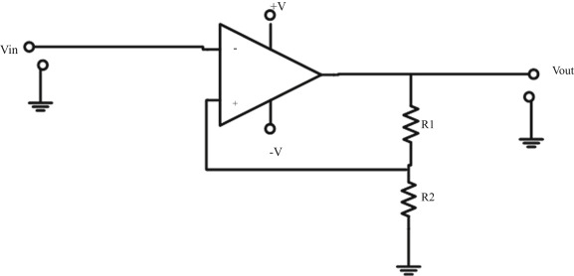
2) Square Wave Generation using Operational Amplifiers:
Component Selection: Choose an op-amp, resistors, and capacitors. For a Schmitt trigger, add feedback resistors and a positive feedback network.
Schmitt Trigger Setup: Connect the inverting input to the output. Use resistors (Rf and Rg) for positive feedback to create a hysteresis loop. Adjust resistor values to set switching thresholds.
Comparator-Based Oscillator: Configure the op-amp as a comparator. Set a reference voltage with a voltage divider on the non-inverting input. Input signal on the inverting input causes switching at the reference voltage.
Gain Adjustment: Modify feedback resistor values to control square wave amplitude. Frequency Adjustment: Fine-tune frequency by adjusting resistor and capacitor values.
Testing and Simulation: Simulate using software or build a prototype on a breadboard. Analyze the output with an oscilloscope for stable square wave generation.
Applications:
A. PWM Control: Used in motor control, power inverters, and LED dimming.
B. Digital Clocks: used in timing circuits.
C. Signal Processing: Applied in frequency synthesis and signal modulation.
D. Audio Tone: Used in sound synthesis for distinctive tones.
Notes:
2) Square Wave Generation using Operational Amplifiers:
1. Component Selection: Begin by selecting components such as an operational amplifier, resistors, and capacitors. For a Schmitt trigger configuration, additional components like feedback resistors and a positive feedback network will be necessary.
2. Schmitt Trigger Configuration: For a Schmitt trigger-based square wave generator: Connect the inverting input (-) to the output. Connect positive feedback resistors (Rf and Rg) to create a hysteresis loop. Adjust the resistor values to set the threshold voltages for switching.
3. Comparator-Based Square Wave Oscillator: Alternatively, a comparator-based approach can be used: Configure the op-amp as a comparator. Use a voltage divider to set the reference voltage for the non-inverting input. The input signal is applied to the inverting input. The comparator switches states when the input signal crosses the reference voltage.
4. Gain Adjustment: Adjust the gain of the amplifier by modifying the resistor values in the feedback network. This determines the amplitude of the square wave.
5. Frequency Adjustment: Fine-tune the frequency by adjusting the values of resistors and capacitors in the circuit. The frequency is influenced by the timing components in the oscillator circuit.
6. Testing and Simulation: Simulate the circuit using software tools or build a prototype on a breadboard. Use an oscilloscope to analyze the output waveform and ensure stable square wave generation.

Slide 6
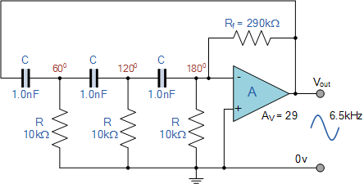
3) Sine Wave Generation using Operational Amplifiers with RC Phase Shift Oscillator
Choose Parts: Pick an op-amp, resistors (R1, R2, R3, R4), and capacitors (C1, C2, C3, C4).
Set Frequency: Decide how fast you want your oscillator (frequency). Use a formula to choose resistor and capacitor values for that frequency.
Build Oscillator: Connect resistors and capacitors to make a phase shift network. Connect the op-amp as an inverting amplifier.
Op-Amp Setup: Connect the input to R2 and C2. Connect the output to the inverting input.
Phase Shift Network: Use R1, C1, R2, C2, R3, C3, R4 for a 180-degree phase shift. Adjust Gain: Change resistor ratios for the right wave height (amplitude).
Applications:
Audio Signal Generation: Used for precise sine waves in audio testing.
Frequency Standardization: Provides stable reference frequency for timekeeping.
Instrumentation and Testing: Calibrates instruments like oscilloscopes.
Signal Processing: Crucial for modulation and demodulation in signal processing

Slide 7
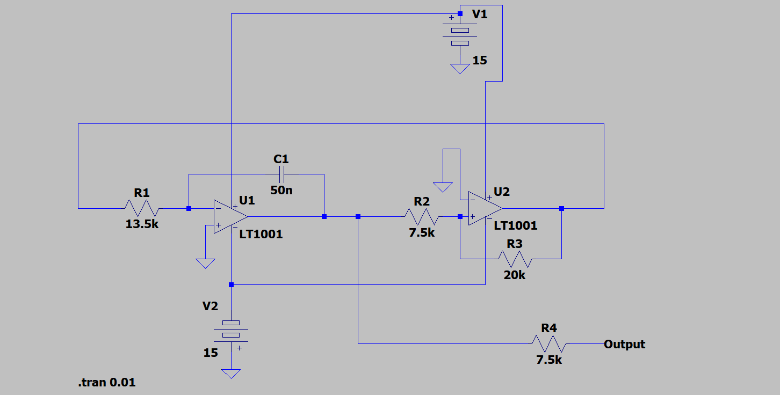
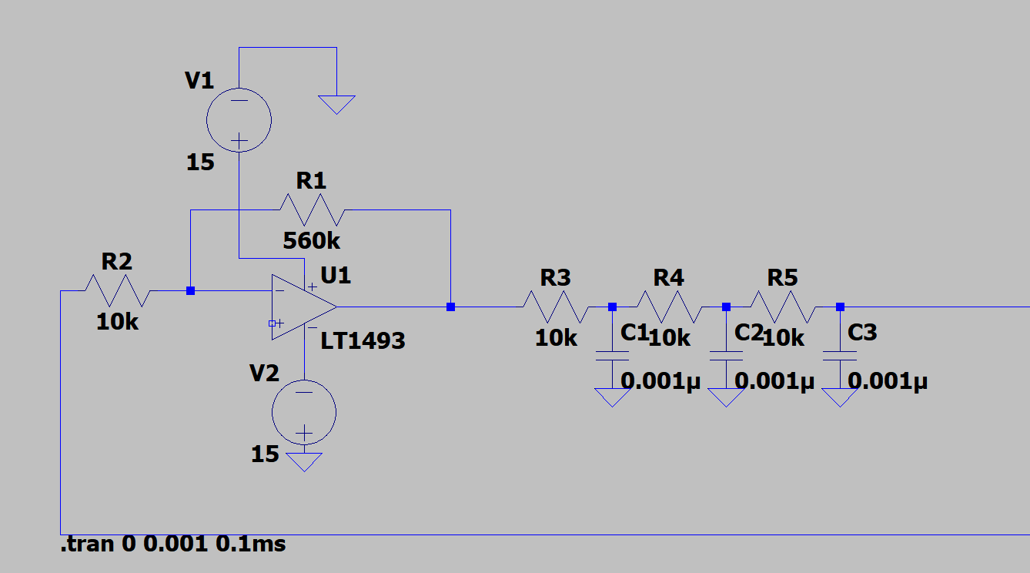
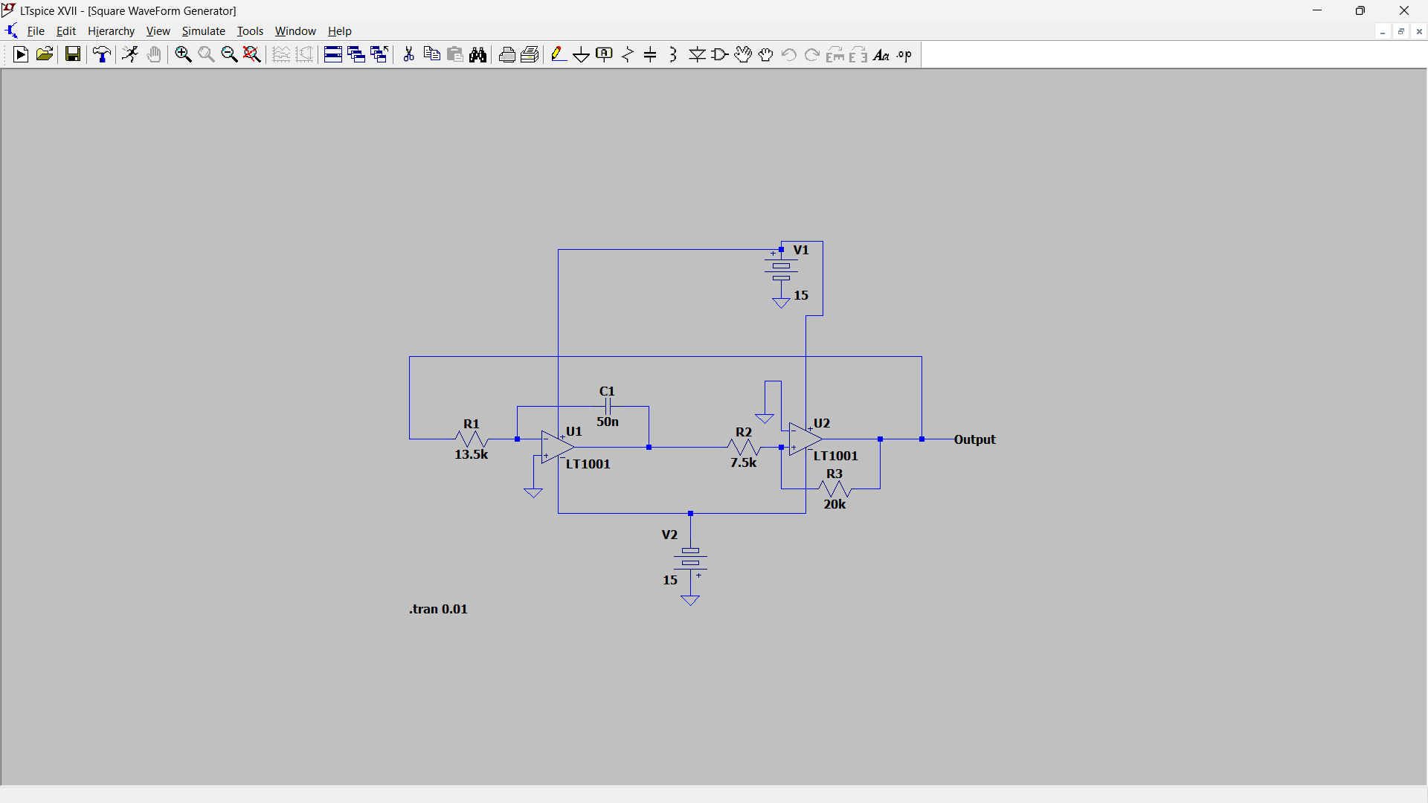
Circuit diagrams:
Triangular wave:
Sine wave:
Square wave:
Notes:
7. Frequency Fine-Tuning: Fine-tune the frequency by adjusting the values of resistors and capacitors in the phase shift network.
8. Testing and Simulation: Simulate the circuit using software tools or build a prototype on a breadboard for testing. Analyze the output waveform using an oscilloscope to ensure stable and accurate sine wave generation.
Applications:
A. Audio Signal Generation: Op-amp-based sine wave generators find applications in audio signal processing, where clean and precise sine waves are required for testing and analysis of audio equipment.
B. Frequency Standardization: Sine wave generators using op-amps are employed in frequency standardization systems, providing a stable reference frequency for various applications, including timekeeping devices.
C. Instrumentation and Testing: Instruments requiring calibrated and accurate sine wave signals, such as oscilloscopes and spectrum analyzers, often incorporate op-amp-based sine wave generators for testing and calibration purposes.
D. Signal Processing: Op-amp-based sine wave generators play a crucial role in signal processing applications, including modulation and demodulation processes, where sine waves are fundamental for carrying information.

Slide 8
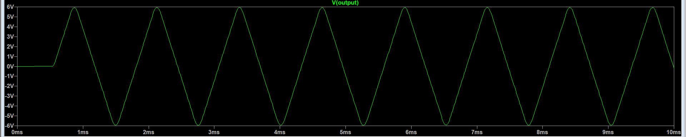
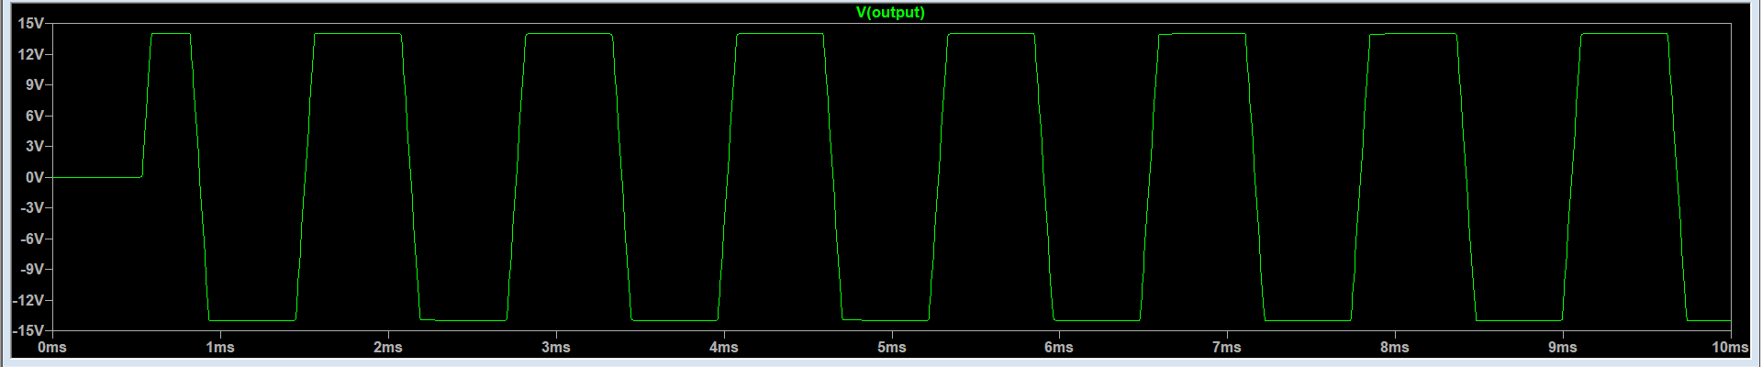
Results:
Triangular wave:
Square wave:

Slide 9
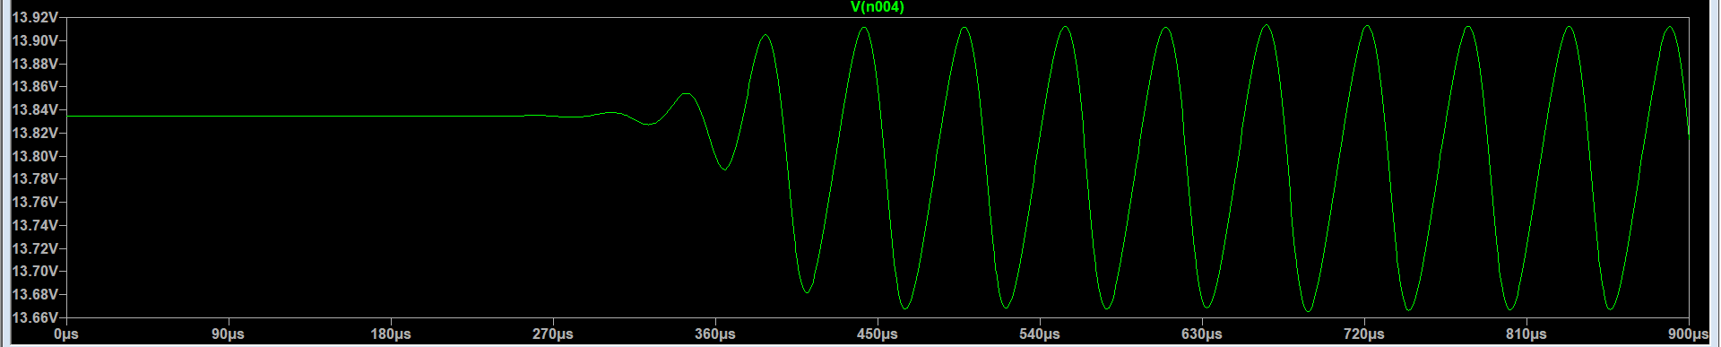
Sine wave:
References:
1.Youtube.com
2.io.wp.com
3.ee.cet.ac.in
4.groups.io
5.Analog.com
6.electronicsbd.com
------Thank You------

