Slide 1

Crop Yield Chatbot
AI-Powered Agriculture Insights
Presented by Arjit Sharma

Slide 2
Project Objective
• Provide intelligent crop insights
• Generate charts from agricultural data
• Answer queries using AI (Gemini)
• Accessible via web and Google Chat App

Slide 3
Key Features
• Gemini-powered agricultural insight engine
• NLP with spaCy for query understanding
• Auto chart generation using matplotlib
• Clean web UI and Can be a Google Chat App bot
• Cloud-ready (Google Cloud Run / GCP)

Slide 4
Technology Stack
Backend: Python + Flask
NLP: spaCy (en_core_web_sm)
AI Model: Gemini (Google Generative AI)
Charts: Matplotlib
UI: HTML + JavaScript
Hosting: Google Cloud Run
Optional: Telegram Bot API

Slide 5
Logical Flow
1. User inputs a crop-related question
2. spaCy processes and extracts keywords
3. Intent matched in chat_handler.py
4. Gemini returns a smart response
5. Matplotlib generates a chart
6. Flask sends both insight + chart to UI

Slide 6
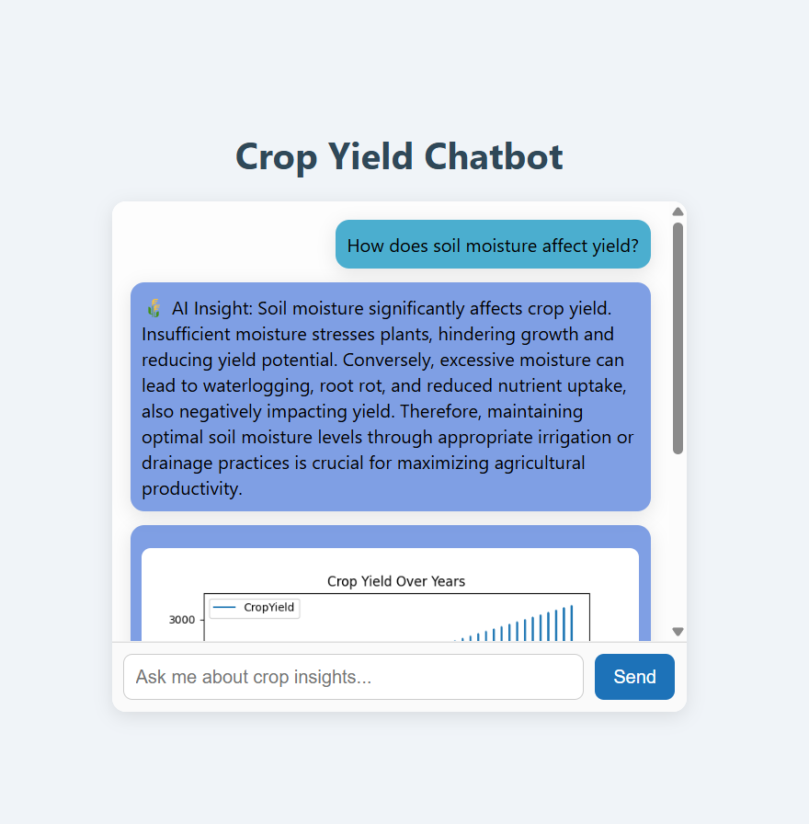
Final Output:

Slide 7
Example Interaction
User: Show yield trend for rice in Assam
Gemini Response: Insightful text on rice production
Chart: Line graph of yield over time
Frontend: Displays text + chart

Slide 8
Future Scope
• Upgrade CSV to Firebase or BigQuery
• Integrate with Google Chat App (Cloud Functions)
• Add speech-to-text support
• Mobile UI support & deployment

Slide 9
Conclusion
• AI-powered assistant for agriculture
• Supports visual + text insights
• Built on modern NLP & visualization stack
• Scalable, extensible, and cloud-ready

Slide 10
Thank You

