Slide 1

Improving Inventory Management and Customer Engagement for Big Basket
Presented by
Arjita Singh Kushwaha
21f3000507

Slide 2
Contents
01. About The Company
02. Problem Statement
A brief introduction of the organization.
An overview of the problems faced in the project.
03. Key Findings and Interpretation
04. Recommendations
05. Closing
Results and Key findings found after the data analysis.
Recommendations to the organization after analysis.
Thank You .
April 20, 2025

Slide 3
About The Company
Founded in 2011, headquartered in Bangalore.
Operates in 30+ cities across India.
Offers over 18,000 products across categories like fresh produce, dairy, staples, and personal care.
Works on an inventory-based model with its own warehouses and logistics.
Known for convenience, on-time delivery, and wide product variety.
April 20, 2025

Slide 4
Dataset Overview
Source: Kaggle.
Total Records: 62,141 rows
Key Columns:
Member: Unique customer ID
Order Number: Unique order number
SKU: Product identifier
Description: Name of the product ordered
Created On: Date of the order
Data Type Summary:
2 numerical columns (Order, SKU)
3 Categorical columns (Member, Description,Created On)scription)
April 20, 2025

Slide 5
Problem Statement
Inefficient Inventory Management:
Difficulty in anticipating product demand leads to stockouts or overstocking.
Lack of Personalized Recommendations:
Limited engagement due to absence of product suggestions tailored to customer behavior.
Repetitive Customer Purchase Patterns:
Customers often buy the same products, reducing the chance of product discovery.
Fluctuating Demand Patterns:
Sales vary across months, especially during festivals or seasonal periods, complicating inventory planning.
April 20, 2025

Slide 6
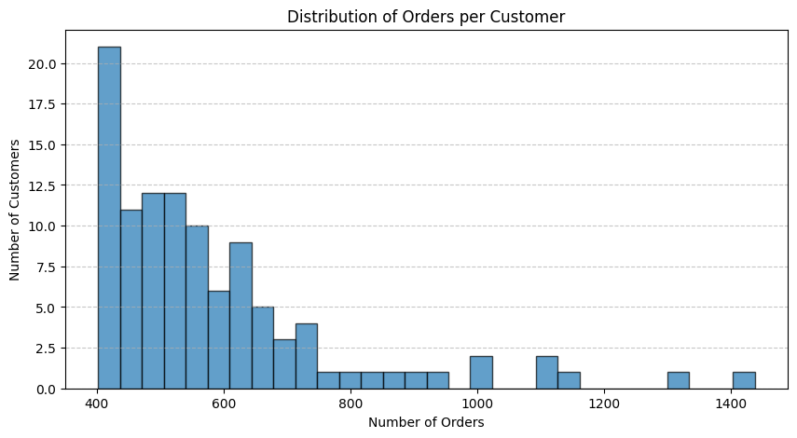
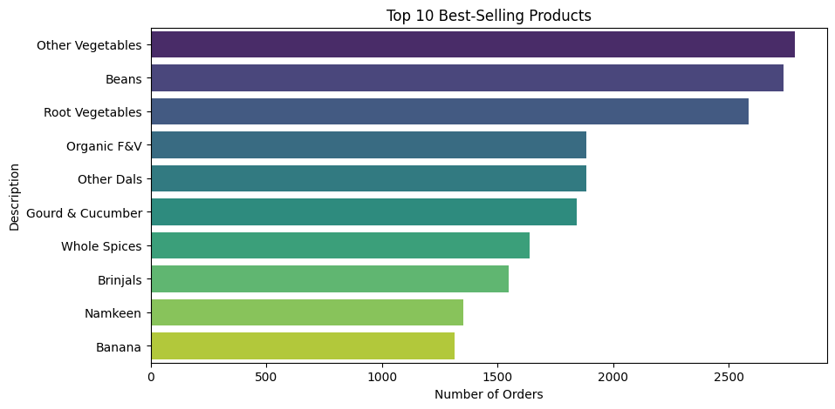
Key Findings
Figure 1: Distribution of Orders per Customer
Some customers placed frequent orders while there is also a substantial portion which had minimal engagement
Highlights scope for increasing repeat purchases.
Figure 2: Top 10 Most Ordered Products
‘Other Vegetables’, ‘Fruits’, and ‘Dairy Products’ dominate.
Suggests essential items drive frequent purchases.
April 20, 2025

Slide 7
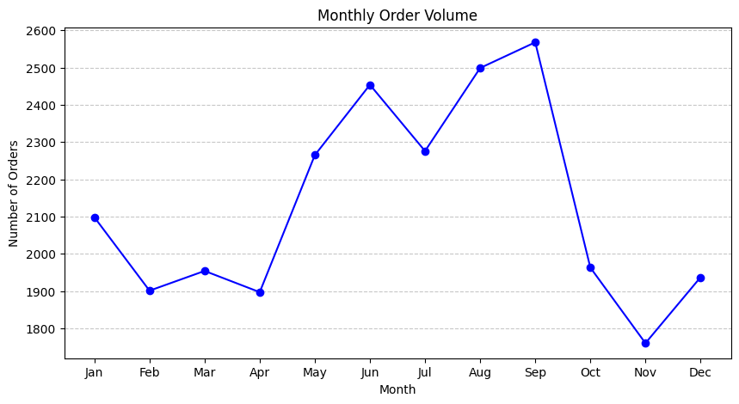
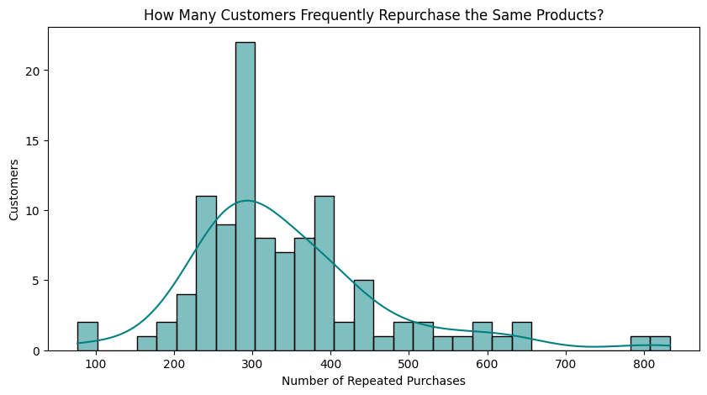
Key Findings
Figure 3: Monthly Order Trends
Peak sales in September, lowest in November.
Indicates seasonal buying behavior and festival impact.
Figure 4: Repeat Purchase Trends
Majority of customers repeat purchases between 300–500 times.
A smaller but significant group exceeds 1000 repeat purchases.
The distribution is right-skewed, indicating a loyal customer base.
April 20, 2025

Slide 8
Interpretation of Results
Customers mostly place limited repeat orders — engagement is low.
Demand peaks in festive months (e.g., September) — opportunity for seasonal promotions.
High volume of essential items ordered — consistent demand for staples.
A large number of repeat purchases suggests high customer retention.

Slide 9
Recommendations
1. Inventory Planning
Align stock levels with high-demand months (e.g., festive seasons like September).
Ensure buffer stock for top-selling products (e.g., vegetables, fruits, dairy).
2. Personalized Marketing
Leverage customer repeat purchase data to recommend related or new products.
Use purchase frequency to build loyalty reward programs.
3. Improve Product Discovery
Highlight frequently bought-together items.
Feature lesser-known but similar products to drive cross-selling.
4. Demand Forecasting
Use monthly trends and seasonal behavior to forecast demand accurately.
Adjust procurement and delivery schedules accordingly.
5. Customer Segmentation
Segment customers by purchase frequency to deliver targeted campaigns.
Offer incentives to low-engagement customers to boost retention.
April 20, 2025

Slide 10

Thank you
Thank you for your time and thank you for all the support throughout the project.
Arjita Singh Kushwaha
21f3000507
10

