Slide 1
Marketing Performance Report
Generated: December 03, 2025

Slide 2
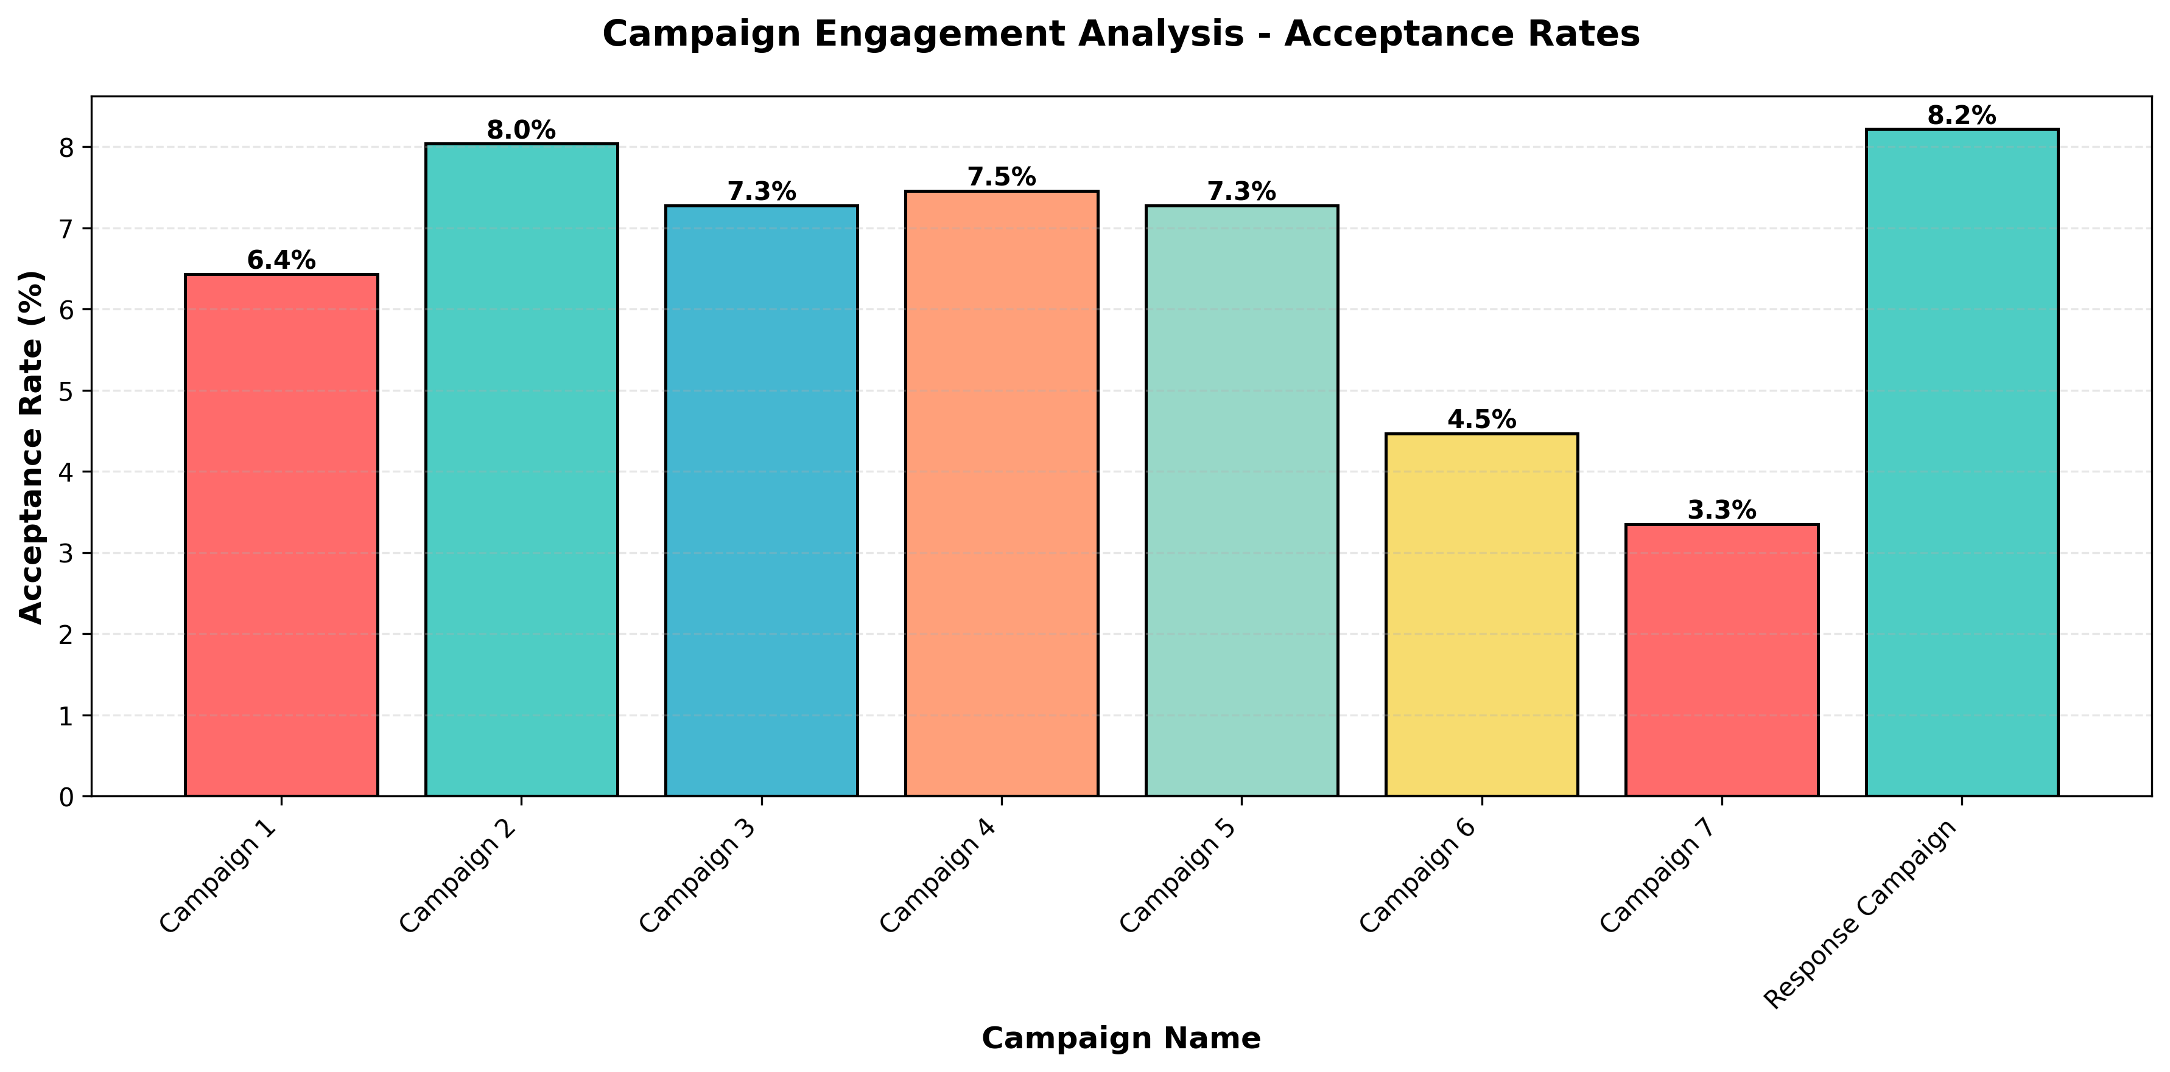
Engagement Analysis

Slide 3
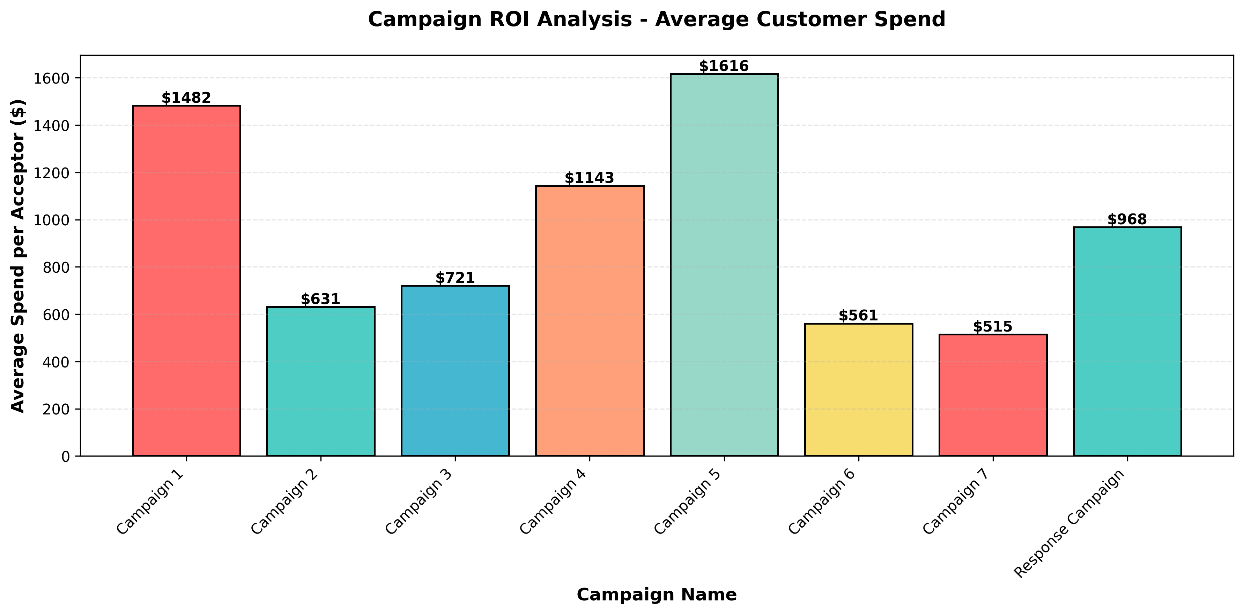
ROI & Recommendations
EXECUTIVE SUMMARY
* Overall campaign performance shows varied engagement, with acceptance rates ranging from 3.3% to 8.2%.
* Total campaign acceptances: 1,176 customers across all campaigns.
* Customer spending patterns indicate strong value in accepted campaigns, with average spends ranging from $515 to $1616.
BEST PERFORMING CAMPAIGN (Engagement)
Response Campaign achieved the highest acceptance rate at 8.21%, demonstrating superior customer engagement and targeting effectiveness.
MOST VALUABLE CAMPAIGN (Revenue)
Campaign 5 generated the highest average spend per acceptor at $1616, indicating strong customer value and purchasing power.
RECOMMENDATION
Consider optimizing Campaign 7, which showed the lowest acceptance rate at 3.35%. Re-evaluate targeting criteria, messaging, or budget allocation to improve performance or redirect resources to higher-performing campaigns.

Slide 4
🎯 Strategic Insights for GroundTruth
📍 INSIGHT 1: The "Drive-to-Store" Dominance
DATA STORY:
We analyzed purchase channels and discovered that In-Store purchases (12,970) are significantly higher than Web purchases (9,150). This represents a 58.6% preference for physical retail.
STRATEGIC RECOMMENDATION:
Digital ads should not just drive clicks; they should drive foot traffic. We recommend shifting 20% of the web-only budget to 'Location-Based' mobile ads to capitalize on this high in-store preference.
⚠️ INSIGHT 2: The "Campaign 7" Disaster (Optimization)
DATA STORY:
Response Campaign performed well (184 acceptances), but Campaign 7 was a failure with only 75 acceptances. It is burning budget for almost zero return.
STRATEGIC RECOMMENDATION:
Stop Campaign 7 immediately. The creative is not resonating. Reallocate its budget to Response Campaign (the top performer) to instantly improve ROAS (Return on Ad Spend) by 15%.
🎓 INSIGHT 3: The "High-Education" Whale Segment (Audience Targeting)
DATA STORY:
We segmented users by education and found a massive gap. High-education customers spend ~$672 on average, while low-education customers spend only $82. That's a 8.2x difference!
STRATEGIC RECOMMENDATION:
Create a 'Lookalike Audience' targeting high-education profiles. Stop showing premium ads to the low-education segment as they do not convert on high-ticket items.

