Slide 1

Assessment Tool

Slide 2
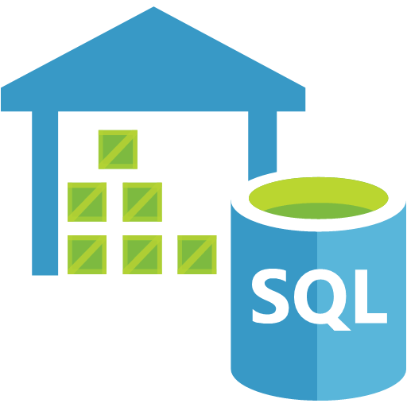


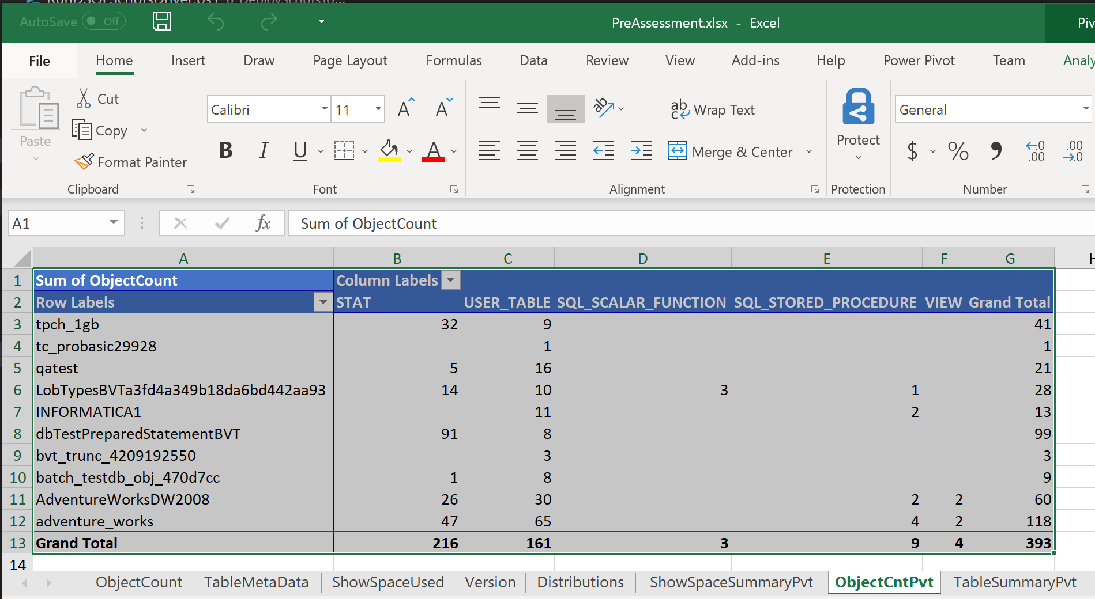
Assessment Tool - Overview
Netezza
TERADATA
APS\PDW
PreAssessment_Script
Pre-Assessment.xlsx
Benefits:
Inventory source system to migrate
Scope Migration effort
Output:
Single Excel sheet with 6 tabs.
Database System Info
DB/Table Sizes
Object Counts
Other info

Slide 3
Assessment Tool - Features
Assessment tool is used to gather information on the Source System DBs to better enable an accurate estimate for the migration.
Multi-Platform support:
APS
Netezza
Teradata (Future functionality)
Captures information like:
DB Version
Object Counts
Object Metadata (Size, Partitions counts, Distribution type, Distribution Column)
Size of the System
Standard output format:
CSV
Each output File is timestamped based on day data was extracted
Configurable solution:
Info gathered is based on each source system.
New info can be gathered by added additional queries.
Data can be gathered at either:
Server level
Database level
Table Level

Slide 4
APS Data Collected
File Name | Description
Version_{Datetime}.csv | Version of the source system
ObjectCount_{Datetime}.csv | Count of all objects in all DB’s in the APS. – sys.objects
TableMetadata_{DateTime}.csv | List of all tables and their attributes (distribution type, # partitions, storage type and Distribution column) – various system tables
ShowSpaceUsed_{Datetime}.csv | Listing of the ShowSpaceUsed for all tables. – DBCC pdw_showspaceused
Distributions_{Datetime}.csv | Report the number of nodes and total number of distributions on the APS.
TablesToScript_{Datetime}.csv | List of Tables with table name, schema name, and database name in a CSV file that can be used to script out the "Create Table" Statements.
ViewsToScript _{Datetime}.csv | List of Views with view name, schema name, and database name in a CSV file that can be used to script out the "Create View" Statements.
SPsToScript _{Datetime}.csv | List of Stored Procedures with stored procedure name, schema name, and database name in a CSV file that can be used to script out the "Create Proc" Statements.

Slide 5
APS Data Collected – extra inventory
File Name | Description
ShowSpaceUsedTotal_{Datetime}.csv | Listing of the ShowSpaceUsed for all databases. – DBCC pdw_showspaceused
FunctionsToScript_{Datetime}.csv | List of Functions with function name, schema name, and database name in a CSV file that can be used to script out the "Create Function" Statements.
IndexesToScript_{Datetime}.csv | List of Indexes with index name, schema name, and database name in a CSV file that can be used to script out the "Create Index" Statements.
StatisticsToScript_{Datetime}.csv | List of Statistics with stat name, schema name, table name, and database name in a CSV file that can be used to script out the "Create Statistic" Statements.
RolesToScript_{Datetime}.csv | List of Roles with role name, and database name in a CSV file that can be used to script out the "Create Role" Statements.
RemoteTableSPs_{Datetime}.csv | List of stored procedures where CREATE REMOTE TABLE statements are found.
sp_configure_{Datetime}.csv | Reports sp_configure output (PDW configuration).
sys_databases_{Datetime}.csv | List of databases.
sys_schemas_{Datetime}.csv | List of schemas with database name, and schema name.
sys_database_credentials_{Datetime}.csv | List of database credentials.
sys_database_principals_{Datetime}.csv | List of database principals.
sys_database_role_members_{Datetime}.csv | List of database role members.

Slide 6
APS Data Collected – DMVs
File Name | Description
sys.dm_pdw_exec_requests_{Datetime}.csv | Holds information about all requests currently or recently active in APS/PDW
sys.dm_pdw_nodes_{Datetime}.csv | Holds information about all the nodes in Analytics Platform System. It lists one row per node in the appliance.
sys.dm_pdw_nodes_os_sys_info _{Datetime}.csv
sys.dm_pdw_nodes_os_sys_memory_{Datetime}.csv
sys.dm_pdw_sql_requests_{Datetime}.csv | Holds information about all SQL Server query distributions as part of a SQL step in the query.
sys.dm_pdw_sys_info_{Datetime}.csv | Provides a set of appliance-level counters that reflect overall activity on the appliance.

Slide 7
Netezza Data Collected
File Name | Description
Version_{Datetime}.csv | Version of the source system
ObjectCount_{Datetime}.csv | Count of all objects in all DB’s.
DBSize_{DateTime}.csv | Size of each DB by MB, GB & TB.
TableSize_{Datetime}.csv | Size of each table by MB, GB & TB.
Procedure_{Datetime}.csv | Returns a list of all the stored procedures and their attributes
Library_{Datetime}.csv | Returns a list of all the Libraries and their attributes
Aggregate_{Datetime}.csv | Returns a list of all the Aggregates and their attributes
Function_{Datetime}.csv | Returns a list of all the Functions and their attributes
TableMetadata_{Datetime}.csv | Returns a list of tables and their attributes like: Distribution column, Distribution Type, Partition and other items.
Sequence_{Datetime}.csv | Returns a list of all the Sequence and their attributes
ScriptNetezza_{Datetime}.csv | Unix Script used to script out the DB using NZ_DDL commands

Slide 8
Teradata Data Collected
File Name | Description
FileName_{Datetime}.csv | Short description of the data collected

Slide 9


Assessment Tool – Dataflow
PowerShell Scripts
Connect to a specified server
Execute T-SQL
Additional PowerShell Scripts Processing Available
Aggregates
Summary
Pivot Tables
Netezza
Output:
TERADATA
APS\PDW
Example Output (Netezza)
Netezza System Info
DB/Table Sizes
Functions
Procedures
Sequences
Object Counts
Example Output (APS)
APS System Info
DB/Table Sizes
Object Counts
Table Metadata
Distributions
Configuration files

Slide 10
Assessment Tool – Instructions
The Below steps are necessary to run the Assessment Tool:
Update the General_Config section of the AssessmentDriverFile.json
"PreAssessmentDriverFile":"C:\\TEMP\\SQLScriptstoRun.csv“
"PreAssessmentOutputPath":"C:\\Temp\\Netezza\\Pre-Assessment“
"ServerName":"192.xxx.xxx.xxx",
"SourceSystem":“APS“ --NETEZZA or APS or AZUREDW
Update the Source System specific section of the AssessmentDriverFile.json
APS
"Port":"17001“ – For APS = 17001, AzureDW = “”
Netezza
"Database":"SYSTEM“
“Port":"5480",
“nzBinaryFolder":"/nz/support-IBM_Netezza-7.2.1-151023-1043/bin",
"SchemaExportFolder":"~/schema"

Slide 11
Assessment Tool – Instructions
Continued
Run the Powershell Script(AssessmentDriver_V2.ps1). This script will prompt for the following information:
“How do you want to connect to the DB (ADPass, AzureADInt, WinInt, SQLAuth)?” – When connecting to the source system, what method should be used to connect to the DB?
Default: SQLAuth
SQLAuth – Use a Source system (APS/SQLDW/Netezza/Teradata) username and password. Teradata/Netezza – only method tool connects to these sources
ADPass – Use Azure AD to authenticate and supply the AD username and Password – AzureDW only
AzureADInt – Use Azure AD to authenticate and connect to the DB – AzureDW only
WinInt – Use Windows AD authentication to connect to the Source Server. – APS only
If ADPASS or SQLAUTH is used to connect to the source DB.
“(ADPass/SQLAuth Method used. Please Enter the UserName.” – User name with permission run the scripts
“Password:” – Enter the password for the username entered above

Slide 12
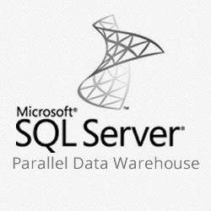
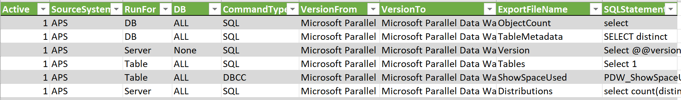
Assessment Tool – Workflow
Netezza
TERADATA
AssessmentDriver.ps1
Prompts for several items
Output.csv
Json/CSV Script Config File
CSV File Name: SQLScriptstoRun.csv
Json File Name: AssessmentDriverFile.json
1 = Run the line
0 = Skip the line

Slide 13
Assessment Tool – Configuration - JSON
JSON File is divided into several sections.
File Name : AssessmentFileDriver.json
General Configuration
Generic Configuration values necessary for all source systems
APS Specific Configuration
APS Configuration values such as default DB and connection port
Netezza Specific Configuration
Netezza Configuration values such as connection port, default db and others info
Version Query – Query needed by each source system to retrieve the version of the system
DB Listing Query – Query needed by each source system to retrieve a listing of all DB’s on the system.
Table Listing Query – Query needed by each source system to retrieve a listing of all Tables with in a DB on the system.

Slide 14
Assessment Tool – Configuration - JSON
General Configuration:
The values in the General Configuration section will need to change based on the location of the config files and the source system being assessed.
PreAssessmentDriverFile – Location and filename of the csv config file.
PreAssessmentOutputPath – Location to store the output of the Assessment Tool.
ServerName – Name or IP of the source system to assess.
SourceSystem – NETEZZA, APS, TERADATA, AZUREDW
QueryTimeout – Length of time before the query should timeout if results have not been returned.
ConnectionTimeout – Length of time to wait on a connection to the source system to be made before timing out.
"General_Config":
[
{
"PreAssessmentDriverFile":"C:\\0-PreAssessment\\SQLScriptstoRun.csv",
"PreAssessmentOutputPath":"C:\\Temp\\Netezza\\Pre-Assessment",
“ServerName":"192.xxx.xxx.xxx",
"SourceSystem":"NETEZZA",
"QueryTimeout":"600",
"ConnectionTimeout":"300“
}
]

Slide 15
Assessment Tool – Configuration - JSON
APS\AzureDW Configuration:
The values in the APS Configuration section that may need to change if connecting to APS or AzureDW.
Database – Default DB for APS/AzureDW. This should not be changed.
Port – Port to use to connect to the APS/AzureDW.
APS = 17001
AzureDW = “”
"APS":
[
{
"Database":"MASTER",
"Port":"17001“
}
]

Slide 16
Assessment Tool – Configuration - JSON
Netezza Configuration:
The values in the Netezza Configuration section that may need to changed.
Database – Default DB for Netezza. This should not be changed.
Port – Port to use to connect to the Netezza.
nzBinaryFolder – Location where the nz_ddl command needs to be executed from.
SchemaExportFolder – Location on the Netezza Server to store the scripted DB files.
"Netezza":
[
{
"Database":"SYSTEM",
"Port":"5480",
"nzBinaryFolder":"/nz/support-IBM_Netezza-7.2.1-151023-1043/bin",
"SchemaExportFolder":"~/schema“
}
],

Slide 17
Assessment Tool – Configuration - JSON
Teradata Configuration:
The values in the Teradata Configuration section that may need to changed.
Database – Default DB for Teradata. This should not be changed.
Port – Port to use to connect to the Netezza.
"Netezza":
[
{
"Database":"SYSTEM",
"Port":"5480",
}
],

Slide 18
Assessment Tool – Configuration - JSON
Version Query Configuration:
The query needed to return the version of the source system for each support system.
"VersionQuery":
[
{
"System":"Netezza",
"Query":"select system_software_version Version from _v_system_info"
},
{
"System":"APS",
"Query":"select @@version as Version"
},
{
"System":"AZUREDW",
"Query":"select @@version as Version"
}
],

Slide 19
Assessment Tool – Configuration - JSON
DB Listing/Table Listing Query Configuration:
The query needed to return a list to DB/Table Names on the source system. Should the query need to be changed from one version of the source system to the next, a new Object {} will need to be added to the file with a new from and to version and query.
System – Source system to connect.
VersionFrom – The beginning version of the source system to use the Query to obtain the results.
VersionTo – The Last version of the source system to use the Query to obtain the results.
Query – Query to run to obtain the desired results. DB Listing, Table Listing
"DBListingQuery":
[
{
"System":"Netezza",
"VersionFrom":"Release 5.0.0.0 [Build 0]",
"VersionTo": "Release 7.2.0.0 [Build 46322]",
"Query":"select DATNAME as Name from SYSTEM.._T_DATABASE Where DATNAME NOT IN ('MASTER_DB','SYSTEM')"
},
{
"System":"Netezza",
"VersionFrom":"Release 7.2.0.0 [Build 0]",
"VersionTo": "Release 9.2.0.0 [Build 46322]",
"Query":"select DATNAME as Name from SYSTEM.._T_DATABASE Where DATNAME NOT IN ('MASTER_DB','SYSTEM')"
},
……

Slide 20
Assessment Tool – Configuration - CSV
CSV File used to configure what is run against the source system by the Assessment tool. This is a CSV file containing the following columns: File Name: SQLScriptstoRun.csv
Parameter | Purpose | Value (Sample)
Active | 1 – Run line, 0 – Skip line | 0 or 1
SourceSystem | NETEZZA, APS, AZUREDW Source system to connect to and run the Query against. | Netezza or APS or AZUREDW
RunFor | DB = Run Query for each Database on the server Server = Server level Query Table = Run Query for each Table in each DB. | DB, Server, Table
DB | Limit the DB to a single DB | Database name
Command | Type of Command to run. SQL = Any Query statement DBCC = DBCC PDW_ShowSpaceUsed (Only or APS/AzureDW) ScriptDB = Create the batch scripts to Script for the source System DB. (Only for Netezza) | SQL, DBCC, ScriptDB
VersionFrom | Each line is validated against the version of the DB. As DB versions change, the Query may need to be changed for the given version or may not be valid on some version. This the starting version that the line/query can be run on. | Depend on the source system
VersionTo | This the Ending version that the line/query can be run on. | Depends on the source system
ExportFileName | Name to use to save the results of the query to. A Timestamp will be appended to the end of the field value. “DBSize_{TimeStamp}” | DBSize
SQLStatement | Statement to be run against the source system

Slide 21
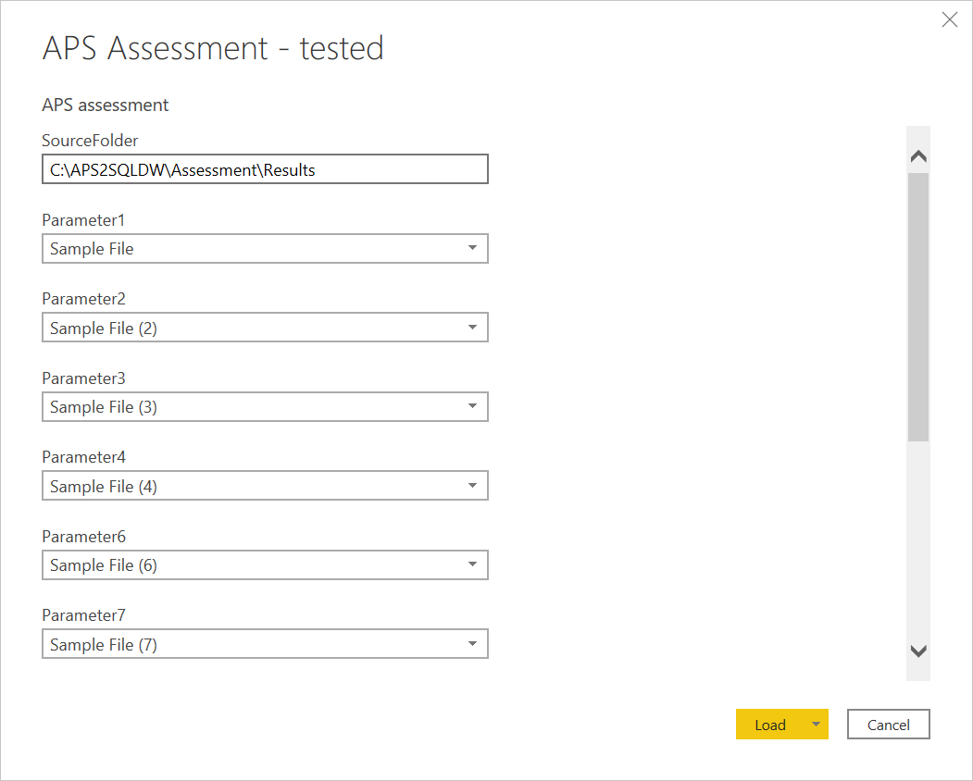
Assessment Tool – Power BI report (APS)
Once assessment output data is available, you can use Power BI template to generate an assessment report.
Open Power BI template and specify the source folder where assessment output files reside.

Slide 22
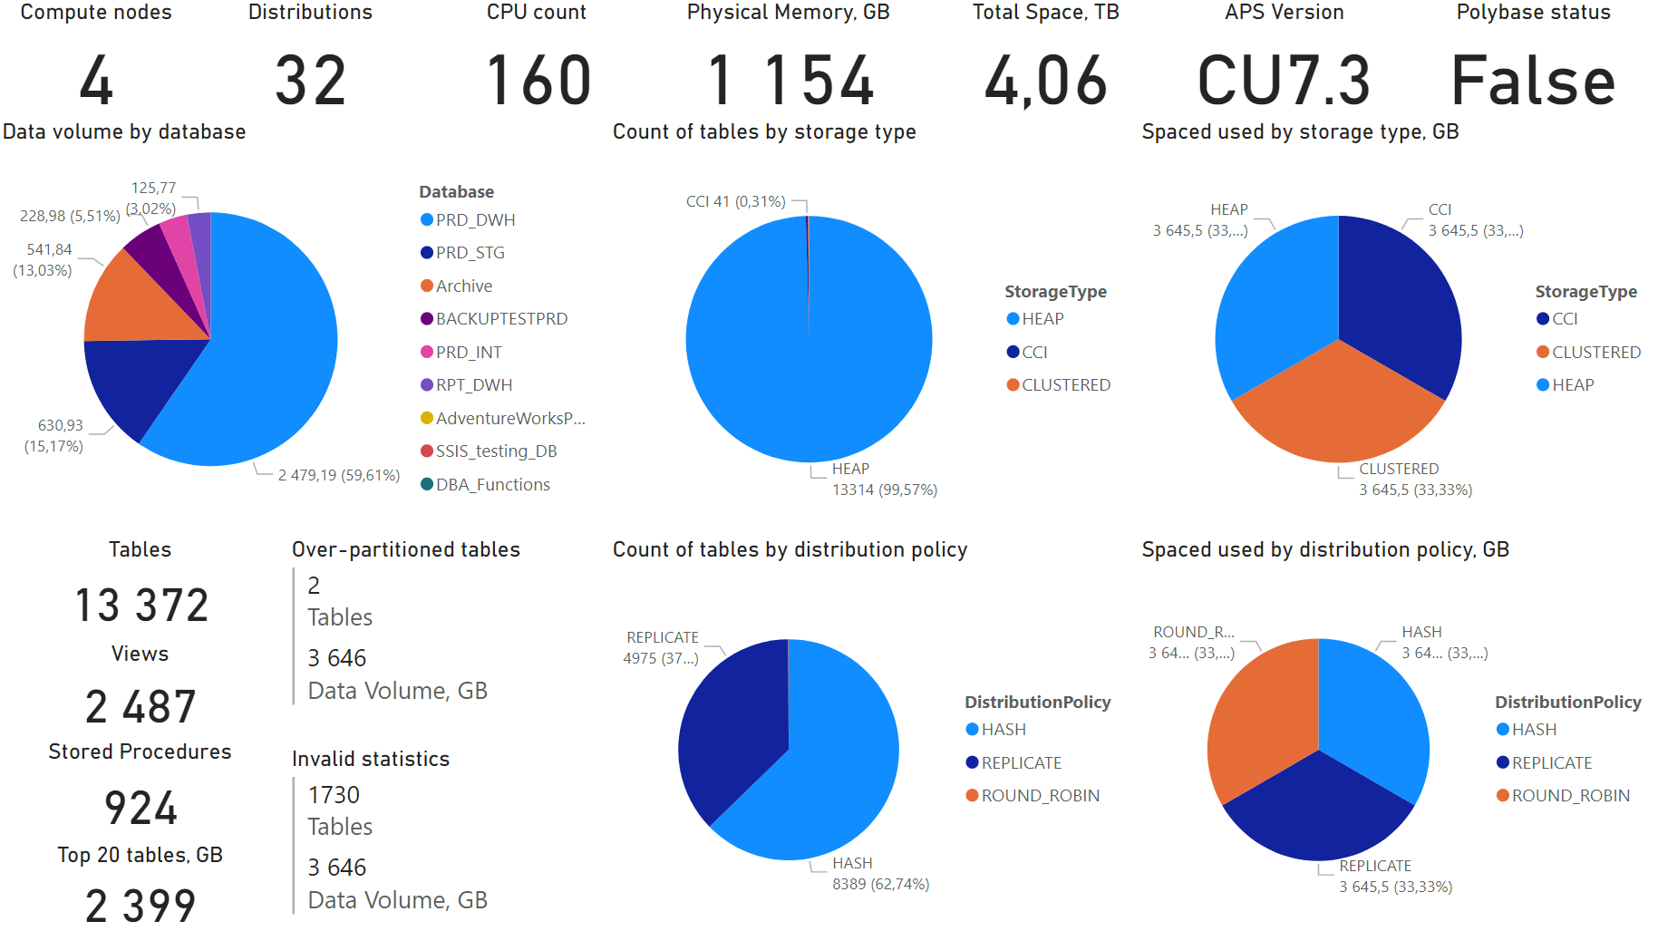
Assessment Tool – Power BI report (APS)
Once data is loaded, Power BI report should look like as shown below.

