Slide 1
APS to Azure SQL DW (ADW) Migration Considerations
July 2019

Slide 2
Outlines
Benefits of Migrating to Azure SQLDW
APS vs. Azure SQL DW (Comparison)
Migration Roadmap
Sample Migration Architectures
Migration Process, and Tools

Slide 3
Benefits of Migrating to Azure SQL DW

Slide 4
APS to SQLDW Migration General Benefits
General Benefit Summary
Business Benefits:
Support Business Agility: Azure platforms have advanced and growing capabilities ready to use. Company is relieved from infrastructure planning and management which costs money and time. With Azure platforms and Azure SQLDW, company can focus on providing expediated business solutions.
Advanced Security Features (Built-In): SQLDW firewall rules, Transparent Data Encryption, Row level Security, Column Level Security.
Speed to Market: Azure Platforms with growing capabilities support the needs to deploy solutions quickly. In addition, Azure platform has built-in security features that meet foundational and common regulatory and compliance requirements.
Cost Predictability: Pay as you go model. Many options. Published usage prices. Possible discount for large volume consumption customers.
Cost Efficiency: Scale up or down in a matter of minutes. When Azure SQLDW is paused, customer will not pay for the compute resources.
Technology Simplification: Eliminate the responsibilities associated with owing APS such maintain/upgrade hardware and software.
Technical and Internal Benefits:
Better Skillset Availability: APS knowledge is scarce. Azure SQL DW and Azure Platforms are supported by very large number of developers/practitioners worldwide.
PaaS model: Eliminate the responsibilities to upgrade and maintain hardware, software, or back up data.
Instant Scalability: Azure SQLDW can be scaled up or down in minutes.

Slide 5
Example Azure SQLDW Business Benefits
Key Points
Faster time to market with new services that requires capital expenditure and new hardware
No infrastructure to stand up
For cloud born data, easily to process in Azure platforms, and utilize ML and Advanced Analytics to produce new business insights/reports.
Cross region / country reporting
Data from multiple countries/regions can be integrated into one data set, in one place, to allow the global business to produce cross region/country reports.
Reduction of IT cost (example: for backups, storage)
Single Azure Platform and Database for all countries, eliminate the cost of multiple infrastructure and systems.
Secured data repositories in Azure Blob Storage
Flexibility of storing data for specified length of time or indefinitely to support new/additional business requirements
Lower cost

Slide 6
APS vs.
Azure SQL DW (ADW)

Slide 7
APS vs. ADW
Category | Sub-category | APS | Azure Data Warehouse | Comment
Architecture | Topology | Server as an instance. Cross database queries allowed with 3-part names. | Database as an instance. Cross database queries are not supported. | ADW is a single database supporting multiple schemas to manage security and support queries.
 | Scale up/down | Scale up by adding unit (takes months to acquire hardware and days to expand data) Scaling down is not an option. | Quickly scale up for more or scale down for less compute. Scaling up for ETL and then scaling down for queries is a common cost saving pattern. | Compute and storage are separate in ADW, no need to purchase more scale when your dataset grows, storage grows automatically.
 | Tables | Hash Round Robin Replicated (default) | Hash Round Robin (Default) Replicated | Replicated tables incur NO increase in storage or storage costs on ADW.
 | Index | Heap (default) CCI CI | Heap CCI (default) CI | CCI offers unlimited storage and takes advantage of Adaptive Caching for improved query performance on ADW
 | Workload Management (WLM) | Dynamic resource classes | Dynamic resource classes Static resource classes Workload classification with importance | ADW offers more features to control your resource usage when needed
Notes:
I tried to spin all these in a little more positive light. And eliminate any sense of complexity.
Scale up/down comment : Compute and storage are separate, no need to purchase more scale when your dataset grows when using ADW, storage grows automatically. Move the existing comment into the SQLDW cell.
Eliminate the word complex whenever you see it – Change REPLICATE comment to highlight its benefits. This description points out that the work behind the scenes is complex, one of the BIG issues with ADW. On slide 7 ne one needs to know how anything really works yet – I have a great slide that animates exactly how replicated tables work now ☺
Replicated tables incur NO increase in storage and ADW.
Index comment – lets not put in this advice as it is a little questionable and will definitely go away when Ordered CCI becomes available. How about a big positive that will guide them to the default (defaults are less complex)
CCI offers unlimited storage and takes advantage of Adaptive Caching for improved query performance

Slide 8
APS vs. ADW
Category | Sub-category | APS | Azure Data Warehouse | Comment
Security |  | TDE Firewall | TDE (BYOK with Azure Key Vault integration) Firewall Auditing VNet Isolation Row Level Security Column Level Security
Performance | Benchmark | No published benchmark exists | SQL DW is leading in price-performance with various benchmarks against competitors published by independent companies
Connection | Port | 17001 | 1433, (default SQL Server Port) | No need to specify port in ADW connections
Language Surface | T-SQL | SQLDW - n | ADW supports more T-SQL statements than APS such as; · GROUP BY ROLLUP · TRIM · TRANSLATE · FORMAT · DROP object IF EXISTS | This is not an exhaustive list. ADW T-SQL language area is much more advanced than what APS supports today.
Tools | Client tools | SSDT | SSMS, SSDT (with support for database projects), Azure Data Studio, Azure DevOps

Slide 9
APS vs. ADW
Category | Sub-category | APS | Azure Data Warehouse | Comment
Loading | PolyBase | APS can read and load data from Hadoop (HDP and CDH) and v1 Blob Storage | ADW can read from blob storage and Azure Data Lake | Polybase is the fastest loading method and supports many file formats and file compression
 | Command line loader | DWLoader, BCP | BCP | BCP is used for loading max types on both
 | SSIS | APS specific destination adapter | Azure Feature Pack optimized for ADW. Packages can be hosted in Azure Data Factory (ADF) SSIS-IR
 | Orchestration | SQL Agent or other tools outside of APS | Azure Data Factory (ADF,) PaaS Job Service, Azure Functions

Slide 10
APS vs. ADW
Category | Sub-category | APS | Azure Data Warehouse | Comment
BCDR | Data | 2 copies in raid 1 pair disks | 3 copies of data in blob storage (active) 3 copies of data in blob storage (passive) 3 copies of data in secondary region (passive) | ADW runs on Azure Premium Storage with all the High Availability and data availability features of Azure Storage
 | Backup | User/DBA initiated | Automatic storage snapshots (restore points) User Created restore points | ADW backups take seconds and do not disrupt user activities.
 | Geo redundant backup | User's responsibility | Automatic, 1 per day | On by default in ADW and must opt out of it if not needed.
 | Backup retention | Unlimited | 7 days | Longer retention by request.

Slide 11
Migration Roadmap

Slide 12
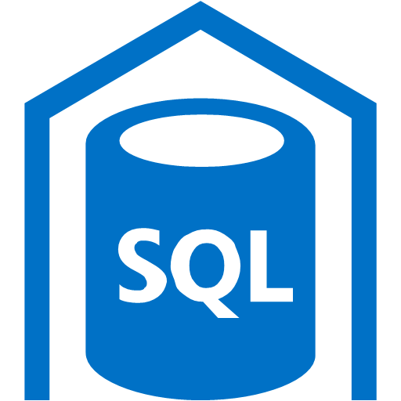
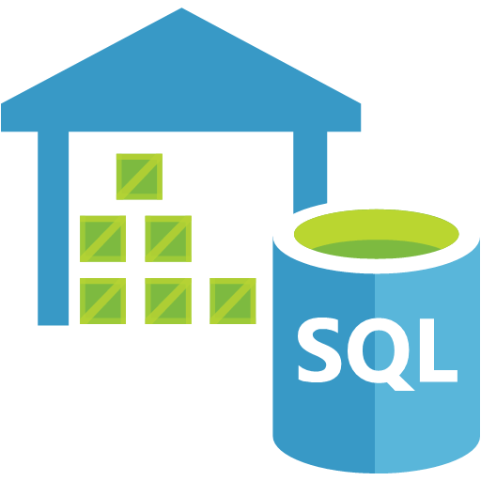
APS to Azure SQLDW Migration Roadmap
Phase 1: Assessment, Decision, Architecture, and POC
Migration Business Drivers
Product Fit,
Azure SQLDW Benefits
APS Assessment
Modern DW Architecture
POC
(Optional)
Scripts
Available
APS
Phase 2: Detailed Design and Implementation
Project
Planning
APS To Azure SQLDW Migration
Operational
Azure
SQLDW
APS
Automated Code and Data Migration Framework

Slide 13
APS to Azure SQLDW Migration Roadmap
Migration Business Drivers
Product Fit,
Azure SQLDW Benefits
Example Business Drivers
Business Transformation program
Growing business
Growing data volumes
Moving to cloud
Technology simplification
Needs for data aggregations
APS retirement
Product Fit Analysis
APS environments, source data, usage patterns
ETL/ELT processes
Data Flows
Technical architecture options
Azure SQLDW capabilities and Benefits

Slide 14
APS to Azure SQLDW Migration Roadmap
APS Assessment
Modern DW Architecture
POC
(Optional)
Scripts
Available
APS
Goals of APS Assessment (1-day)
Discovery of customer business needs, environment and technical requirements
Deep-dive into customer objectives and use case scenarios
Deep-dive into APS implementation so that scope and complexity of migration can be identified
Provide guidance on possible high-level solution approaches that meets business needs
Modern DW Architecture
Data sources Identified
ETL / ETL / Data Ingestion Process
Azure SQLDW logical architecture
Downstream Systems
Users & Usage Patterns
POC (Optional)
Prove out proposed architecture
Clear out any technical roadblocks
Build foundations for production migration

Slide 15
APS to Azure SQLDW Migration Roadmap
Project
Planning
Project Planning
Secure Executive Sponsorship
Estimate Effort and Cost
Develop Project Plan
Secure Resources

Slide 16
APS to Azure SQLDW Migration Roadmap
One Time Meta Data and Data Migration
DDL (Table Definitions)
DML/Code (Views and Stored Procedures)
Data
Security
Ongoing Data Ingestion
Source Data to Azure Blob Storage / Data Lake Store
Azure Blob Storage / Data Lake Store to Azure SQLDW
Azure SQLDW to Downstream Systems such as Power BI
APS To Azure SQLDW Migration
Azure
SQLDW
Operational
APS
Automated Code and Data Migration Framework
Migration Complete
Azure SQLDW operational
APS Retired or repurposed

Slide 17
Sample Migration Architectures

Slide 18

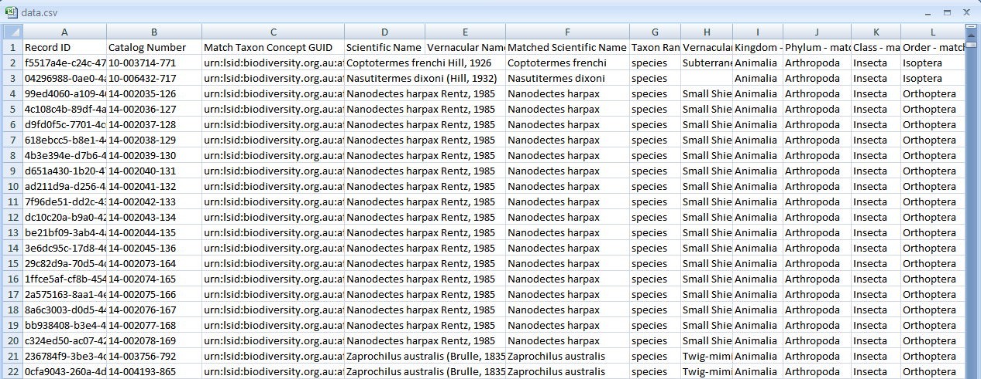


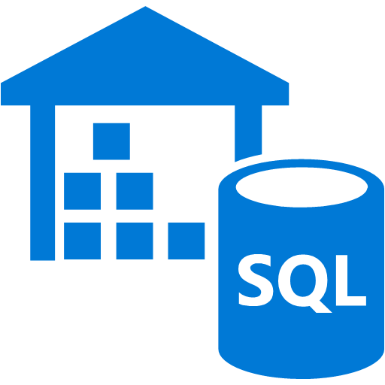

Initial Data Load From APS to Azure SQLDW
Sample
Bridge Server (Windows Server)
Has connection to Internet and APS(s)
Has Microsoft SQL Server Data Tools Installed (Visual Studio Data Tools)
Migration Tools installed
Azure
APS has no Internet Connection. A bridge to Internet is needed.
Options:
AZCopy
ADF
Data Box
Azure Blob Storage
SSRS
BCP
Exported APS
Data Files
Polybase
Reports
APS Data
(in Files)
SQL Cube
MS Tools
Tools
MSTools
Meta Data
Installation Scripts
Other
Data Stores
Manual
APS Meta Data
Azure SQLDW
Meta Data
Azure SQL Data Warehouse
APS
(Not Connected to Internet)
Bridge Server
(Windows Server, Connected to Internet)
Site to Site VPN
Site to Site VPN

Slide 19










Initial Data Load From APS to Azure SQLDW
Sample
Polybase needs to be enabled in APS.
APS needs internet access (via Express Route) to reach out to Azure Blob Storage.
Polybase process and data transfer to blob storage will run in the background while APS is in operation, minimising disruption to the business.
Azure
Infiniband Switch
Ethernet Switch
Orchestration Host
Polybase
Passive Host
Azure Blob Storage
Server X or empty slot
Server Y
Staging DB
One-Off Load into Staging / Data Warehouse / Data Mart schemas
Polybase
Move to Azure?
Server Z
SQL Stored Proc
On-Prem
System?
3a
Back Up Server
VM
Data Warehouse
STAGING
DATA WAREHOUSE
DATA MART
3b
SQL Stored Proc
STORED PROCEDURES
And VIEWS
Data Mart
APS (Qtr Rack)
Analytics Platform System
Azure SQL Data Warehouse
(One Single DB with Unique Staging / Data Warehouse / Data Mart Schemas)
Express Route
Express Route

Slide 20

On-Going Data Ingestion Mechanism (Sample)
Sample
Azure
System to Deliver all Files to File Server
File Server
Data extracts generated by BODS
Polybase
Gateway
Azure Blob Storage
Azure Data Factory V2
Azure
On-going data ingestion process to load data into Azure SQLDW
Downstream System
(Move to Azure?)
Downstream Systems
(Stay On-Prem?)
Polybase
Schedule BODS jobs to create file extracts
Schedule ADF Pipelines
Schedule SQLDW Stored Procedures
Schedular
Central Process Scheduling
STATING Schemas and Tables
DW Schemas and Tables
DATA MART Schemas and Tables
Job Scheduler & Orchestrator
STORED PROCEDURES
And VIEWS
(with New Schemas)
Express Route
Express Route

Slide 21
Migration Framework and Tools

Slide 22
Migration Tasks
The following items need to be migrated from APS to Azure SQL DW
DDLs (Tables)
DMLs (Stored Procedures, Views)
Data
Security
ETL process
The DDLs, DMLs, and Data Migration can be migrated using
proven tools/scripts (Github link)
Security will need to be migrated manually.
ETL process needs to be modified to load Data into Azure SQL DW.
Migration Scripts and Utilities (Link)
Training Available

Slide 23


https://www.microsoft.com/en-us/download/confirmation.aspx?id=53591
DDL and DML Migration
DDL
1
Script MPP Objects
DDL
Create Users
Create Table
2
Clean Scripts
5
Manual
Create Table
DML
4
Execute Scripts
3
Change Schemas
DML
Create View
Create Stored Procedure
Create View
Create Stored Procedure
DDL
ADW
APS
APS DDL and DML Scripts
Create Index
Create Statistics
Azure SQL DW DDL and DML Scripts
Notes:
This is a little hard to follow
Maybe have Code Migration be one set of numbers in Yellow and Data Migration another set of numbers in bright green
OR have the creation of the scripts 1,2,3,4 be yellow and the execution of the scripts 5, 6a, 6b, 6c, and missing execution of create table, view and sp scripts be bright green
OR is 5 the execution of all the DDL scrips tables, external tables, views and sp?
As you can see I find it a little hard to follow and I know what it is doing ☺
Code Migration: 1 – 2 – 3 – ? Where is the create objects (Tables, Views, SP) on ADW?
Data Migration: 1 – 4 – 5 - 6a – 6b – 6c

Slide 24
https://www.microsoft.com/en-us/download/confirmation.aspx?id=53591
Data Migration – Export
1
Create CETAS
Scripts
2
Execute
CETAS Scripts
DDL
DDL
Create Table
CETAS Scripts
Exported Data
CETAS = Create External Table As Select
APS
Notes:
This is a little hard to follow
Maybe have Code Migration be one set of numbers in Yellow and Data Migration another set of numbers in bright green
OR have the creation of the scripts 1,2,3,4 be yellow and the execution of the scripts 5, 6a, 6b, 6c, and missing execution of create table, view and sp scripts be bright green
OR is 5 the execution of all the DDL scrips tables, external tables, views and sp?
As you can see I find it a little hard to follow and I know what it is doing ☺
Code Migration: 1 – 2 – 3 – ? Where is the create objects (Tables, Views, SP) on ADW?
Data Migration: 1 – 4 – 5 - 6a – 6b – 6c

Slide 25
https://www.microsoft.com/en-us/download/confirmation.aspx?id=53591
Data Migration – Import
1
Create External Table Scripts
2
Execute
Create External Table Scripts
DDL
DDL
Create Table
Create External
Table
3
Create Insert Into
Scripts
4
Execute Insert Into Scripts
DDL
DML
Create Table
Insert Into
Exported Data
Notes:
This is a little hard to follow
Maybe have Code Migration be one set of numbers in Yellow and Data Migration another set of numbers in bright green
OR have the creation of the scripts 1,2,3,4 be yellow and the execution of the scripts 5, 6a, 6b, 6c, and missing execution of create table, view and sp scripts be bright green
OR is 5 the execution of all the DDL scrips tables, external tables, views and sp?
As you can see I find it a little hard to follow and I know what it is doing ☺
Code Migration: 1 – 2 – 3 – ? Where is the create objects (Tables, Views, SP) on ADW?
Data Migration: 1 – 4 – 5 - 6a – 6b – 6c

