Slide 1
IRONHACK · DATA SCIENCE & ML
AI-Powered High-Growth
Stock Selector & Advisor
Forecasting 3–4× Returns in 4–5 Years for a $30–50k Portfolio
Final Project Presentation · Ironhack Bootcamp
Prepared by: Dr. Arjola ARAPI-GJINI

Slide 2
The Business Problem
🎯
💰
🤖
Goal
Context
Solution
Identify stocks with the highest probability of delivering 3–4× returns over 4–5 years.
Simulate investing $30–50k with explainable, data-driven recommendations.
ML classification + regression + a GenAI RAG advisor — a full end-to-end product.

Slide 3
End-to-End Pipeline
01
02
03
04
05
Data
Collection
Feature
Engineering
EDA
ML / DL
Models
GenAI
Advisor
yfinance + Kaggle datasets; 200–500 US stocks; prices & fundamentals
Growth rates, momentum, volatility, sector dummies, CAGR labels
Sector heatmaps, return distributions, interactive Tableau dashboard
XGBoost / LightGBM classification
RAG chatbot (Lightweight RAG)

Slide 4
01. Data Collection
Primary Source: yfinance
Target Variable
4–5 year forward return — label stocks that actually delivered 3× or more between 2020–2025.
✔ Historical prices (daily) — 10–20 yr history
✔ Fundamentals: P/E, EPS, revenue growth, ROE, D/E
✔ Income statement, balance sheet, cash flow
✔ Analyst recommendations & company info
✔ Free — no API key needed
Stock Universe
100–120 S&P 500 stocks → solid baseline
30–60 high-potential seeds → tech, biotech, AI, semiconductors
Total: ~200 tickers → balanced dataset
Supplementary Sources
Kaggle (Price-Volume, S&P 500, News Sentiment) • Finnhub (backup)

Slide 5
02. EDA and Feature Engineering
Goal: Understand the data deeply and create powerful features for Machine Learning
I analyzed 180 stocks with 21 high-growth stocks (3x+ return in 5 years)
Turned raw data into meaningful insights and new features

Slide 6
High Growth Stock Summary
Total stocks analyzed: 180
Stocks that delivered 3x or more return in 5 years: 21 (11.7%)
This is a realistic and healthy imbalance for prediction
Key Insight: Only a small percentage of stocks become big winners — exactly what we want our model to learn to find.

Slide 7
Top Performers — 5-Year Return
Rank | Ticker | Company | Sector | 5Y Return (×)
17 | NVDA | NVIDIA Corporation | Technology | 12.04×
109 | LITE | Lumentum Holdings Inc. | Technology | 8.93×
124 | ASTS | AST SpaceMobile, Inc. | Technology | 8.61×
94 | PWR | Quanta Services, Inc. | Industrials | 5.29×
151 | SMCI | Super Micro Computer, Inc. | Technology | 5.14×
31 | SATS | EchoStar Corporation | Communication Services | 3.97×
140 | NRG | NRG Energy, Inc. | Utilities | 3.90×
142 | MPC | Marathon Petroleum Corporation | Energy | 3.70×
86 | MCK | McKesson Corporation | Healthcare | 3.65×
48 | STLD | Steel Dynamics, Inc. | Basic Materials | 3.07×
67 | IBKR | Interactive Brokers Group, Inc. | Financial Services | 2.89×
6 | VLO | Valero Energy Corporation | Energy | 2.89×
34 | COHR | Coherent Corp. | Technology | 2.84×
154 | CAT | Caterpillar Inc. | Industrials | 2.76×
120 | EQT | EQT Corporation | Energy | 2.63×
119 | BKR | Baker Hughes Company | Energy | 2.53×
5 | ETN | Eaton Corporation plc | Industrials | 2.12×
65 | GWW | W.W. Grainger, Inc. | Industrials | 2.09×
2 | FANG | Diamondback Energy, Inc. | Energy | 2.09×
135 | GS | The Goldman Sachs Group, Inc. | Financial Services | 2.07×
130 | BK | The Bank of New York Mellon Corporation | Financial Services | 2.02×

Slide 8
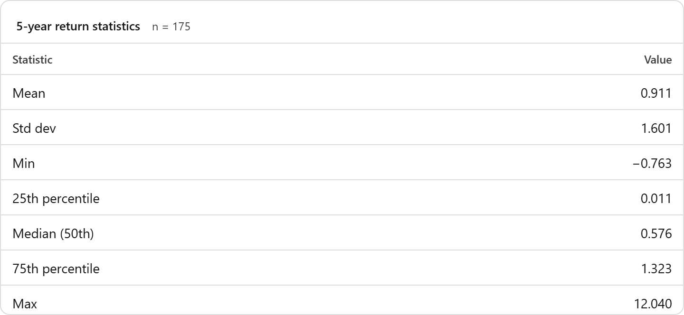

Slide 9
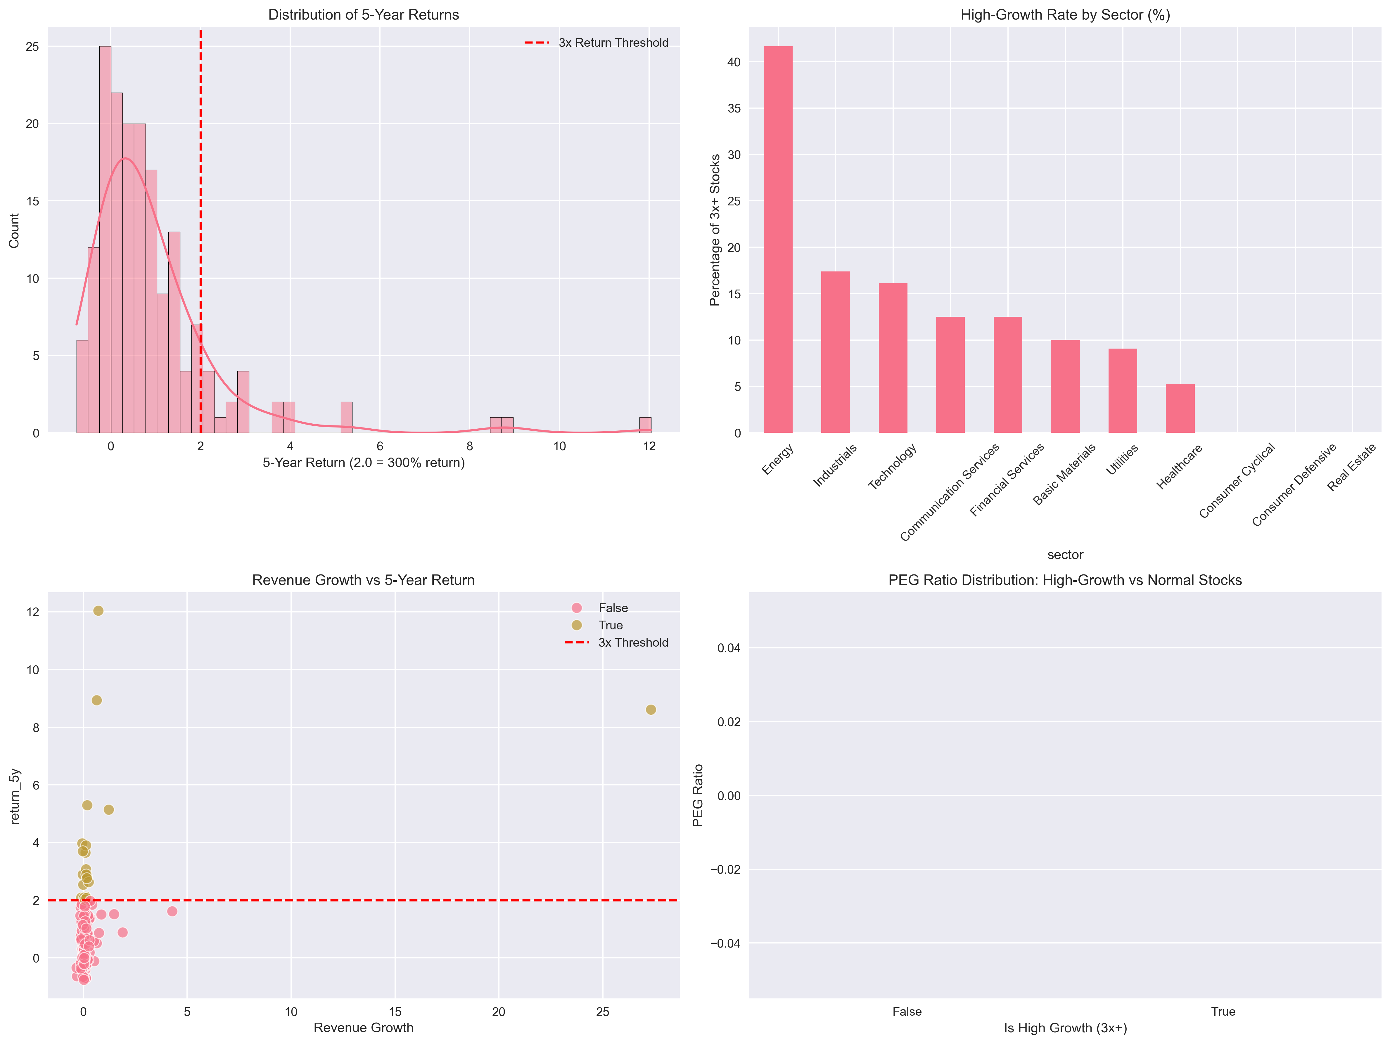
Visual 1 – Distribution of 5 Year Return
Most stocks had moderate returns
Clear threshold at 3x return (200%+)
Long tail on the right = few stocks had extremely high returns

Slide 10
Visual 2 — High-Growth Rates (%) by Sector

Slide 11

Feature Engineering – What Was Created?
Created new features to help the model better understand what makes a stock a potential 3x winner:
Growth Features
revenue_growth_strong: Is revenue growing faster than 20%?
earnings_growth_strong: Is profit growing faster than 25%?
growth_score: Combined growth strength
Valuation Features
peg_ratio_clean: Cleaned PEG ratio (lower = better value for growth)
pe_category: Cheap / Fair / Expensive / Very Expensive
Quality & Safety Features
roe_strong: Is the company good at generating profit? (ROE > 15%)
low_debt: Does the company have low debt?
Risk Feature
beta_category: How volatile is the stock? (Low / Moderate / High / Very High)
Overall Quality Score
quality_score: A custom score combining profitability, low debt, strong growth, and good valuation

Slide 12
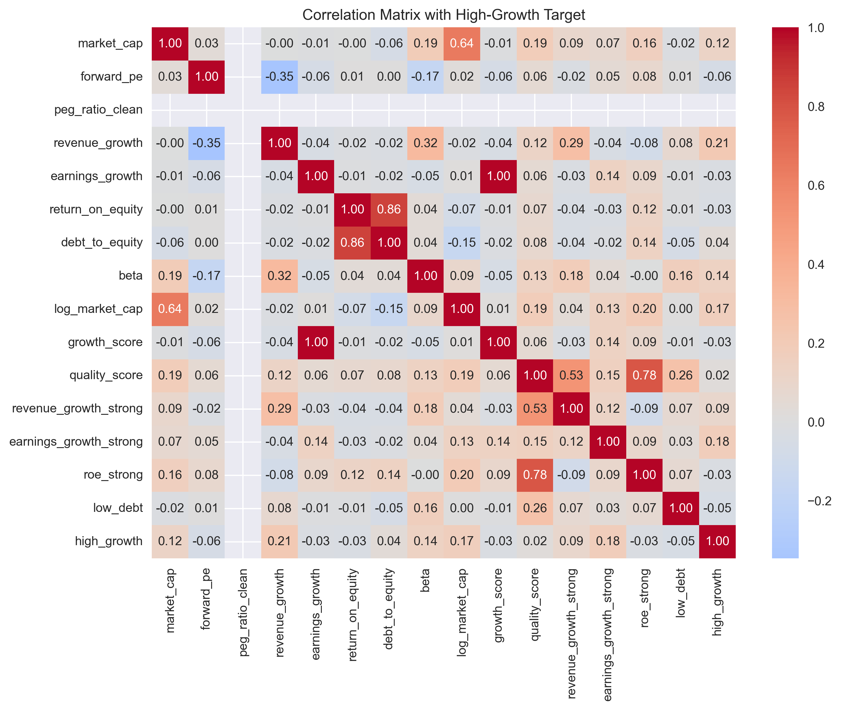
Most Important Features - Correlations
Top 5 features correlated with high_growth:
revenue_growth → 0.21 (weak positive)
log_market_cap → 0.19 (larger companies slightly better)
roe_strong → 0.18
growth_score → 0.18
beta → 0.17 (higher volatility associated with high returns)

Slide 13
Insights from EDA and Feature Engineering
The features showed only weak to moderate correlations with high-growth stocks (highest being 0.21 for revenue_growth – stocks in new and exciting industries like AI, Biotech)
This reflects the well-known difficulty of predicting stock returns!
Nevertheless, EDA was still able to identify some useful patterns, particularly around revenue growth, company size, return on equity, and high-beta stocks (stocks with high volatility compared to the overall market, e.g. S&P 500).
Saved final engineered dataset (175 stocks and 18 features) for machine learning.
Model learns: Based on fundamentals, which stocks are more likely to be in the high_return group?

Slide 14
03 · Machine Learning Models
Task 1 — Classification
Task 2 — Ranking stocks by probability of extreme performance
Task 3 — Back Testing
› Will this stock 3× in 5 years?
› Feature importance using the best performing model
› Top -N Equal-Weigh Back test
› Create Predictions
› Predict top 10 high growth stocks and rank accordingly
› Models: XGBoost · LightGBM · Random Forest
› Simulate Buy Top-10
› Real Investment Performance Style metrics: How many real high- growth stocks are in the top 10 predicted list?
› Compute Return Proxy
› Metric: Precision/Recall for high-growth class
Compare to Random Strategy
› Challenges: extremely rare, positive class and strong class imbalance.

Slide 15
Approach and Methodology
Data Pipeline
Feature selection (financial + valuation metrics)
Missing value imputation (median / most frequent)
One-hot encoding for categorical variables
Train-test split (75% / 25%, stratified)
Models Tested
Random Forest
XGBoost
LightGBM

Slide 16
Model Performance Results
Key Observations
Random Forest has highest AUC (best ranking ability)
LightGBM finds some positive cases
XGBoost and RF perform weakly at classification threshold

Slide 17
Why classical evaluation metrics maybe misleading?
Core Issue: Extreme Class Imbalance
Only 21 positive samples
Standard threshold = 0.5 is too strict
Why Precision / Recall fail here
Models predict few positives
Accuracy becomes misleadingly high
Small dataset → unstable classification metrics
Key Insight
Models are NOT failing – But could be improved (e.g. Improve feature engineering, larger dataset)
They are producing useful probability rankings
Problem is evaluation method, not model performance
With extremey rare events:
It is a ranking problem, not a classification problem!

Slide 18
Ranking-Based Evaluation – Top 10 Stock Selection
Evaluation Shift: From Classification → Ranking
Due to extreme class imbalance (21 positive cases out of 175 stocks), the problem was reframed as a ranking task instead of binary classification.
Methodology
Model outputs probability of high growth
Stocks ranked by predicted probability
Evaluation focused on Top-10 highest-ranked stocks

Slide 19
Key Results
Metric | Value
Total Stocks Evaluated | 175
True High-Growth Stocks in Dataset | 21
Model Top-10 Selection | 10 stocks
Correct High-Growth Stocks in Top 10 | 2 stocks
Interpretation
The model successfully identified 2 true high-growth stocks in its top 10 predictions
This indicates non-random structure learning in ranking space
Performance exceeds naive expectation from random selection (~1.2 hits)
In stock prediction, a small edge over random is often more valuable than high accuracy!

Slide 20
Backtesting Results (Strategy Validation)
Backtesting Objective
To evaluate whether the model can function as a portfolio selection strategy, rather than a pure classifier.
Simulated Strategy
Rank all stocks by predicted probability of high growth
Construct an equal-weight portfolio of Top 10 stocks
Evaluate against actual high-growth outcomes

Slide 21
Backtest
Strategy | True High-Growth Stocks in Top 10 | Hit Rate
Model-Based Ranking | 2 / 10 | 20%
Random Selection (Baseline) | ~1.2 / 10 | ~12%
Key Insight
The model-based portfolio outperforms random selection
Demonstrates predictive lift in extreme-return identification
Suggests usefulness as a decision-support ranking system
Limitations of Backtest
No price simulation (labels used as proxy for returns)
No time-series or holding-period modeling
Small dataset limits statistical robustness

Slide 22
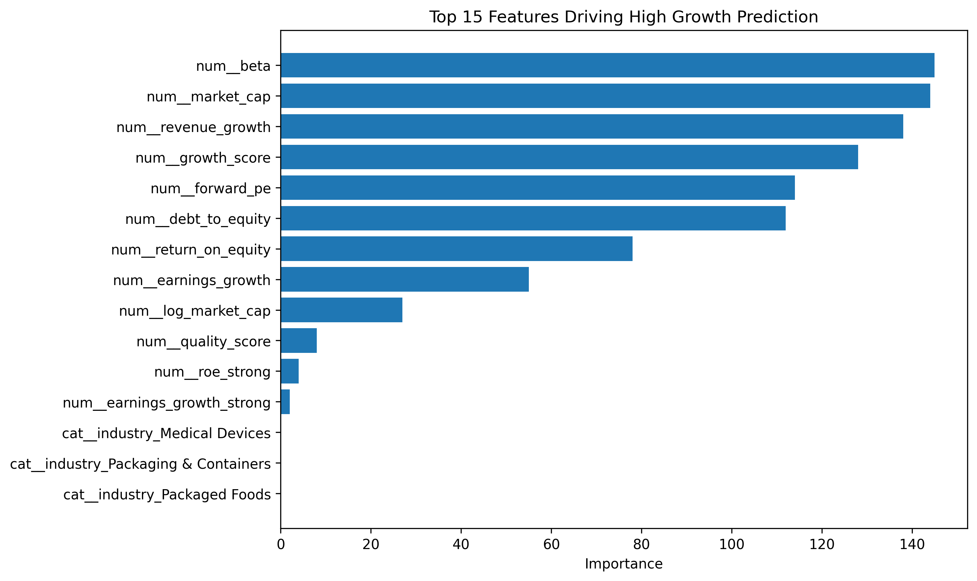
Feature Importance Analysis (Model Interpretability)

Slide 23
05 · Generative AI Integration
Dataset +
Model Outputs
+ News
Vector DB
(FAISS /
Chroma)
LangChain
RAG
Pipeline
Streamlit
Advisor
App
User: "Explain whether this stock (name of stock) is a strong candidate for long-term high growth (3x return)?"

Slide 24
GenAI-Enhanced Stock Analysis (RAG System)
System Overview
Machine learning model predicts probability of high-growth stocks
Structured financial data (fundamentals) is retrieved
A Large Language Model (LLM) generates human-readable explanations
Stock Data → ML Model → Probability Score
↓
Knowledge Base (features + predictions)
↓
GenAI (LLM explanation)
↓
Interpretable investment insight
Key Contribution
Transforms black-box predictions into explainable insights
Bridges quantitative modeling and qualitative financial reasoning
Enables decision-support for investors

Slide 25
Example: GenAI Stock Analysis Output
Task:
Explain whether this stock (name of stock) is a strong candidate for long-term high growth (3x return)?
Input (Model + Data)
Probability of High Growth: 11%
Market Cap: $27.9B
Revenue Growth: 11.4%
Forward P/E: 9.9
Beta: 1.33
Debt-to-Equity: 254.7
🤖 GenAI Output (Generated Insight)
“An 11% probability for high growth is relatively low, suggesting limited expectation of a 3× return.”
“Revenue growth is healthy but not sufficient for aggressive upside; typically >20% is needed for high-growth outcomes.”
“Exceptionally high leverage increases financial risk and limits flexibility.”
“Large-cap size reduces the likelihood of exponential appreciation.”
🧾 Final Conclusion
“This stock is not a strong candidate for long-term high growth (3× return). It reflects a high-risk, value-oriented profile rather than explosive growth potential.”

Slide 26
Next Steps
Connect to live market data APIs (e.g. Yahoo Finance) to replace static dataset
Scale model to a larger stock universe (e.g. S&P 500 or global equities)
Upgrade RAG using vector database + embeddings for richer financial retrieval
Improve GenAI layer with better prompts and scenario-based explanations (bull/base/bear)
Deploy as a web application (Streamlit) for interactive stock analysis and demo use

Slide 27
⚠ Reality Check — Responsible Investing
📉
3–4× in 5 years is RARE — most stocks underperform. The ML models will flag very few candidates!
🔍
Past performance ≠ future results. Markets are noisy; this is an educational model, not financial advice.
📝
All deliverables include disclaimers. Strong README: 'This is an educational project. Not financial advice.'

Slide 28
Thank You
AI-Powered High-Growth Stock Selector & Advisor
Ironhack · Data Science & Machine Learning · Final Project
Questions?

