Slide 1
THE BATTLE OF NEIGHBORHOODS
APPLIED DATA SCIENCE SPECIALIZATION
- THE CAPSTONE PROJECT

Slide 2
Background
Canada is a country of migrants. It has one of the highest rates of migration intensity of any country in the world (second only to Australia). In 2019, over three quarters of a million temporary residents and over a quarter of a million permanent residents arrived in Canada.
In recent years, migration patterns to Canada have changed rapidly. While permanent migration has remained remarkably steady, temporary migration has grown rapidly over the past decade. Particularly, temporary migration of foreign workers has quadrupled between 2000 and 2019, with a small dip in 2015.
Asian countries are the fastest growing senders of migrants to Canada, in particular from South Asia and South East Asia. Specifically, India (29%), China (12%), and the Philippines (4%) were the largest sources of origins for new migrants to Canada in 2019 and together provide over a third of all Canada’s incoming residents.
Globally, Canada’s international student programs are the largest driver for temporary migration to Canada accounting for 400,995 temporary residents in 2019. Further, the increase in temporary migrants to Canada is almost exclusively due to substantially rising numbers of international students coming from the low and middle income countries. India provides the most striking example, with a more than eighty-fold increase in international students between 2000 and 2019.

Slide 3
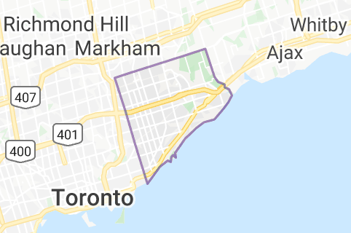
Problem
Migration of people from different parts of the world to different states in Canada has increased over the years. So, they need a lot of research for finding affordable housing prices and reputed schools for their children. Not only that, they also prefer easy to cafeterias, schools, supermarkets, medical shops, grocery shops, malls, theatres, hospitals, etc.
This project intends to create an analysis of features for people who are migrating to Scarborough in search of the best neighborhood as a relative analysis between neighborhoods. The highlights include median housing price and better school according to ratings, crime rates of that particular area, road connectivity, weather conditions, good management for an emergency, water resources both fresh and wastewater and excrement conveyed in sewers and recreational facilities.
It will help people to get the awareness of the area and neighborhood before moving to a new city, state, country or place for their work or to start a fresh life.
Map of Scarborough

Slide 4
DATA
For the Scarborough neighborhood data, a Wikipedia page exists that has all the information we need to explore and cluster the neighborhoods in Scarborough. We will have to scrape the Wikipedia page and wrangle the data, clean it, and then read it into a pandas data frame so that it is in a structured format.
The Wikipedia page that has to be scraped in order to get the necessary data is: https://en.wikipedia.org/wiki/List_of_postal_codes_of_Canada:_M
Once the data is in a structured format, We can perform the analysis explore and cluster the neighborhoods in the city of Scarborough.
Foursquare API Data
We will need data about different venues in different neighborhoods of specific borough. In order to gain that information we will use "Foursquare" locational information. Foursquare is a location data provider with information about all manner of venues and events within an area of interest. Such information includes venue names, locations, menus and even photos. As such, the foursquare location platform will be used as the sole data source since all the stated required information can be obtained through the API.
After finding the list of neighborhoods, we then connect to the Foursquare API to gather information about venues inside each and every neighborhood. For each neighborhood, we have chosen the radius to be 100 meter.

Slide 5
PYTHON LIBRARIES
Pandas: To create and manipulate data frames.
Folium: Python visualization library used to visualize the neighborhood cluster distribution
Scikit Learn: To import k-means clustering.
JSON: Library to handle JSON files.
XML: To separate data from presentation and XML stores data in plain text format.
Geocoder: To retrieve Location Data.
Beautiful Soup and Requests: To scrap and to handle HTTP requests.
Matplotlib: Python Plotting Module.

Slide 6
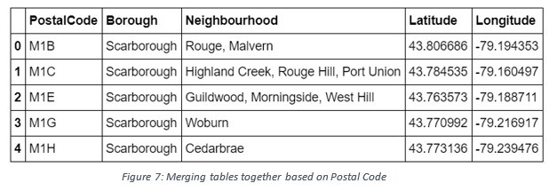
DATA ANALYSIS
The HTML table containing the postal codes of the regions in Scarborough, Canada was converted into a panda data frame. using the pandas methods, a table containing the neighborhoods Scarborough along with their respective postal codes were formed.
The latitudes and longitudes of the places were retrieved using the geocoder library. Using this latitudes and longitudes, the map of Scarborough was obtained along with the venues around the region with the help of folium.

Slide 7
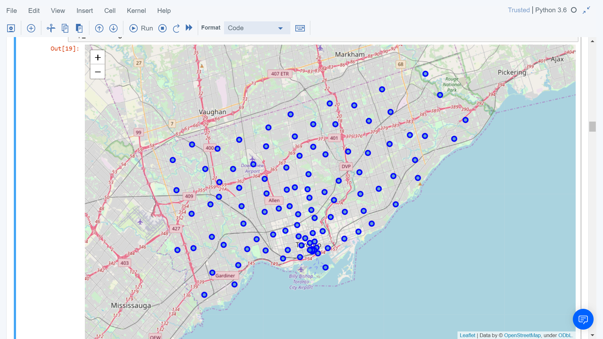
Map of neighborhoods in Scarborough, Canada

Slide 8
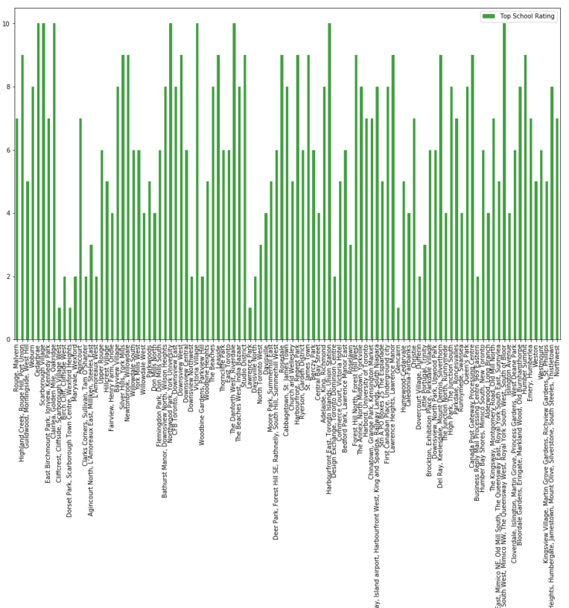
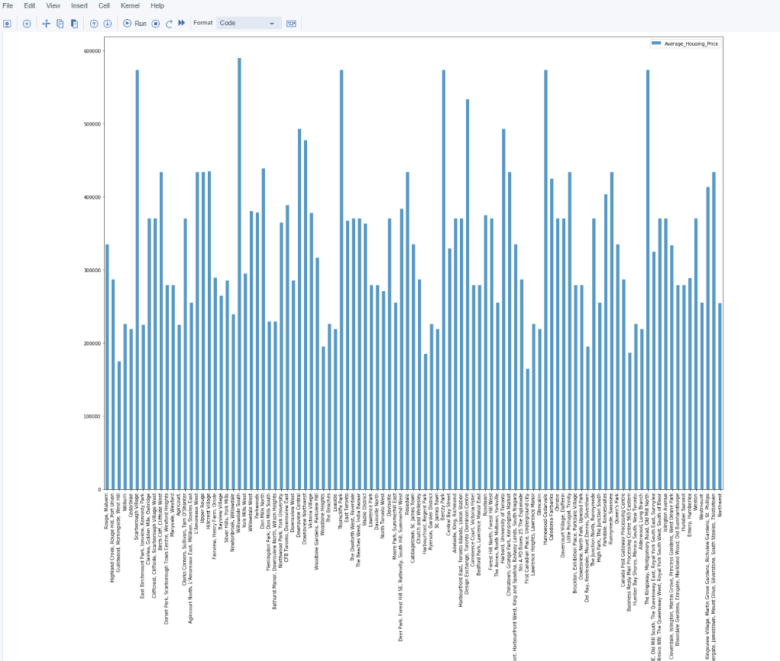
School Ratings in Scarborough
Average house prices in Scarborough

Slide 9
CONCLUSION
Although Scarborough has a reputation for high crime rates, these are unfounded and many city councilors have spoken out about how unfair and untrue they are. It's a friendly, safe place to live and there are many excellent schools – making Scarborough a great choice for families with young children.
According to all the data that had been worked with, Scarborough would be one of the best place of choice for living for the migrants from differents parts of the world to Canada.

