Slide 1

CODE RED 3.0
CODE TILL YOU DROP
Secure federated AI solution for multi-hospital training
Problem Statement Code: CR(S)3
Team Name: MedCrypt
Team Leader Name: Arjun R
Institution Name: AJ Institute of Engineering & Technology Mangalore, Karnataka

Slide 2

IDEA/APPROACH DETAILS
IDEA/APPROACH DETAILS
  IDEA:
We propose a Federated Learning (FL) framework where each hospital trains a local AI model on-site and only encrypted model updates are shared to a central aggregator. No raw patient data ever leaves hospital servers.
  USE CASES:
1. Multi-Hospital Disease Detection
Training a unified model for disease detection (e.g., cancer, pneumonia) across multiple hospitals without data sharing.
2. Treatment Response Prediction
Predicts likely treatment success based on demographic and clinical patterns learned from decentralized datasets.
3. Privacy-Compliant Medical Research
Allows collaboration with pharma companies & research institutions without exposing patient data.

Slide 3
IDEA/APPROACH DETAILS
IDEA/APPROACH DETAILS
Methodology and Technologies
  Each hospital trains an AI model on its private patient data without sharing raw records.
  Differential Privacy and Homomorphic Encryption ensure that individual patient data cannot be reconstructed.
  Federated Aggregation
  The central server aggregates encrypted updates to create a global model.
  Handling Non-IID Data
  FedProx algorithm stabilizes training across hospitals with varying demographics and data distributions.
  Each hospital receives both the global model and a personalized version adapted to its local dataset.
  Frontend: React
  Backend: Python
  Deep Learning Framework: PyTorch
  API Layer: FastAPI
  Federated Learning Framework: TensorFlow Federated
  FL Algorithms: FedAvg, FedProx
  Privacy and Security: Differential Privacy, Homomorphic Encryption, SMPC, SSL–TLS
  Deployment: Docker + Kubernetes
  Model Type: CNNs for imaging, Transformers for EHR
  Data Standard: FHIR

Slide 4
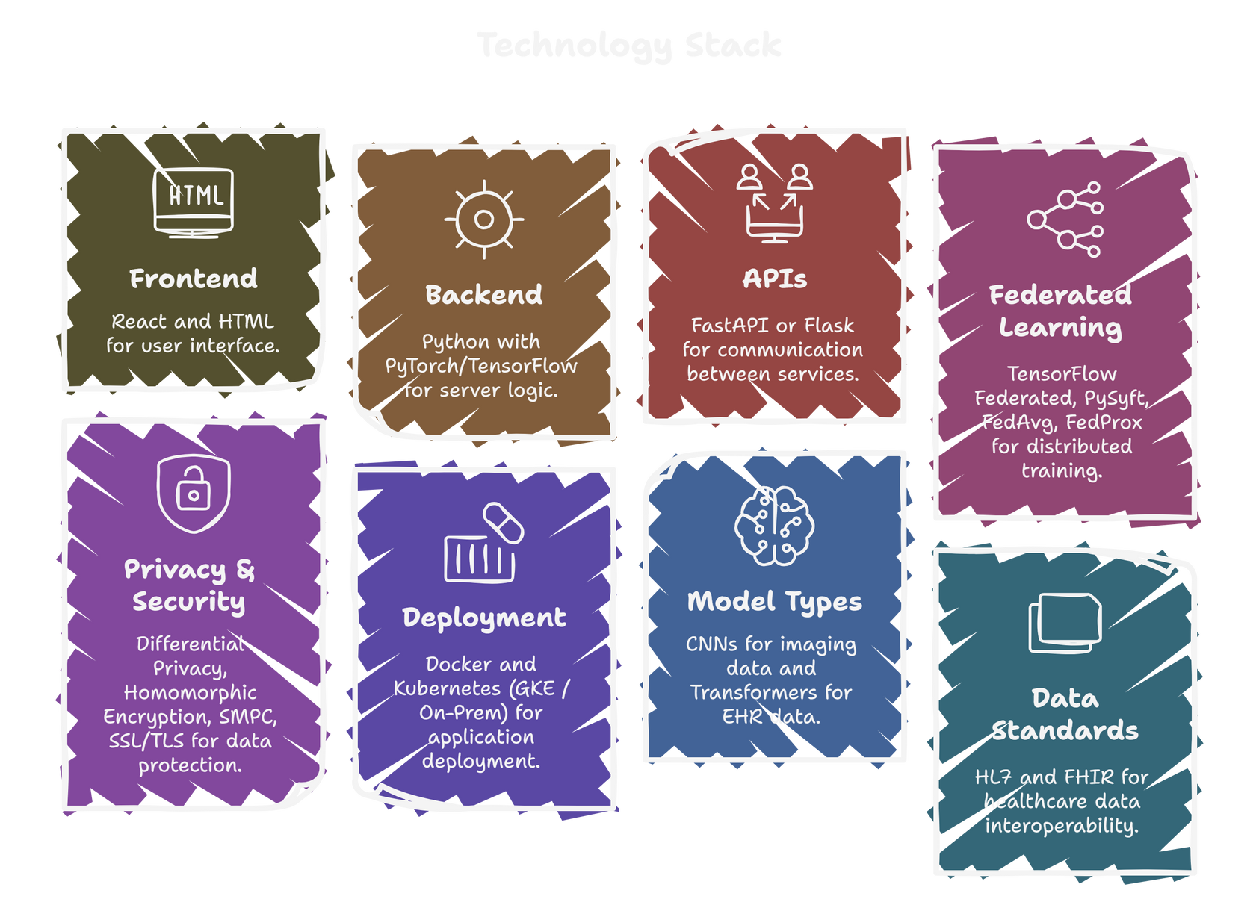
IDEA/APPROACH DETAILS
IDEA/APPROACH DETAILS

Slide 5
IDEA/APPROACH DETAILS
IDEA/APPROACH DETAILS
Novelty
  Dual-Layer Privacy Protection: Differential Privacy at the hospital level + secure aggregation with Homomorphic Encryption/SMPC ensures patient data is never exposed.
  Non-IID Data Handling: Uses FedProx to stabilize training across hospitals with different patient demographics (pediatric, geriatric, specialty hospitals).
  Personalized Federated Models: Each hospital receives a customized local model built on top of a global model for improved accuracy.
  Attack Resistance: Strong defense against membership inference and gradient inversion attacks through calibrated privacy noise.
  Scalable Multi-Hospital Collaboration: Works seamlessly across distributed hospital networks using Docker + Kubernetes.

Slide 6
IDEA/APPROACH DETAILS
TEAM DETAILS
Team Leader Name: Arjun R
Student ID: 4JK23CS014
Institution Name: AJ Institute of Engineering & Technology Mangalore, Karnataka
Phone Number: +91 9019934133
Email ID: arjunr252005@gmail.com
Member 1 Name : Suyash Devadiga
Member 2 Name : Neekshith
Member 3 Name : Krithi

