Slide 1
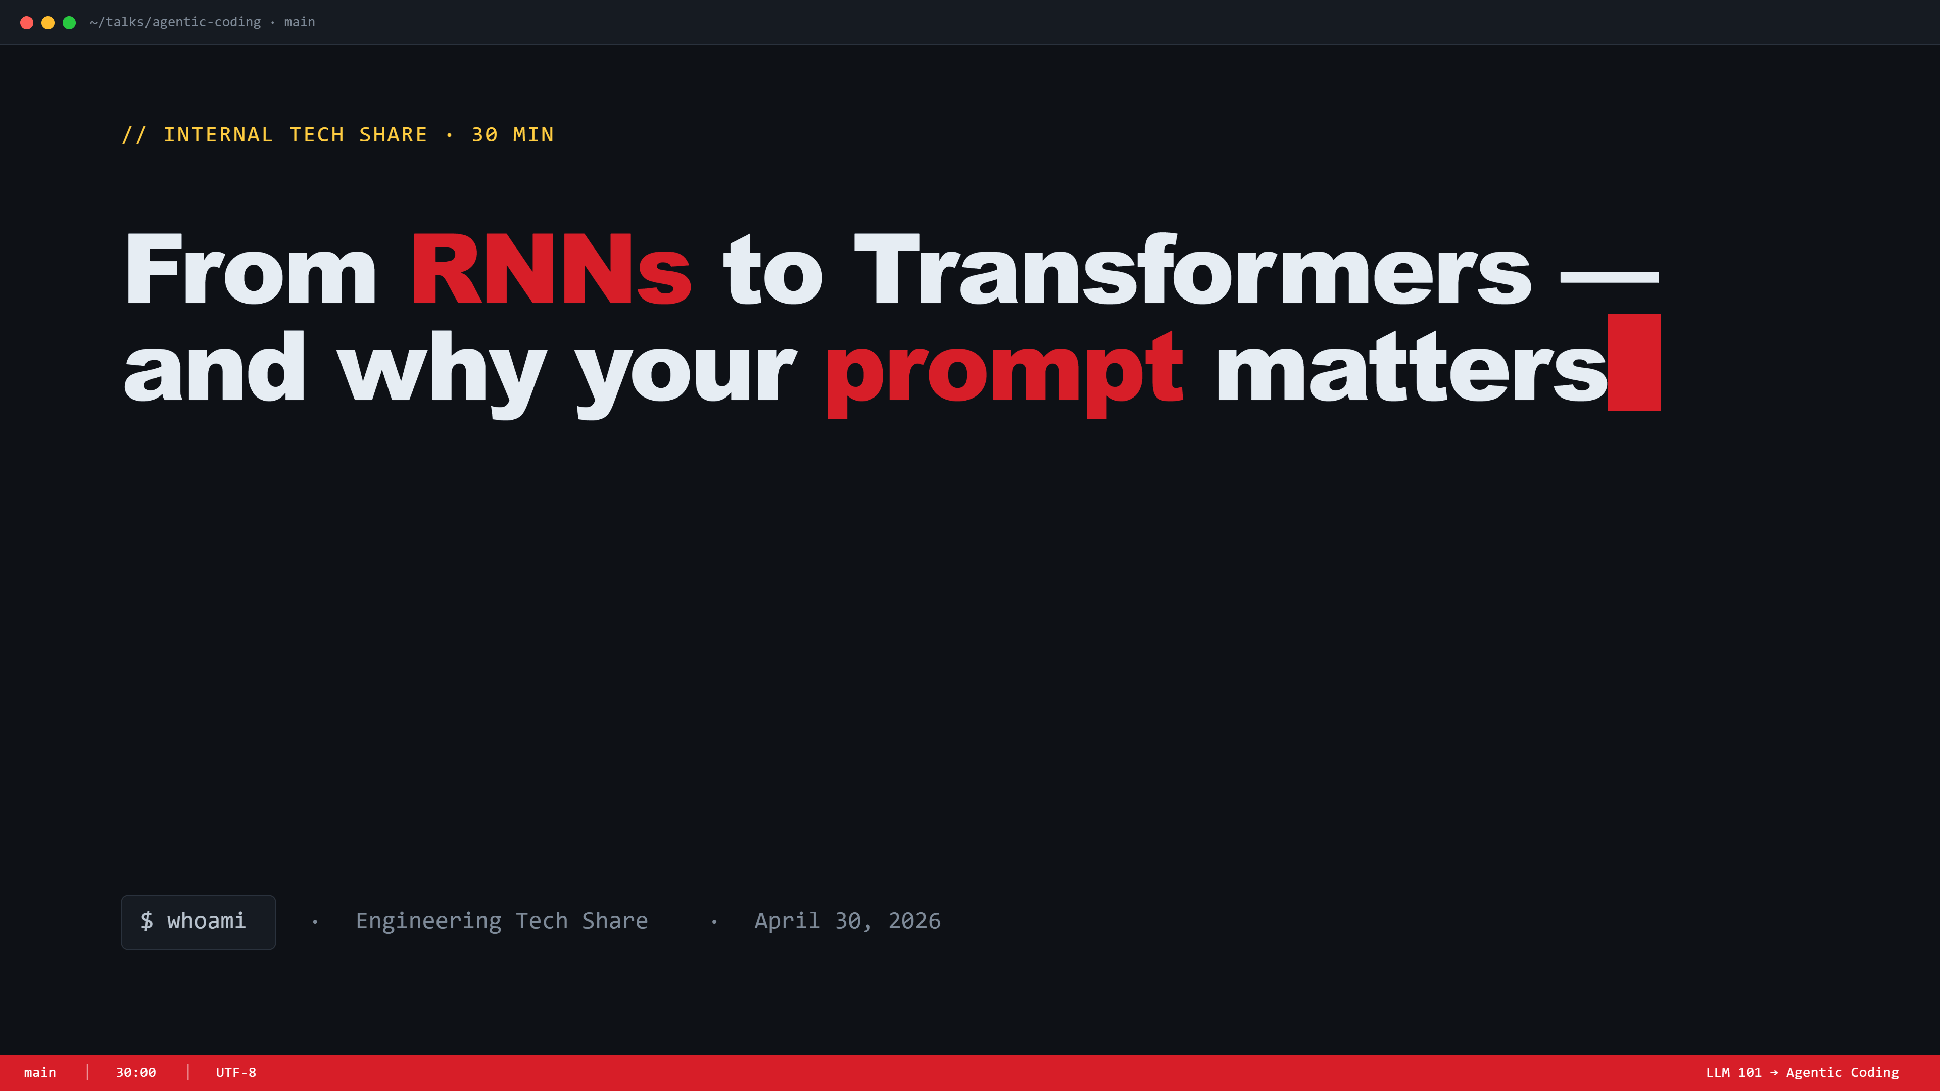
Notes:
Title slide. Quick intro. 'In the next 30 min — first, how this LLM thing actually works under the hood; then, why prompting and context matter so much; then how I turned that into a workflow in VS Code that shipped 6 stories faster than the first one.'

Slide 2

Notes:
Part 1 divider. 'Quick history — promise it's only 5 minutes. We're going RNN → LSTM → Transformer. I'm setting this up so the prompting stuff later actually clicks.'

Slide 3
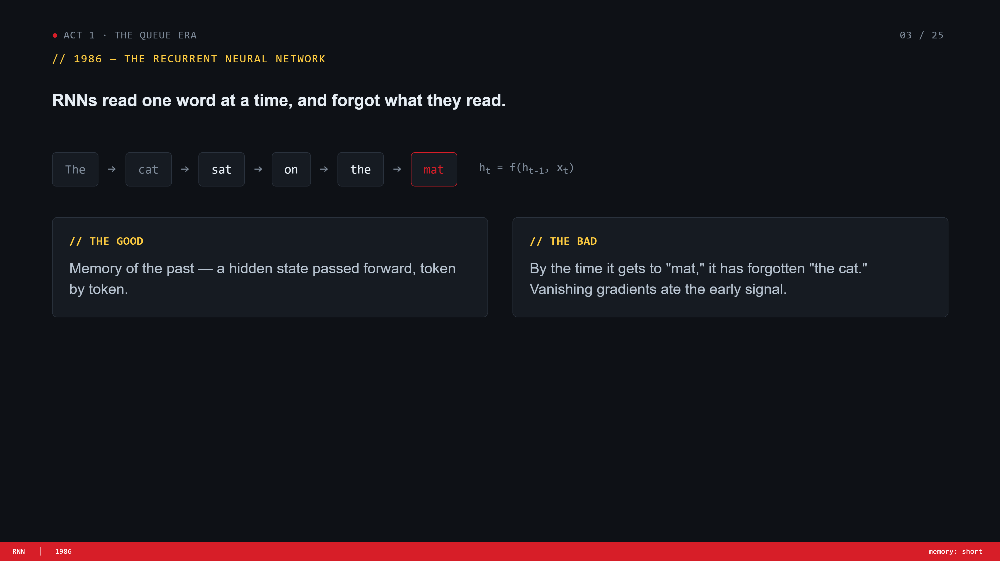
Notes:
RNN slide. Read tokens left-to-right, hidden state passed forward. By the end of a sentence the early tokens are basically gone — vanishing gradient. Ground the example with 'the cat sat on the mat — by mat, it's forgotten the cat.'

Slide 4
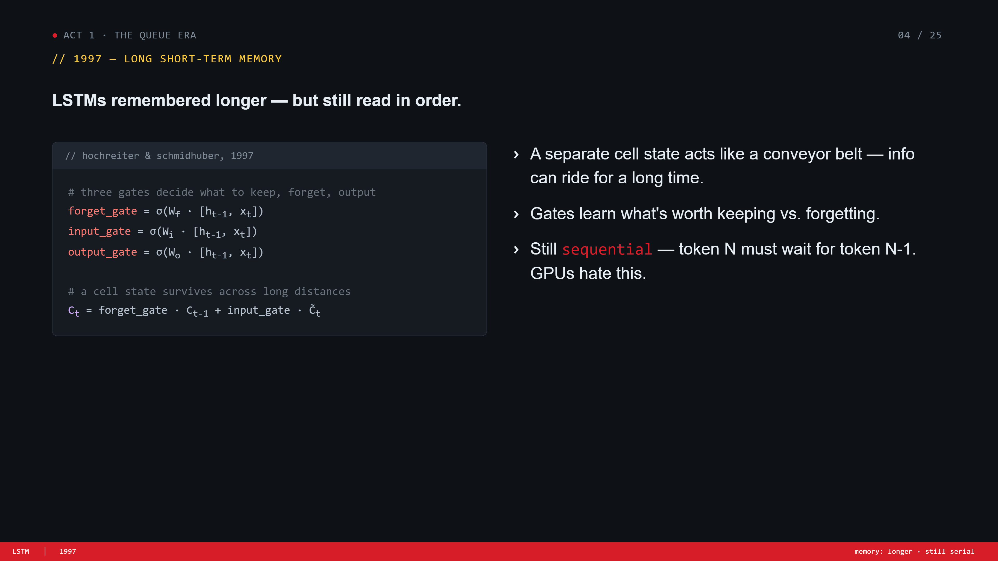
Notes:
LSTM slide. Same idea, three gates (forget/input/output) + a cell-state conveyor belt. Better memory. But still serial — token N waits on token N-1. Punchline: 'GPUs hate this. We have all this parallel hardware sitting idle.'

Slide 5
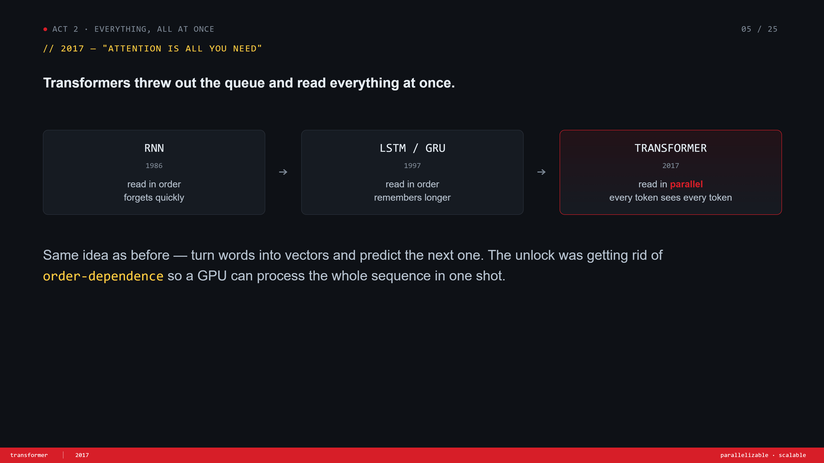
Notes:
Transformer arrives. 2017, Attention Is All You Need. Big idea: drop the queue. Read the whole sequence at once, in parallel. Use the row of three boxes to show the lineage — RNN → LSTM → Transformer. Land the line: 'this is the unlock that made GPT and friends possible.'

Slide 6
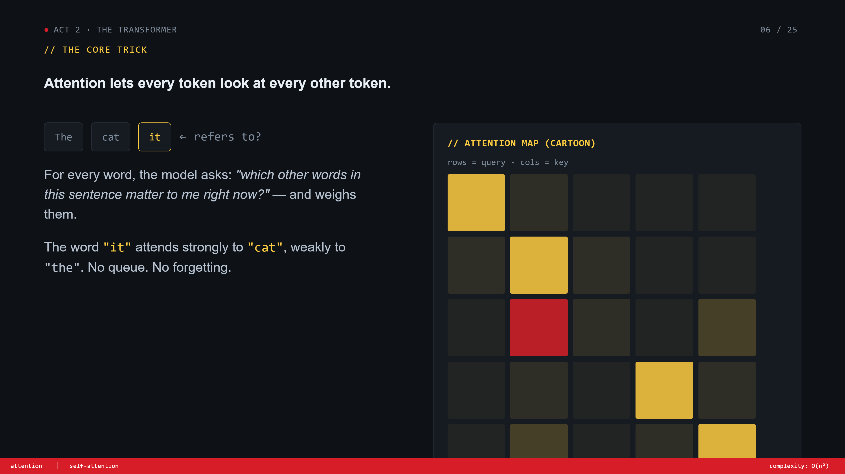
Notes:
Attention. The core trick. 'Every word asks: which other words matter to me right now?' Use the cat / it example — the word 'it' attends strongly to 'cat'. Point at the heatmap, the bright red square is exactly that link. No queue, no forgetting.

Slide 7
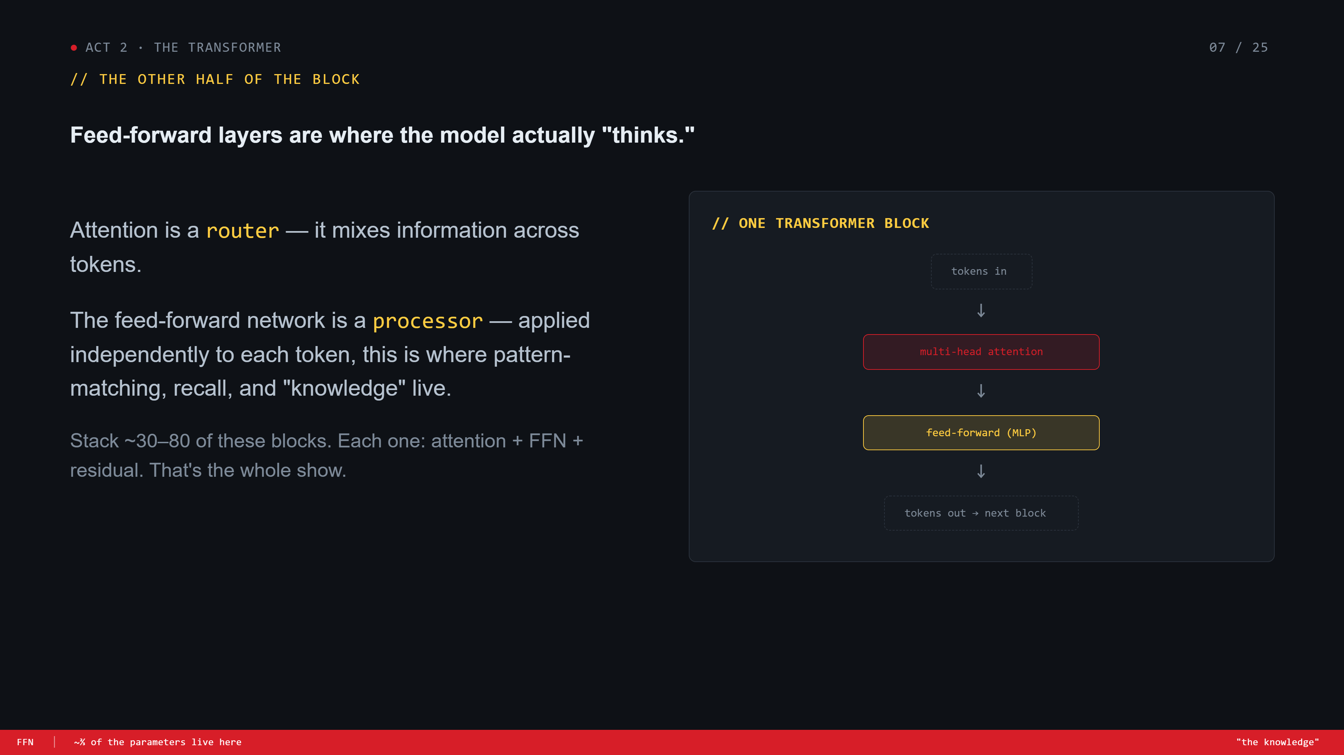
Notes:
Feed-forward. Two halves of every block. Attention = router (mixes info across tokens). FFN = processor (does the actual thinking, applied per token). Most of the model's parameters live in FFN — that's where 'knowledge' lives. Stack 30–80 of these and you have an LLM.

Slide 8
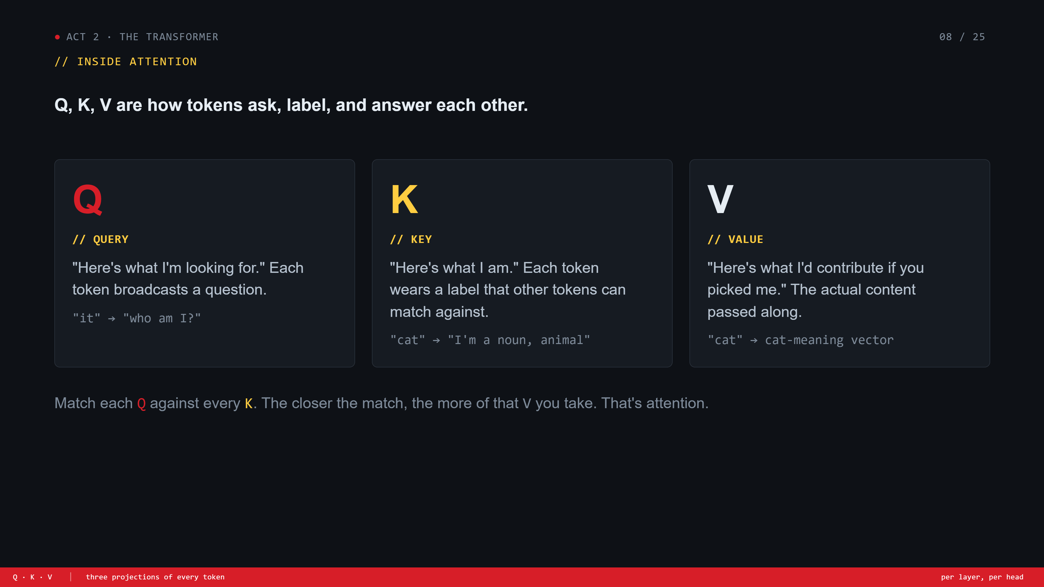
Notes:
Q K V. Stay intuitive — no math. Q = the question each token asks. K = the label each token wears. V = what it'd contribute if picked. Match Qs against Ks, weighted-sum the Vs. That's all attention is. Joke: 'it's basically a dating app for tokens.'

Slide 9
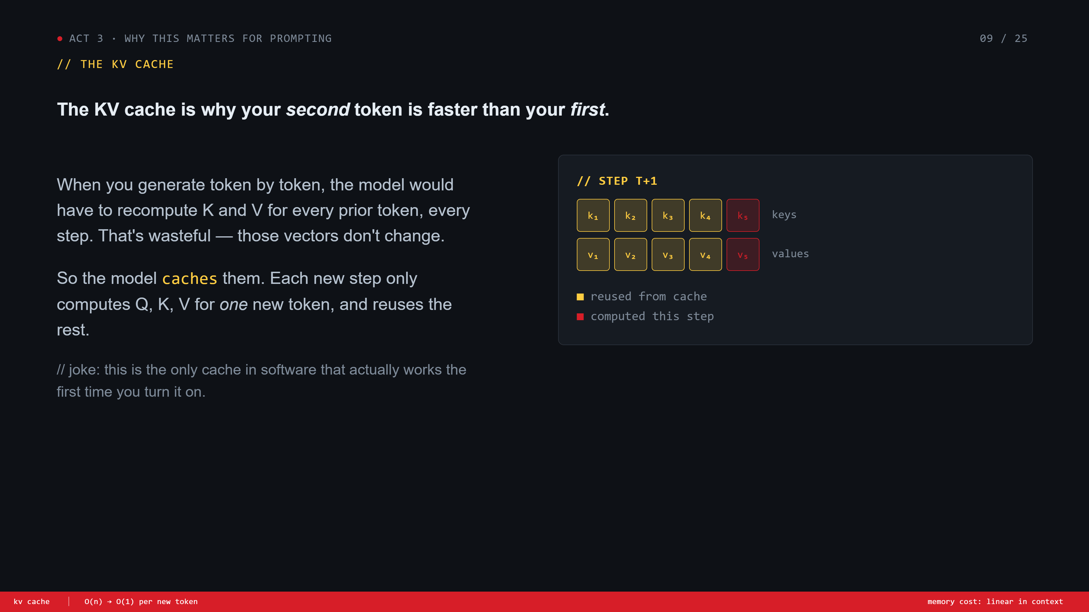
Notes:
KV cache. Set up Part 3 — why this matters for prompting. K and V vectors don't change after they're computed, so we cache them. Each new generated token only computes one new K and V, reuses the rest. Drop the cache joke — 'only cache that works first time.'

Slide 10
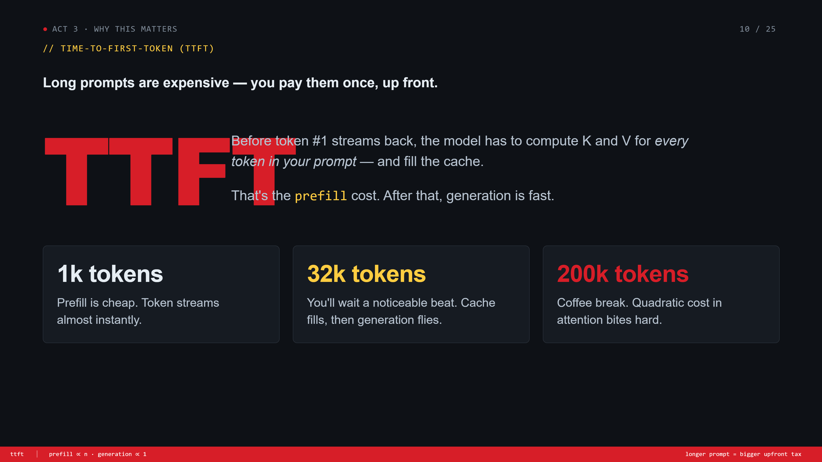
Notes:
TTFT. Time to first token. Before token 1 streams, the model has to prefill — compute K and V for the WHOLE prompt. That's the cost of long prompts. After prefill, generation flies. Walk through 1k / 32k / 200k. 'Coffee break' joke on 200k.

Slide 11
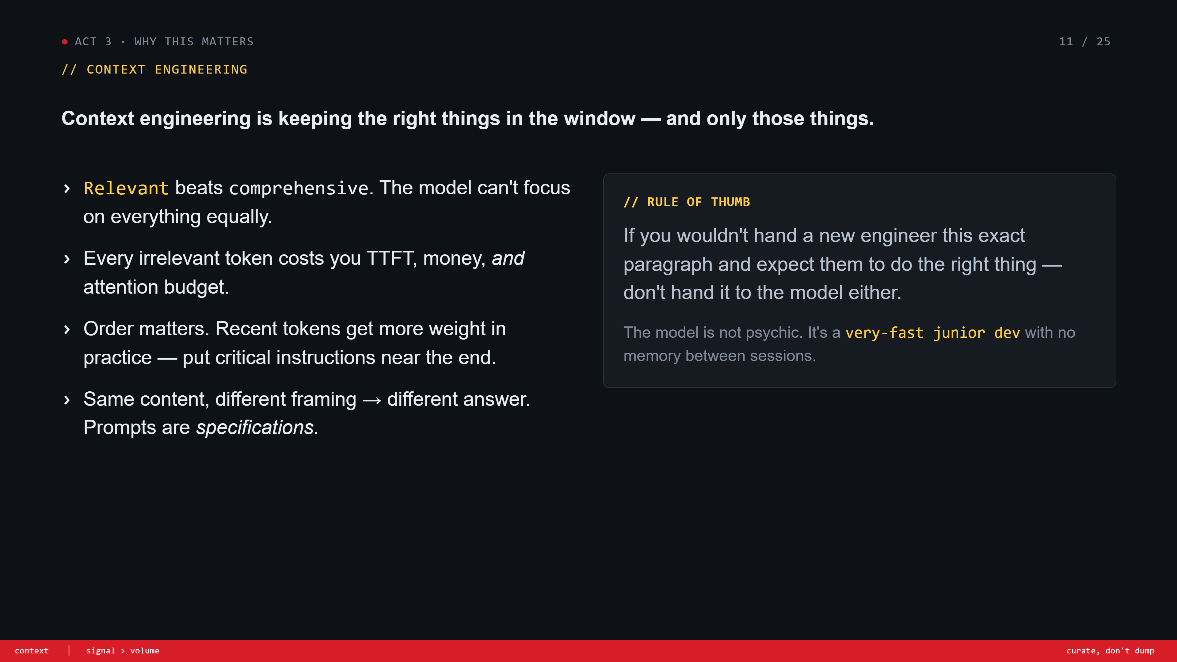
Notes:
Context engineering. The takeaway. Relevant > comprehensive. Every irrelevant token costs TTFT, money, AND attention budget. Order matters. Prompts are specs. End with 'the model is a fast junior dev with no memory between sessions.'

Slide 12
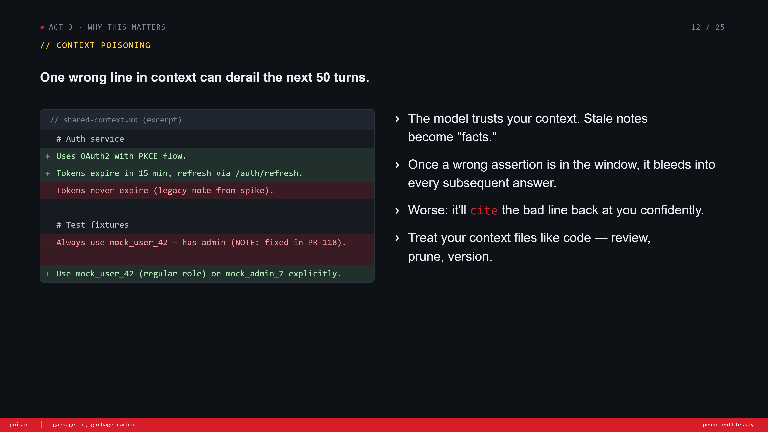
Notes:
Context poisoning. Show the diff. Stale notes become 'facts.' The model will cite the wrong line back at you confidently — that's the scary part. So: treat context files like code. Review them, prune them, version them.

Slide 13
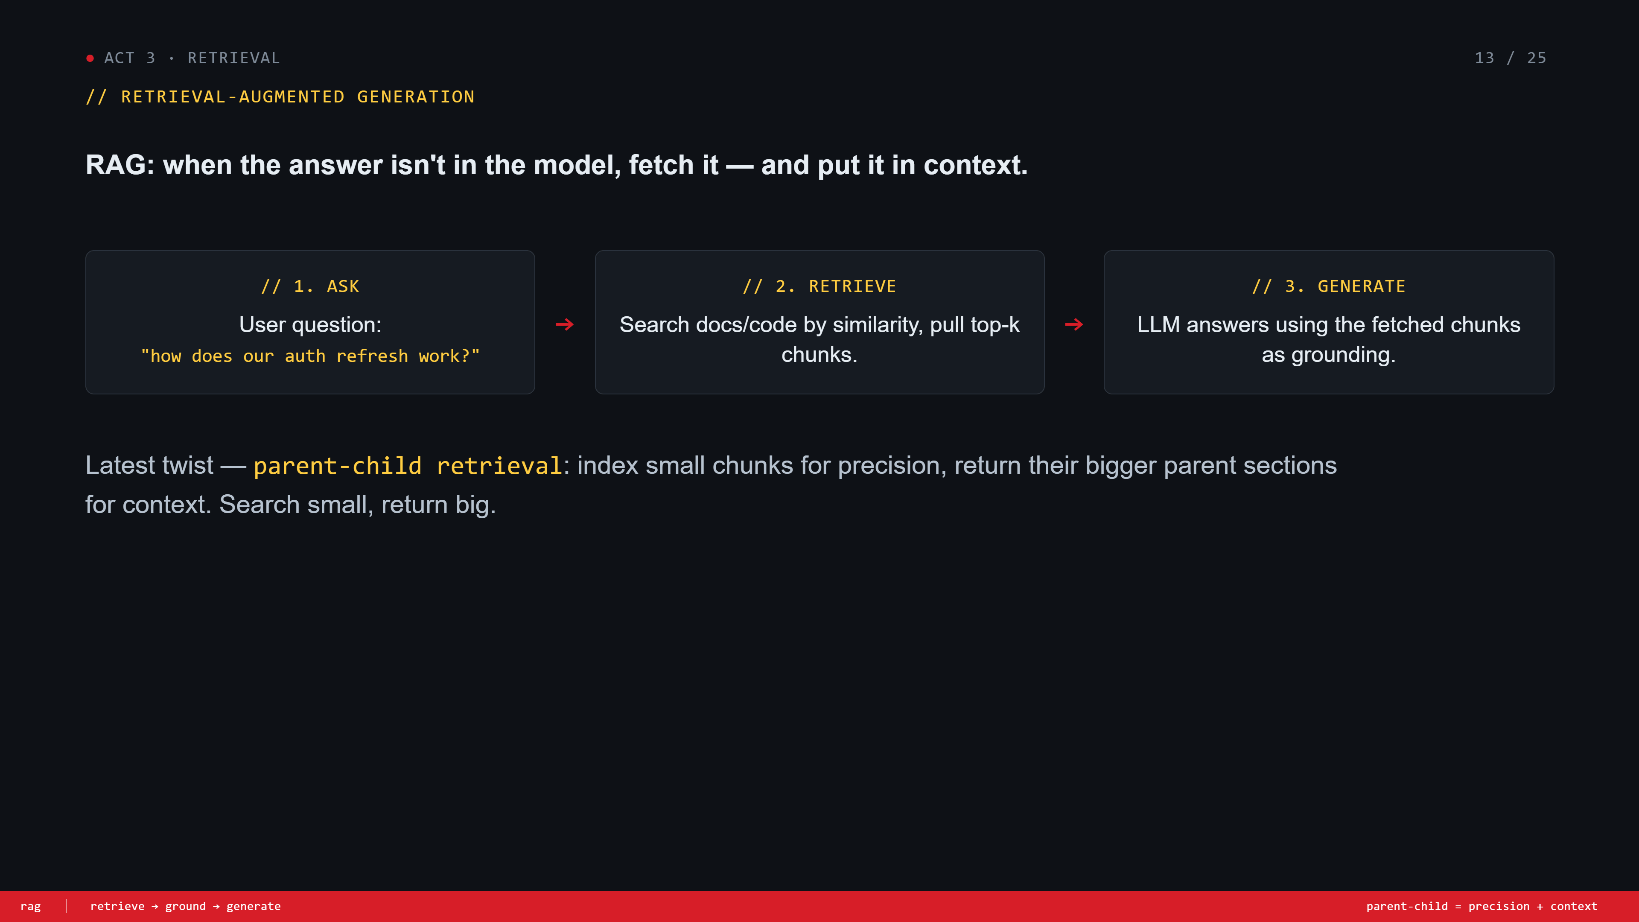
Notes:
RAG. One slide. When the answer isn't in the model, fetch it. 3-step loop: ask, retrieve, generate. Mention the latest twist — parent-child retrieval: search small for precision, return big chunks for context. Don't go deeper.

Slide 14
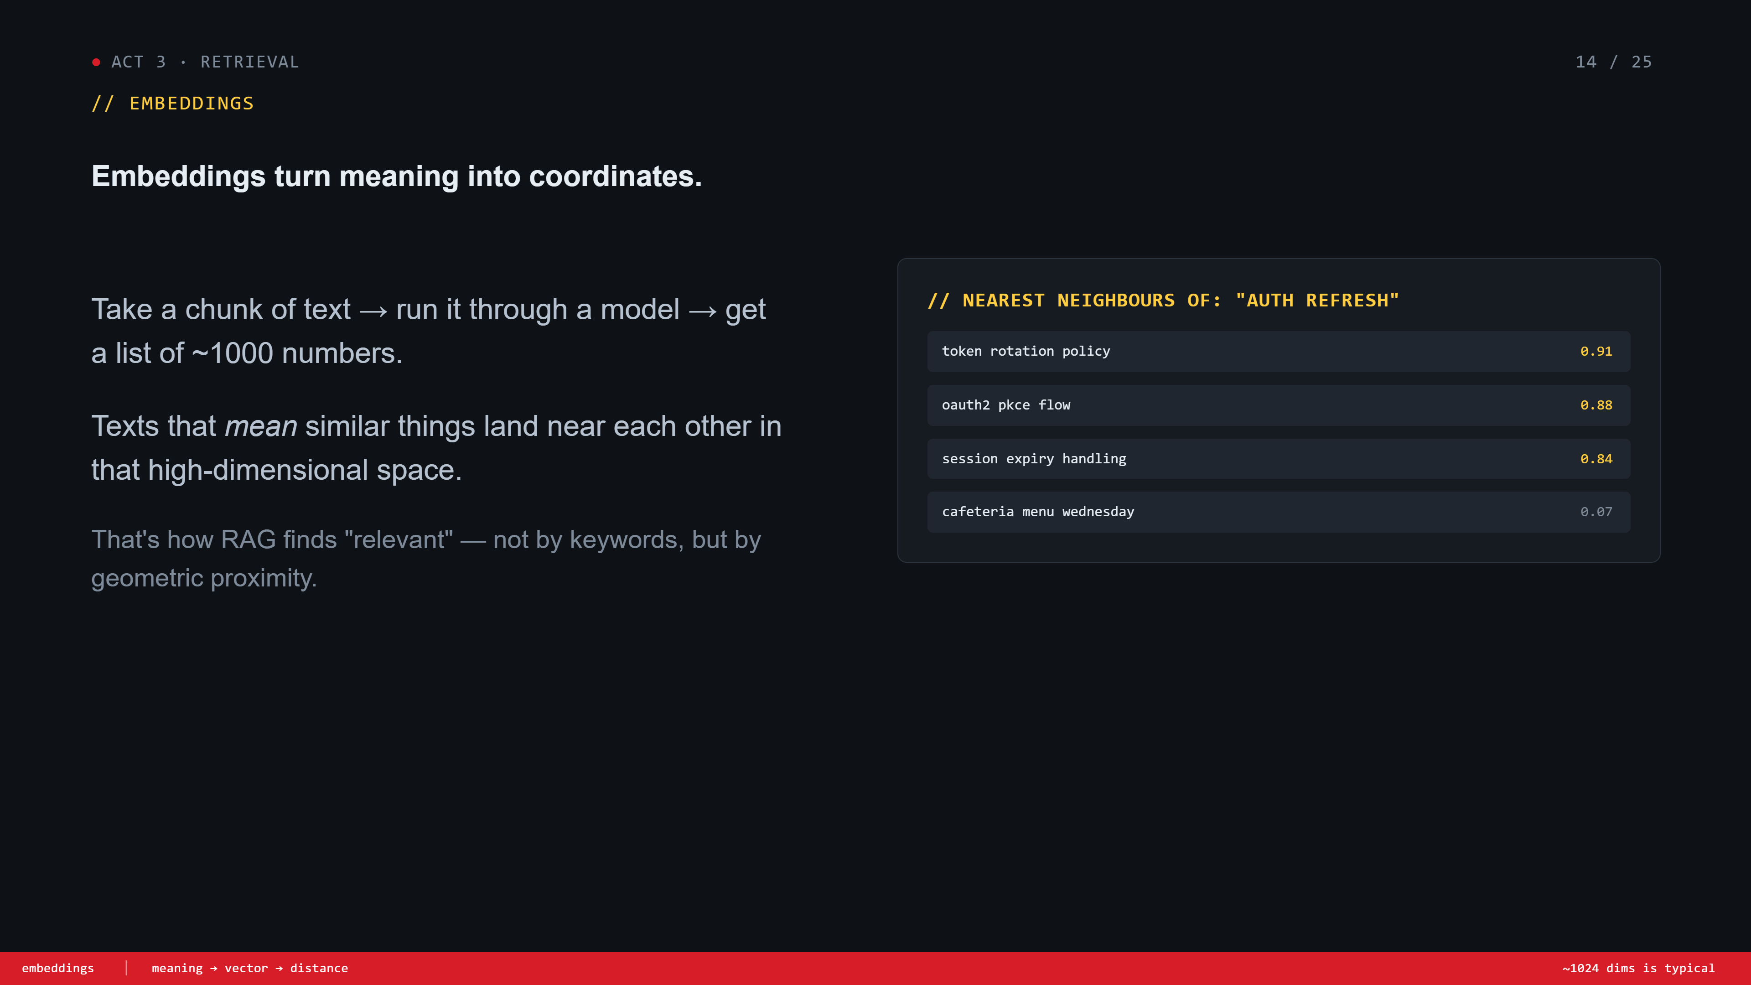
Notes:
Embeddings. Text → ~1000 numbers. Texts that mean similar things end up near each other. That's how RAG finds 'relevant' — geometry, not keywords. Use the table — 'auth refresh' vs 'cafeteria menu' to make it concrete.

Slide 15
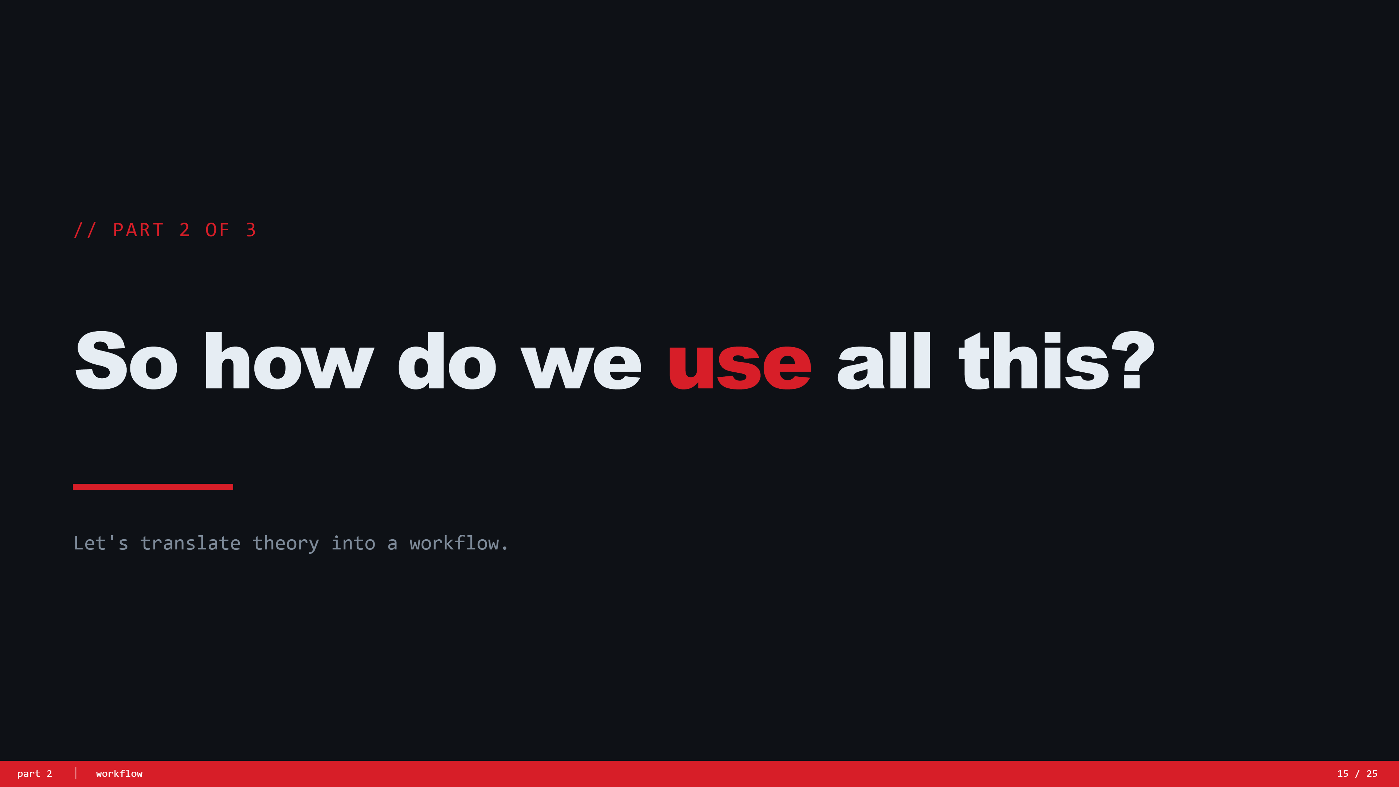
Notes:
Part 2 divider. Reset the room. 'OK — that's the theory. Now let me show you what I actually did in VS Code with all this in mind.'

Slide 16
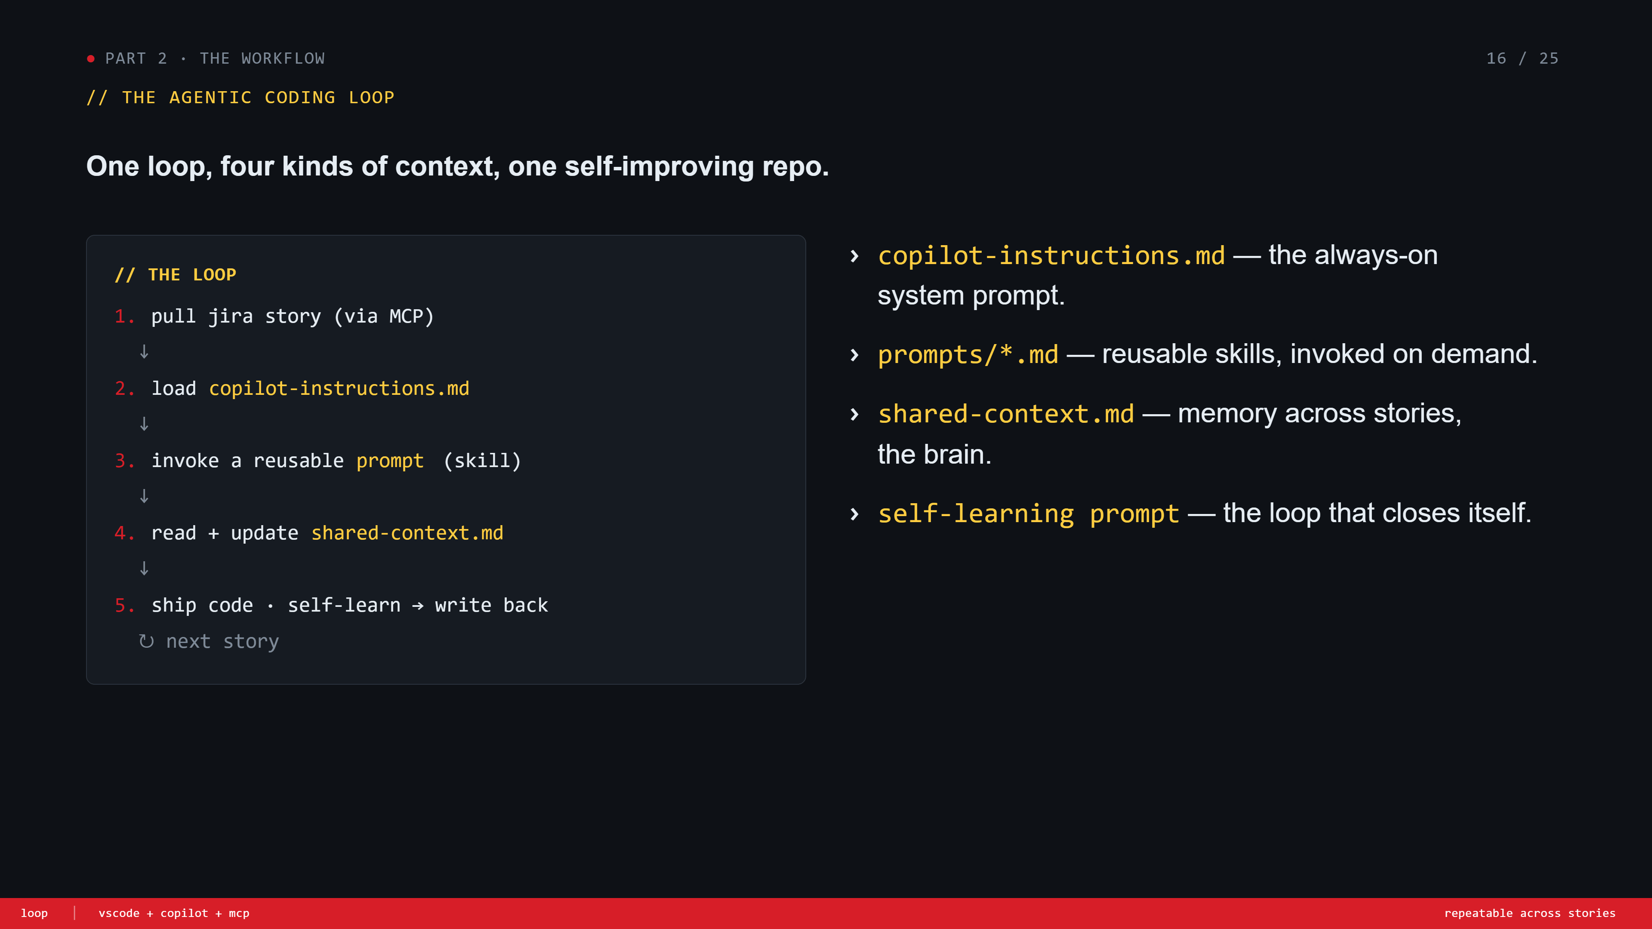
Notes:
The loop diagram. Walk through the 5 steps once. Pull jira, load instructions, invoke a prompt, read+update shared-context, ship + self-learn. Then call out the four files on the right. Set up the next four slides.

Slide 17
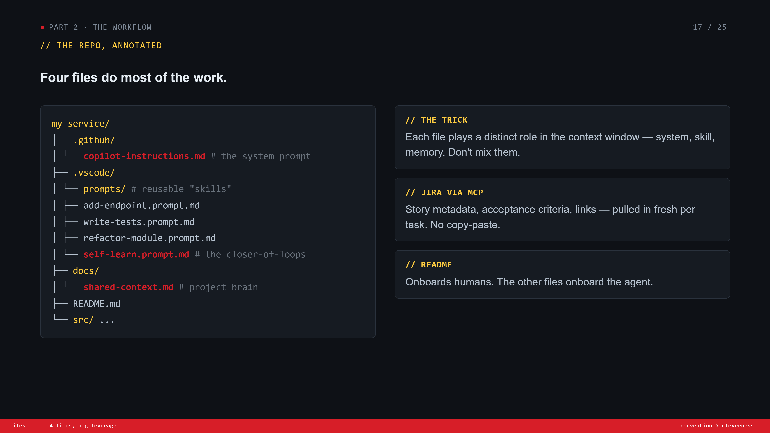
Notes:
File structure. Show the tree. 'These four highlighted files do most of the work — copilot-instructions, the prompts folder, shared-context, and the self-learn prompt.' README is for humans, the rest is for the agent. Mention Jira via MCP feeds in fresh per task.

Slide 18
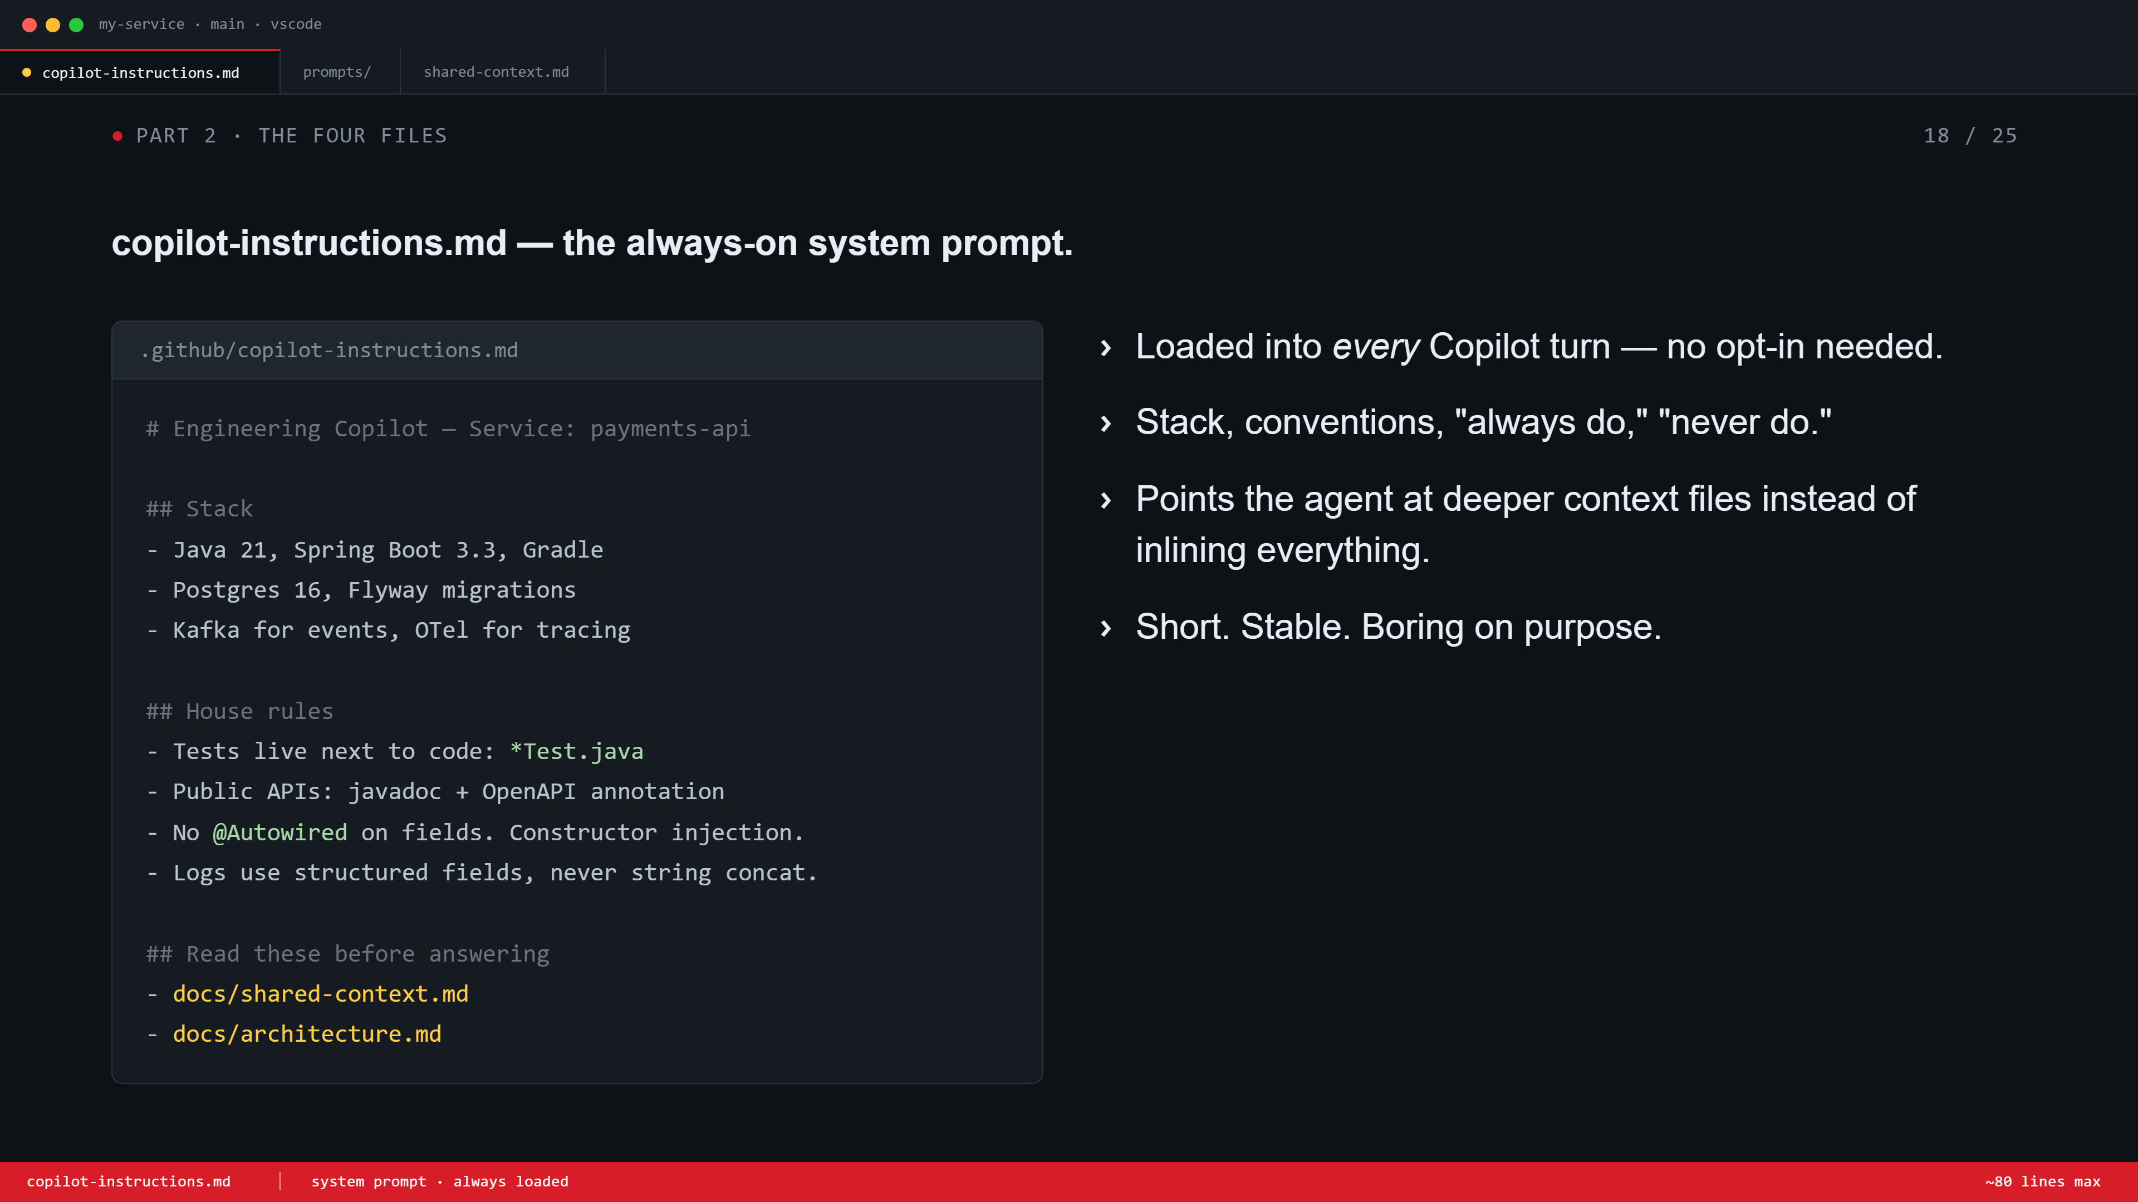
Notes:
copilot-instructions.md. Always-on system prompt. Stack, conventions, do/don't. Points at deeper context files instead of inlining everything. 'Short, stable, boring on purpose.' If it changes every day, you're doing it wrong.

Slide 19
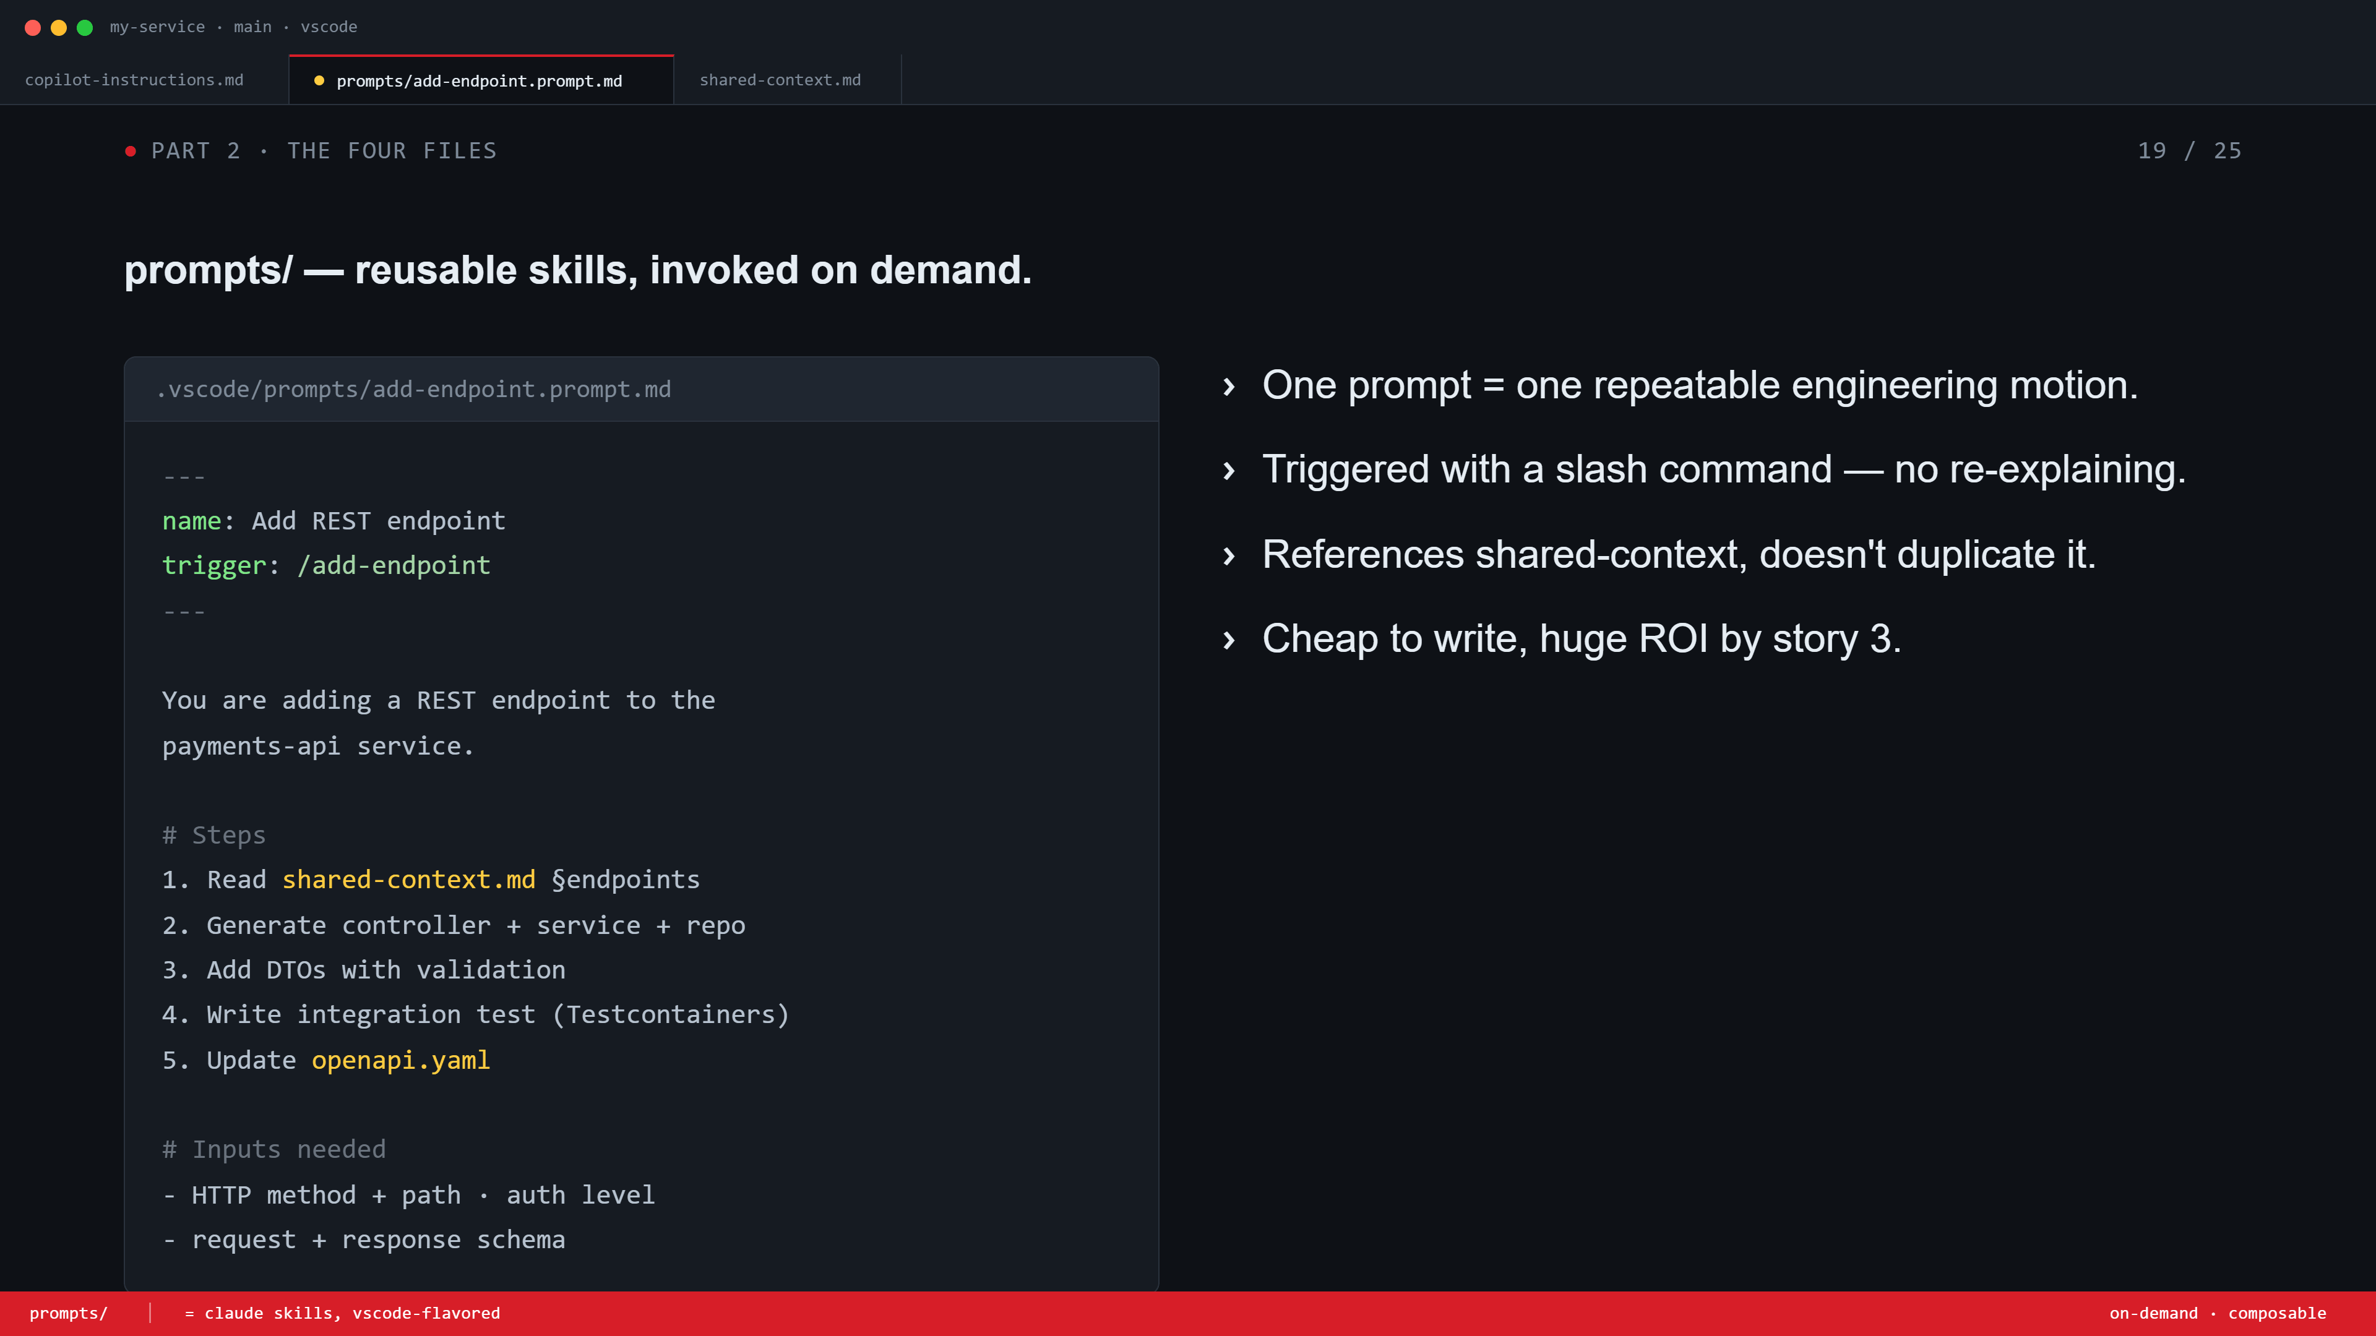
Notes:
prompts/ folder. Reusable skills, slash-commands. One prompt = one repeatable engineering motion (add endpoint, write tests, refactor). References shared-context, doesn't duplicate. 'Cheap to write, huge ROI by story 3.' Tie it back: 'this is what skills are in Claude — same idea.'

Slide 20
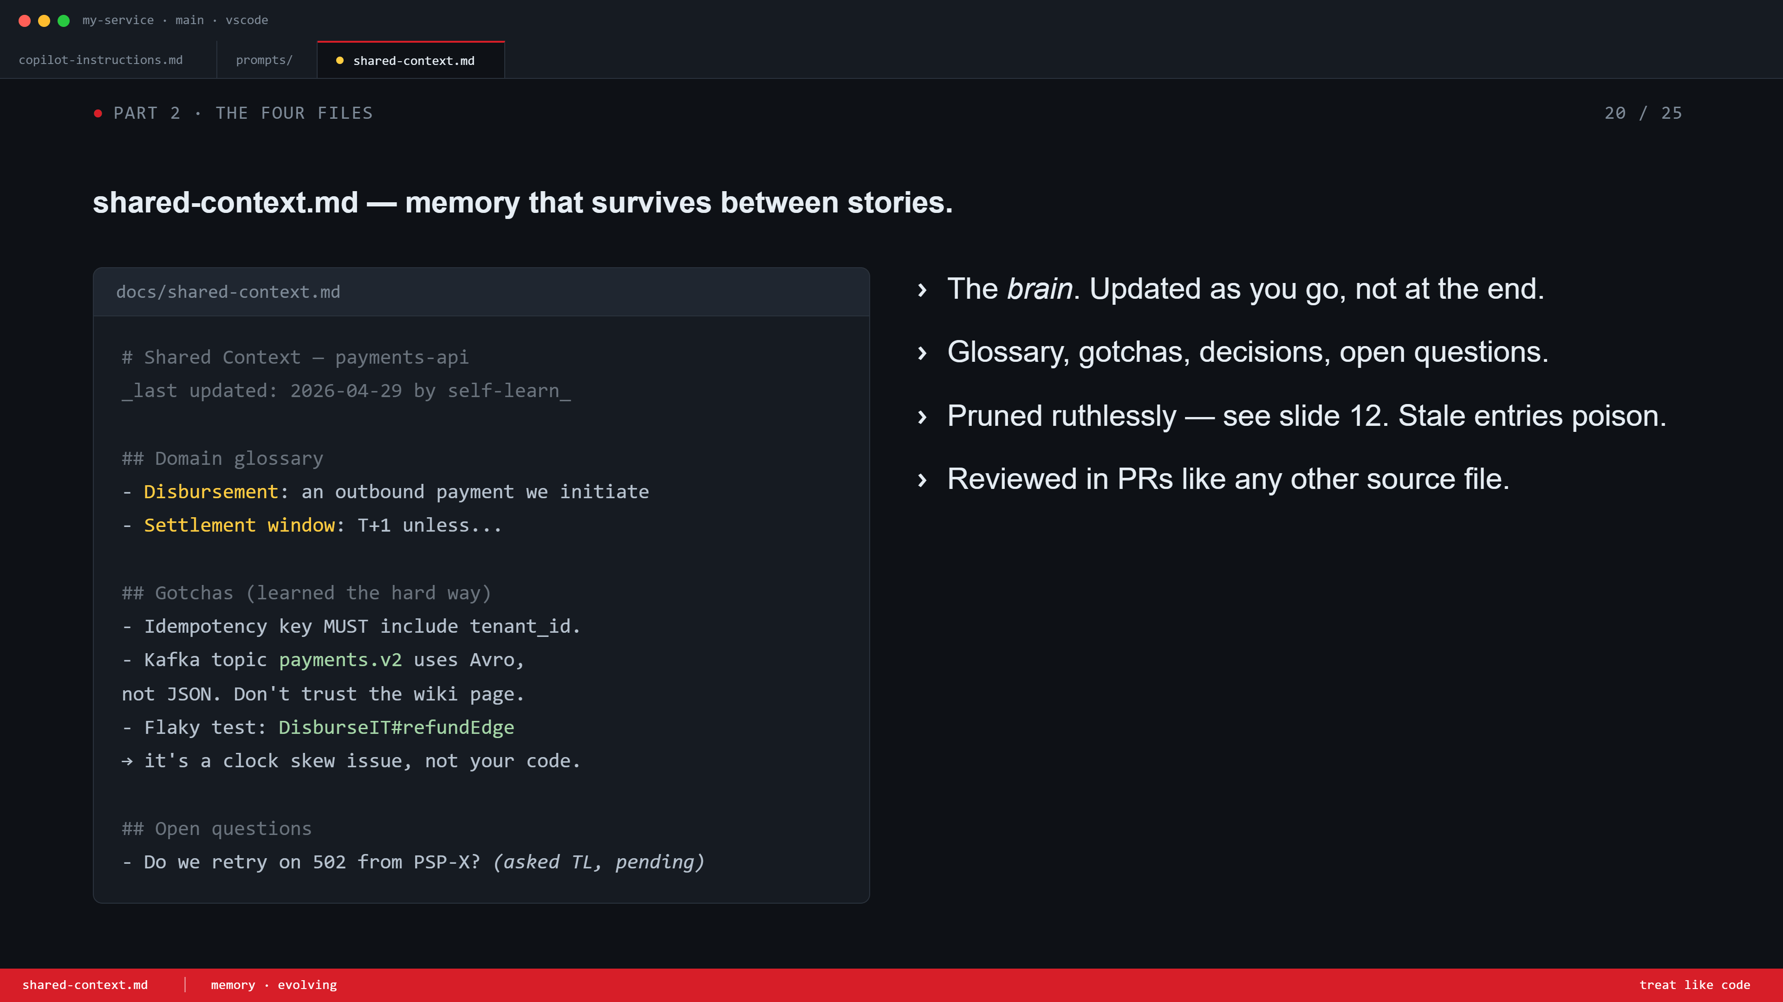
Notes:
shared-context.md. The brain. Glossary, gotchas, decisions, open questions. Updated as you go. Pruned ruthlessly — refer back to slide 12 (poisoning). Reviewed in PRs like source code.

Slide 21
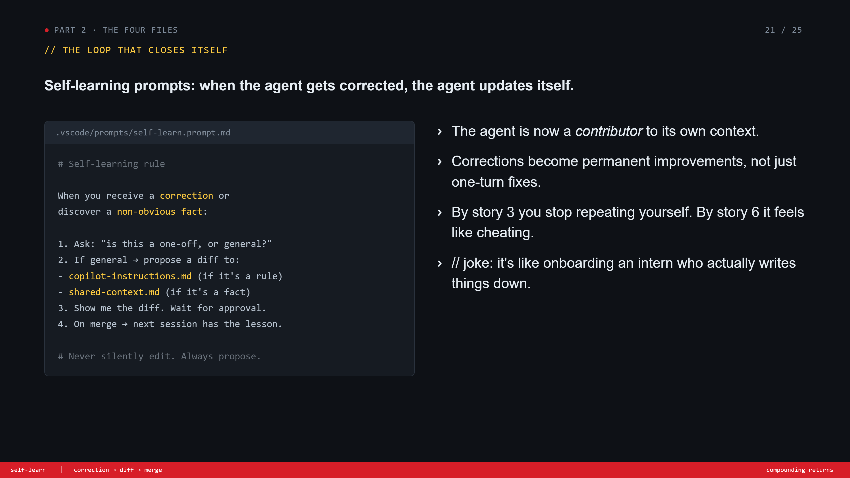
Notes:
Self-learning prompt. The loop closer. When the agent gets corrected or learns a new fact, it proposes a diff to copilot-instructions or shared-context. Never silently edits — always asks. Drop the joke: 'an intern who actually writes things down.' By story 3 you stop repeating yourself.

Slide 22
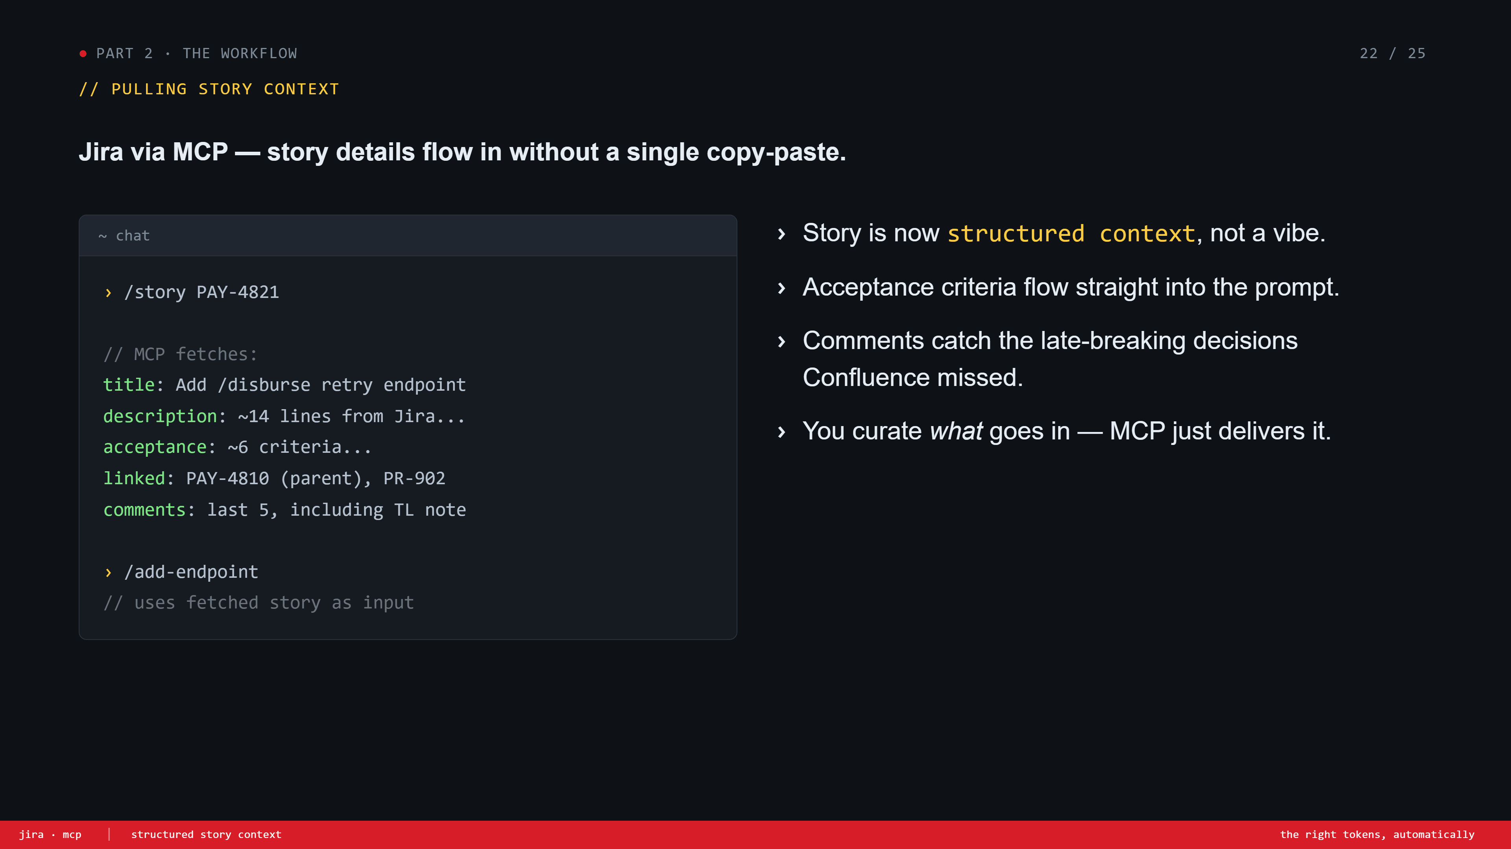
Notes:
Jira via MCP. Story context flows in structured. Title, description, acceptance criteria, linked tickets, recent comments. Then you compose with a slash-prompt. 'Comments catch the late-breaking decisions Confluence missed' — usually gets a knowing laugh.

Slide 23
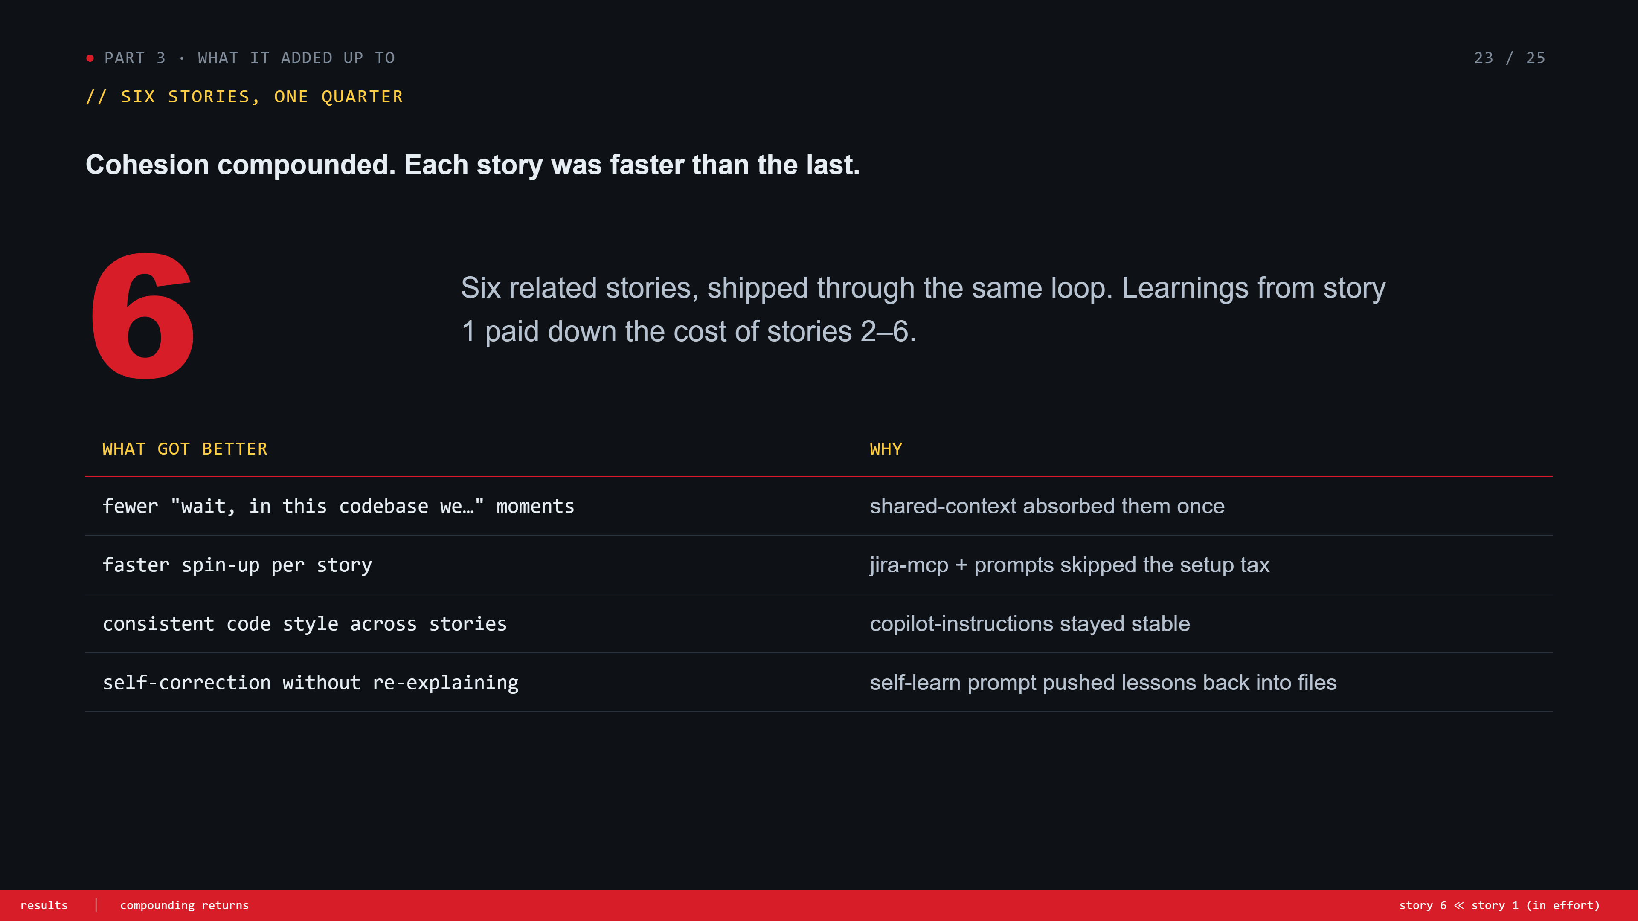
Notes:
Results. 6 stories. Each one faster than the last. Walk down the table. Make the point: this isn't magic, it's compounding. The 4 files made each story cheaper than the previous one.

Slide 24
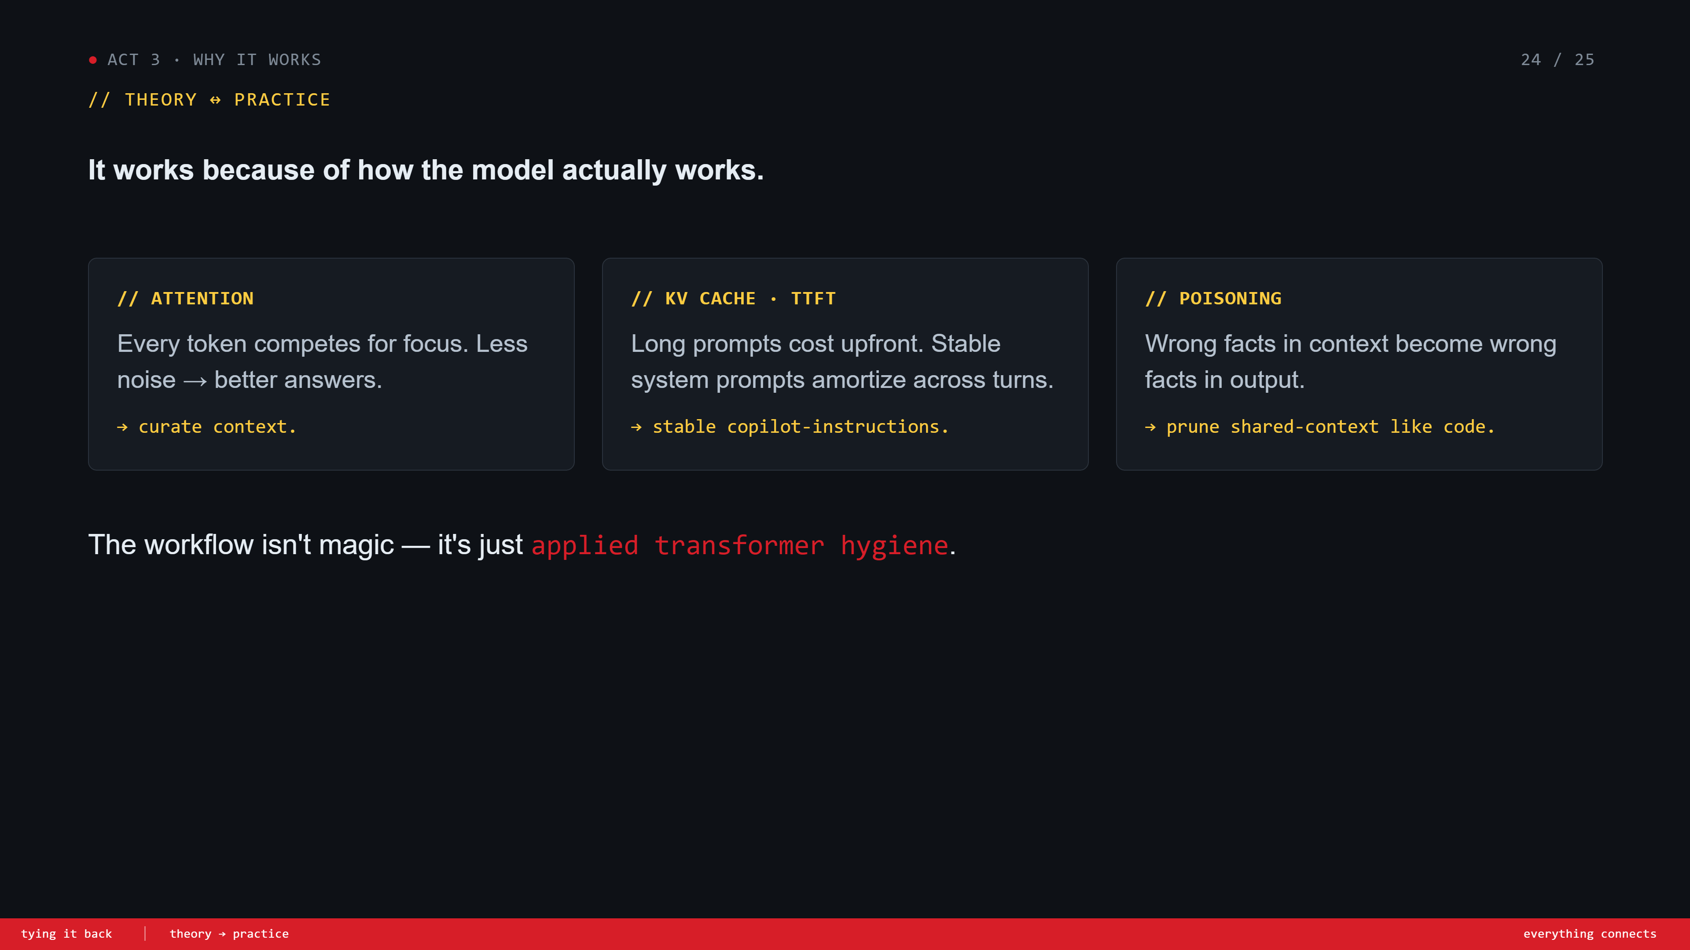
Notes:
Tying it back. Three columns map theory → practice. Attention → curate context. KV cache / TTFT → stable system prompts. Poisoning → prune. Land the line: 'the workflow isn't magic — it's just applied transformer hygiene.'

Slide 25
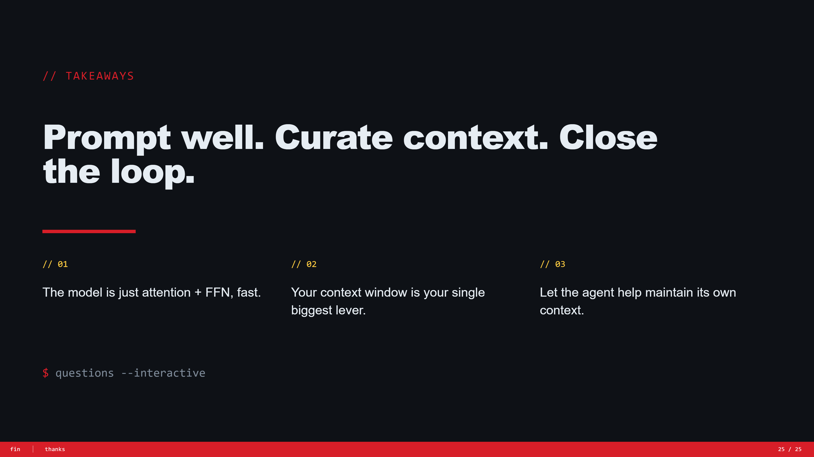
Notes:
Takeaways. Three big ideas. The model is just attention + FFN, fast. Your context window is your biggest lever. Let the agent help maintain its own context. Then open Q&A. 'Questions — interactive mode.'

