Slide 1
DOORDASH
Mission-
First Home.
Turning the things people are trying to accomplish into completed missions.
Team Mission A / MBAi 420 / Spring 2026
Notes:
ERIC OPENS (~10s) Walk on. Brief pause to let the room settle. Then: DoorDash exists to grow local economies. What we're proposing is the next layer of that. Turning the things people are trying to accomplish into completed missions. Beat. Advance to the pillars slide. Don't open with 'hi we're team Mission B' or 'today we're going to present.' Just walk into the idea.

Slide 2
THE PROBLEM
It's 6:47 PM
on a Saturday
in February.
DOORDASH / MISSION-FIRST HOME
Notes:
SPEAKER 1, cold open (~7s) It's 6:47 PM on a Saturday in February. Slow. One line, then half a beat before advancing. The slide is doing the work.

Slide 3
Meet
Maya.
M
Second-year MBA. Lives at E2. Just got home from a club hang.
She's been thinking about hosting Galentine's all week.
Confidence level: 9/10. Wine in fridge: 0.
Notes:
SPEAKER 1, Meet Maya (~15s) Meet Maya. Second-year MBA. Just got home from a club hang. And in that warm post-event high, she decides she's going to host Galentine's tomorrow. Beat. Confidence level, 9 out of 10. Wine in fridge, zero. Land dry. Don't smile. Let the audience be the ones who chuckle. Aside for delivery: if they laugh at 'wine in fridge: zero,' the room is yours. If they don't, keep moving like nothing happened. The line works either way.

Slide 4
FRIDAY NIGHT. COUCH. PHONE OPEN.
Her brain opens five tabs at once.
9:41
8:38
She's trying to host.
Friday, February 13
Five apps.
Pinterest
8:14 PM
Five carts.
That's it. That's the goal.
20 charcuterie boards that will impress
Trader Joe's
8:23 PM
Five checkouts.
Did you mean: brie or camembert?
Apple Maps
8:26 PM
One host.
Trader Joe's closes in 34 minutes
Whole Foods
8:31 PM
$89.46 in your cart
Instacart
8:33 PM
Your order has 4 substitutions
Notes
8:38 PM
things to remember: ICE!!
Notes:
SPEAKER 2, the cascade (~18s) Friday night. She's on her couch. She opens one tab to look up wine. Beat. Gesture at the phone. Twenty minutes later her phone looks like this. Pinterest has thoughts. Trader Joe's wants to know if she means brie or camembert. Apple Maps is reminding her the store closes in thirty four minutes. Whole Foods is sitting on an eighty nine dollar cart. Instacart is offering four substitutions, none of which she would have picked. She's trying to host. That's it. That's the goal. Five apps. Five carts. Five checkouts. One host. Aside for delivery: if the room laughs at 'things to remember: ICE!!', that's the line that's working. The all caps is doing the joke.

Slide 5
It's a lot.
It's tomorrow.
She just wants to put her phone down.
Notes:
SPEAKER 2, the weight (~8s) It's 20 degrees. It's dark. She just wants to go home. Three beats. One for each line.

Slide 6
galentines 💖
So they do
what they always do.
ok hosting is too much…
just meet at the ridge?
They downgrade.
seen 11:42 PM
Notes:
SPEAKER 2, the downgrade (~10s) So she does what we all do. She cancels. Beat. She didn't decide not to host. She decided not to coordinate. Two different problems. Drop the last line quiet. Don't sell it.

Slide 7
WHAT SHE WANTED
WHAT SHE GOT
A curated
Galentine's
at home.
A loud bar.
$18 rosé.
Pink everything.
The DJ played Mr. Brightside.
Good rosé. A cheese board.
Four Venmo requests, no chairs.
Flowers on the table.
Home by 10:30.
Six of her favorite people.
Already thinking about next year.
Notes:
SPEAKER 2, what she wanted vs. what she got (~20s) Let the slide load. Full beat before talking. She wanted a curated Galentine's at home. She got an 18-dollar glass of rose at a loud bar where the DJ played Mr. Brightside. Half the group bailed once the plan changed. She was home by 10:30. Beat. Quieter: Already thinking about next year. That's the line. Don't add anything after it. The slide ends there. Hand off to Shinjini. Aside for delivery: Mr. Brightside isn't actually playing in this scenario. Mr. Brightside is always playing somewhere. If anyone in the room nods, you're in. If they don't, the line still works as a description of a generic bad night out.

Slide 8
THE PROBLEM ISN'T HOSTING.
It's everything
in between.
Notes:
SPEAKER 3, the pivot (~6s) Pick up directly from Speaker 2's last line. No transition language. The problem isn't hosting. It's everything in between. Long pause after. Then: So what if it wasn't?

Slide 9
OUR BET
DoorDash stops delivering parts.
It starts orchestrating gatherings.
Mission Intelligence.
Trust.
Order data tells us what. Mission data tells us why.
Reliable missions earn the next hand-off.
Both compound. Both feed more missions completed on DoorDash.
Notes:
SPEAKER 3, our bet (~18s) Pick up directly from Rohan's pivot. No transition language. Today DoorDash delivers parts. Wine from one merchant. Cheese from another. Flowers from a third. Maya has to be the project manager that strings them together. And when that gets too heavy, the whole thing collapses. Our bet: DoorDash stops delivering parts. It starts orchestrating gatherings. Beat. Then walk the pillars: Mission Intelligence. Order data tells DoorDash what people bought. Mission data tells DoorDash why. Trust. Reliable missions earn the next hand-off. They compound. Intelligence earns trust. Trust earns more missions. Hand off to Shinjini, who picks up with 'Let's rewind.'

Slide 10
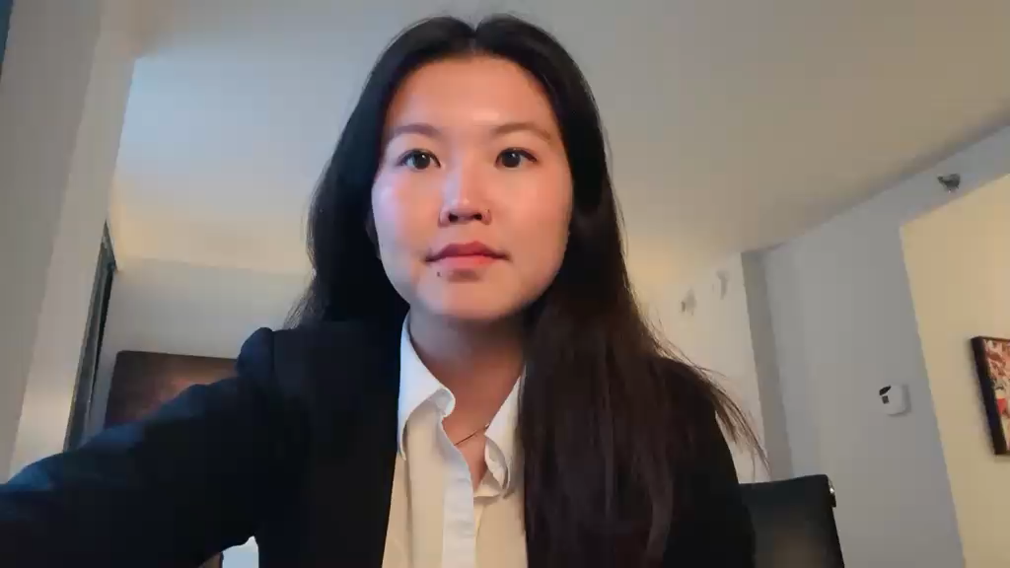
Let's rewind.
Same Saturday. Same Maya. One thing changes.
Notes:
SHINJINI, rewind (~5s) Let's rewind. Same Saturday. Same Maya. One thing changes. Brisk. Energy shifts here. The room's been somber for three slides. Now we're moving forward.

Slide 11
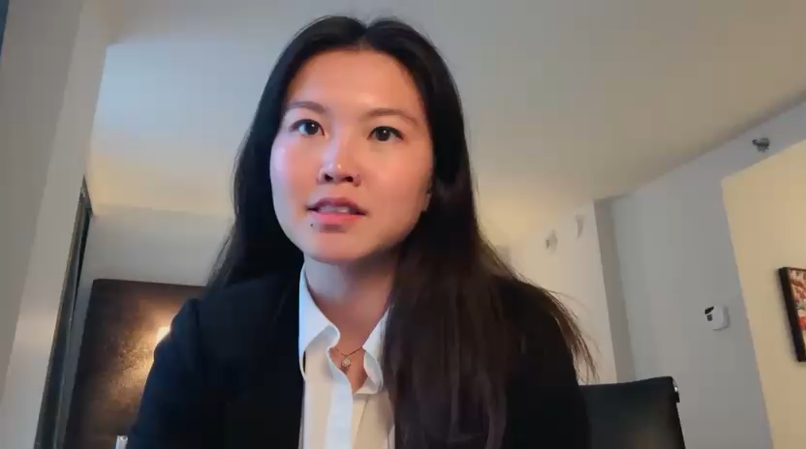
MISSION-FIRST HOME
Three things have to be true.
Each one already exists at DoorDash. We just wire them together.
1
A mission lives on the home screen.
Host Galentine's. Game day. Birthday. Discovery starts before the cart does.
2
One cart spans every merchant.
Wine, cheese, flowers, candles. Six merchants, one checkout, one fee.
3
Templates are authored by ops.
Curated bundles per mission. Editable. No model required to launch.
Notes:
SPEAKER 4, what the product actually is (~15s) Mission-First Home is three things working together. First, a mission lives on the home screen. Host Galentine's. Game day. Birthday. Discovery starts before the cart does. Second, one cart spans every merchant. Wine from the liquor store, cheese from the grocer, flowers from the florist. Six merchants, one checkout, one delivery fee. Third, templates are authored by ops. No new ML. Real curation, editable by the host, ready to ship. Each piece exists at DoorDash today. We're wiring them together. Hand into the storyboard, which shows what this looks like in Maya's hands.

Slide 12
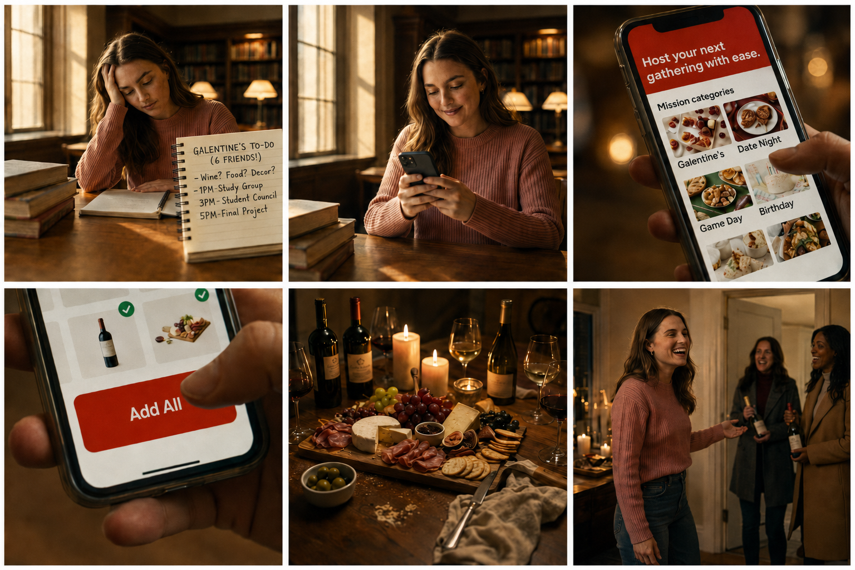
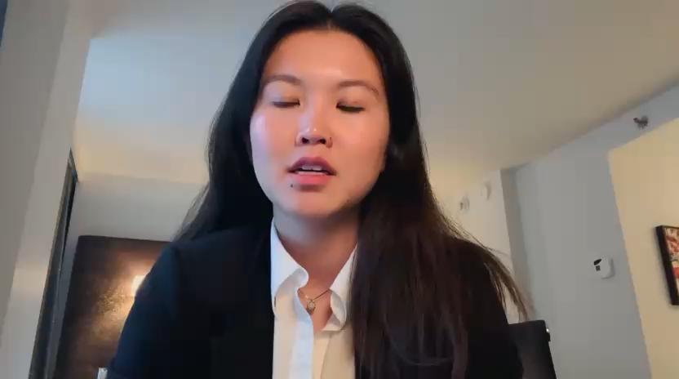
ONE TAP. ONE CART. ONE HOST WHO ACTUALLY HOSTS.
Three minutes of planning. Saturday she's ready.
Notes:
SHINJINI, storyboard (~20s) Brief pause to let people scan the grid. Same Saturday with Mission-First Home. She opens DoorDash. Host Galentine's is right there on the home screen. She taps it. Confirms six guests. What would have been five carts becomes one cart, six merchants, one checkout. Beat. She edits two things. Swaps the cheese, adds extra rose. That's it. Three minutes of planning instead of three hours of orchestrating. Close: Saturday, she actually hosts. Don't read every panel. Narrate the shape of the change.

Slide 13
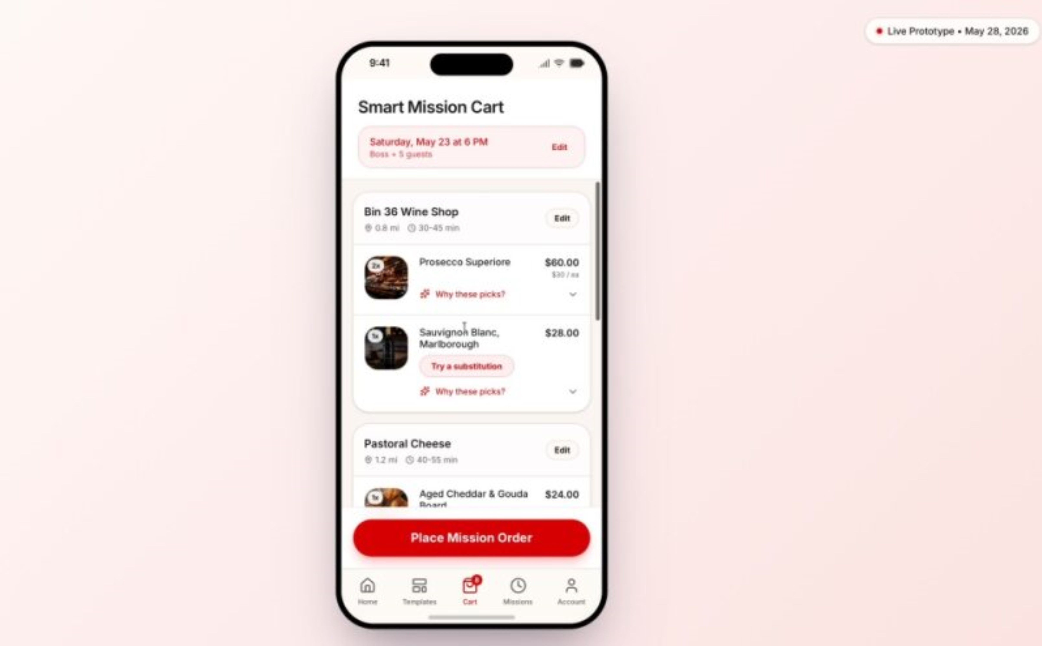
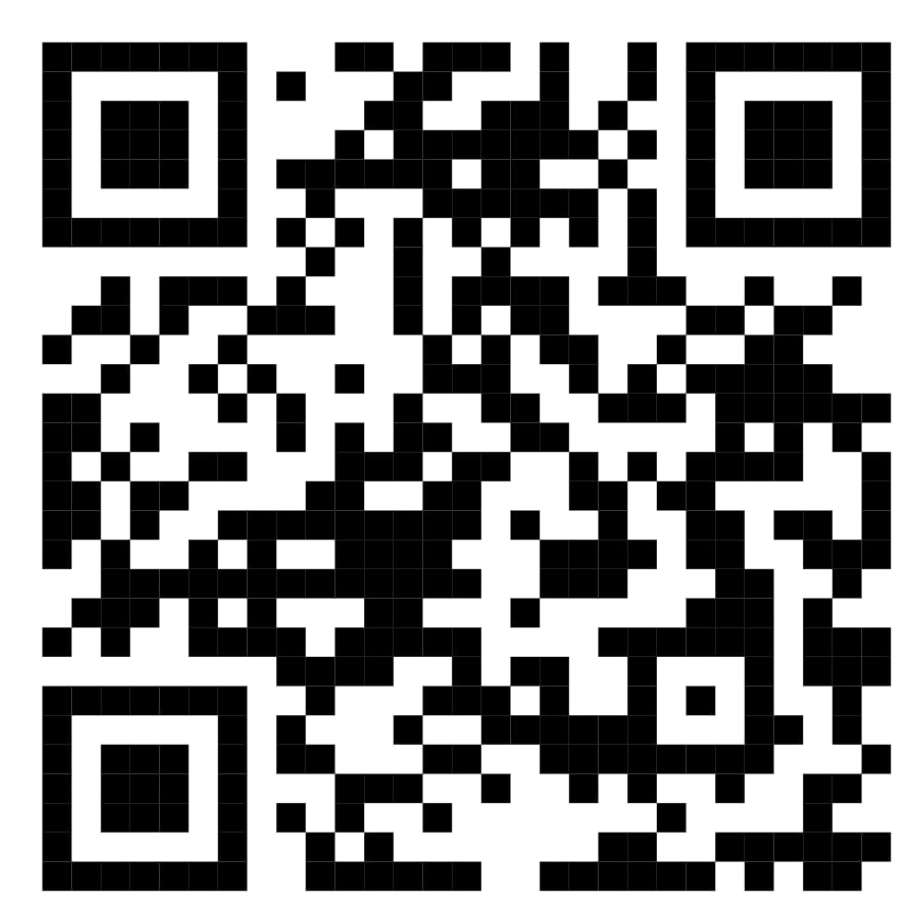
LIVE FROM THE PROTOTYPE
[ insert demo recording ]
Watch Maya do it in real time.
Notes:
SHINJINI, demo (~30s) And here's what that actually looks like. Play video. Stand still. Don't talk over it. Watch with the room. When it ends: Three minutes. One cart. Six merchants. Placeholder slide: drop the real screen recording in before submission. Target length 25 to 30 seconds.

Slide 14
Meet
Maya.
M
Same second-year MBA. Same E2 apartment. Same Saturday.
This time, she actually hosts.
Confidence level: 9/10. Wine in fridge: 6 bottles. Cart in hand: 1.
Notes:
SPEAKER 4, the callback (~12s) Same Maya. Same Saturday. Wine in the fridge, six bottles. Cart in hand, one. Beat. Let the callback land. Quieter: That's what Mission-First Home does. It turns the host she wanted to be into the host she actually was. Then pick up the thread into Eric's close: But getting there means making three deliberate bets first.

Slide 15
WHAT IT'S WORTH TO DOORDASH
$108M incremental GOV.
And a new retention vector.
PESSIMISTIC
BASE
OPTIMISTIC
4% declare
8% declare
12% declare
$54M
$108M
$162M
incremental GOV / yr
incremental GOV / yr
incremental GOV / yr
Modest as a GOV line item. Meaningful as a DashPass retention lever.
5M hosting-eligible DashPass MAUs / $180 multi-merchant AOV / 1.5 missions / converted user / yr
Anchored to Q1 2026 disclosures: $31.6B quarterly Marketplace GOV. Excludes net-new MAUs, restaurants, non-hosting missions.
Notes:
SPEAKER 5, the sizing slide (~22s) We sized this two ways. Bottom-up: 5 million hosting-eligible DashPass MAUs. 8 percent declare a mission per quarter. 180 dollars in multi-merchant AOV. One and a half missions per year. That's 108 million in incremental Marketplace GOV at the base case. Beat. Now here's the honest read: 108 million dollars is a rounding error against DoorDash's 126 billion in annualized GOV. As a topline number, it's modest. What it actually is, is a new retention vector for DashPass. Multi-merchant hosting missions are the strongest behavioral signal a user is in for the long haul. That's what makes this worth building, and that's what the next slide is about. Aside for delivery: if anyone asks 'is 108M big enough to fund this?' the honest answer is no, not on GOV alone. The case rests on DashPass retention. Be ready to redirect to slide 15.

Slide 16
ONE NUMBER ON THE WALL
Mission declaration rate.
The one metric this team rallies around. Earliest in the funnel. Fully product-controlled.
LEADING
LAGGING
Declaration rate
Incremental GOV
$54M-$162M / yr
4-12%
DashPass retention
+1.5-4pp at 12 mo
of hosting-eligible MAUs
Multi-merchant share
10-20% of party orders
Ranges, not point estimates. Pressure-tested against Instacart Occasions and DoorDash DashPass cohort disclosures.
Notes:
SPEAKER 5, one number on the wall (~20s) Per Class 9: the PM's job is to pick one leading indicator the team rallies around. We're picking mission declaration rate. Why this one: it's the earliest signal in the funnel. It's fully within product's control. And it directly drives the three lagging outcomes leadership tracks. Beat. Then walk the lagging side: GOV: 54 to 162 million dollars incremental, driven directly by declaration rate, AOV, and frequency. DashPass retention: a 1.5 to 4 point lift at the 12 month mark. Hosting cohorts retain at a premium to single-vertical users. Multi-merchant share: 10 to 20 percent of party orders shift to multi-merchant baskets. End with confidence. No closing aphorism. The numbers speak. Aside for delivery: if anyone in Q&A pushes 'where did the ranges come from?' the answer is: ranges instead of point estimates because we don't have access to internal DoorDash cohort data. The shape of the ranges is informed by Instacart Occasions launch performance and DoorDash's own DashPass retention disclosures. This is the slide that earns the rest of the pitch with the analytical audience.

Slide 17
HOW WE GET THERE
Three deliberate bets.
01
02
03
Start with hosting.
Rules first. ML later.
Measure missions.
The mission with the most user value and the most logistics moat.
Real declared-mission data before any model trusts it.
New platform, new metrics. New leading indicators for retention.
Notes:
ERIC, three bets (~25s) Bet 1. Start with hosting because it's where multi-merchant orchestration creates the most user value and the most differentiated logistics moat. Win this, earn the right to expand into game day, dinner parties, cocktail nights. Bet 2. Rules first, ML later. Ops-authored templates and real declared-mission data before any machine learning. Reliability before intelligence. That's how the Trust pillar gets earned. Bet 3. New platform, new metrics. Declaration rate. Multi-merchant completion. Repeat declarations within 30 days. Leading indicators of DashPass retention we don't have today. Brisk and confident. The slide is support. The voice carries the depth.

Slide 18
ONE YEAR LATER
It's 6:47 PM
on a Saturday
in February.
Maya already poured the rosé.
DOORDASH / MISSION-FIRST HOME
Notes:
SPEAKER 5, close (~10s) Slow. Mirror the cold open. One year later. It's 6:47 PM on a Saturday in February. Beat. Then quieter: Maya already poured the rosé. Beat. Then: Thank you. The rosé callback ties the close to the bad-bar slide ($18 rosé) and to Maya's original vision (good rosé on her cheese board). Same drink, but now she's the host. Don't explain it. Let the audience connect it themselves.

Slide 19
ONE TAP. ONE CART. ONE HOST WHO ACTUALLY HOSTS.
01
7:14 PM
02
7:15 PM
03
7:16 PM
Opens DoorDash.
Taps the mission.
One cart appears.
Sees 'Host Galentine's' on home screen.
Confirms 6 guests, tomorrow.
Six merchants. One checkout.
04
7:17 PM
05
Sat 4 PM
06
Sat 8 PM
She edits two things.
Everything arrives.
She actually hosts.
Swaps the cheese. Adds extra rosé.
Wine, flowers, board, candles. Together.
Six friends. One table. Zero stress.
Three minutes of planning. Saturday she's ready.
Notes:
SHINJINI, storyboard (~20s) Brief pause to let people scan the grid. Same Saturday with Mission-First Home. She opens DoorDash. Host Galentine's is right there on the home screen. She taps it. Confirms six guests. What would have been five carts becomes one cart, six merchants, one checkout. Beat. She edits two things. Swaps the cheese, adds extra rose. That's it. Three minutes of planning instead of three hours of orchestrating. Close: Saturday, she actually hosts. Don't read every panel. Narrate the shape of the change.

Slide 20
THE BET
Live your best life and let us handle the rest -
tell us your mission, and we'll supply your fest!
Host with quality you can trust and luxuriate in the time you've earned back.
Mission Intelligence.
Trust.
Order data tells us what. Mission data tells us why.
Reliable missions earn the next hand-off.
Both compound. Both feed more missions completed on DoorDash.
Notes:
ERIC, strategy + pillars (~20s) The bet: shift from delivery layer to orchestrator. Two pillars carry it. Mission Intelligence. Today, order data tells DoorDash what people bought. Mission data tells DoorDash why. That's the new signal. Trust. The more reliably DoorDash completes missions, the more users hand off the next one. They compound. Intelligence earns trust. Trust earns more missions. More missions feed more intelligence. Close with the handoff into Rohan's section: But before we get into the platform, we should talk about why it has to exist. Because right now, every host is doing this alone. Beat. Let the next slide land. Don't say 'now Rohan will tell you about the problem.'

Slide 21
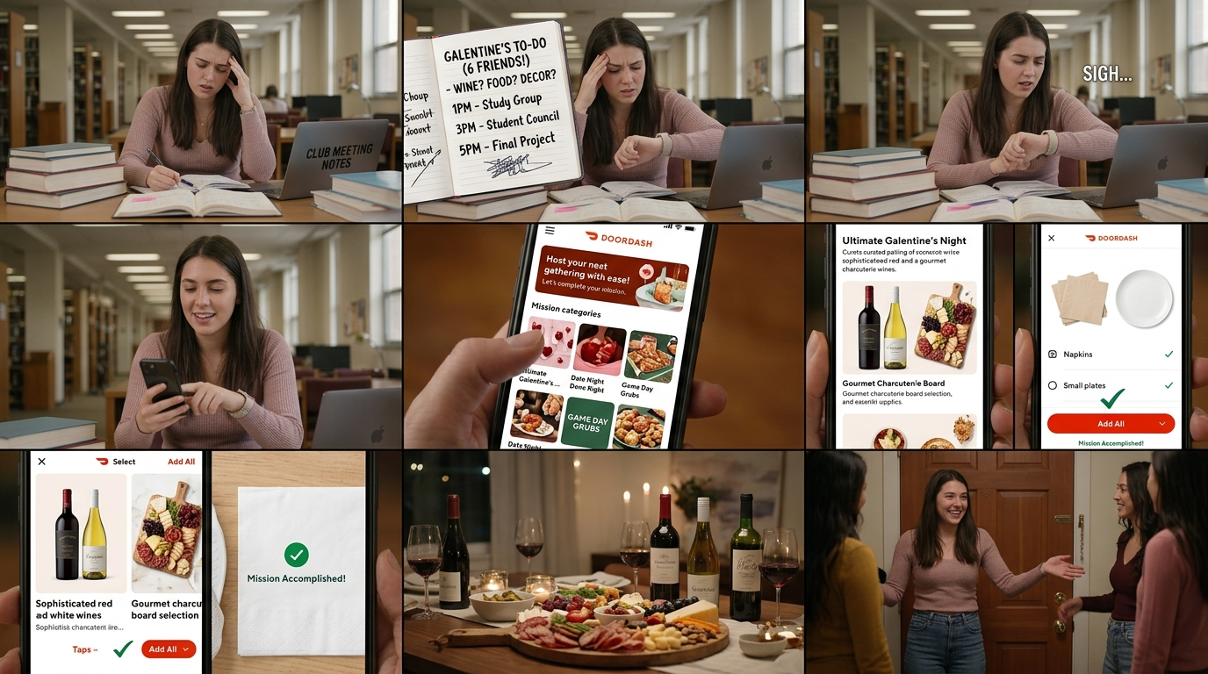
ONE TAP. ONE CART. ONE HOST WHO ACTUALLY HOSTS.
Three minutes of planning. Saturday she's ready.
Notes:
SHINJINI, storyboard (~20s) Brief pause to let people scan the grid. Same Saturday with Mission-First Home. She opens DoorDash. Host Galentine's is right there on the home screen. She taps it. Confirms six guests. What would have been five carts becomes one cart, six merchants, one checkout. Beat. She edits two things. Swaps the cheese, adds extra rose. That's it. Three minutes of planning instead of three hours of orchestrating. Close: Saturday, she actually hosts. Don't read every panel. Narrate the shape of the change.

Slide 22
Meet
Maya.
M
Same second-year MBA. Same E2 apartment. Same Saturday.
This time, she actually hosts.
Confidence level: 9/10. Wine in fridge: 6 bottles. Cart in hand: 1.
Notes:
SHINJINI, the callback (~12s) Same Maya. Same Saturday. Wine in the fridge, six bottles. Cart in hand, one. Beat. Let the callback land. Quieter: That's what Mission-First Home does. It turns the host she wanted to be into the host she actually was. Then pick up the thread into Eric's close: But getting there means making three deliberate bets first.

Slide 23
DOORDASH
From delivering
the parts
to orchestrating
your event.
Team Mission A / MBAi 420
Notes:
ERIC, close (~10s) DoorDash has always delivered the parts. Mission-First Home lets it orchestrate the whole gathering. Beat. Then: Thank you. Slow. Confident. Let the line breathe before smiling. Runtime target: 4:30 talking + 30s demo = 5:00. If running long, tighten setup on slide 5 and drop the second beat on slide 13. Keep slide 8 intact.

