Slide 1
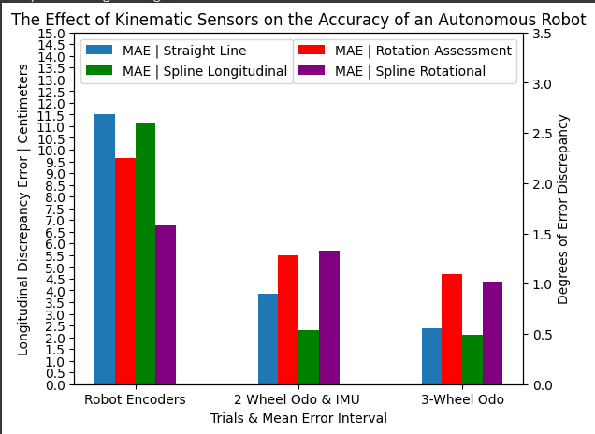
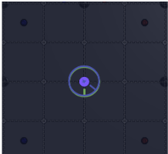
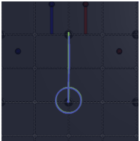
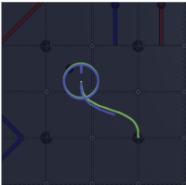
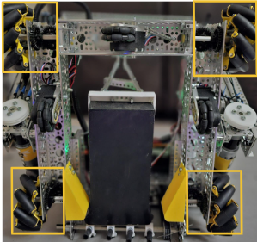
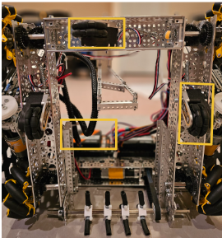
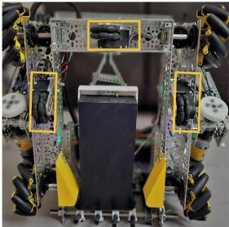
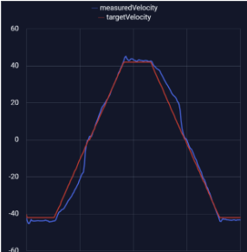
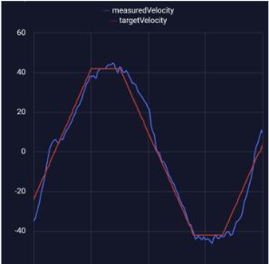
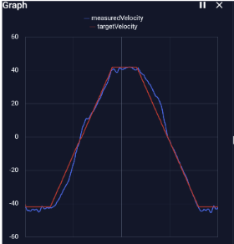
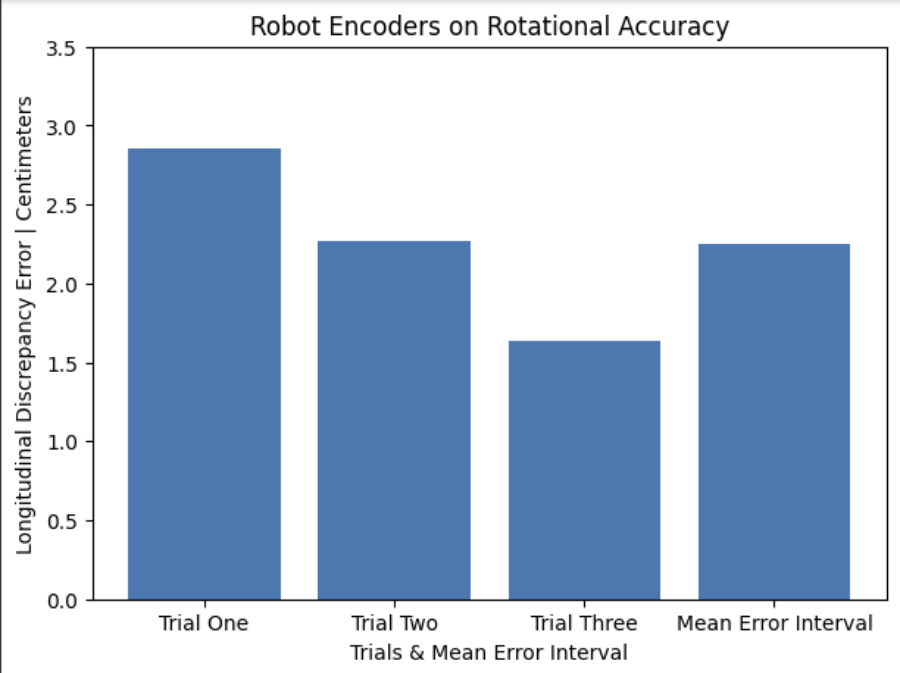
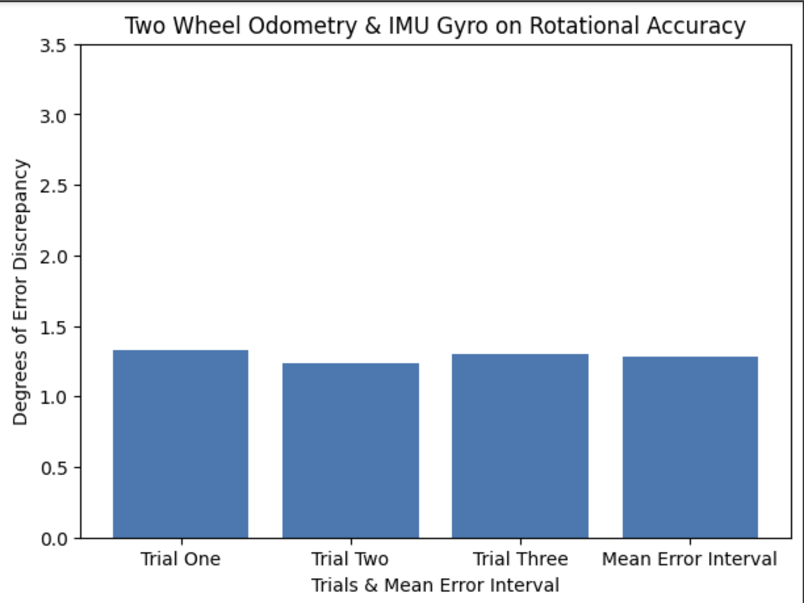
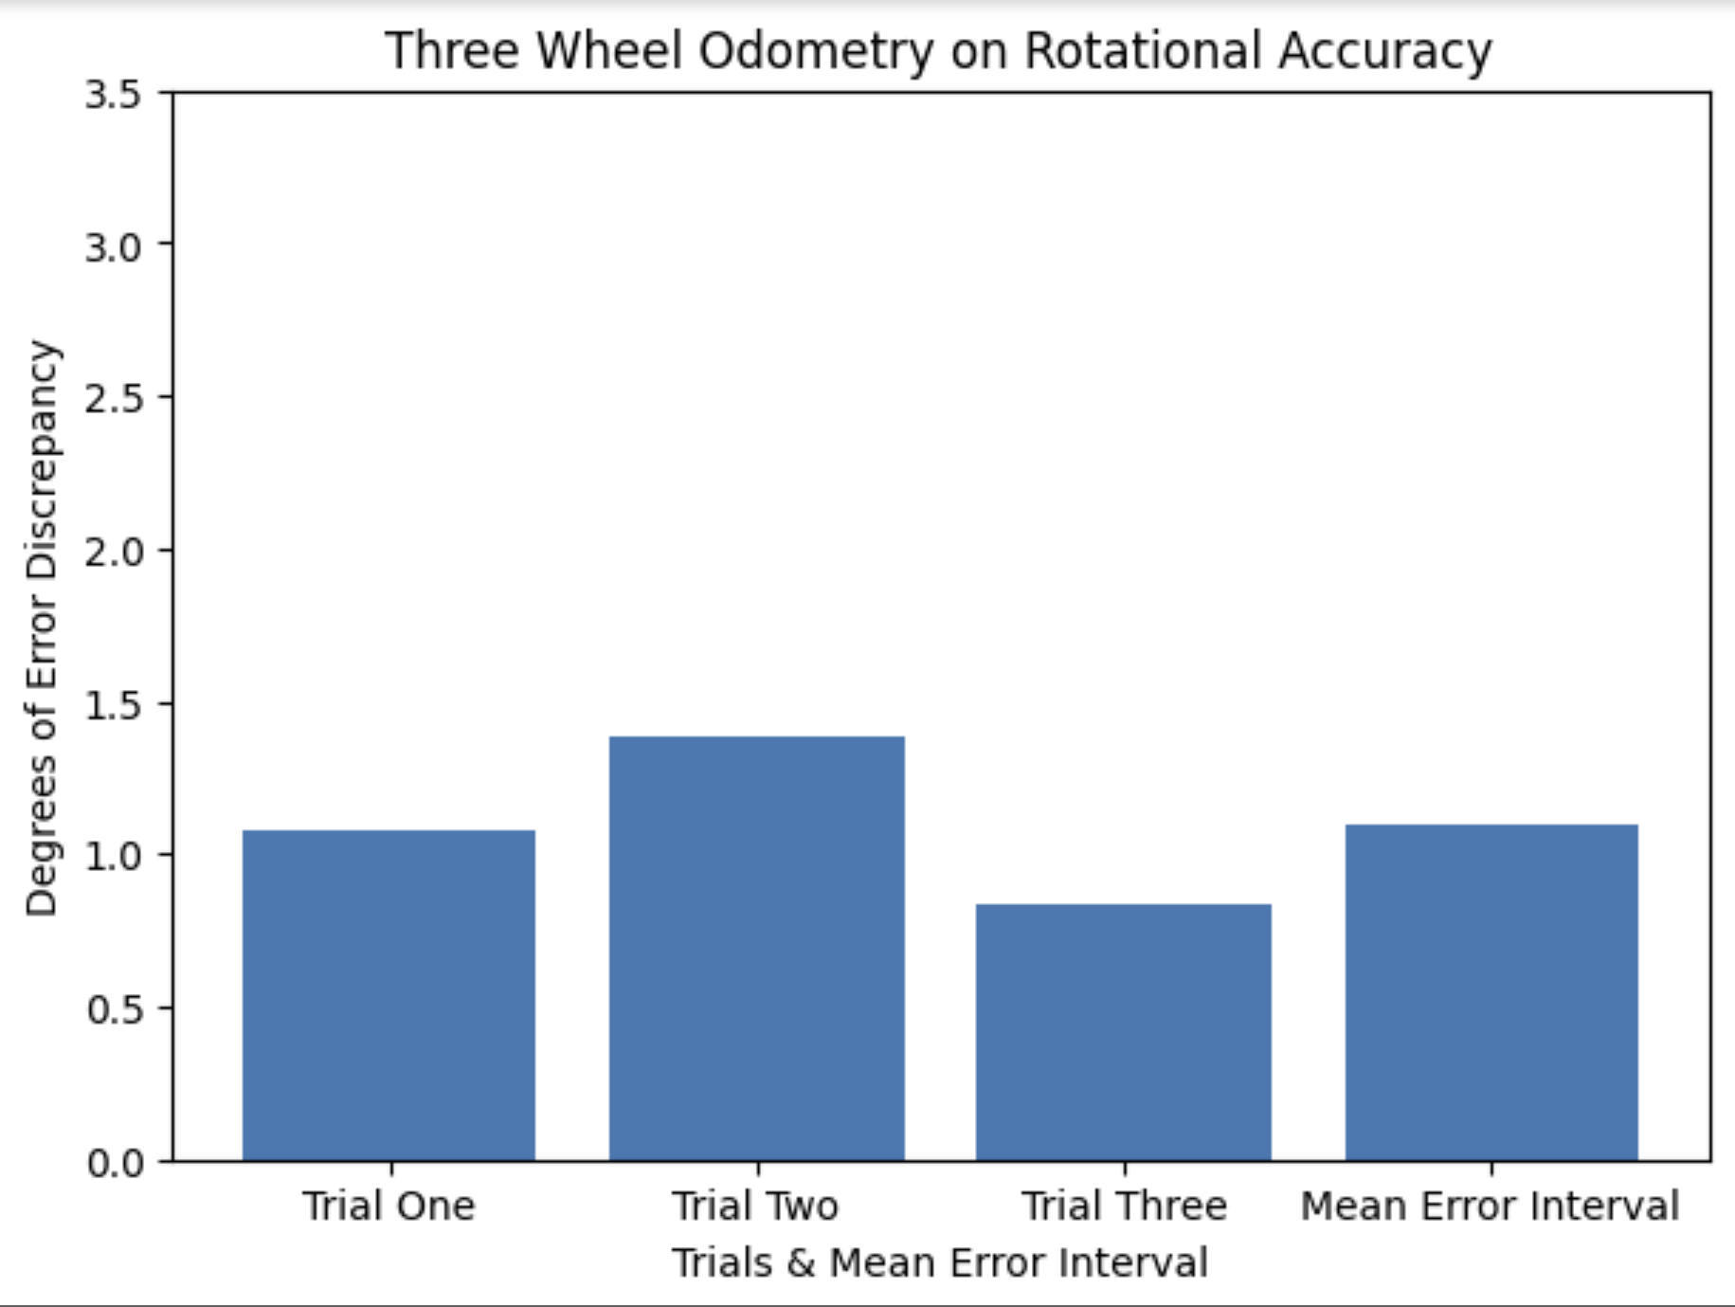
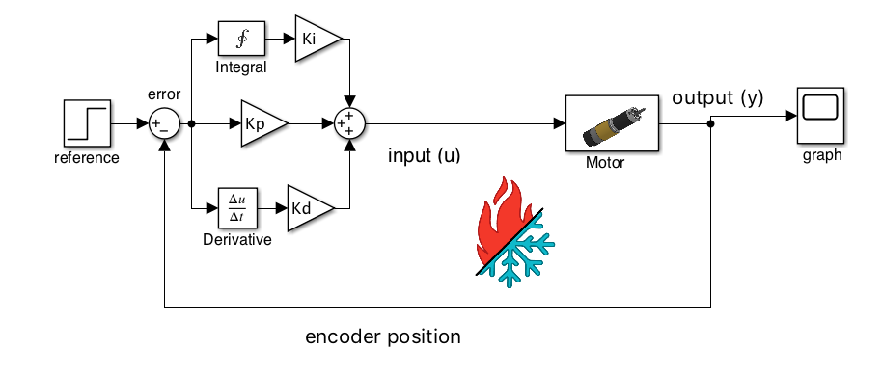
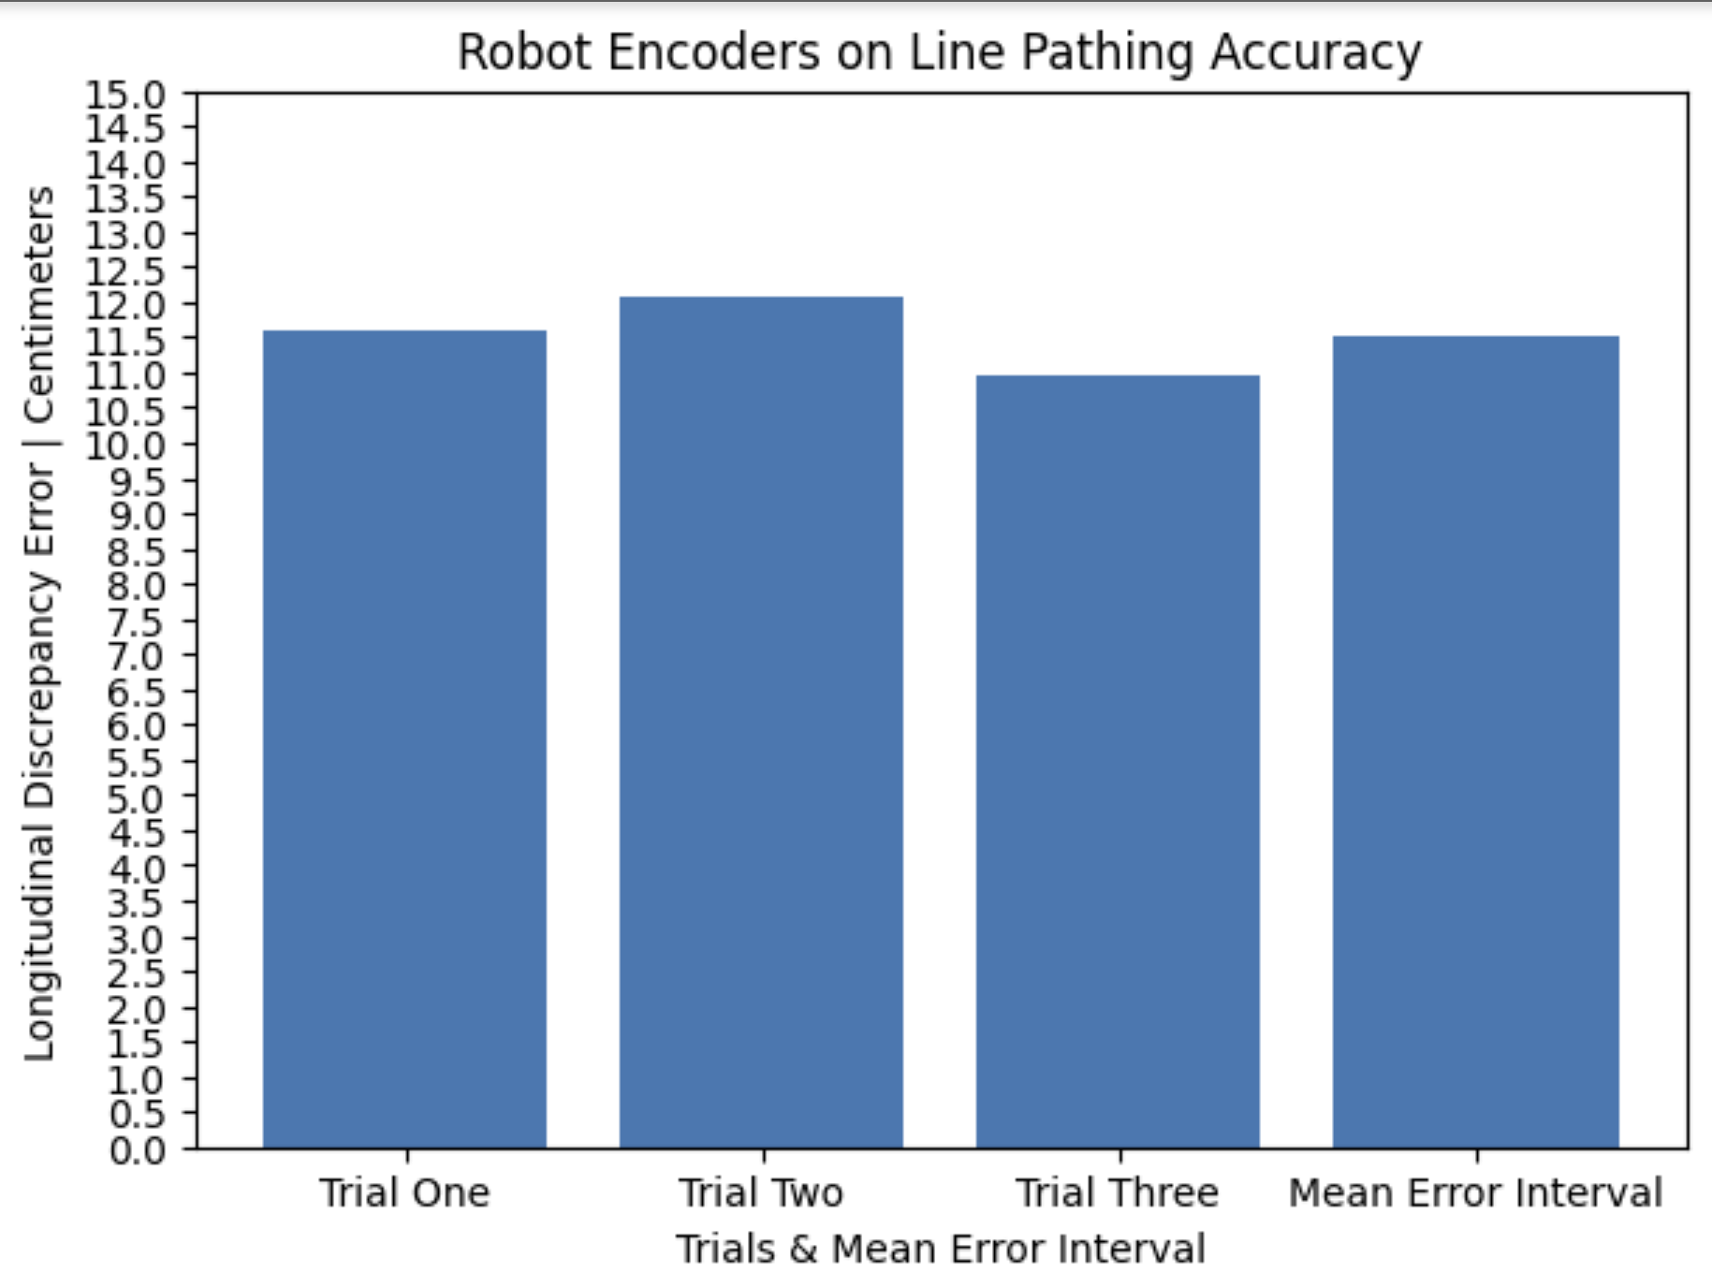
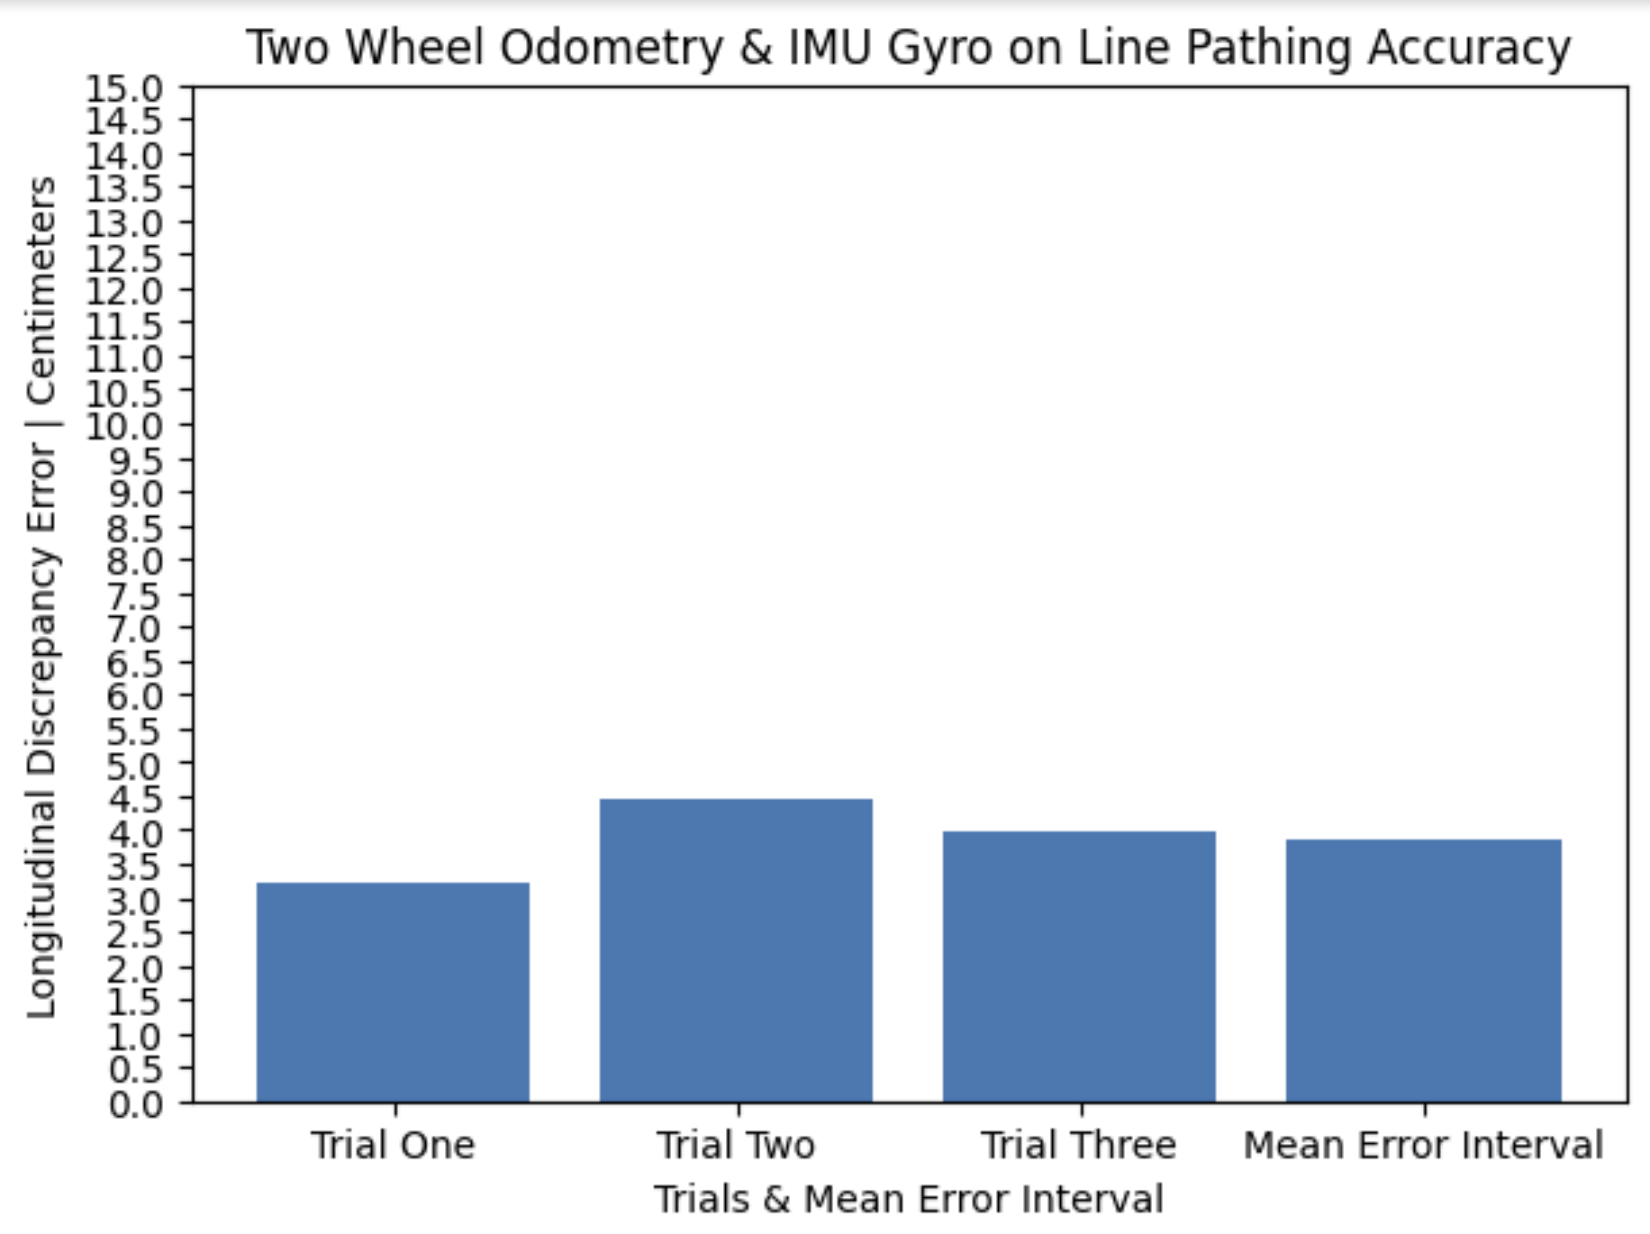
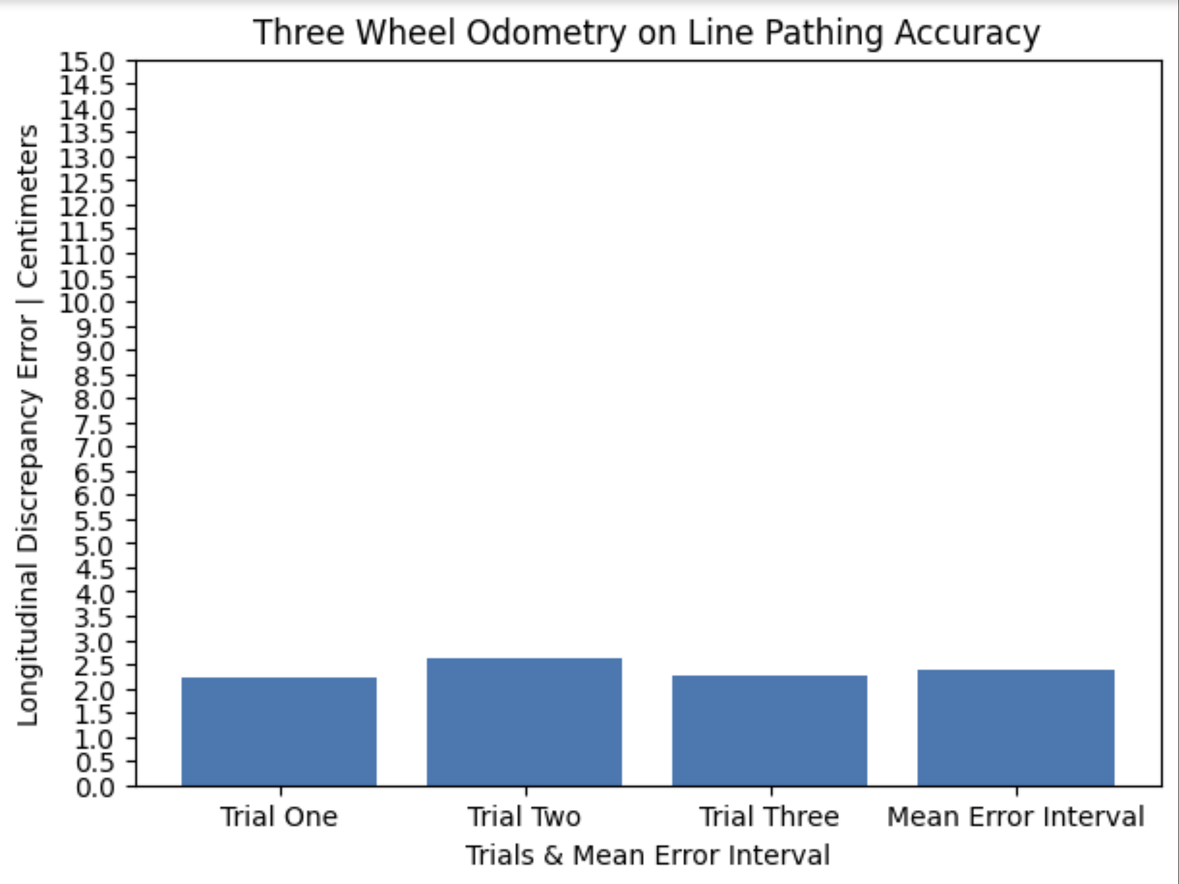
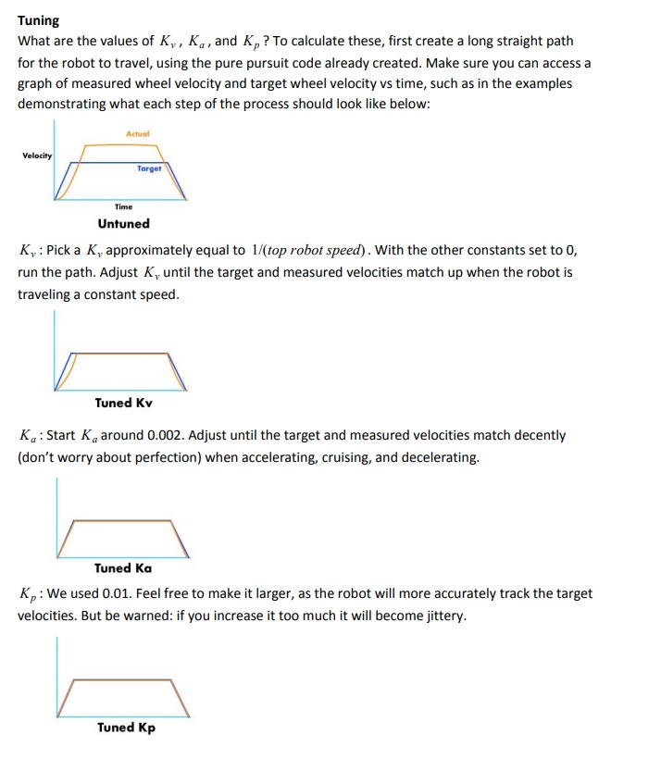
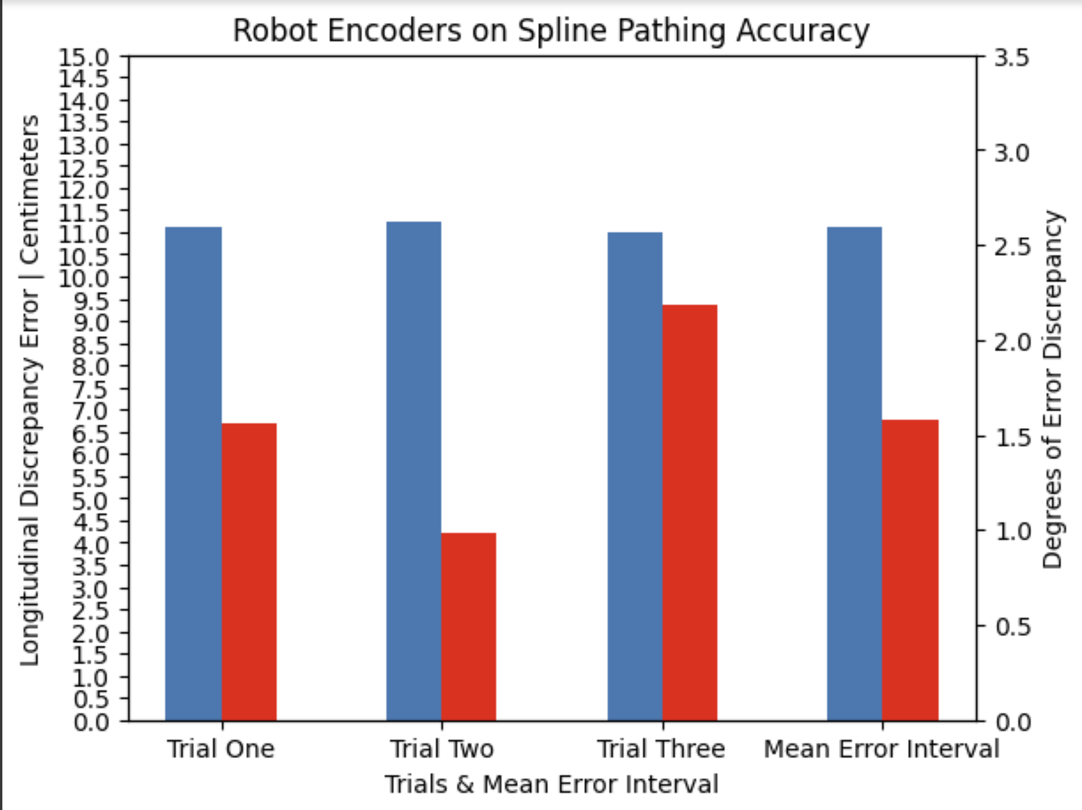
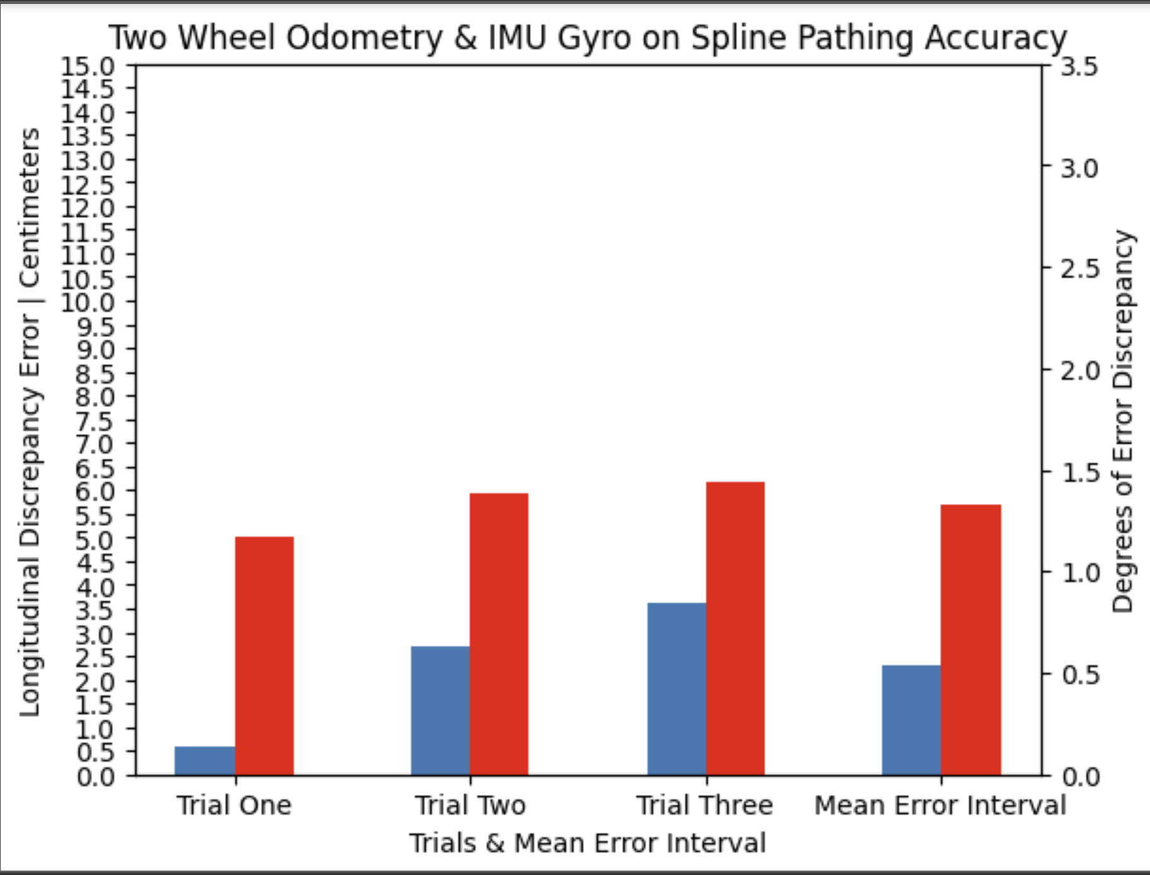
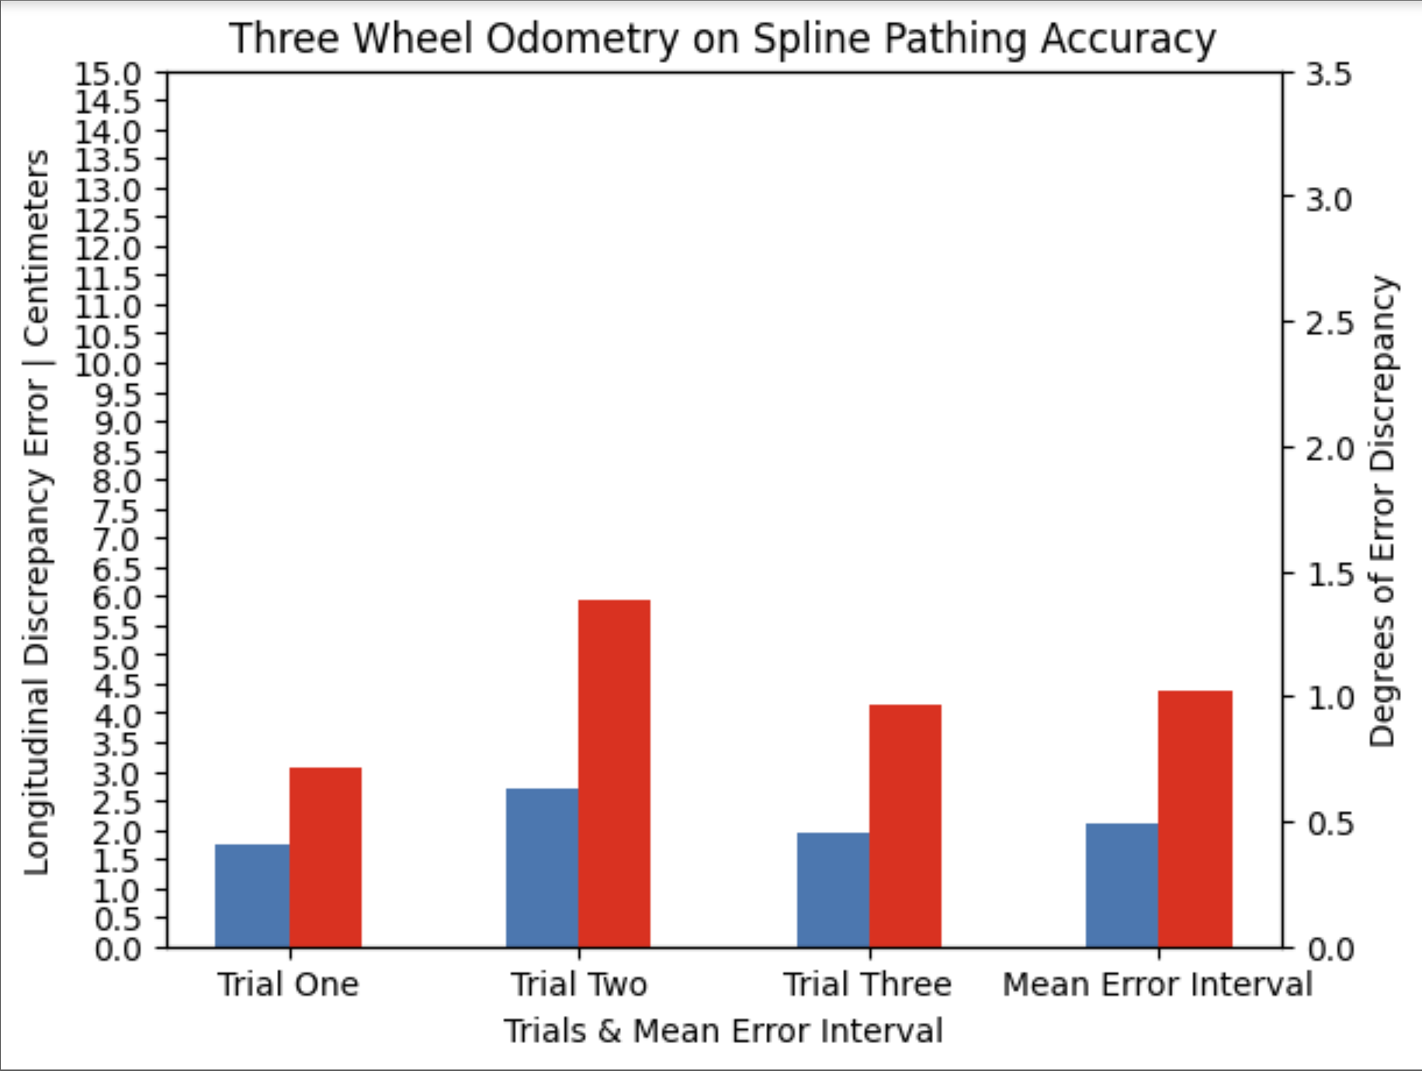
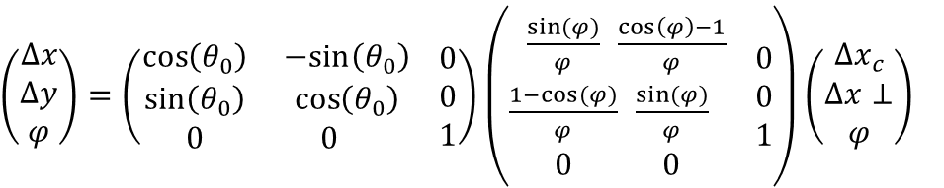
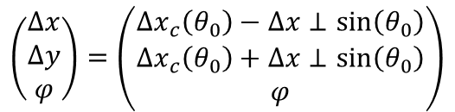
Utilizing Differentiated Kinematic Sensors to Assess & Enhance the Accuracy of a Robot in an Autonomous State
Arjun Ganesan | Class of 2027 | Robot Kinematics & Control Theory
Abstract
Methodology
Assessment of Data
As the field of automation in correspondence to kinematics is increasing its prominence among automobiles and intelligent machines, this research paper conveys the influence of three primary kinematic sensor arrays, four-wheel drive encoders, two-wheel odometry & IMU Gyro, and three-wheel odometry, on the accuracy of an autonomous robot to attain its reference position. This was assessed through three primary kinematic procedures: a 360⁰ rotational assessment, straight 152.4 cm line assessment, and a spline curve assessment, integrating both components into one primary nonlinear curvature trajectory resembling that of an “S” shape. These pathing movements were pursued through two primary algorithms: feedforward projection and PID mitigation. In addition, attaining the alteration in position, or Pose, was attained through integrating differential equations referred to as Pose Exponentials. The obtained data corresponded to the hypothesis, denoting the three-wheel odometry consisted of the greatest accuracy, followed by two-wheel odometry and four drive encoders. This was primarily due to the ideals of tractions and data reliance regarding the odometry wheels and its capability of pursuing these complex trajectories. Similarly, due to dead wheel documentation, the odometry variables consisted of the ability of course correct, indicating it retained its position regardless of external forces. Thus, this study has introduced significant insights in the field of control theory and kinematics and consists of a multitude of enhancements regarding AI, external sensors, and algorithmic interfaces to advance automated kinematics within technological society.
As a method of ensuring validity in this study to assess the influence of kinematic sensors on the accuracy of a robot in an autonomous state, three primary procedures and protocols were utilized. This was a rotational, longitudinal, and complex curvature spline assessment. The rotational assessment was utilized to assess the individual rotational accuracy of the robot, the linear assessment was utilized to assess the individual longitudinal accuracy of the robot, and the spline assessment integrated both components into a complex curvature trajectory to resemble applicative trajectories and assess sensor capacity to pursue these trajectories in absence of immense error. In addition, all movements within society are essentially vectors and curvature trajectories; thus, this robot consisting of the ability to pursue an accurate kinematic profiling of this complex spline curvature proposes its relative ability within society thus contributing to societal application.
Rotational Assessment: Robot pursues a 360⁰ rotation, and the rotational discrepancy is calculated to the nearest 0.001 degree; component assesses the rotational pathing components of kinematics and motion profiling
Straight Line Assessment: Robot pursues a 152.4 cm straight line, and the longitudinal discrepancy is calculated to the nearest 0.001 centimeter; component assesses the linear and longitudinal pathing component of kinematics and motion profiling
Spline Trajectory Assessment: Robot pursues a spline curve, resembling that of an “S,” consisting a 76.2 cm longitudinal extent in addition to rotation throughout the path; component integrates both the rotational and longitudinal trajectories to represent greater application to modern intelligent machines through these nonlinear kinematic sequences to assess compatibility
Experimental Procedure Trajectories
In the rotational assessment, the three-wheel odometry consisted of the greatest efficiency, followed by the two-wheel odometry, and the robot encoders. However, the two-wheel odometry & IMU Gyro consisted of the greatest consistency. This was primarily due to the utilization of the gyroscope in which it consisted of internal consistency. Within the line pathing assessment, the three-wheel odometry consisted of the greatest efficiency, followed by two-wheel odometry & IMU, and the robot encoders. This projection accuracy in this longitudinal trajectory may have been due to the three-wheel odometry consisting of two parallel odometry pods attaining longitudinal data. However, the IMU Gyro consisted of influence thus indicating its inabilities. Similarly, the robot encoders may have
Rotational Assessment
Linear Assessment
Spline Assessment
Relevance & Application to Society
lacked efficiency due to the lack of odometry wheels and reliance on the wheel encoders in which the lack of traction creased error interval. Within the integrated spline pathing assessment, the three-wheel odometry consisted of the greatest efficiency, followed by the two-wheel odometry & IMU Gyro, and robot encoders. Through the documentation of data and assessment, the three-wheel odometry consisted of the greatest efficiency due to its data reliance obtained through the pure utilization of dead wheel encoders as opposed to the two-wheel odometry in which utilized the IMU Gyro lacks optimization abilities and drive encoders due to its lack of consistency through traction and drift. Furthermore, due to the presence of individual dead wheels in odometry modules, the robot consisted of the ability to pursue course correct. Similarly, through observing the spline path, it was observed that the drive encoders pursued greater individual linear trajectories as opposed to the universal curvature trajectory of the three-wheel odometry. This indicates, within the spline curve, the robot was unable to pursue the critical trajectory to attain its position, however, the three-wheel odometry consisted of greater trajectory pathing to the position to contribute to its holistic accuracy. In addition, one may believe these trajectories in the methodology consist of limitations due to the metric extent, in which all endeavors did not surpass five feet within the trajectory. Thus, according to the Second Law of Thermodynamics, in which it denotes entropy or disorder, represented through error within this study, increases as time progresses. This indicates the error obtained would have continued to increase at a constant interval in correspondence to the metric extent of movement. Within the drive encoders, this was present due to the greater drift and lack of course correct. However, due to the accuracy of these odometry modules in conjunction with the constant PID and course correction, this error would not only retain constant, but experience mitigation and regression to contribute to its universal accuracy.
Kinematic Sensor Robot Integration
Feedforward Algorithm Tuning
As technological society is advancing through intelligent machines, primarily exemplified through the automobile industry, the primary objective is to attain the greatest accuracy regarding the utilization of sensors and software algorithms. As progression occurs in automated machines, primarily through kinematics and motion profiling, we must assess the ability to attain the greatest accuracy from the reference position to true position to further enhance these subsystems that are increasing their prominence in society.
Four Robot Encoders
Two-Wheel Odometry & IMU Gyro
Three Wheel Odometry
Robot Encoder Feedforward
2 Wheel Odo & IMU Gyro Feedforward
3 Wheel Odo Feedforward
Research & Scientific Objective
Prior to indicating the objective of this research study, the underlying query regarding this endeavor must be addressed in correspondence. This research inquiry refers to the method in which kinematic sensor utilization and assessment contributes to the accuracy of a robot in its pursuing its trajectory within an autonomous state. Through pursuing this study, the primary objective is to attain a mean absolute error, MAE, below 3% of error within both longitudinal and rotational components within the spline trajectory.
Conclusion
Experimental Design
Euler Integration
Pose Exponentials
Though these PID and feedforward algorithms may have been efficient, the calculational entities of positional difference must have been assessed to determine the effectivity in the method of field relative translation regarding Pose2D, or position coordinates. Originally, the method regarding this utilized the mathematical entity of Euler Integration. However, this assumes linear trajectories thus indicating its lack of application and effectivity in society. This induced alteration of these field relative positions through the utilization of Pose Exponentials, in which it integrates curvature trajectories in these computational determinations through the utilization of differential equations as a method of modification to account for these complex and prominent trajectories to contribute to further accuracy within the internal kinematic profiling. This contributes to the pursuit of the critical route to the beginning and objective positions as opposed to utilizing these two entities and composing an efficient trajectory.
$$\left(\begin{aligned}∆x \\ ∆y \\ φ\end{aligned}\right)=\left(\begin{aligned}∆x_{c}\left(θ_{0}\right)−∆x⊥\sin\left(θ_{0}\right) \\ ∆x_{c}\left(θ_{0}\right)+∆x⊥\sin\left(θ_{0}\right) \\ φ\end{aligned}\right)$$
$\left(\begin{aligned}∆x \\ ∆y \\ φ\end{aligned}\right)=\left(\begin{aligned}\cos\left(θ_{0}\right) \\ \sin\left(θ_{0}\right) \\ 0\end{aligned}\begin{aligned}−sin\left(θ_{0}\right) \\ \cos\left(θ_{0}\right) \\ 0\end{aligned}\begin{aligned} 0 \\ 0 \\ 1\end{aligned}\right)$ $\left(\begin{aligned}\frac{\sin{(}φ)}{φ} \\ \frac{1−cos⁡(φ)}{φ} \\ 0\end{aligned}\begin{aligned}\frac{\cos\left(φ\right)−1}{φ} \\ \frac{\sin{(}φ)}{φ} \\ 0\end{aligned}\begin{aligned} 0 \\ 0 \\ 1\end{aligned}\right)$ $\left(\begin{aligned}∆x_{c} \\ ∆x⊥ \\ φ\end{aligned}\right)$
Through extensive research and interpretation, the data and its assessment corresponded to the hypothesis in which the three-wheel odometry was the most efficient, primarily due to its immense data reliance and physical integration, followed by two-wheel odometry & IMU Gyro, primarily due to its relatively less data reliance though consistency in rotational error, and the robot drive encoders, primarily due to its lack of tension regarding the drive wheels to introduce drift and complications that were substantiated through the complex spline, indicating its lacked the capacity to project these curvature trajectories. This has introduced substantial insights to the field of kinematics through the utilization of feedforward projection and PID in conjunction with these kinematic sensors. In addition, due to the ability of odometry modules to pursue course correct in addition to defy the second law of thermodynamics, trajectories can significantly increase their accuracy regardless of external forces to further simulate ideals within society. In addition, both the two-wheel odometry & IMU gyro and three-wheel odometry exemplified and surpassed the engineering and scientific objective of this research study. Holistically, this study has substantially exemplified the ideals of kinematics in addition to its effectivity and its enhancements previously denoted may alter and advance the field of kinematics and society itself to its greatest extent.
Hypothesis: If three-wheel odometry is implemented, then the accuracy of the robot will consist of the greatest enhancement due to the individual dead wheel documentation assessing critical data to contribute to an advanced feedforward and PID algorithm in addition to greater data attainment through linear and rotational documentation as opposed to drive encoders due to the lack of traction and greater error susceptibility. Independent Variables: Sensor utilized and implemented referred to as four-wheel encoders, two-wheel odometry & IMU Gyro, and three-wheel odometry. Control: Four-wheel encoders due to its integration within the motor and lack of external sensors Dependent Variable: Accuracy of an autonomous robot assessed through differentiated kinematic pathing procedures Constants: Test subject (robot), location of odometry wheels on the robot, testing environment, number of repeated trials for each procedure Repeated Trials: Each procedure will consist of three repeated protocols and the data will be recorded; mean error interval for each procedure will be documented in addition to data obtained from each test.
Data Results
Four Robot Encoders
2 Wheel Odo & IMU Gyro
Three Wheel Odometry
Future Advancements
Foundations of Kinematics
Robot Encoders on Rotational Accuracy
2 Wheel Odo & IMU Gyro on Rotational Accuracy
Three Wheel Odometry on Rotational Accuracy
Though this study has introduced a multitude of insights regarding the accuracy and application of kinematics and control theory within robotic intelligent machines, there are a plethora of apparent limitations and advancements to increase the efficiency and enhance these robotic interfaces.
Feedforward and PID algorithms consisted of robustness though these were relatively simple algorithms and may be enhanced through optimizing these algorithms in addition to integrating greater algorithms and software enhancements regarding Kalman filter and similar methods to further contribute to this accuracy
These algorithms consisted of manual tuning procedures due to specificity of algorithms and with the robot regarding mass thus introducing susceptibility to human error within the sensor accuracy and interpretation in which tuning may continue to occur further and continuously to contribute to the greatest accuracy
The software interfaces in which these algorithms and pathing libraries were implemented to correspond to the robot’s kinematic profiling were referred to as the Control & Expansion Hub in which their lack of capacity regarding advanced and mass software implementation may have induced complications
Though the accuracy of this robot in an autonomous state introduced insights in its societal application, it consists of an inability to pursue its functions in correspondence to the environment thus substantiating the integration of AI deep learning within these interfaces to promote and enhance scientific society; this will contribute to greater industrial and societal application as observed within automated automobiles, biotechnological components, and similar purposes
Within this study, the independent variables consisted of great specificity, however, through assessing their individual abilities, these sensors arrays may be altered to ensure greater accuracy regarding sensor integration of IMU Gyro in conjunction with three-wheel odometry to promote rotational accuracy and consistency in conjunction with the immense data reliance and longitudinal accuracy
As observed within the collision or course correct protocol, external forces upon the robot may be mitigated and accounted for to retain the position and trajectory of the robot, however, the robot must experience physical propulsion for this to occur, indicating it is simply unideal due to susceptible mechanical and electrical complications; thus, utilizing external sensors regarding ultra sonic or similar sensors along the exterior components of the robot may be utilized to detect external entities and masses to evade this obstruction as a method of mitigating complications and retaining the kinematic accuracy
Though this study has introduced significant insights, its lacks the representation of its functionality in society. Thus, through integrating external variables, these robotics systems may be utilized in societal applications regarding automated cars, biotechnological and medical advancements, and aeronautical rovers.
Kinematics refers to the field of pathing and motility of specified objects. In this research endeavor, kinematic algorithms are utilized in conjunction with sensors to attain the greatest accuracy in projected paths in correspondence to the reference position. The algorithms primarily utilized in this research are feedforward and PID loops. Feedforward refers to the projection algorithms in correspondence to sensors through velocity and acceleration tuning. In addition, this consists of no influence on sensor noise or temporal factors. Though this is an open loop controller in which the robot cannot mitigate a given error from the reference position to the true position, it is highly effective in its projection algorithm. This is primarily a model-based feedforward algorithm in which it computes the mathematical model of the system regarding the numerical value of input that will be most effective in attaining the reference position through velocity and acceleration computation. In addition, a prominent controller utilized in kinematics is referred to as PID. This is a closed loop algorithm in which a reference is documented to the true position and the discrepancy is altered into a compensating velocity to mitigate the given error. Thus, this was utilized in conjunction with the feedforward algorithm to increase the accuracy of autonomous robot pathing substantially. Thus, this research endeavor utilized a library referred to as Road Runner that integrated both these open loop and closed loop algorithms into the motion profiling the autonomous robot.
MAE ≈ 2.252° | MAE ≈ 0.625%
MAE ≈ 1.283° | MAE ≈ 0.356%
MAE ≈ 1.098° | MAE ≈ 0.305%
Robot Encoders on Linear Pathing Accuracy
2 Wheel Odo & IMU Gyro on Linear Pathing Accuracy
Three Wheel Odometry on Linear Pathing Accuracy
Feedforward consist of two primary values: Kv & Ka. These are essentially conversions regarding the accuracy to contribute to enhanced trajectory following
kV: Refers to the velocity conversion interval of the plant
kA: Refers to the acceleration conversion interval of the plant
PID Controller
(CTRL ALT FTC: The PID Controller, 2024)
PID refers to three values: Proportional, Integral, and Derivative. These respective values are essentially gains in which its multiplication within the modeled system alters the behavior of the controller in a subsystem. Thus, “tuning” refers to the methods of altering these values to contribute to greater effectivity within a subsystem.
Kp: Proportional term directly proportional to the error of the system; Determines speed of error mitigation
Ki: Integral term directly proportional to the sum of all errors over time to surpass non-linear disturbances, such as static friction. Accumulates remaining error until output consists of the ability to surpass the constant disruption.
Kd: Derivative term directly proportional to the change of error rate through attaining slope of error from previous update in applying it in the running loop. Dampener as it decreases fast system response that may decrease greater error than in the system
MAE ≈ 11.533 cm | MAE ≈ 7.567%
MAE ≈ 3.877 cm | MAE ≈ 2.544%
MAE ≈ 2.367 cm | MAE ≈ 1.533%
Robot Encoders on Spline Pathing Accuracy
2 Wheel Odo & IMU on Spline Pathing Accuracy
Three Wheel Odometry on Spline Pathing Accuracy
(Paper: Implementation of Adaptive Pursuit Controller, n.d.)
Key References
These algorithms originally consist of the concept of Euler Integration in which it essentially approximates position through converting robot relative deltas to a pose differentiation as a field relative delta. However, this assumes a linear trajectory occurred between updates thus, Pose Exponentials are utilized to account for curvature trajectories through differential equations to increase both accuracy and consistency. Odometry itself is a field kinematic concept that is enhanced through the utilization of its given sensors. The primary components implemented in this research are drive encoders, two-wheel odometry, and three-wheel odometry. Drive encoders refer to the documentation of ticks regarding the kinematic motor. Though this may appear feasible and effective, the probable slippage and lack of accuracy is believed to inhibit its localization ability. Two and three-wheel odometry refers to the utilization of external sensors, consisting of wheels in conjunction with an encoder in a parallel and perpendicular position in absence of power. These entities are referred to as dead wheels in which they lack power though consist of internal encoders that track the rotational ticks. This is utilized in conjunction with the robot velocity and projection profiling to increase accuracy as opposed to the proposed hypothesis regarding the lack of traction and slipping of drive wheels.
All depictions, unless it consists of a specified citation, were composed by the student researcher.
FTC Team 22377 The Sigmacorns. (2023). Feedforward Control - CTRL ALT FTC. Ctrlaltftc.com. https://www.ctrlaltftc.com/feedforward-control
Tom, Abigail, Justin, Frank, Nathanael, & Davy. (2024). Odometry. Game Manual 0. https://gm0.org/en/latest/docs/software/concepts/odometry.html
Kinematics | Road Runner. (2020, June 8). Gitbook.io. https://acme-robotics.gitbook.io/road-runner/tour/kinematics
Learn Road Runner. (2024). Learnroadrunner.com. https://learnroadrunner.com/quickstart-overview.html#what-s-feedforward
Odometry | v2.0.0 | FTCLib Docs. (2022, February 22). Ftclib.org. https://docs.ftclib.org/ftclib/v/v2.0.0/kinematics/odometry
Veness, T. (2017). Controls Engineering in the FIRST Robotics Competition Graduate-level control theory for high schoolers. https://file.tavsys.net/control/controls-engineering-in-frc.pdf
Paper: Implementation of the Adaptive Pure Pursuit Controller. (2018, August 11). Chief Delphi. https://www.chiefdelphi.com/t/paper-implementation-of-the-adaptive-pure-pursuit-controller/166552
MAE ≈ 11.125 cm | MAE ≈ 14.5%
MAE ≈ 1.579° | MAE ≈ 0.439%
MAE ≈ 2.301 cm | MAE ≈ 3.02%
MAE ≈ 1.33° | MAE ≈ 0.369%
MAE ≈2.119 cm | MAE ≈ 2.781%
MAE ≈ 1.023° | MAE ≈ 0.284%

