Slide 1
E-Commerce Product Data Analysis and
Machine Learning Insights
Presented by:
Arjun M
DA &DS
March Batch

Slide 2
Project Overview
Objective: Use data science to analyze product data, discover market trends, and improve marketing strategy.

Slide 3
Objectives
1.Collect e-commerce product data.
2. Clean and analyze the dataset.
3. Apply ML to identify patterns.
4. Provide actionable business insights.

Slide 4
Project Workflow
Data Collection → Data Cleaning → Data Storage → Unsupervised Learning → Supervised Learning → Insights

Slide 5
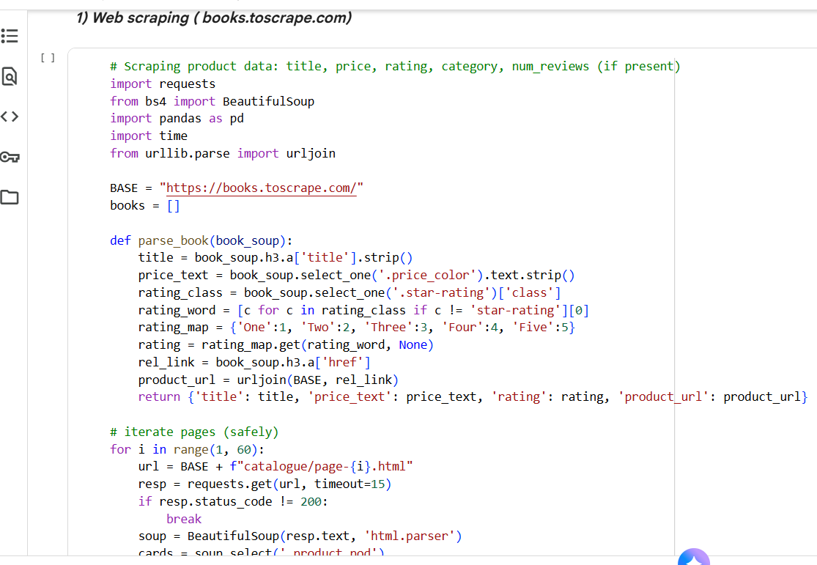
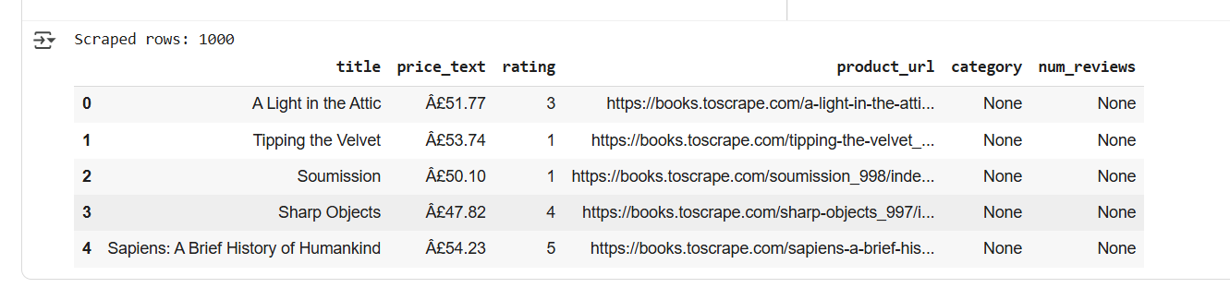
Data Collection (Web Scraping)
Data scraped from an e-commerce website: Product Name, Price, Category, Ratings, Reviews.

Slide 6
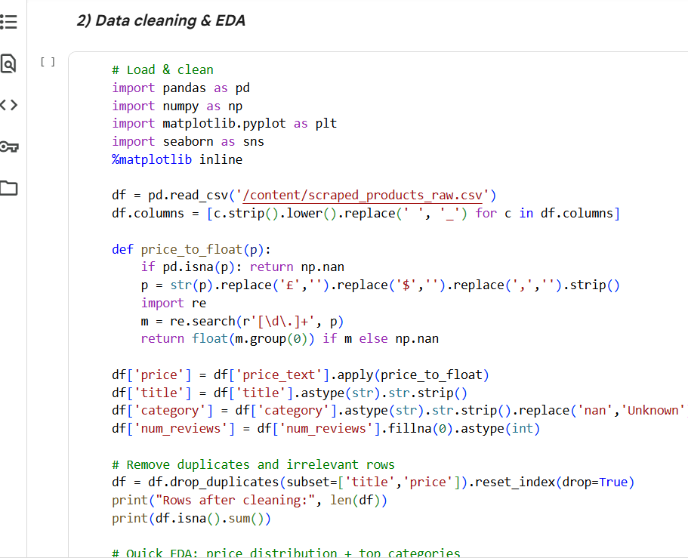
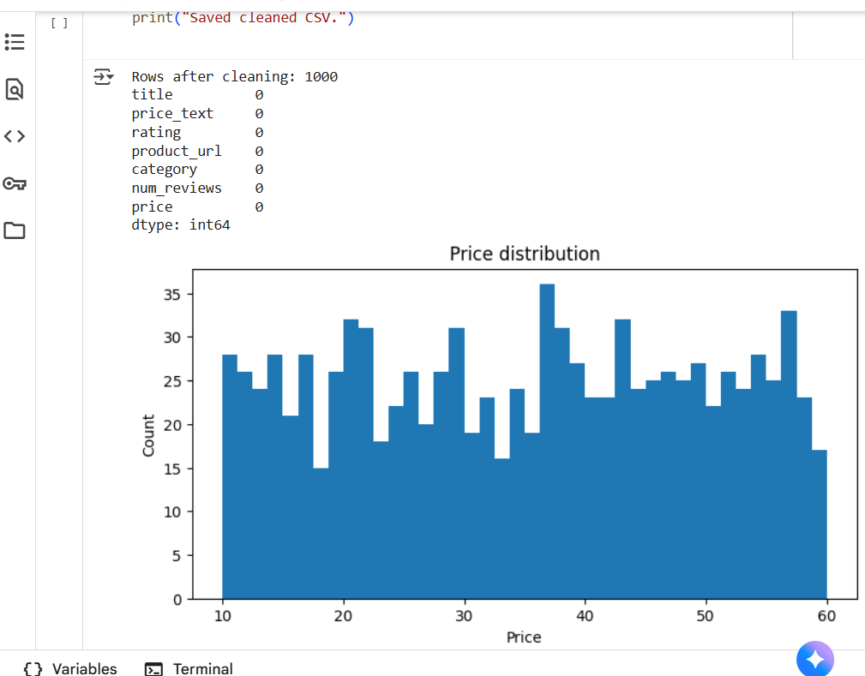
Exploratory Data Analysis (EDA)
Insights:
• Price distribution
• Ratings vs Reviews correlation
• Top product categories

Slide 7
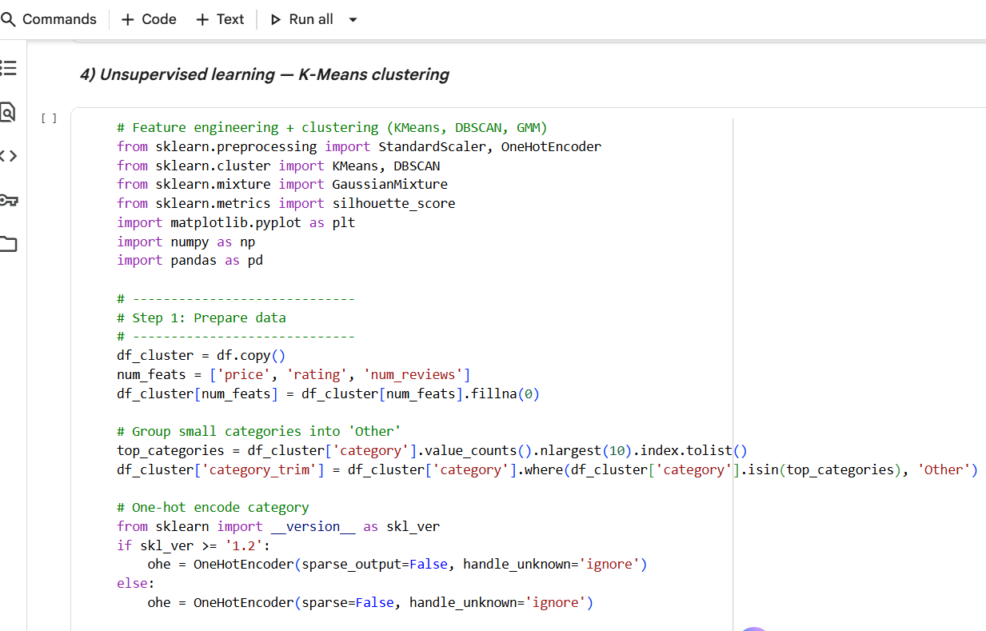
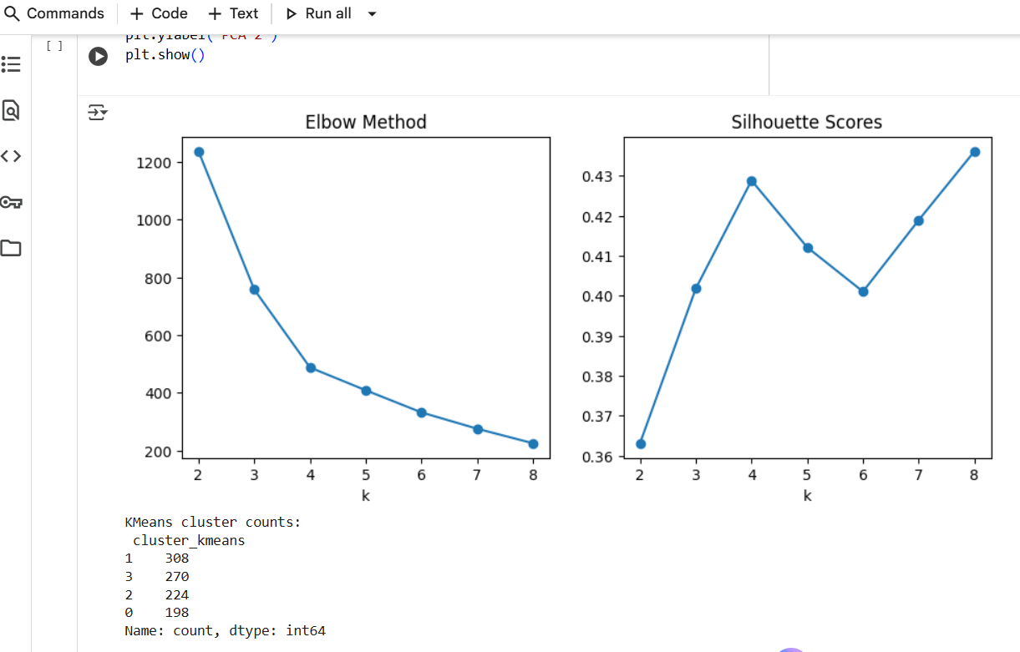
Unsupervised Learning
It’s a a type of machine learning where algorithms learn from unlabeled data to discover hidden patterns, structures, and relationships on their own.
Identify natural product groupings using K-Means clustering.

Slide 8
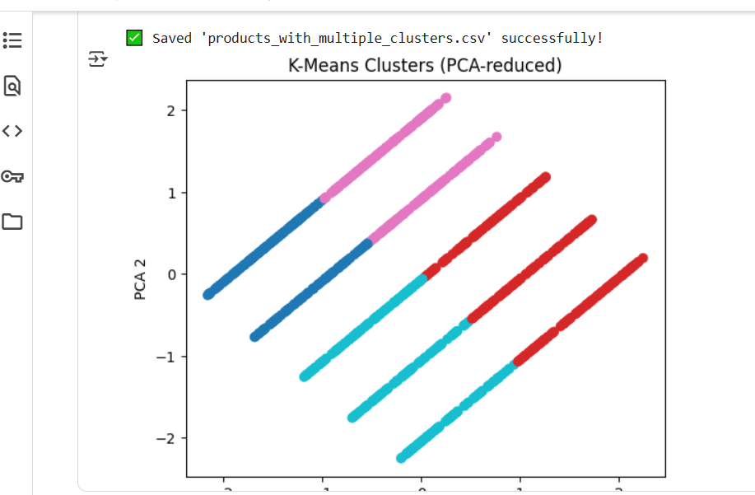
K-Means Clustering Results
Experimented with multiple cluster counts (k). Found optimal k = 4.
Added 'Cluster' column to dataset.
1. Premium products
2. Budget options
3. Mid-range popular items
4. Niche products

Slide 9
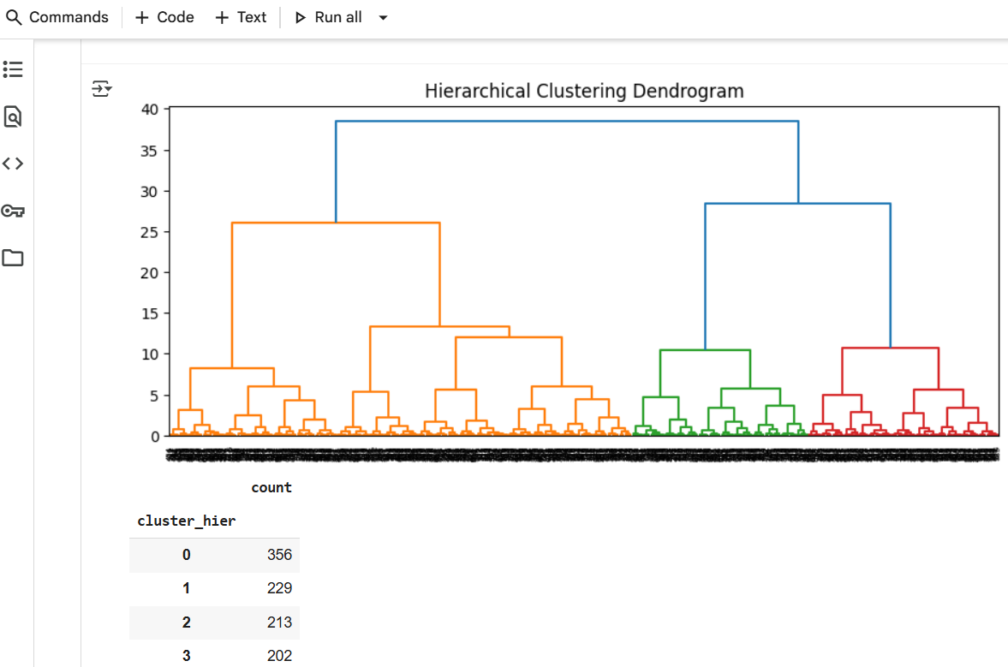
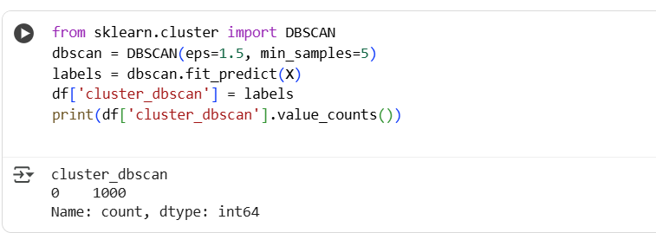
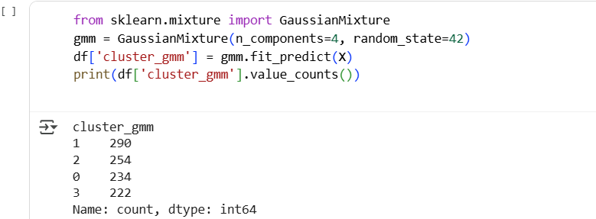
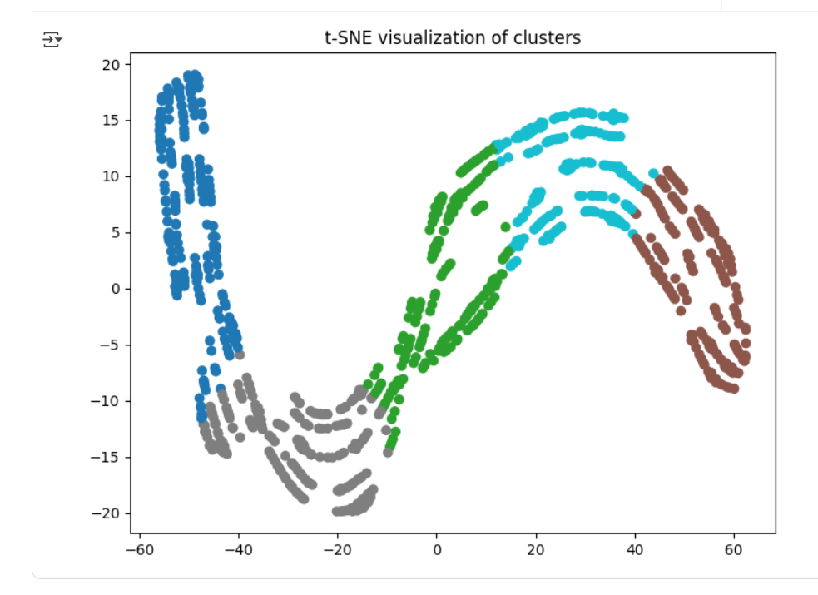
2 Hierarchical Clustering (Agglomerative)
3.DBSCAN (Density-Based Spatial Clustering)
4.Gaussian Mixture Models (GMM)
5.t-SNE or UMAP (Advanced Visualization)

Slide 10
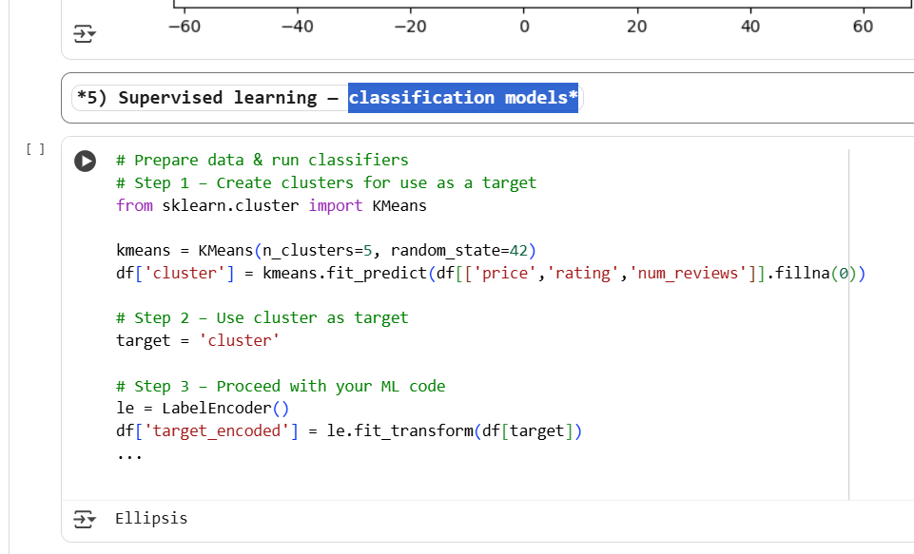
supervised Learning
View all
Supervised learning is a type of machine learning where an algorithm learns from a labeled dataset to make predictions on new, unseen data.

Slide 11
Model Comparison
Accuracy & F1-Score summary:
LogReg: 78%
SVM: 82%
kNN: 80%
RandomForest: 86%
XGBoost: 88%

Slide 12
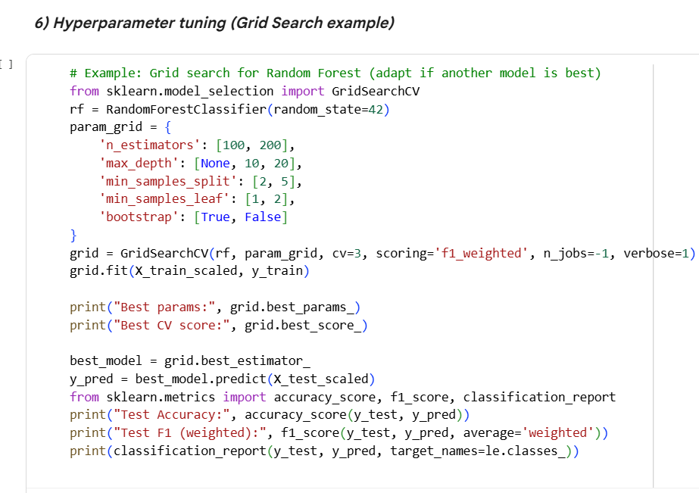
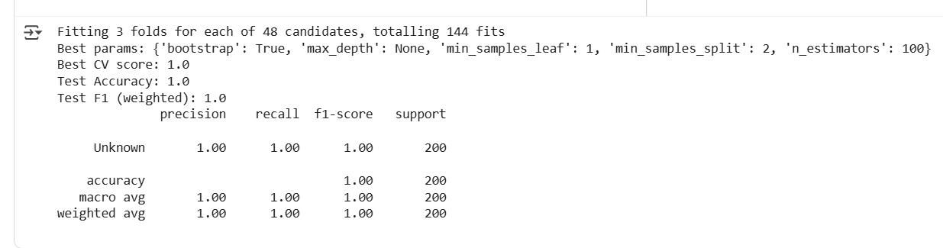
Hyperparameter Tuning
Fine-tuned XGBoost parameters for max accuracy.

Slide 13
Insights & Recommendations
Focus marketing on high-rating clusters.
• Expand mid-range products.
• Optimize pricing on low-converting clusters.

Slide 14
Conclusion
Data-driven insights improved understanding of market segments and product positioning.

