Slide 1
TCL Project Fight the dragon
Arjun Narula

Slide 2
AGENDA
Game Introduction
Code description
Demo
Future Enhancements

Slide 3
GAME INTRODUCTION

Slide 4
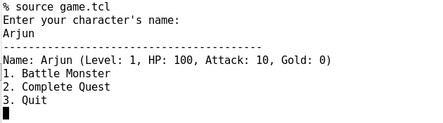
Game Introduction
The player is stuck in a Jungle with a Dragon, which you have to defeat.
Following are the features incorporated in the game
Custom input from the Player for character’s name
The Player starts from Level : 1 , the game has 5 levels in all
The Player has 100 HP in the beginning , if HP reaches to 0 the player looses the game .
The Player has 0 XP on 100 XP the level increases.
The Player starts with Attack as 10 which can be further be increased after completing Quests.
The Player starts with 0 Gold which can be further be increased after completing Quests.

Slide 5
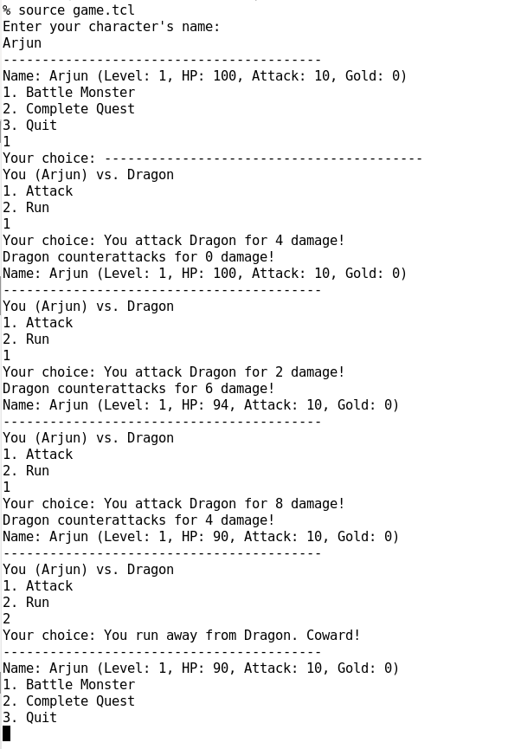
1. Battle Monster
The player presses 1 to battle the Dragon
Next the player has 2 options either to Attack or Run.
If player presses 1 for attack, the Dargon looses some HP and the player also looses HP due to counter-attack from dragon. (The loss in HP is a random number which is implemented in a function)
The objective of the game is to save one’s HP and defeat the Dragon.
The player might run momentarily to complete quests so as to earn more attack, HP and Gold.
Complete Quests option is discussed in next slide.

Slide 6
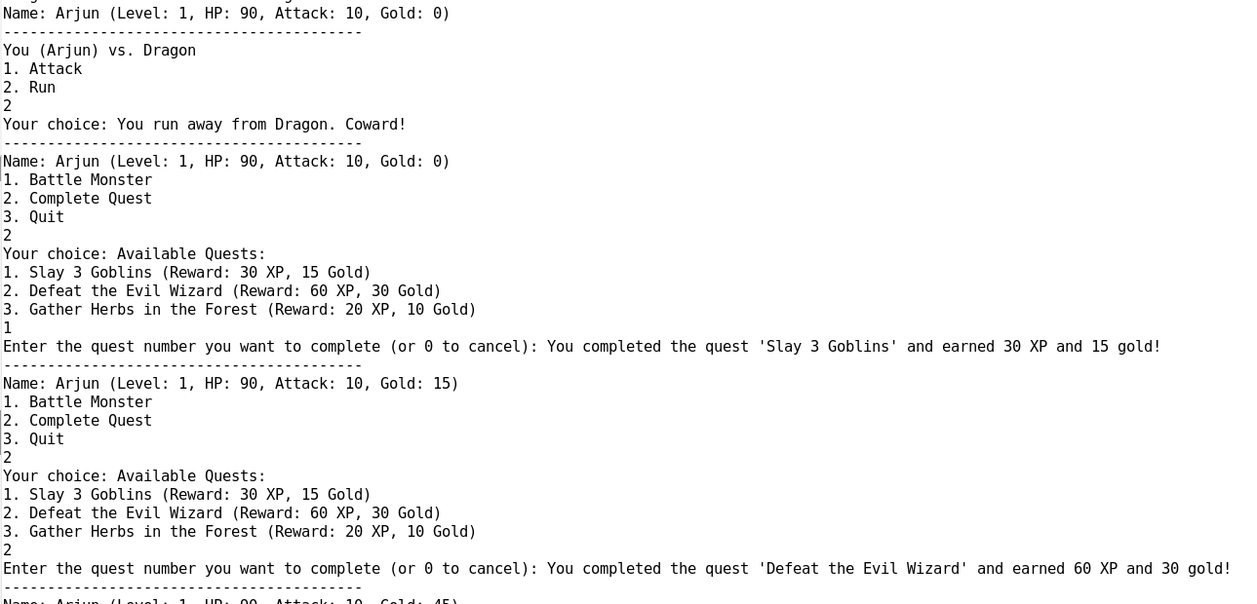
2. Complete Quest
Once you select complete quest option you have 3 quests to complete.
1st is Slay 3 Goblins to with 30 XP (which helps to move to next level) and 15 Gold.
On pressing 1 you can see increase in XP and Gold.
Similarly on pressing 2 player completes Defeat the Evil quest which helps in 60XP increase and 30 Gold

Slide 7
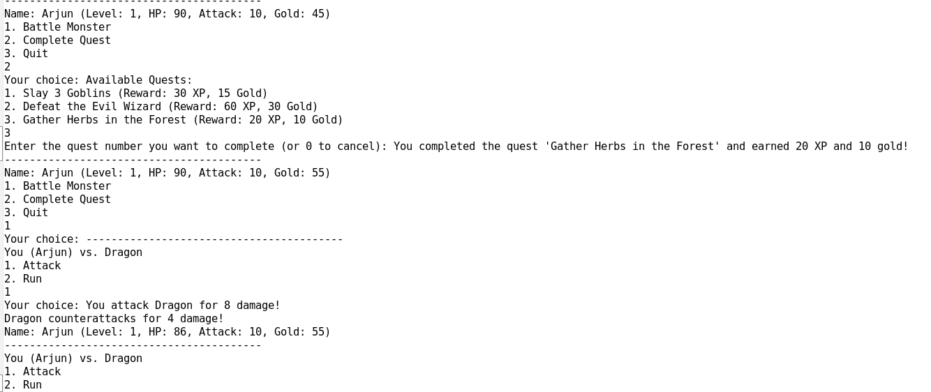
2. Complete Quest
Similarly on selecting 3rd option the player gets to complete Gather herbs in the Forest which increases 20 XP and 30 Gold.
On completing the quests , player can go back and attack the Dragon.

Slide 8
CODE DESCRIPTION

Slide 9
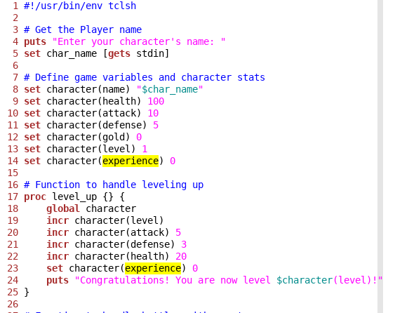
Code description
Line 4 and 5 get the inputs from the user for the character’s name .
Line 8-14 defines the properties of the player.
Line 17-25 in a procedure which will be used below, it defines the increase in characteristics of user once his/her level increases.

Slide 10
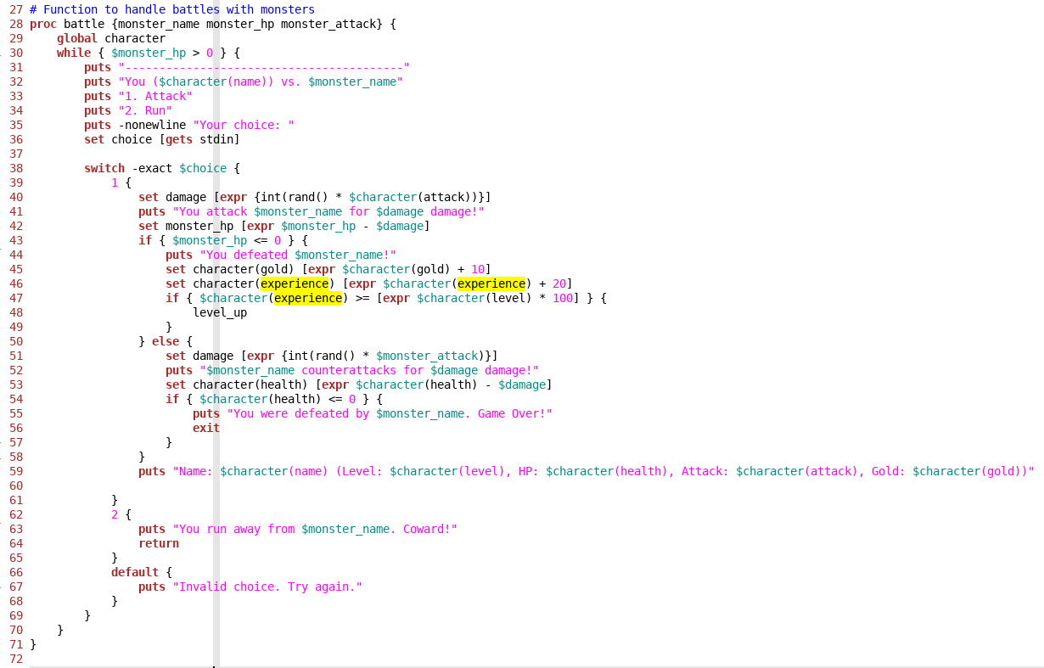
Code description
Line 28 to 72 is a procedure for battle between the player and the monster.
While the monster HP >0 proc gives two choices as discussed earlier.
Next it uses a switch statement to implement, in line number 40 the damage of monster is calculated as a random number multiplied to character attack and hence results in a random number.
If its HP <0 you level up and level_up proc is called.
Else monster counter attacks as same way in a random number multiplied to its attack.

Slide 11
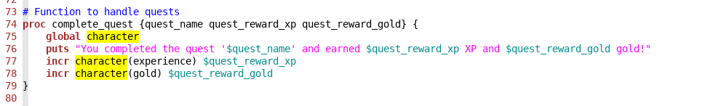
Code description
Line 73 to 80 is a simple proc written for complete quest option.
It simply increments the experience and gold according to the quest.
It is called in the main game.

Slide 12
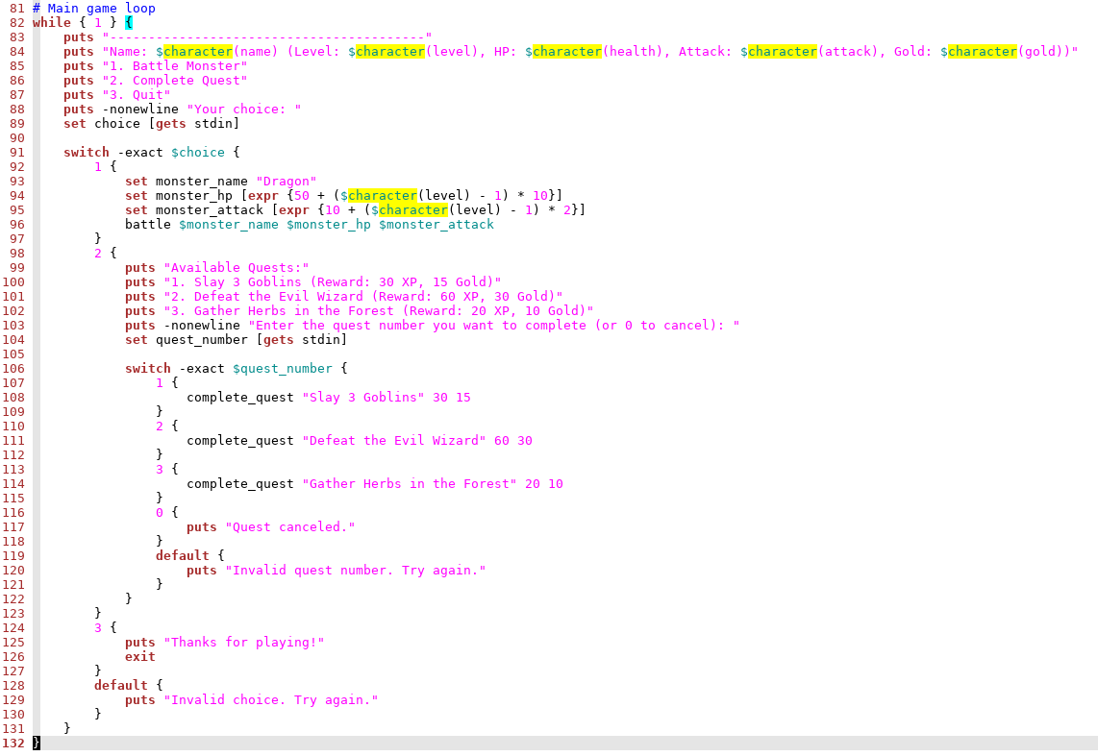
Code description
This is the main loop of the game.
From line 83 to 89, character information is printed.
If Battle Monster is chosen line 93 to 96 defines the characteristics of monster.
Line 99 to 122 is for Quests, everytime a particular quest is selected , complete_quest proc is called with specific quest_name, quest_reward_xp, quest_reward_gold which is incremented as per the proc.
Only on the third option the while loop is exited as user wants to end the game.

Slide 13
DEMO

Slide 14
FUTURE ENHANCEMENTS

Slide 15
FUTURE ENHANCEMENTS
Multiple Monster Types – Add a variety of monsters with different stats and abilities.
Character Inventory – Implement an inventory systems to allow the character to collect and use items like health, potions, weapons and armor.
Leaderboards - Add a leaderboard system to encourage competition.
Random Events – Introduce random events during the game such as finding hidden treasure and stumbling upon the traps.

Slide 16
THANK YOU

