Slide 1
CareerFlowOps: An End-to-End MLOps Pipeline for Explainable Job Ranking on AWS
Internship project presentation
Utkarsh Lakhani (23070126064)
Guide: Prof. Shruti Sunnad
Department of Artificial Intelligence & Machine Learning
Symbiosis Institute of Technology (SIT)
Live system: https://15-252-197-53.sslip.io
Notes:
Introduce yourself and the project. One sentence: a job-ranking application whose model is produced, shipped and monitored through a complete MLOps pipeline, deployed on AWS.

Slide 2
Problem and motivation
Students check many company career pages, and postings are not ranked by fit to their skills.
A suggestion without a reason cannot be trusted or checked.
A model also needs a process: the same data gives the same model, experiments can be compared, a release can be traced and the running service is watched.
Goal: an explainable job ranker whose model moves through a complete MLOps pipeline into production.
Product problem
Rank real postings for a candidate and explain every result
Engineering problem
Make the model reproducible, traceable, deployable and observable
CareerFlowOps | MLOps on AWS | Symbiosis Institute of Technology
2
Notes:
Two problems. The product problem is finding relevant jobs and understanding why. The engineering problem is that a model is only useful if it can be reproduced, released safely and watched. The project addresses both.

Slide 3
What CareerFlowOps does
1 Ingest
Greenhouse, Lever and Ashby public job APIs. 1,052 postings loaded on the server
2 Rank
TF-IDF, sentence-transformer or a hybrid of both
3 Explain
Five component scores, matched and missing skills, a text reason
4 Apply
Official apply link. The system never submits an application
Every job keeps its source name, source job ID, source URL and apply URL.
Raw payloads are stored apart from normalized jobs, and duplicate detection never deletes provenance.
CareerFlowOps | MLOps on AWS | Symbiosis Institute of Technology
3
Notes:
Four steps. Ingest postings from public employer job boards, rank them against the candidate's skills, explain each ranking and give the official apply link. Every job keeps its source name, source job ID, source URL and apply URL, so provenance is never lost.

Slide 4
System architecture on one EC2 host
web
nginx + React
MLflow
experiments
Browser
Caddy
HTTPS, routing
Prometheus
scrapes API
PostgreSQL
API
FastAPI
Grafana
dashboards
Model bundle
read-only, verified
All containers run from Docker Compose. Only ports 80 and 443 are public; PostgreSQL, MLflow, Prometheus and Grafana listen on the loopback interface.
CareerFlowOps | MLOps on AWS | Symbiosis Institute of Technology
4
Notes:
The browser reaches Caddy over HTTPS. Caddy forwards pages to the web container and API calls to the FastAPI container. The API reads PostgreSQL and the verified model bundle. MLflow stores experiments. Prometheus scrapes the API and Grafana draws it. Only ports 80 and 443 are public.

Slide 5
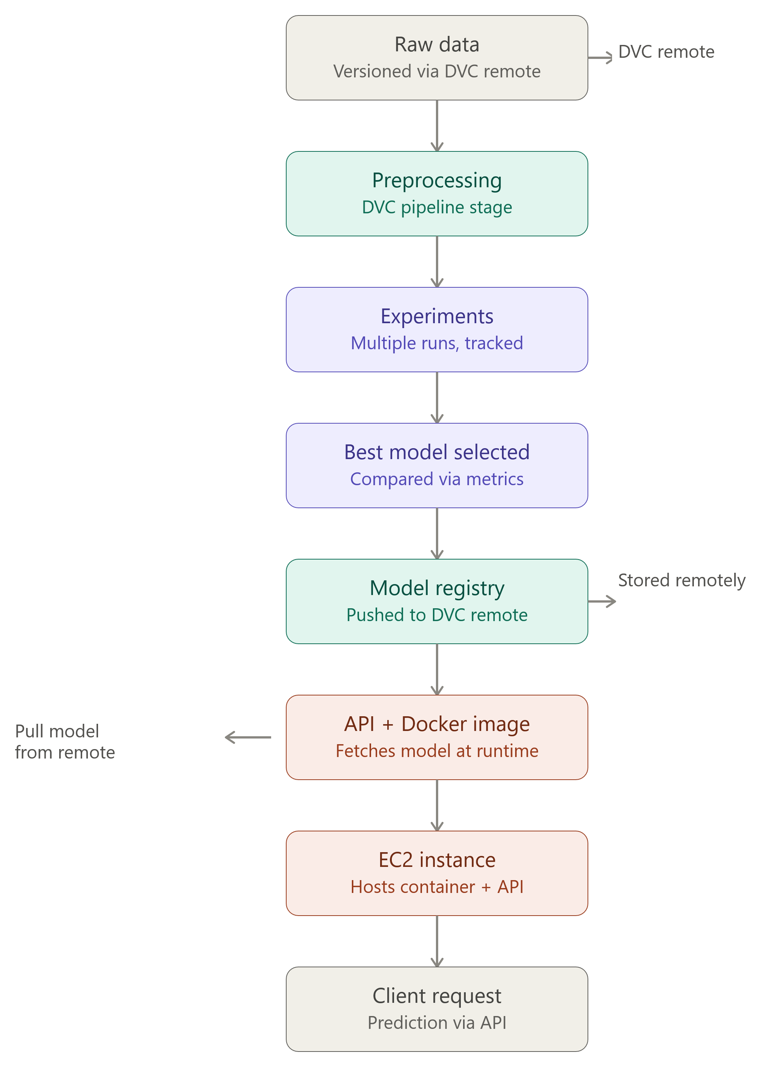
The MLOps lifecycle: data to prediction
Stage | Tool in this project
Raw data versioning | DVC, S3 remote
Preprocessing | DVC pipeline stage
Experiments | MLflow, 12 tracked runs
Best model selected | Validation metrics, fixed rule
Model registry | MLflow alias plus DVC bundle in S3
API and image | FastAPI, Docker, GitHub Actions, ECR
Host | EC2, Docker Compose
Client request | HTTPS, explained prediction
CareerFlowOps | MLOps on AWS | Symbiosis Institute of Technology
5
Notes:
This is the supplied pipeline diagram. Data is versioned with DVC, preprocessed in a DVC stage, experiments are tracked, the best model is selected on metrics, registered, pushed to a remote and fetched by the container at the server. The table on the right names the tool used for each stage in this project.

Slide 6
Data and ranking model
Evaluation set: 29 frozen real postings, six fictional candidate queries, relevance labels written during development.
Ranker 1: TF-IDF over job text.
Ranker 2: sentence-transformer all-MiniLM-L6-v2, pinned to a fixed revision.
Ranker 3: hybrid of the two.
Each result returns scores, matched and missing skills, a text explanation, the model version and a fallback reason (empty in production).
Score component | Weight
Semantic | 0.40
Skill | 0.30
Eligibility | 0.15
Location | 0.08
Freshness | 0.07
Total | 1.00
Weights live in params.yaml, so changing them triggers a DVC rerun.
CareerFlowOps | MLOps on AWS | Symbiosis Institute of Technology
6
Notes:
The training and evaluation set is deliberately small: 29 frozen real postings and six fictional candidate queries. Three rankers are compared. The final match score combines five components with fixed weights from params.yaml. Results always carry an explanation, the model version and a fallback reason, which is empty in production.

Slide 7
Reproducible pipeline with DVC
1 ingest
raw snapshot
2 preprocess
clean jobs
3 build_training_set
dataset
4 train
TF-IDF, embeddings
5 evaluate
metrics
6 register
MLflow version
7 export_model
verified bundle
params.yaml holds the seed (42), the five score weights and the pinned embedding model revision.
dvc.lock records a hash of every input and output; Git commits it, so each commit maps to one data and model version.
Remote: S3 bucket, 21 objects, 92,630,923 bytes. dvc repro reruns only the stages that changed.
CareerFlowOps | MLOps on AWS | Symbiosis Institute of Technology
7
Notes:
Seven DVC stages turn raw data into a deployable bundle. Each stage lists its inputs and outputs, so DVC reruns only what changed. dvc.lock stores a hash for every input and output, and Git commits it, so each commit points to one exact version of data and model. The production remote is an S3 bucket.

Slide 8
Experiment tracking and model registry with MLflow
12
finished runs
4
model versions
v4
alias: production
Selection rule: validation nDCG@5, then Precision@5, then algorithm name.
All three tie on the first two, so the name decides and TF-IDF is chosen.
Latency is not part of the rule.
Benchmark: six fictional queries with illustrative labels. It proves the pipeline works, not ranking quality.
Ranker | Val. nDCG@5 | Test nDCG@5 | Test MRR | Test latency (ms)
tfidf | 1.0 | 1.0 | 1.0 | 26.94
sentence_transformer | 1.0 | 1.0 | 1.0 | 30.88
hybrid | 1.0 | 0.7426 | 1.0 | 29.00
Metrics are copied from the saved MLflow run records, not typed by hand.
CareerFlowOps | MLOps on AWS | Symbiosis Institute of Technology
8
Notes:
MLflow holds one experiment with 12 finished runs and a registry with four versions of the ranker; the production alias points to version 4. These are the saved metrics of the three current rankers. All three tie on the validation metrics, so the rule falls to the algorithm name and TF-IDF is selected. With six queries these numbers show the pipeline works; they do not prove ranking quality.

Slide 9
Model bundle and fail-closed serving
Export bundle
Fail closed: missing, corrupt or incompatible bundle gives HTTP 503, never a silent fallback.
Live bundle ID: ded4d86e980bff82...
Model version b3e854956e87-574536b6 is the dataset hash prefix plus the training commit prefix.
Every result carries model_version and fallback_reason (empty in production).
manifest.json with checksums
Bundle ID = SHA-256 of manifest
Push to S3 with DVC
Pull on EC2 and validate
Serve
CareerFlowOps | MLOps on AWS | Symbiosis Institute of Technology
9
Notes:
Instead of copying a model file, the pipeline exports a bundle: model files plus a manifest with a checksum for each file. The bundle ID is the SHA-256 hash of the manifest, so any change gives a new ID. The server reports the ID at /ready, so you can prove which model is live. If the bundle is missing or damaged, the API returns 503 instead of falling back to another model.

Slide 10
CI/CD pipeline with GitHub Actions
Push to main
Checks
Build images
Push to ECR
Deploy (SSM)
Verify /ready
Checks
Build and publish
Deploy
Backend: Ruff, pytest, migration check
Frontend: types, ESLint, Prettier, tests, build, npm audit
Monitoring: config and alert-rule tests
API and web images tagged with the full commit SHA
ECR tags are immutable, so they cannot be overwritten
ECR scans images on push
Short-lived OIDC credentials, no stored AWS key
Two roles: push to ECR, and send one command to the tagged host
Guard: the commit must still be the tip of main
CareerFlowOps | MLOps on AWS | Symbiosis Institute of Technology
10
Notes:
A push to main starts the workflow. Checks run first: backend, frontend and monitoring. Then the images are built and tagged with the commit SHA, pushed to ECR with immutable tags, and the server is updated through Systems Manager. GitHub logs in to AWS with a short-lived OIDC token, so no AWS key is stored. A failed step stops everything after it.

Slide 11
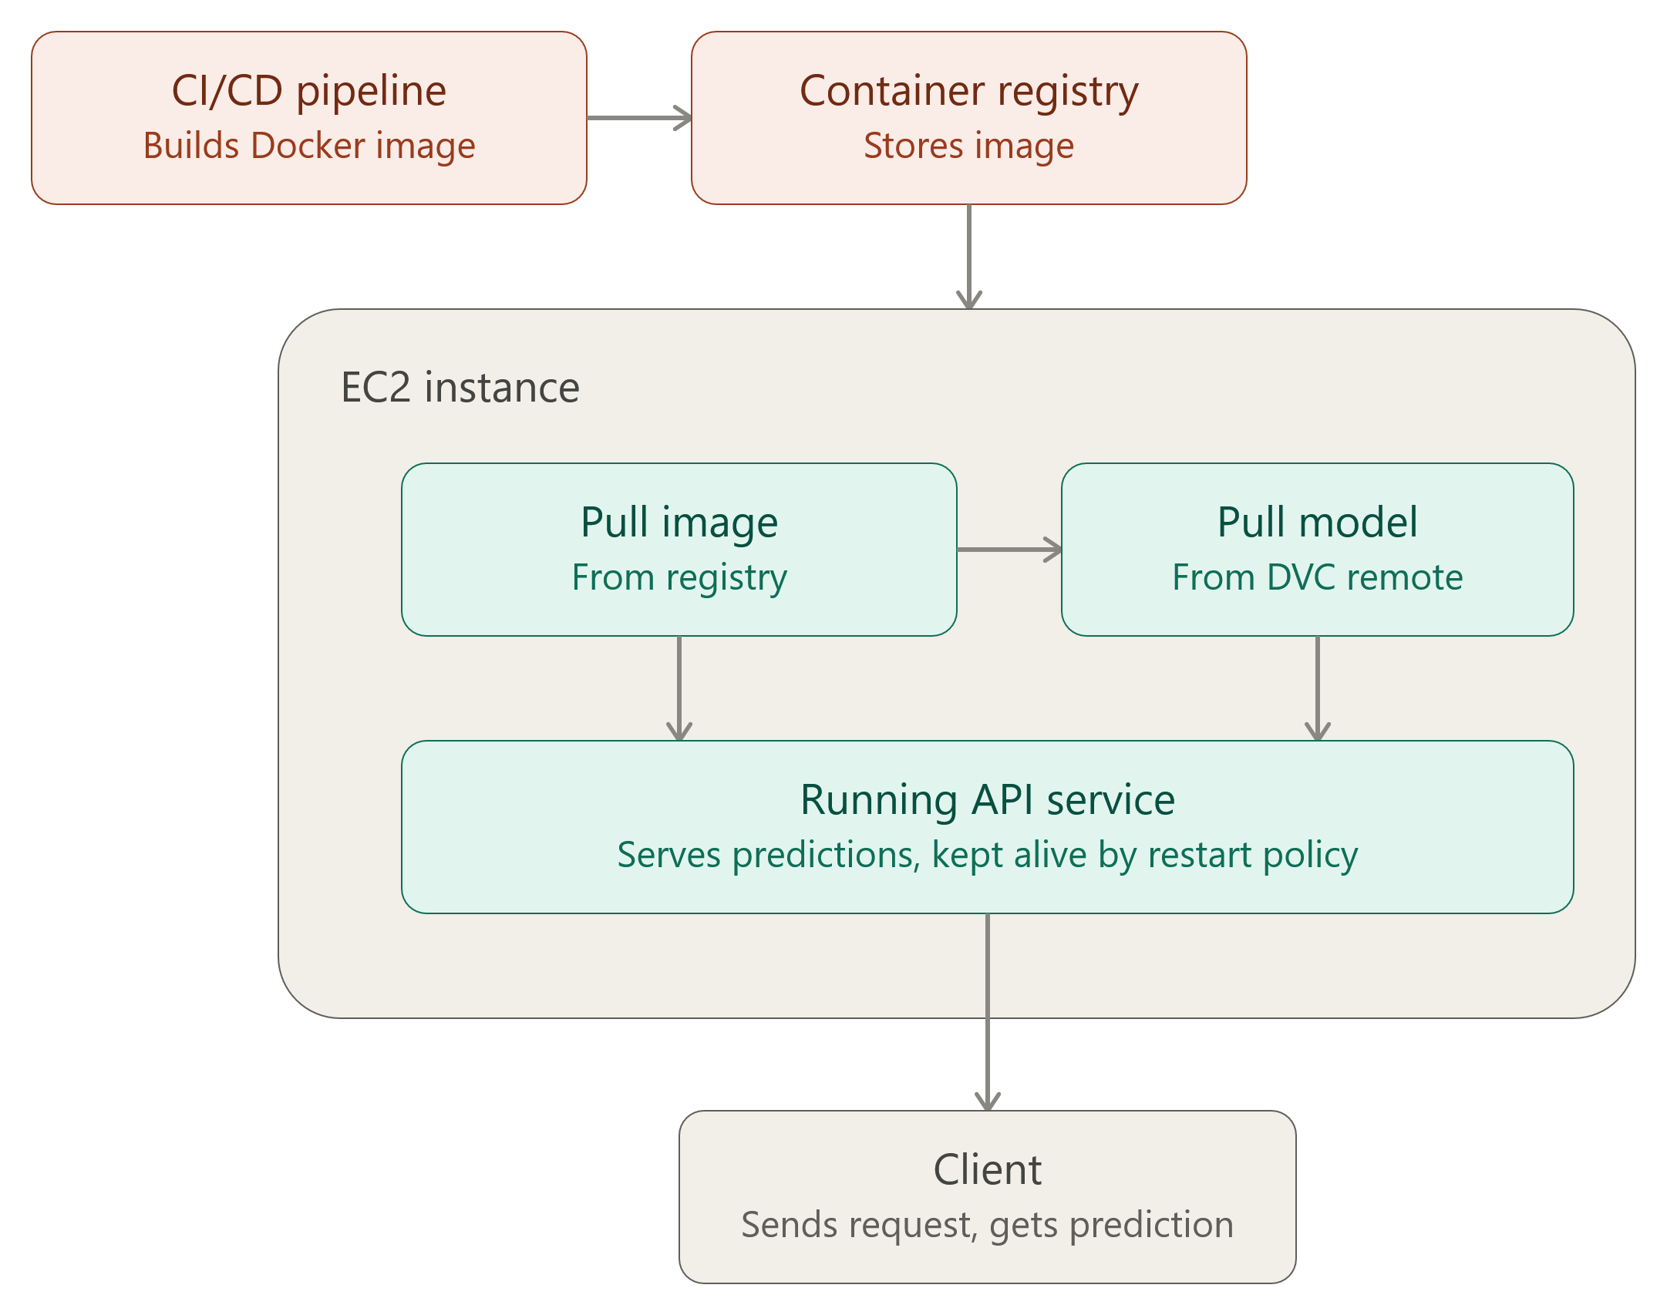
Deployment on AWS: image and model delivery
AWS service | Job
S3 | DVC model storage (versioned)
ECR | Private images, immutable tags
EC2 | m7i-flex.large, 8 GiB
IAM + OIDC | Keyless CI, least privilege
Systems Manager | Deploy and access, no SSH
Elastic IP + SG | Fixed address, ports 80/443 only
Region ap-south-1. The Free plan blocked t3.medium, so an eligible 8 GiB type was used.
CareerFlowOps | MLOps on AWS | Symbiosis Institute of Technology
11
Notes:
This is the supplied EC2 deployment flow. The pipeline builds the image, the registry stores it, and the EC2 instance pulls the image and the model, then runs the API service kept alive by a restart policy. The table lists the AWS services used and why each one is there.

Slide 12
Deployment procedure and live verification
On the host, in order
Live check | Result
GET /ready | ready, bundle ded4d86e...
No token | HTTP 401
With token | 5 ranked jobs, no fallback
Foreign origin (CORS) | Refused
Certificate | Let's Encrypt, valid
Jobs stored | 1,045 after 7 duplicates
1. Stop the API and web containers
2. Pull both images from ECR
3. Pull the model bundle from S3 with DVC
4. Test inference inside the published image
5. Start PostgreSQL, MLflow, then API (migrations first) and web
6. Compare the running bundle ID with the manifest
CareerFlowOps | MLOps on AWS | Symbiosis Institute of Technology
12
Notes:
The deploy script stops at the first failed check. The last step compares the bundle ID the running API reports with the manifest that was downloaded, which proves the right model is live. The right side lists the checks run against the live system.

Slide 13
Monitoring and reliability
Metrics: request count and duration, inference time, ingestion runs, duplicates detected.
Four alert rules: API unreachable, repeated readiness failures, sustained server errors, failed or partial ingestion. Tested in CI.
Health checks: /health and /ready, used by Docker Compose.
Restart policy unless-stopped on every container; Docker starts at boot.
Not built: alert delivery, drift detection, host metrics.
About 4 s
API recovered after its server process was killed (restart count 1)
Lesson
docker kill counts as a manual stop and the container stays down, so crash tests must kill the process inside
CareerFlowOps | MLOps on AWS | Symbiosis Institute of Technology
13
Notes:
The API exports request, duration, inference and ingestion metrics. Prometheus scrapes them and Grafana draws a provisioned dashboard. Four alert rules are tested in CI. Containers have a restart policy. We tested it by killing the server process inside the API container: Docker restarted it without help and the readiness endpoint answered again in about four seconds. docker kill does not work as a test because Docker treats it as a manual stop.

Slide 14
Results at a glance
1,052
postings loaded live (714 Greenhouse, 306 Lever, 32 Ashby)
12
MLflow runs; registry v4 is production
7
DVC stages, 21 objects (92.6 MB) in S3
5 / 5
pipeline jobs passed on the final run
~4 s
crash recovery by the restart policy
0
AWS keys stored in GitHub or on the server
Ranking metrics use a six-query benchmark with illustrative labels: evidence that the pipeline works, not of ranking accuracy.
CareerFlowOps | MLOps on AWS | Symbiosis Institute of Technology
14
Notes:
Key numbers from the live deployment. All values come from commands run against the system. The benchmark for the ranking metrics is small, so they show the pipeline works rather than ranking quality.

Slide 15
Problems met and how they were solved
Problem | Fix
Production refused a plain HTTP address | Kept the safety check; served over HTTPS on an IP-derived hostname
GitHub could not log in to AWS (OIDC) | Trust policy now accepts GitHub's repository-ID subject format too
Pushes did not start CI on the fork | Set the repository's Actions permission explicitly through the API
docker kill did not trigger a restart | Crash test kills the server process inside the container
New MLflow server was empty | Copied the original run history once, checksum-verified
CareerFlowOps | MLOps on AWS | Symbiosis Institute of Technology
15
Notes:
Five problems came up during deployment and none was solved by weakening a safety check. These are good examples of why a pipeline needs to be verified end to end.

Slide 16
Limitations and future work
Limitations
Future work
One shared candidate token and one admin token; no user accounts.
Alert rules fire but nothing receives them.
No drift detection and no host metrics.
Single host; database migrations are not rolled back automatically.
Six-query benchmark with illustrative labels.
Reboot recovery expected from restart policies but not tested.
Human-labelled benchmark of 30+ real queries.
Per-user accounts and roles.
Alert delivery to email or chat.
Drift monitoring for resume and job features.
Infrastructure as code for the AWS resources.
Off-host backups and zero-downtime releases.
CareerFlowOps | MLOps on AWS | Symbiosis Institute of Technology
16
Notes:
Be direct about limits. One shared token guards the site. Alerts have no receiver. There is no drift detection. The system runs on one host. The ranking benchmark is small. The future work list addresses each of these.

Slide 17
Conclusion
CareerFlowOps delivers an explainable job ranker through a complete MLOps pipeline: DVC, MLflow, a verified model bundle, Docker, GitHub Actions, ECR and EC2.
Every release is traceable: Git commit, dataset hash, MLflow run, bundle ID and image digest.
The pipeline is keyless and verified: OIDC instead of stored keys, a bundle checked before serving, a deploy that compares the live model with the manifest.
The deployed system was verified end to end, and its limits are stated, notably the small benchmark and the shared token.
CareerFlowOps | MLOps on AWS | Symbiosis Institute of Technology
17
Notes:
Summarise: the model is reproducible, tracked, packaged with a checksum, shipped by an automated pipeline without stored keys, verified on the server and monitored. The deployment was verified end to end and the limits are documented.

Slide 18
References
[1] D. Sculley et al., "Hidden technical debt in machine learning systems," in Adv. Neural Inf. Process. Syst. 28, 2015, pp. 2503-2511.
[2] M. Zaharia et al., "Accelerating the machine learning lifecycle with MLflow," IEEE Data Eng. Bull., vol. 41, no. 4, pp. 39-45, 2018.
[3] D. Kreuzberger, N. Kuhl and S. Hirschl, "Machine learning operations (MLOps): Overview, definition, and architecture," IEEE Access, vol. 11, pp. 31866-31879, 2023.
[4] N. Reimers and I. Gurevych, "Sentence-BERT: Sentence embeddings using Siamese BERT-networks," in Proc. EMNLP-IJCNLP, 2019, pp. 3982-3992.
[5] G. Salton and C. Buckley, "Term-weighting approaches in automatic text retrieval," Inf. Process. Manag., vol. 24, no. 5, pp. 513-523, 1988.
[6] K. Jarvelin and J. Kekalainen, "Cumulated gain-based evaluation of IR techniques," ACM Trans. Inf. Syst., vol. 20, no. 4, pp. 422-446, 2002.
[7] J. Humble and D. Farley, Continuous Delivery. Boston, MA, USA: Addison-Wesley, 2010.
[8] DVC documentation, Iterative, Inc. [Online]. Available: https://dvc.org/doc
CareerFlowOps | MLOps on AWS | Symbiosis Institute of Technology
18
Notes:
Key references used for the background and methods.

Slide 19
Thank you
Questions?
Utkarsh Lakhani (23070126064)
Live system: https://15-252-197-53.sslip.io
Code: github.com/Arjun-Reddy-I/CareerFlowOps
Notes:
Invite questions. Likely ones: DVC versus MLflow, how deployment works without stored keys, why TF-IDF was selected, what the limits are.

