Slide 1

STUDENT MANAGEMENT SYSTEM

Slide 2
CONTENT
INTRODUCTION
OBJECTIVES
ER DIAGRAM
SCREENSHOT
ADVANTAGE
DISADVNTAGE
CONCLUSION
REFRENCES

Slide 3
INTRODUCTION
Student Management System (SMS) is a solution tool that is designed to track, maintain and manage all the data generated by a School, including the grades of a student, their attendance, their interpersonal activities records, etc.
Student management system is provided the detail of student, teacher, course, etc. which is related to the student.
It is also stored the data into the database which is important for the school because if physical data will be lost then the school will be get data from database.
Student management system is used to stored the detail of the student at once without getting error through the system.

Slide 4
OBJECTIVES
To store the data of the new student.
To update the data of the passed student.
Reduce the workload of school.
To get information of student faster .
To make privacy and security for the open access environment.
To get all the detail of the student through the database.

Slide 5
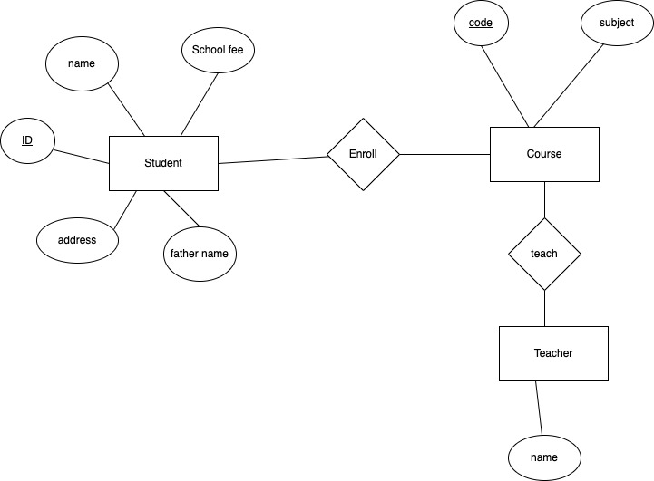
ER-DIAGRAM

Slide 6
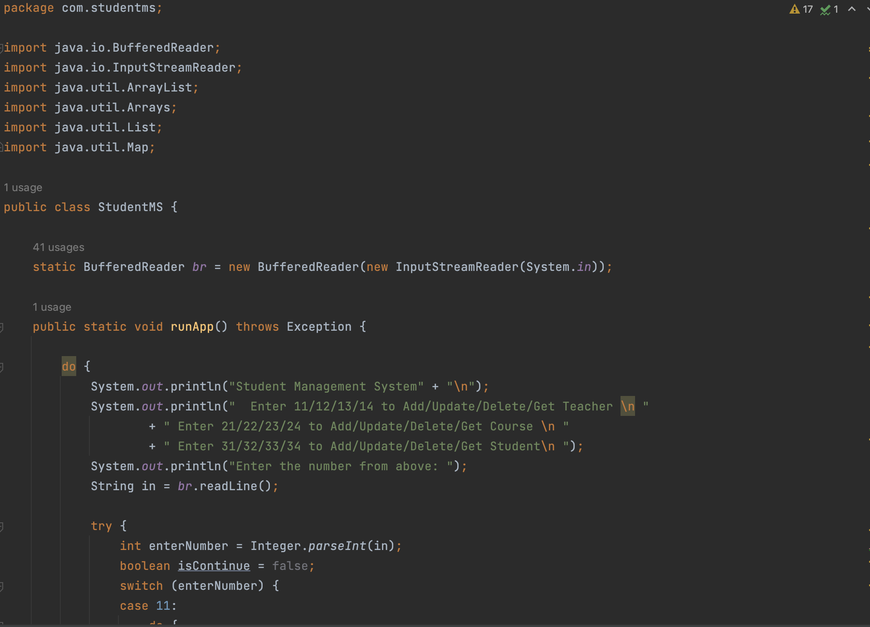
SCREENSHOT
FIG:- StudentMS

Slide 7
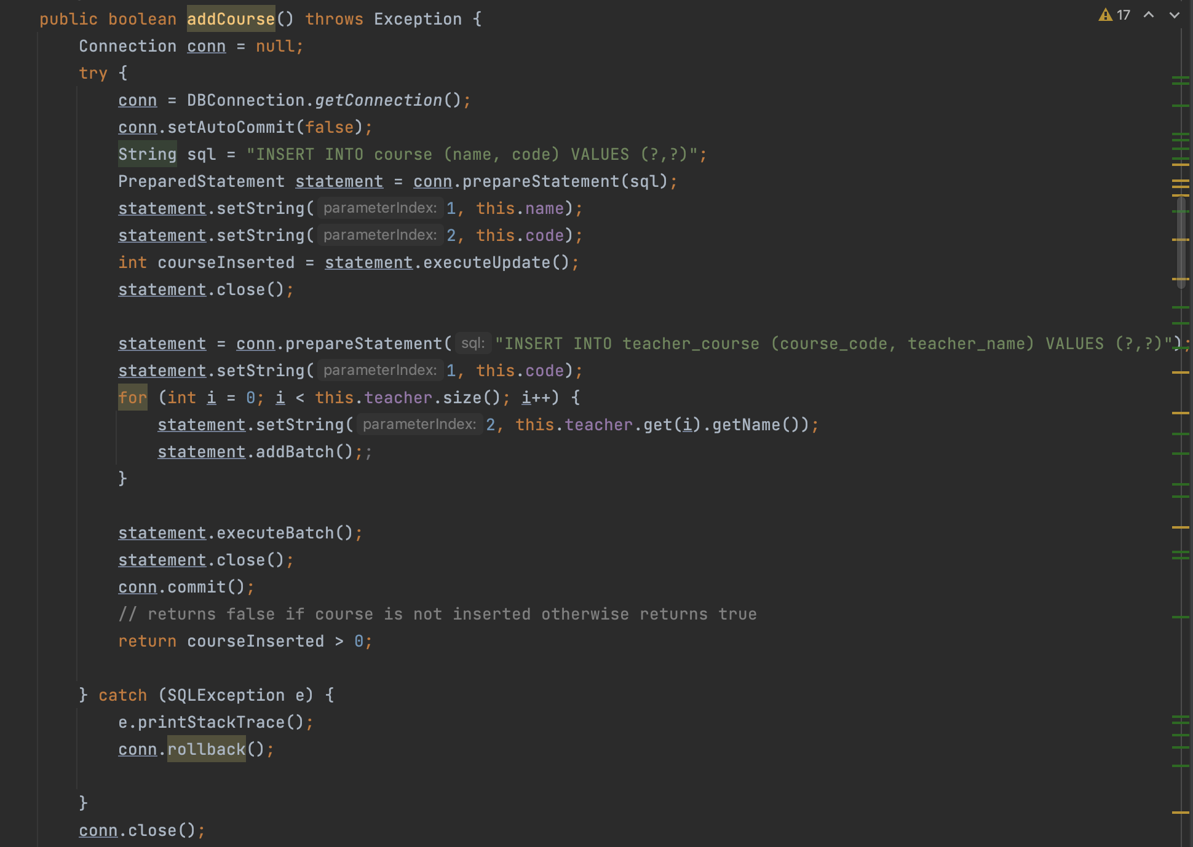
SCREENSHOT
Fig:- course

Slide 8
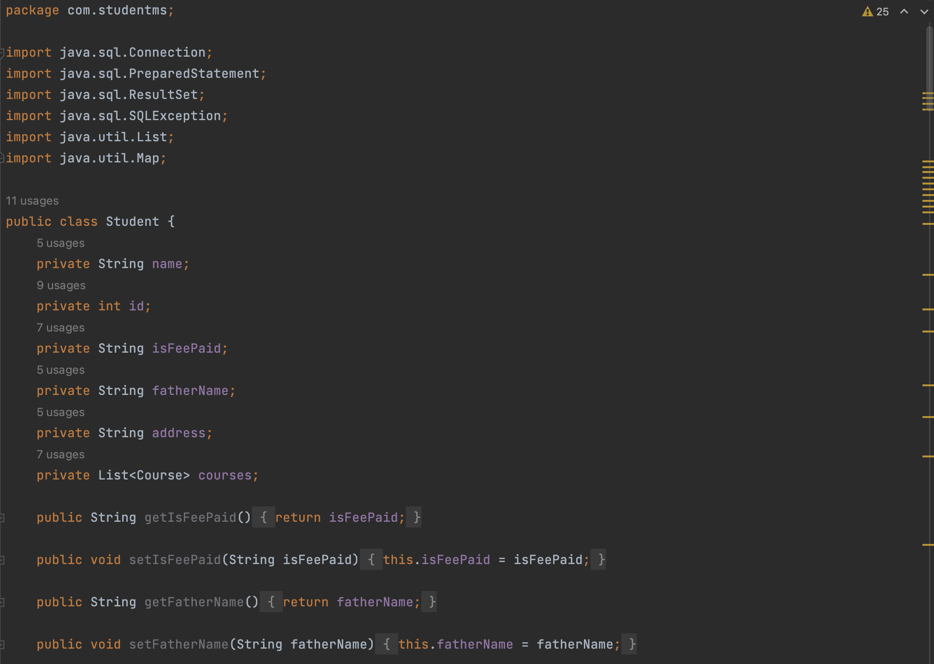
SCREENSHOT
Fig:- student

Slide 9
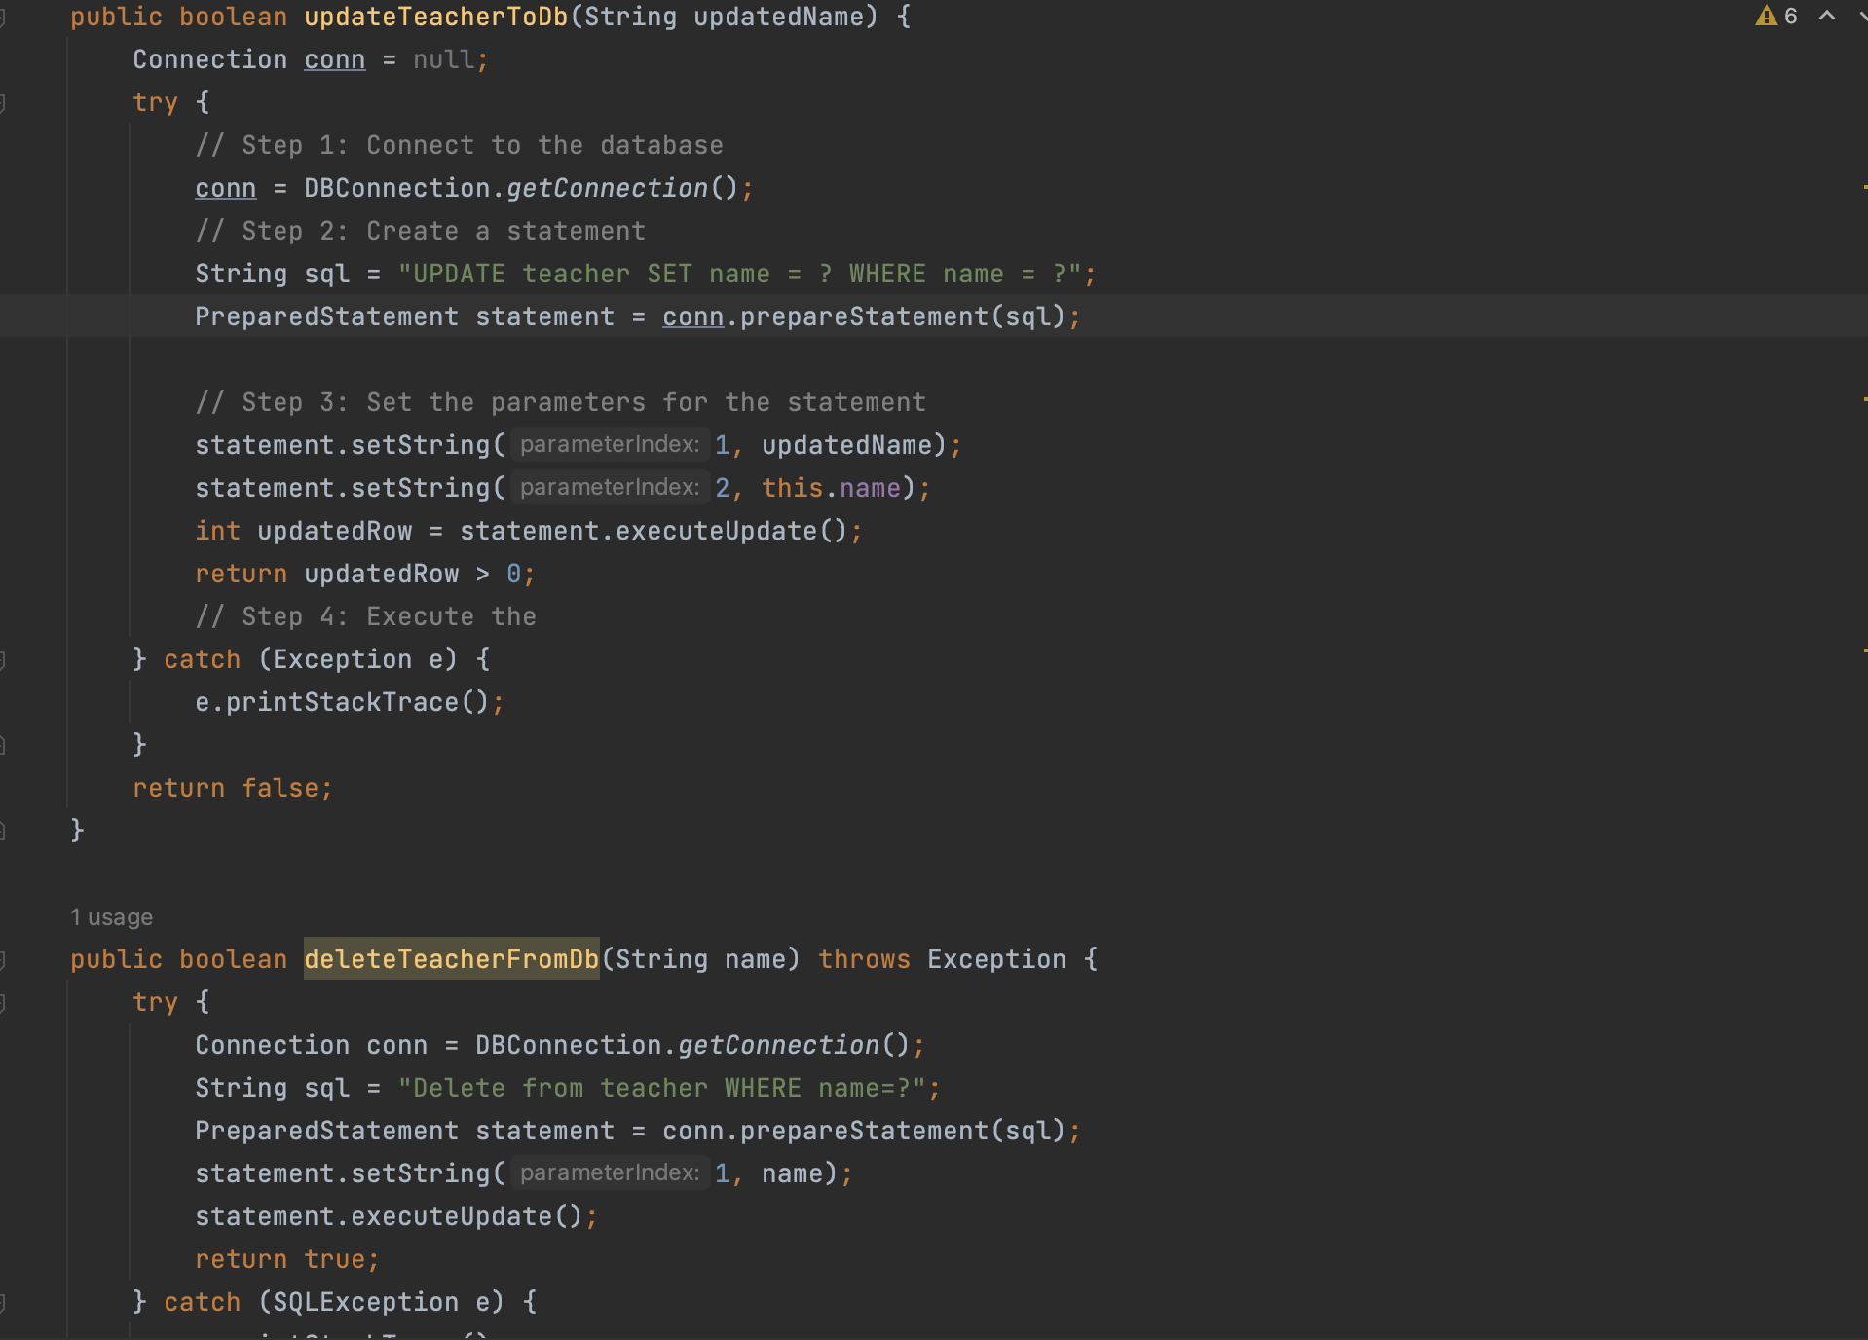
SCREENSHOT
Fig:- Teacher

Slide 10
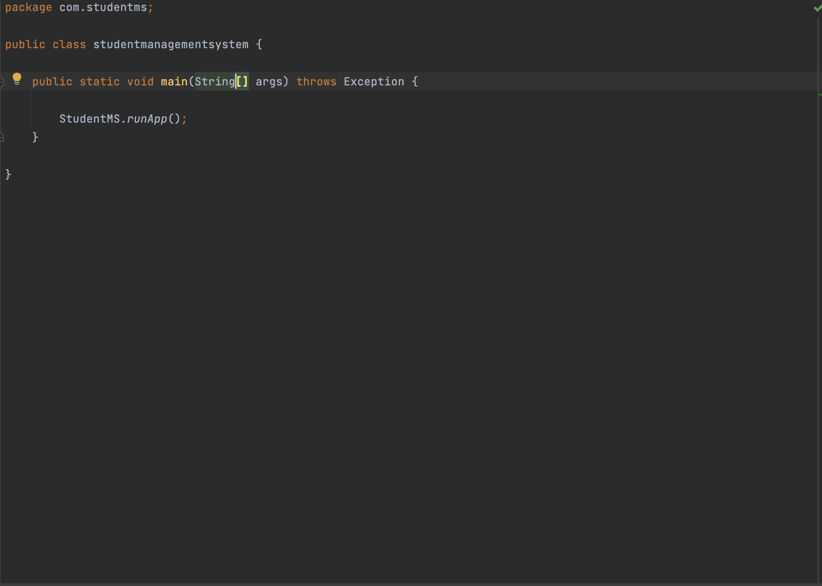
SCREENSHOT
Fig:- student management system

Slide 11
ADVANTAGE
It stores the data of the student for the long period of time.
It is secure the data without getting a problem.
They can add many student data at store at the database.
It is secure private data of the student.
It is easy to use and understand.
Better efficiency.

Slide 12
DISADVANTAGE
If the database is lost, then system will be not giving the output.
Office staff will take a lot of time to add student because they have to add one by one.
To main the school management system will be cost more for the school.

Slide 13
CONCLUSION
This project is fully based on the students.
This project is collect the data of students and store into the database.
This is reduced the time consuming for the school because it give all the data to the school about the students.
It has some drawbacks of the system because it is connected to the databas. so, if the database is delete then the whole system will not run into the system.

Slide 14
REFERENCES
https://www.manaarah.com/student-management-system/
https://skoolsheet.com/advantages-and-disadvantages-of-school-management-system/

