Slide 1
Lending Club Case Study
Group Members
Aratrika Chaudhury
Arjun Kumar

Slide 2
BACKGROUND
Lending Club is a peer-to-peer lending platform that connects borrowers seeking loans with investors looking to provide funds.
OBJECTIVE
The case study analyzes loan data from Lending Club to gain insights into borrower characteristics, loan features, and factors influencing loan repayment.
KEY ANALYSIS POINTS | DESCRIPTION
Loan Performance | The study examines loan repayment rates, default patterns, and the impact of borrower attributes such as credit score and annual income
Interest Rates | It investigates the relationship between interest rates and loan amounts, loan terms, and borrower profiles.
Loan Purpose | The study explores the most common purposes for which borrowers seek loans and whether loan purpose affects repayment behavior.

Slide 3
DIFFERENT STEPS OF EXPLORATORY DATA ANALYSIS
Univariate Analysis
Descriptive Statistics
Frequency Distribution
Histograms
Box Plots
Percentiles
Bivariate Analysis
Scatter Plots
Correlation Analysis
Covariance
Joint Distributions
Cross Tabulation
Heatmaps
Data Understanding
START
END
Data Wrangling & Manipulation
Handling Missing Values
Removing Duplicates
Data Transformation
Feature Extraction
Encoding Categorical
Scaling/Normalization
Outlier Handling
Segmented Univariate Analysis
Subset Visualization
Category Analysis
Subset Descriptives
Group Profiling
Subgroup Insights
Segmentation Trends

Slide 4
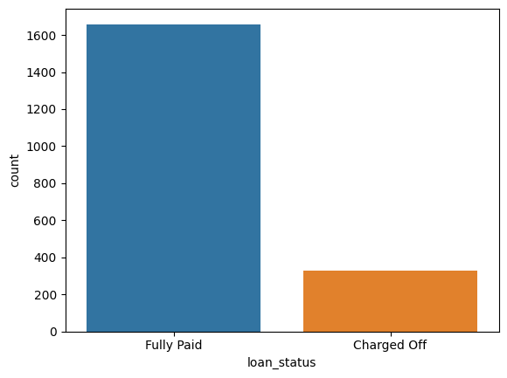
COUNT OF FULLY PAID LOANS VS. DEFAULTED LOANS
The above count plot shows that the percentage of charged-off loans is lower than the percentage of fully paid loans which can be due to :
Rigorous risk assessment selects borrowers with higher repayment probabilities.
Loans with shorter terms and smaller amounts tend to have higher repayment rates.
Lending institutions implement strict policies to reduce default risk.
Purpose-driven loans, like education or home improvement, often have better repayment rates.
Ongoing collection and recovery efforts mitigate defaults, reducing charged-off loans.
Lenders learn from historical data and refine models to predict loan outcomes more accurately

Slide 5
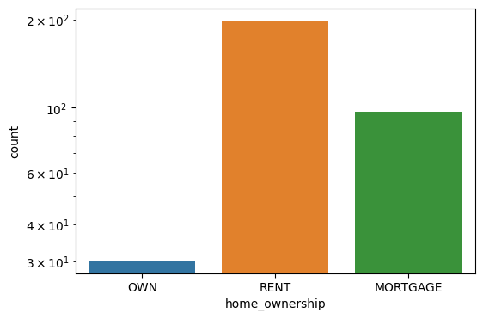
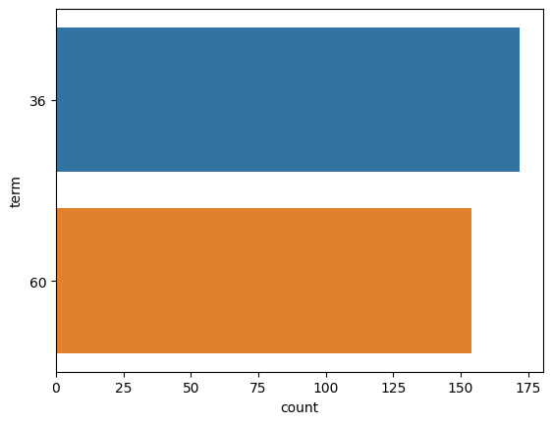
IMPACT OF HOME OWNERSHIP AND LOAN TERM ON DEFAULTING LOAN
Borrowers who are renting among those who have the option of owning a home, and who have opted for a 36-month loan repayment term exhibit a notably higher count of loan defaults.
This trend could be attributed to the financial constraints often associated with renting, potentially impacting borrowers' ability to consistently meet loan obligations over the specified term

Slide 6
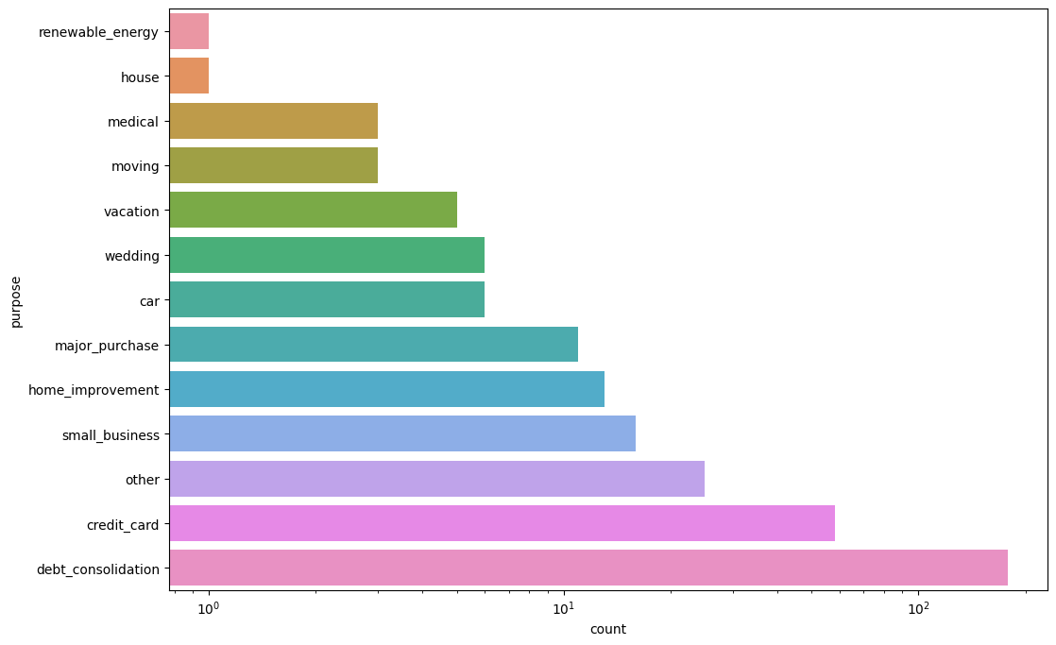
IMPACT OF LOAN PURPOSE ON DEFAULTING LOAN
The impact of loan purpose on loan defaulting is evident, with the "debt consolidation" loan purpose exhibiting the highest percentage of loan defaults. This trend might be due to borrowers consolidating existing debts, potentially signaling financial challenges that could lead to repayment difficulties.

Slide 7
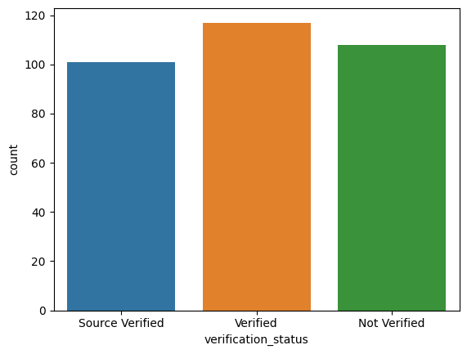
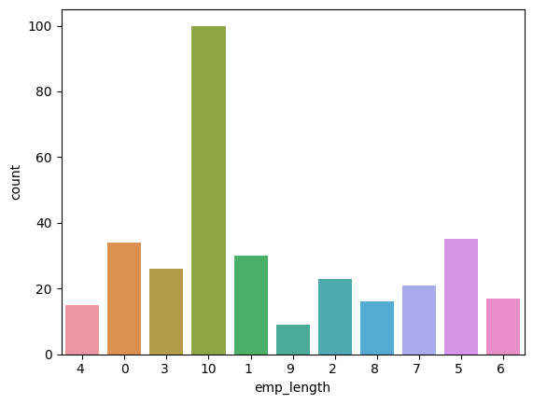
IMPACT OF VERFICATION STATUS AND EMPLOYEE WORK EXPERIENCE YEARS ON DEFAULTING LOAN
Borrowers with unverified income sources and 10 years of work experience have a higher likelihood of loan defaulting which is quite interesting.
This trend could arise from a combination of factors, including potential financial instability due to lack of verified income and other financial commitments despite the longer work experience.

Slide 8
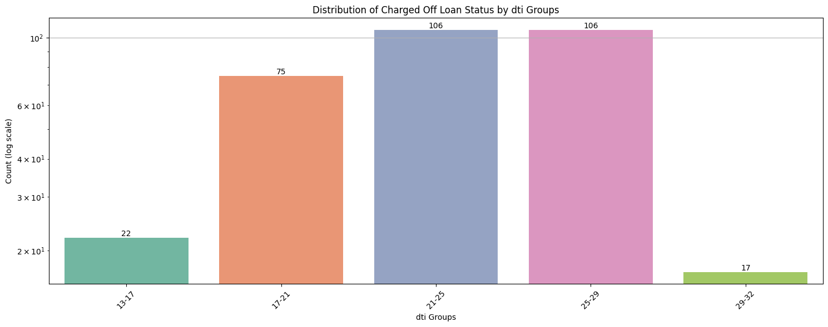
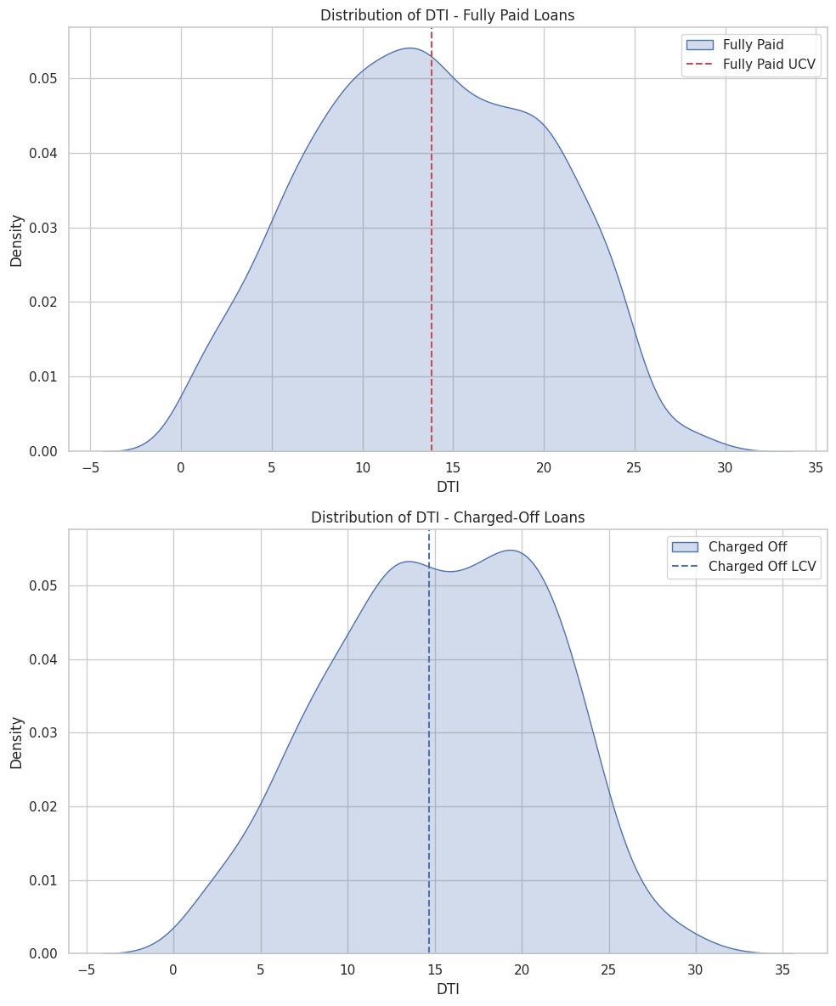
IMPACT OF DEBT TO INCOME RATIO ON DEFAULTING LOAN
Borrowers with a debt-to-income ratio (DTI) between 21-29 exhibit the highest loan default counts.
Hypothesis Testing Results
T-Statistic: -4.54
P-Value: 7.11e-06
Interpretation:
Strong evidence supports that mean DTI differs significantly between fully paid and charged-off loans.\
Implications:
The substantial difference in mean DTI values suggests that DTI can be a predictive indicator for loan repayment status.
Higher DTI ratios may signify increased default risk.
Recommendation: DTI is a crucial factor in assessing borrower risk and tailor lending strategies accordingly.

Slide 9
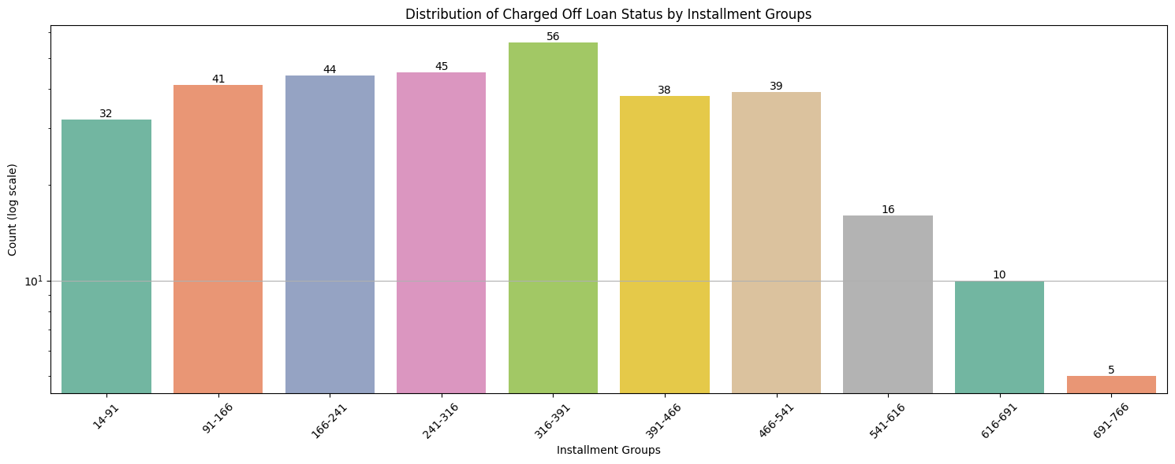
IMPACT OF MONTHLY INSTALLMENTS ON DEFAULTING LOAN
CONCLUSION :Those have monthly instalment between 316-391 have highest counts of loan defaulting .

Slide 10
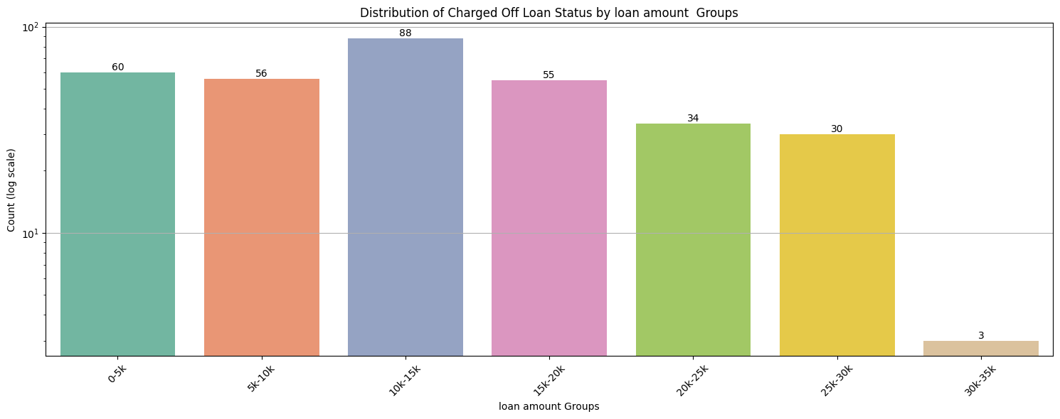
IMPACT OF LOAN AMOUNTS ON DEFAULTING LOAN
CONCLUSION :Those have loan amount in the range of 10-15k have highest counts of loan defaulting .

Slide 11
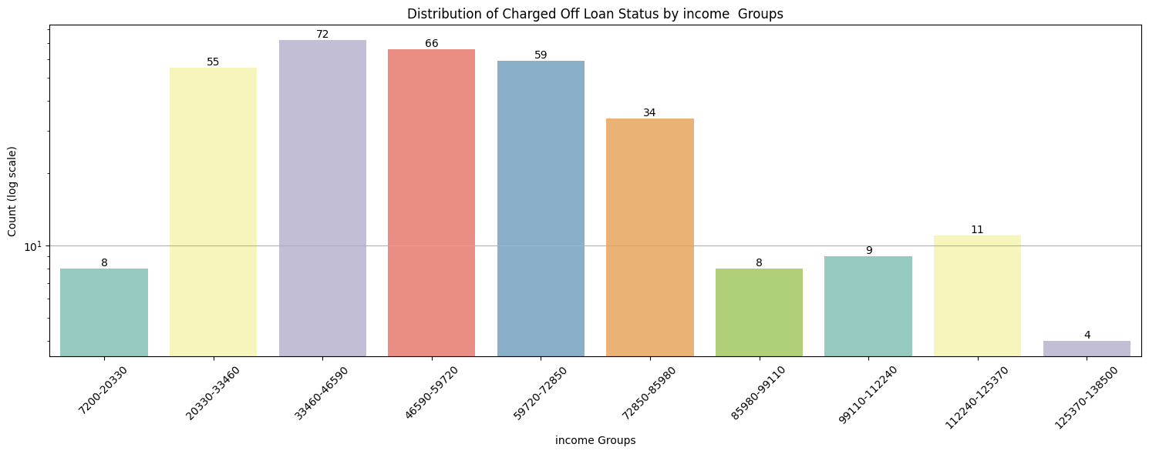
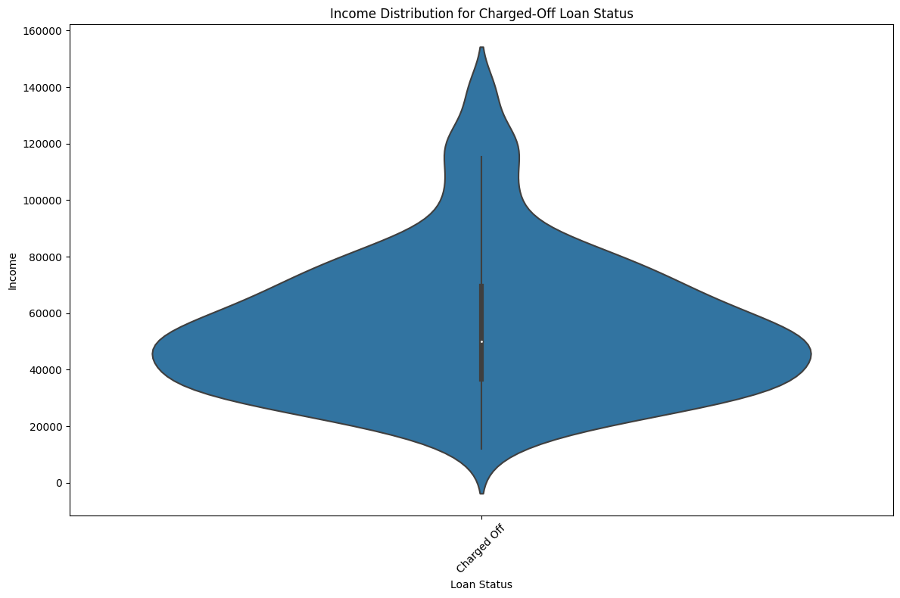
IMPACT OF INCOME ON DEFAULTING LOAN
CONCLUSION :
The number of charged off loans gradually increases as income increases and after a monthly income range of approx. 85k , the count of defaulting loans again decreases which is also evident from the violin plot.
From the violin plot , we can see that in mid income range , the data density of charged off loans increases .
Higher income correlates with lower default rates due to enhanced repayment capacity.
Lower-income borrowers often have smaller debts, offering financial stability.
Income's impact varies; initially manageable debt might become overleveraging, raising defaults.

Slide 12
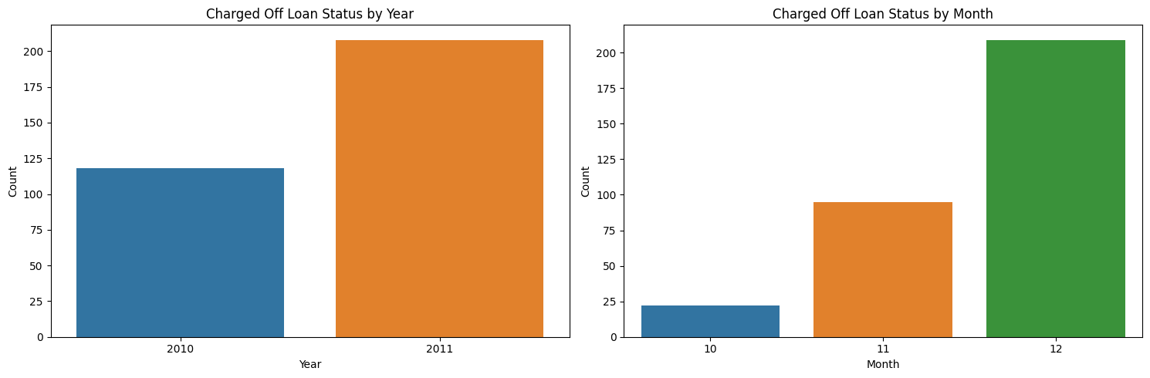
IMPACT OF INCOME ON DEFAULTING LOAN
CONCLUSIONS :
Over the analyzed period, Lending Club has steadily increased its loan disbursements. A marked upswing is observed from 2010 to 2011.
Intra-year loan issuance patterns fluctuate, with December witnessing the highest loan volume. This raises the question of whether end-of-year targets influence lending strategies.

Slide 13
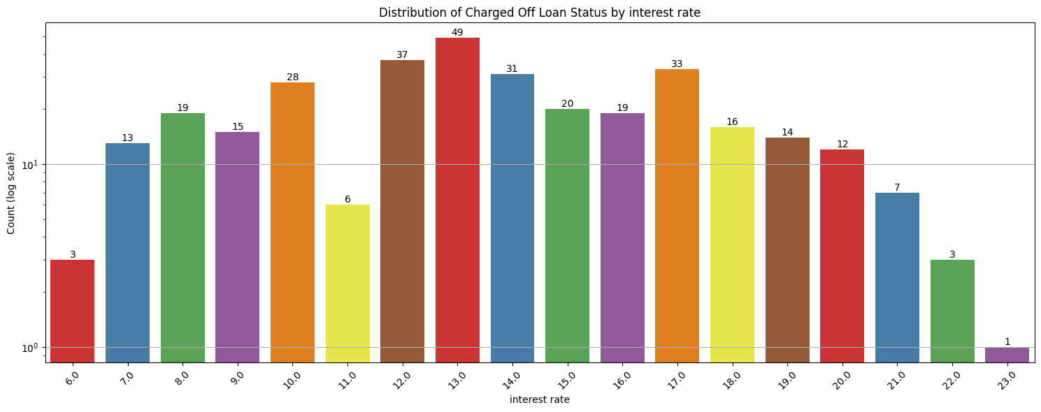
IMPACT OF INTEREST RATE ON DEFAULTING LOAN
CONCLUSIONS:
Rising interest rates initially correlate with increased defaulting count, followed by a decline beyond a certain threshold.
Impact of interest rates on defaults shows a bell curve distribution.
Majority of loans cluster around central rates, with fewer at extremes.
Higher rates: lower defaulting (stronger repayment intent); lower rates: riskier borrowers, higher defaults.

Slide 14
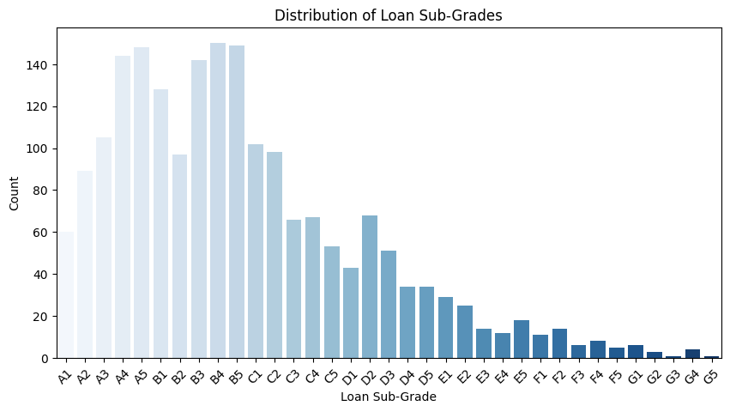
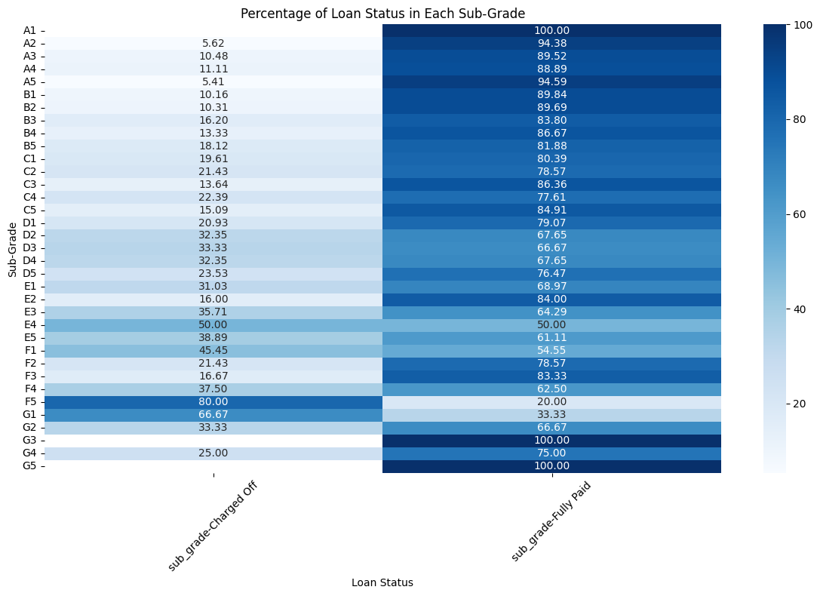
IMPACT OF LOAN SUBGRADE ON DEFAULTING LOAN
CONCLUSION :
Borrowers with loan grades beyond D2 exhibit higher default rates, indicating riskier repayment behavior.
Borrowers obtaining loan grades A or B demonstrate better repayment tendencies, resulting in higher successful loan payoffs.
Borrowers have greater tendencies of going for loan grades A or B.

Slide 15
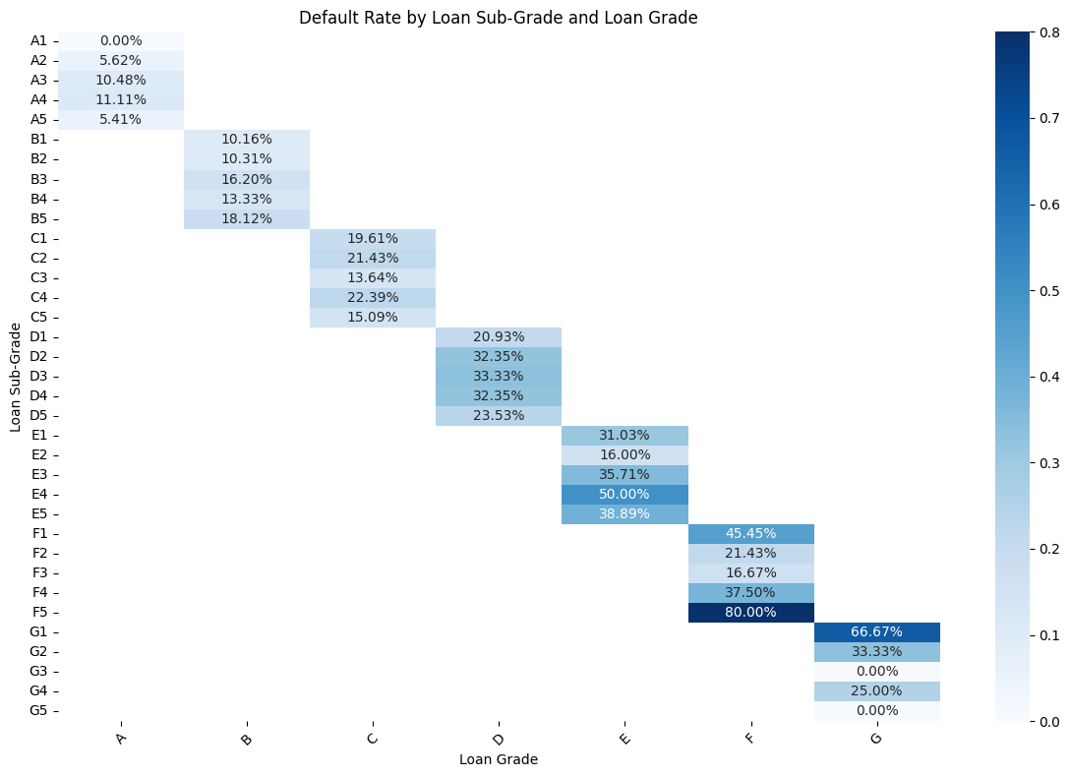
IMPACT OF LOAN GRADE & SUBGRADE ON DEFAULTING LOAN
CONCLUSIONS :
A or B grade loans have lesser chance of loan defaulting
Loan grade beyond D have higher chance of loan defaulting
Highest chance of loan defaulting comes under F grade(F5) followed by G grade (G1)
Highest chance of loan defaulting comes under A grade(A1)

Slide 16
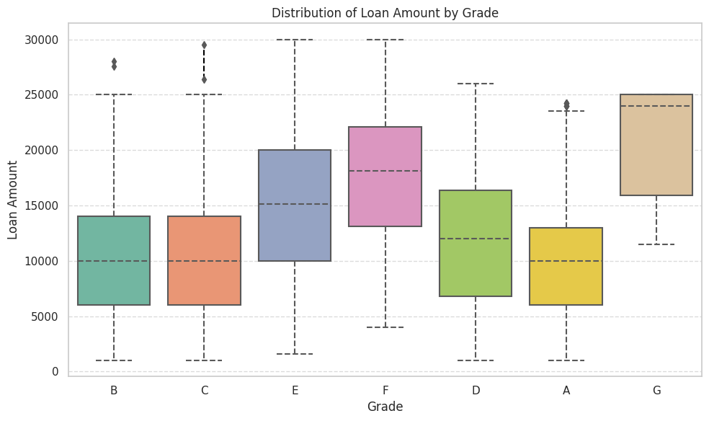
DISTRIBUTION OF LOAN AMOUNT BY LOAN GRADE
Typically, larger loans receive lower grades; the median amount for grade G loans is approximately $10,000 higher than that for grade A, B, or C loans.

Slide 17
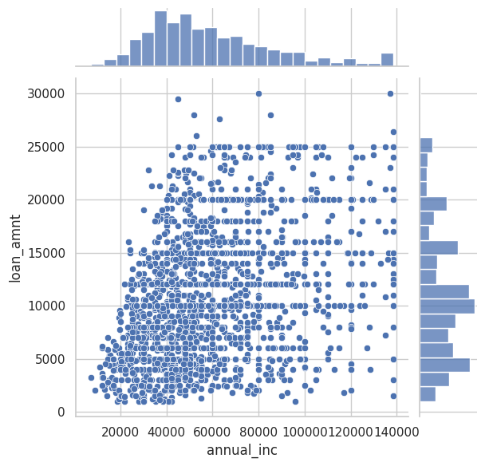
RELATION BETWEEN LOAN AMOUNT AND ANNUAL INCOME
CONCLUSION :
Borrowers with incomes below $50,000 securing loans of $25,000 or more pose potential risk due to potential financial strain.

Slide 18
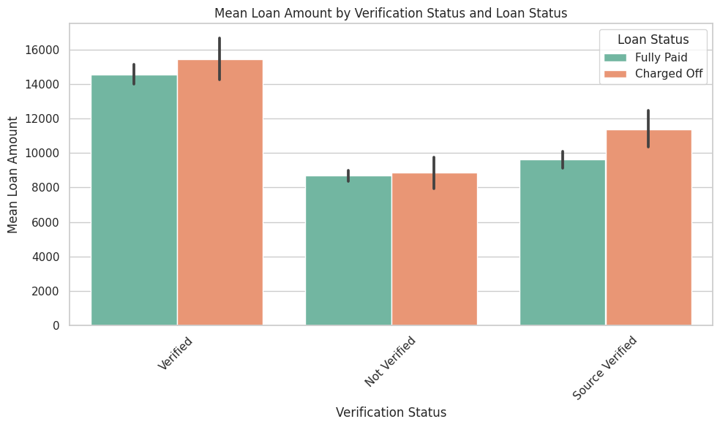
DISTRIBUTION OF LOAN AMOUNT BY VERIFICATION & LOAN STATUS
Mean loan amount for borrowers whose income source is verified is greater than the borrowers whose income source is not verified.
However , we can see the count of charged off loans is also high for income-verified borrowers which might due to greater count of loans of income source verified borrowers. Hence, finding out the percentage of total income verified borrowers would give a better insight to the data .

Slide 19
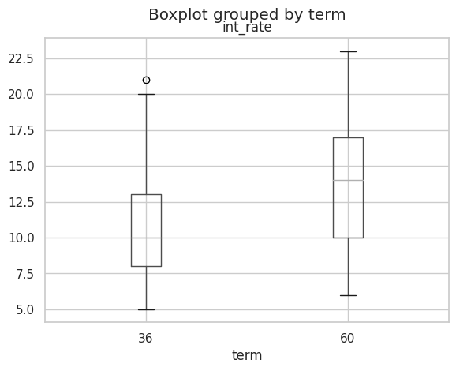
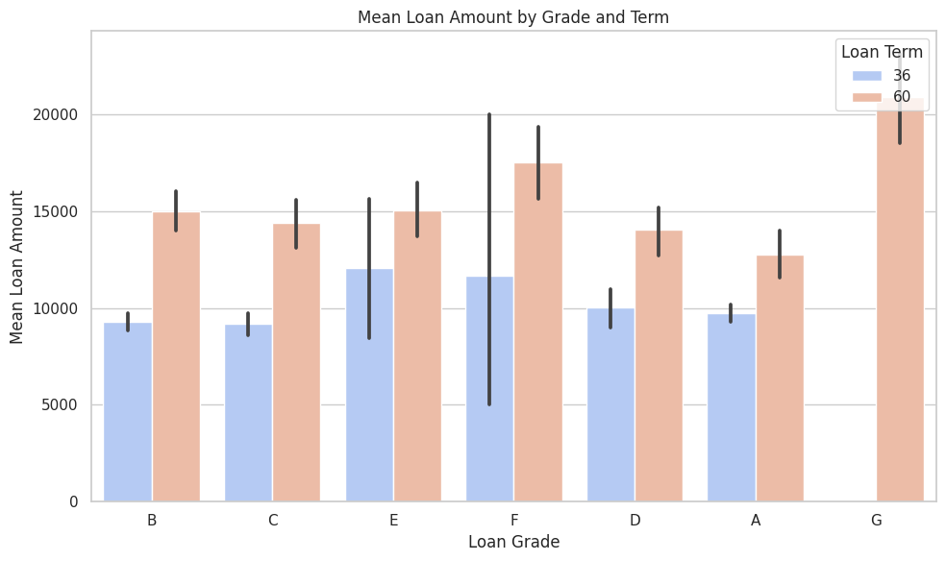
DISTRIBUTION OF INTEREST RATE AND LOAN AMOUNT OVER LOAN GRADES
Higher loan amount is given for low grade loans(like F or G)
Higher loan amount is given for 60 month loan term .
The median interest rate (including the range of interest ) at which the loan is given is higher for 60 month loan term than the 36 month loan term.

Slide 20
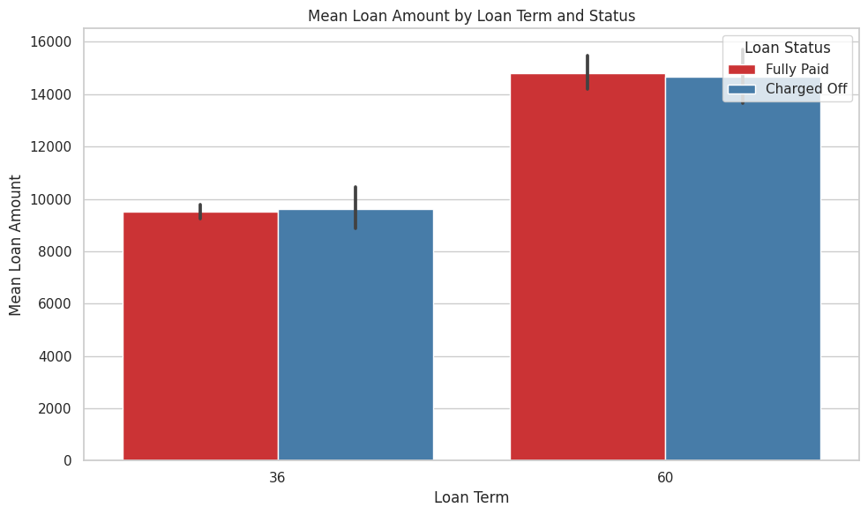
DISTRIBUTION OF LOAN AMOUNT OVER LOAN TERM
Higher loan amount is given for 60 month loan term .
The count of charged off loans is higher for 60 month loan term than 36 month loan term.

Slide 21
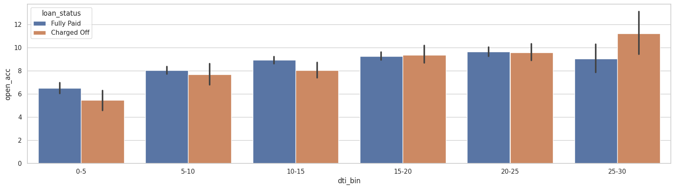
DISTRIBUTION OF NO. OF OPEN ACCOUNTS OVER DTI
Accumulated Debt: More credit lines can lead to borrowing from multiple sources, increasing total debt burden.
Higher Credit Utilization: Borrowers may use more available credit, elevating the ratio of debt to income.
Monthly Obligations: Each credit line adds monthly payments, contributing to higher DTI.
Risk Perception: Lenders might perceive numerous credit lines as higher risk due to potential overextension.

Slide 22
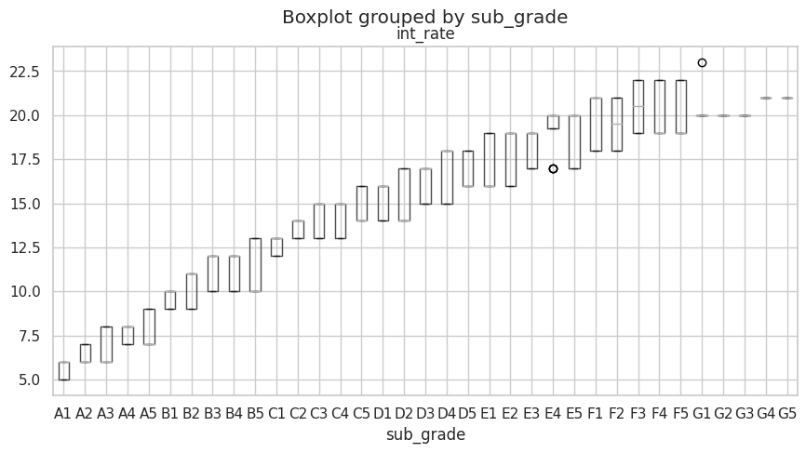
BOXPLOT BY SUB_GRADE
Interest rates show a direct correlation with subgrade.
Higher subgrades correspond to higher interest rates for loans, indicating increased perceived risk associated with larger or worse subgrades.

Slide 23
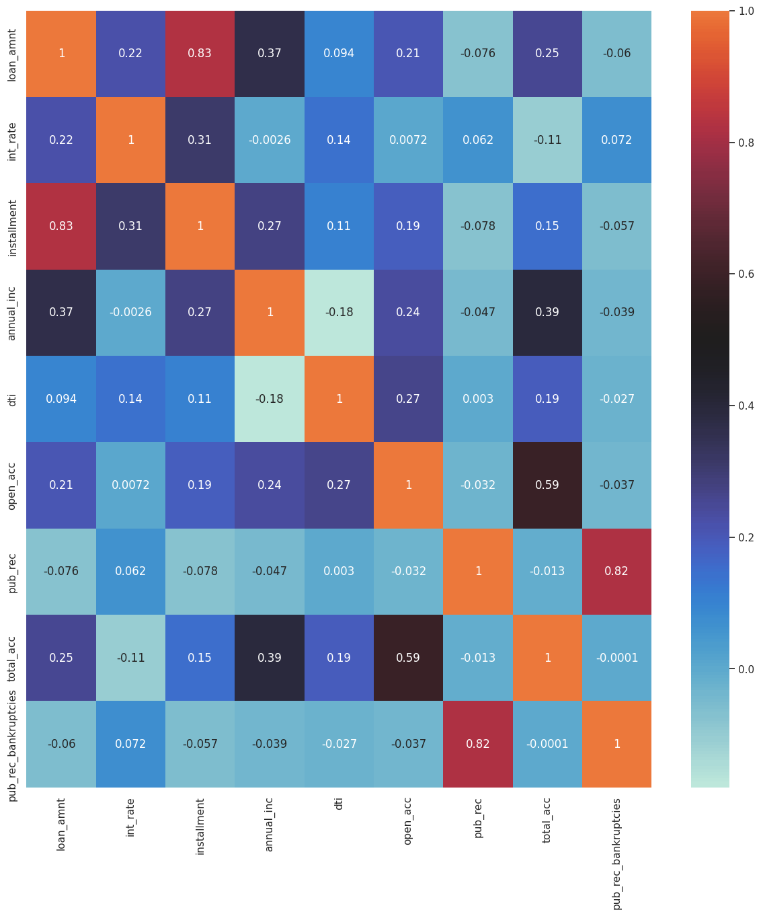
HEATMAP BETWEEN VARIABLES
The total number of credit lines currently in the borrower's credit file shows high correlation with opening credit line of borrower.
The monthly installment amount also have high correlation with loan amount which is self explanatory.

Slide 24
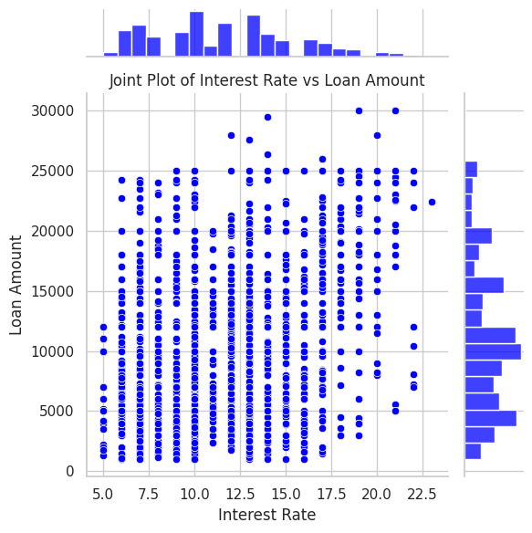
JOINT PLOT OF INTEREST RATE VS. LOAN AMOUNT
Lenders assess risk based on loan amount. Larger loans pose higher potential losses if defaulted. Hence, to compensate for this risk, lenders often charge higher interest rates. Higher loan amounts usually greater than $25000 are given at higher interest rates.

Slide 25
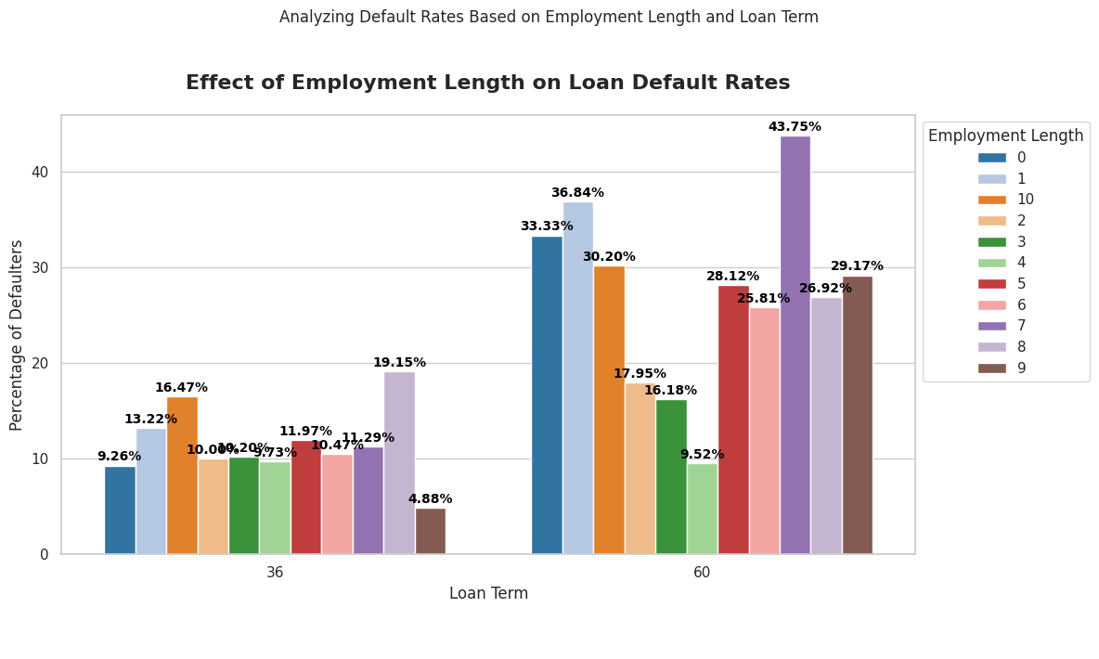
IMPACT OF EMPLOYMENT LENGTH ON LOAN DEFAULT STATUS
Clearly we can see that borrowers who have 10 + years of work experience shows highest percentage of loan defaulting both on 36 months and 60 months loan term .
Chances of defaulting are higher for 60 month loan term irrespective of employment length.

Slide 26
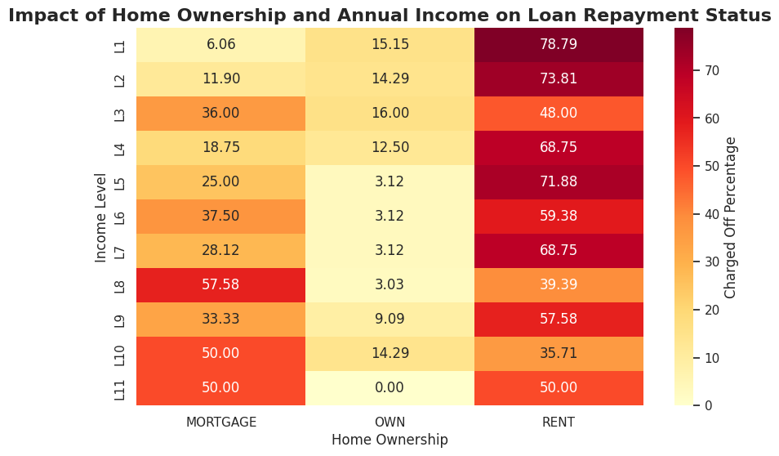
IMPACT OF HOME OWNERSHIP AND ANNUAL INCOME ON LOAN REPAYMENT STATUS
Clearly we can see that borrowers who have rent accommodation and L1 income level(lowest income level) shows the highest percentage of loan defaulting( 78.79 %) which is self explanatory.
Borrowers having their own home and highest income level ( L11) have 0 chance of loan defaulting.

Slide 27
SUMMARY
Borrowers who are renting among those who have the option of owning a home, and who have opted for a 36-month loan repayment term exhibit a notably higher count of loan defaults.
The impact of loan purpose on loan defaulting is evident, with the "debt consolidation" loan purpose exhibiting the highest percentage of loan defaults
Borrowers with unverified income sources and 10 years of work experience have a higher likelihood of loan defaulting which is quite interesting.
Borrowers with a debt-to-income ratio (DTI) between 21-29 exhibit the highest loan default counts.
Higher DTI ratios signify increased default risk.
Those have monthly instalment between 316-391 have highest counts of loan defaulting .
Higher income correlates with lower default rates due to enhanced repayment capacity.
Intra-year loan issuance patterns fluctuate, with December witnessing the highest loan volume. This raises the question of whether end-of-year targets influence lending strategies.
Borrowers with loan grades beyond D2 exhibit higher default rates, indicating riskier repayment behavior.
Borrowers obtaining loan grades A or B demonstrate better repayment tendencies, resulting in higher successful loan payoffs.
Highest chance of loan defaulting comes under F grade(F5) followed by G grade (G1)
Least chance of loan defaulting comes under A grade(A1)

Slide 28
SUMMARY
Typically, larger loans receive lower grades; the median amount for grade G loans is approximately $10,000 higher than that for grade A, B, or C loans.
The total number of credit lines currently in the borrower's credit file shows high correlation with opening credit line of borrower.
The monthly installment amount also have high correlation with loan amount which is self explanatory.
Lenders assess risk based on loan amount. Larger loans pose higher potential losses if defaulted. Hence, to compensate for this risk, lenders often charge higher interest rates. Higher loan amounts usually greater than $25000 are given at higher interest rates.
Clearly we can see that borrowers who have 10 + years of work experience shows highest percentage of loan defaulting both on 36 months and 60 months loan term .
Chances of defaulting are higher for 60 month loan term irrespective of employment length.
Clearly we can see that borrowers who have rent accommodation and L1 income level(lowest income level) shows the highest percentage of loan defaulting( 78.79 %) which is self explanatory.
Borrowers having their own home and highest income level ( L11) have 0 chance of loan defaulting.

