Slide 1
♻
EcoSort AI
AI-Powered Waste Identification
& Responsible Disposal Assistant
AI for Sustainability Virtual Internship
In collaboration with IBM SkillsBuild & AICTE
Presented by
Arjun Patil
Sphoorthy Engineering College
SDG 12 • Responsible Consumption & Production

Slide 2
The Problem
02
Why everyday waste segregation needs accessible guidance
01 Confusion
02 Incorrect Segregation
03 Lack of Accessible Guidance
People may not know which category an unfamiliar waste item belongs to.
Incorrect sorting can reduce the effectiveness of recycling and waste-management processes.
Users need quick, understandable guidance at the moment they dispose of an item.
PROBLEM STATEMENT
How might we use AI to identify and classify everyday waste so that people can make more informed and responsible disposal decisions?
EcoSort AI • AI for Sustainability Virtual Internship
2

Slide 3
Target Users & Stakeholders
03
Who benefits from easier access to waste-classification guidance
Students & Households
Educational Institutions
Communities
Environment
Quick guidance when disposing of unfamiliar everyday items.
A practical tool for demonstrating sustainable waste-segregation habits.
Accessible information that can support more responsible disposal decisions.
Potentially better segregation and greater awareness of responsible waste handling.
EcoSort AI • AI for Sustainability Virtual Internship
3

Slide 4
Our Solution — EcoSort AI
04
A simple image-based workflow focused on the user's disposal decision
Upload a photo of a waste item and receive an AI-assisted classification, disposal guidance, and an eco tip.
01
02
03
04
05
UPLOAD
ANALYZE
CLASSIFY
GUIDE
ACT
User uploads an image
Vision model examines the item
Waste category is identified
Disposal guidance is provided
User makes a more informed choice
SUPPORTED CATEGORIES
Organic • Paper • Plastic • Glass • Metal • E-Waste • Other / Unknown
EcoSort AI • AI for Sustainability Virtual Internship
4

Slide 5
AI Technology & Workflow
05
Where AI contributes to the solution
Multimodal AI
Prompt-Guided Decision Support
The application is designed to accept an image as input and use a vision-capable model to identify the primary waste item.
A structured prompt requests an item, category, assessment, disposal guidance, and eco tip while handling unclear images conservatively.
AI WORKFLOW
Image
→
Vision Model
→
Classification
→
Guidance
Planned integration
IBM watsonx.ai + IBM Granite Vision
Submission status: prototype interface and AI workflow are implemented; live IBM credential/model configuration is a future technical step.
EcoSort AI • AI for Sustainability Virtual Internship
5

Slide 6
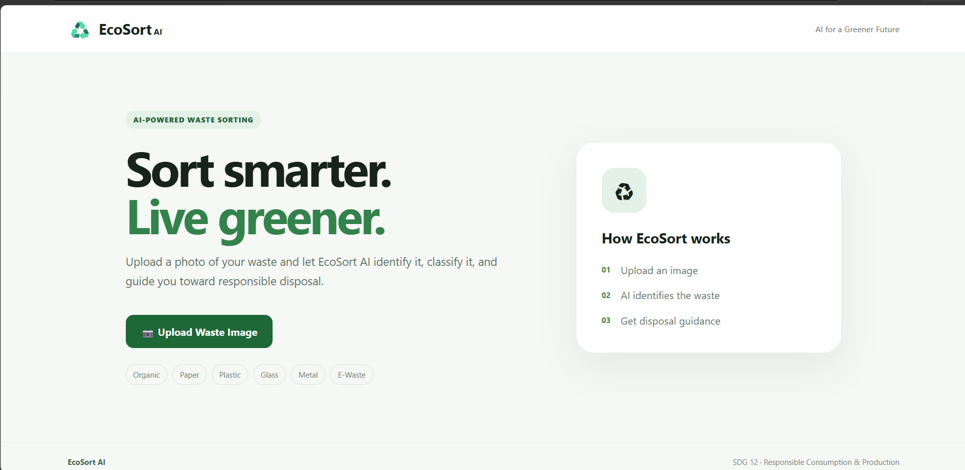
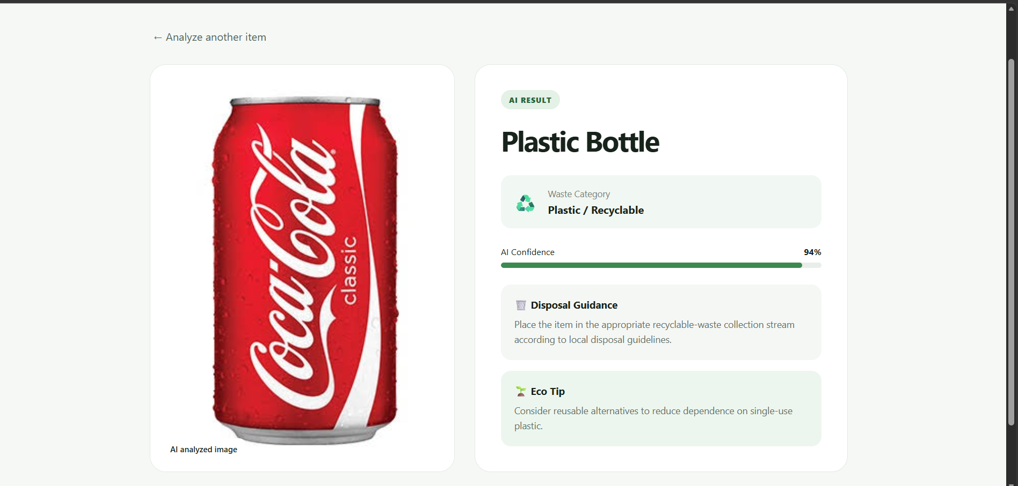
Prototype — User Interface
06
Screenshots of the current EcoSort AI prototype
Home / upload experience
Prototype analysis result screen
EcoSort AI • AI for Sustainability Virtual Internship
6

Slide 7
Prototype Output
07
Illustrative output captured from the current prototype
Disposal Guidance
Plastic Bottle
Place the item in the appropriate recyclable-waste collection stream according to local disposal guidelines.
WASTE CATEGORY
Plastic / Recyclable
PROTOTYPE ASSESSMENT
94%
Eco Tip
The percentage shown here is a prototype display value, not a calibrated probability.
Consider reusable alternatives to reduce dependence on single-use plastic.
EcoSort AI • AI for Sustainability Virtual Internship
7

Slide 8
Responsible AI Considerations
08
Required considerations for fairness, transparency, ethics, and privacy
Fairness
Transparency
Privacy
Focus decisions on the waste item rather than user characteristics or unrelated assumptions.
Explain that classifications are AI-generated assessments and may be uncertain.
Avoid unnecessary personal or sensitive information in uploaded images.
Safety & Accuracy
Local Context
When an image is unclear, avoid confident guessing and use an unknown category or recommend verification.
Waste rules differ by location; guidance should encourage users to follow local waste-management policies.
EcoSort AI • AI for Sustainability Virtual Internship
8

Slide 9
SDG Alignment
09
Primary focus: SDG 12 — Responsible Consumption & Production
HOW ECOSORT AI SUPPORTS SDG 12
SDG
01
Promotes awareness of responsible waste segregation.
12
02
Supports more informed disposal decisions.
Responsible
Consumption
& Production
03
Encourages recycling and reuse-oriented thinking.
04
Creates a practical AI application for sustainability education.
Secondary relevance: SDG 11 — Sustainable Cities & Communities • SDG 13 — Climate Action
EcoSort AI • AI for Sustainability Virtual Internship
9

Slide 10
Expected Impact
10
What changes if EcoSort AI is implemented?
Environmental
Social
Future Potential
• Better awareness of waste segregation
• Potentially improved recycling decisions
• Greater visibility of reuse and responsible disposal
• Quick and accessible guidance
• Supports sustainability education
• Helps users handle unfamiliar items with more confidence
• Local disposal guidance
• Recycling/reuse recommendations
• Larger evaluation dataset
• Improved uncertainty handling
IDENTIFY → INFORM → ENABLE RESPONSIBLE ACTION
EcoSort AI • AI for Sustainability Virtual Internship
10

Slide 11
Project Status & Future Development
11
What is complete and what can be developed next
COMPLETED
Concept, problem definition, SDG mapping, UI prototype, upload flow, result interface, disposal guidance, and eco tips.
PROTOTYPE EVIDENCE
Screenshots demonstrate the intended user journey from image upload to a structured waste-analysis result.
NEXT TECHNICAL STEP
Connect the existing backend to a configured IBM watsonx.ai / Granite Vision deployment when access is available.
FUTURE ENHANCEMENTS
Local policy/RAG integration, stronger validation, expanded categories, evaluation dataset, and improved uncertainty communication.
EcoSort AI • AI for Sustainability Virtual Internship
11

Slide 12
♻
Thank You
EcoSort AI
Sort smarter. Live greener.
AI for Sustainability Virtual Internship
Sphoorthy Engineering College
Arjun Patil
SDG 12 • Responsible Consumption & Production

