Slide 1
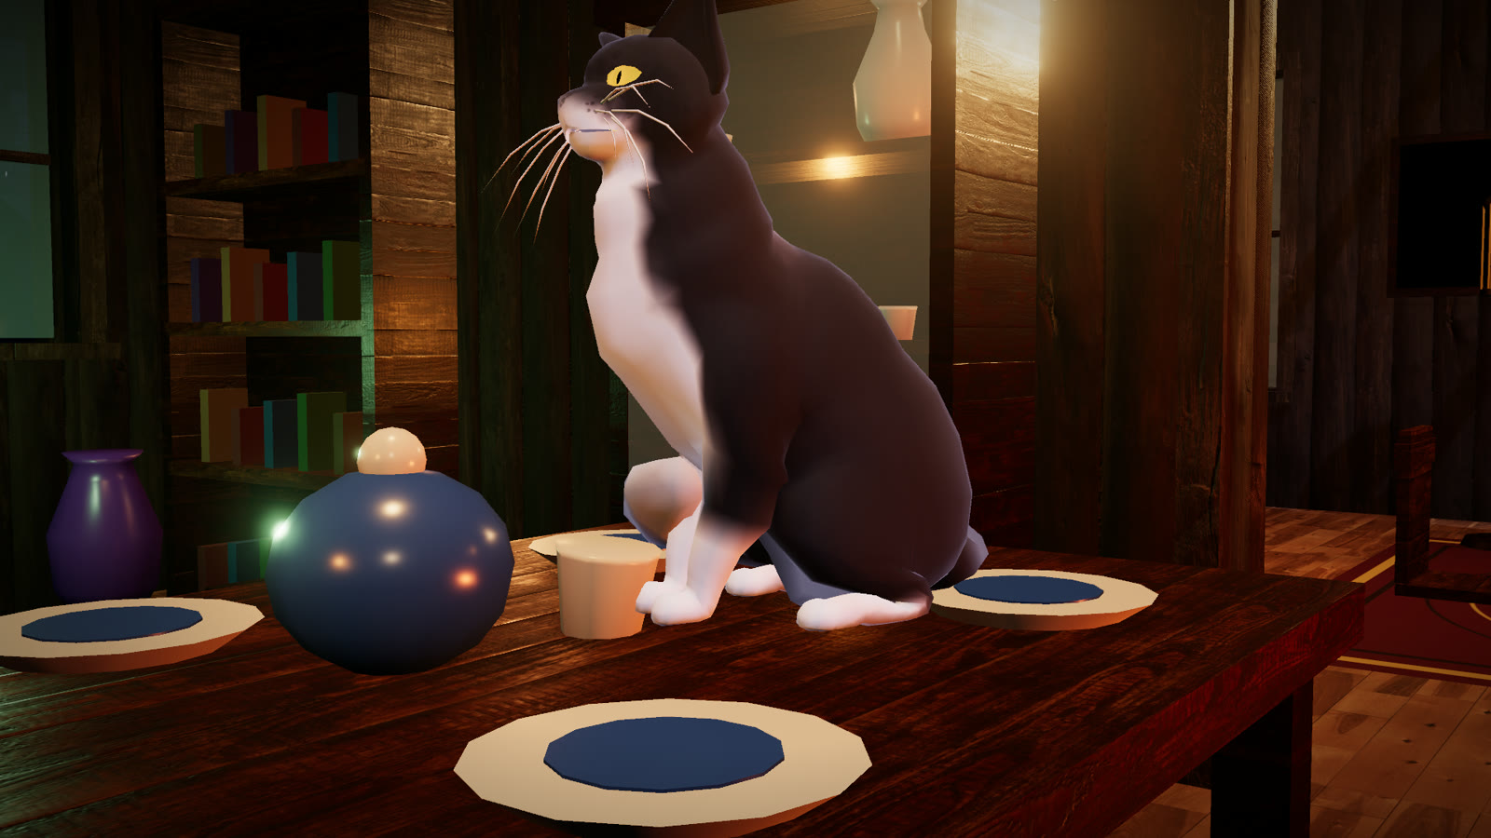

ONE CAT. TWO FLOORS. NO DEPOSIT REFUNDS.
Use Grandma’s temper to destroy her house.
A third-person physics comedy starring Komur, a black cat with white paws and amber eyes.
Game Jam Europe 2026 · plays in the browser
Notes:
Hook: a black cat who makes a superstitious Grandma wreck her own house.

Slide 2
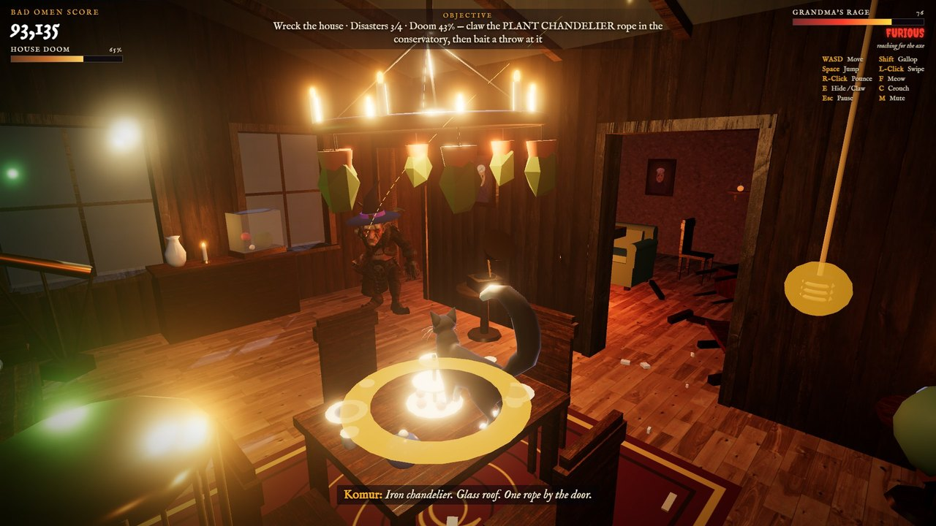
Taunt. Dodge. Let Granny smash it
1
TAUNT
Meow at Grandma until she reaches for the heavy cutlery.
2
AIM
Stand in front of a glowing weak spot: her throw is aimed through you.
3
DODGE
Gallop clear at the last moment. A hit leaves you seeing stars, and she grabs.
4
SHE SMASHES IT
Grandma winds up an axe; its glowing arc runs past Komur to the plant chandelier’s rope in the conservatory.
Ropes, stoves, floors, the glass roof, and finally the roof brace.
“GRANNY DID IT” doubles the points.
Notes:
The core loop: the cat cannot break the big stuff; the angry homeowner does it for him.

Slide 3
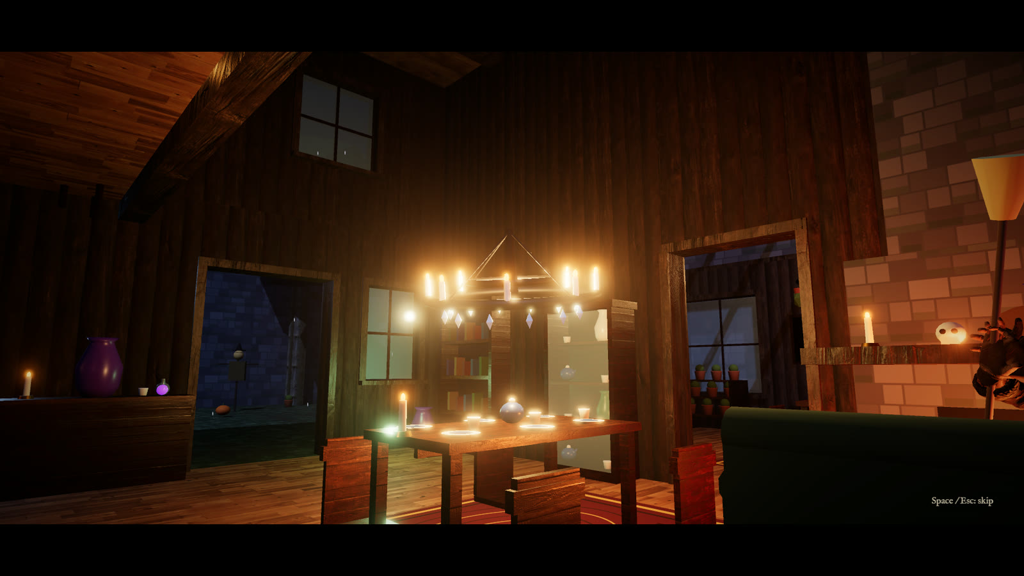
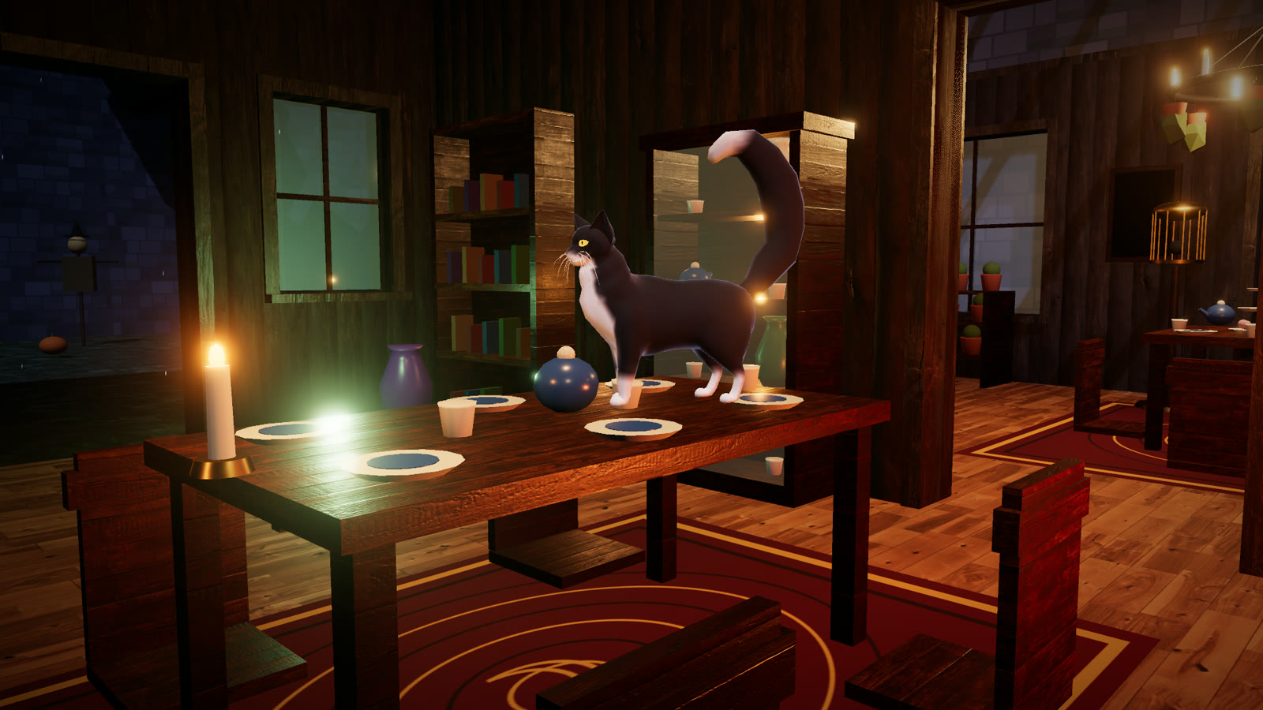
A cat that moves like one, a house that breaks like one
375
42
77
9
breakable props
cat animations
voiced lines
disasters
Komur in headless Blender
Grandma’s brain
Recoloured base model, 38 procedural clips: catwalk, gallop, aimed leaps, climbs, grooming. A runtime layer bends spine, tail and head.
Sight and hearing, A* across two floors and the garden, telegraphed throws steered by the cat’s bait.
Physics destruction
Runs in a browser tab
Rapier rigid bodies; props fracture into persistent debris, then five authored set pieces take over.
three.js WebGL2 with no shader hitches; music that follows the chase; touch controls on phones.
The Last Supper (top); Komur on the dining table.
Notes:
Technical execution: everything here was built during the jam on top of two licensed base characters.

Slide 4
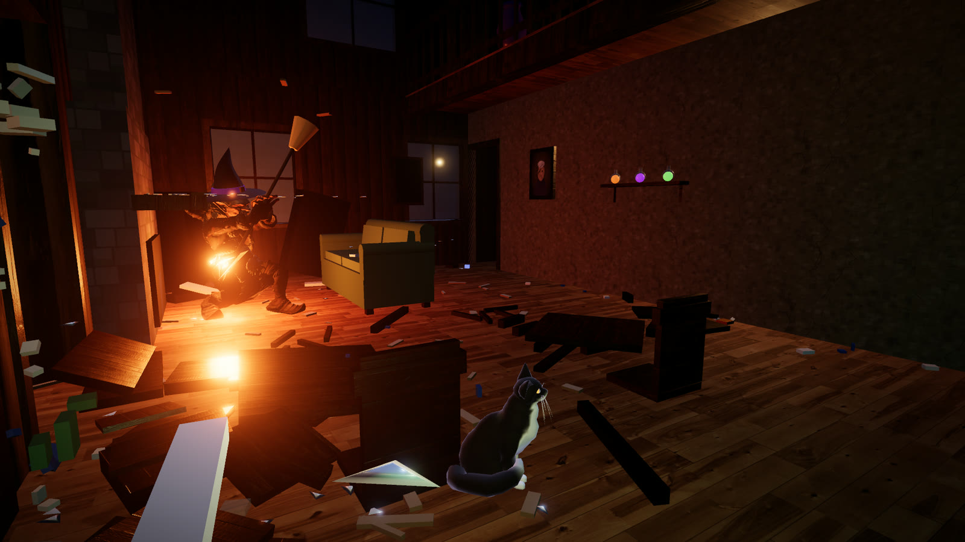
The angrier she gets, the more the house loses
GRANDMA’S RAGE
Suspicious
mutters and follows noises
Hunting
chases you; teapots and plates
Enraged
the good china, the frying pan
Furious
axes and pitchforks
MELTDOWN
tantrums and the enchanted axe
The Last Supper · The Kitchen Curse · The Bedroom Below · The Glass House · The Final Straw
Plus four bonus disasters, combos up to x5, 16 achievements and a rank. Damage persists. Get caught after the tutorial and it’s into her cauldron.
Notes:
Progression: rage phases unlock heavier weapons; disasters unlock the finale; scoring rewards chains and making Grandma do it.

Slide 5
So who’s the bad omen?
The superstition is the premise
Grandma blames the black cat for her bad luck, then demolishes her own house trying to catch him.
The cat is the mechanic
Leaps, swipes, taunts and dodges. Komur has no weapons, only mischief and timing.
The cat is the narrator
WASD walk · Shift gallop · Space leap · Click swipe · F taunt · E hide / scratch · phones and tablets: touch controls, in landscape
A dry inner monologue against an increasingly unhinged Grandma: “I barely lifted a paw.”
Play in the browser: [link to be added on upload]
Komur’s base model: “Somali Cat Animated ver 1.2” by DreamNoms (CC BY 4.0) · Grandma: Adobe Mixamo · wood textures: Poly Haven (CC0) · voices: ElevenLabs · music: Bombinsound (Pixabay), ElevenLabs
Notes:
Why Komur matters: the superstition is the premise, the cat is the mechanic and the narrator.

