Slide 1
DL-Vizard A Visualization Toolkit for Deep Learning Models
Team Name – npHard

Slide 2
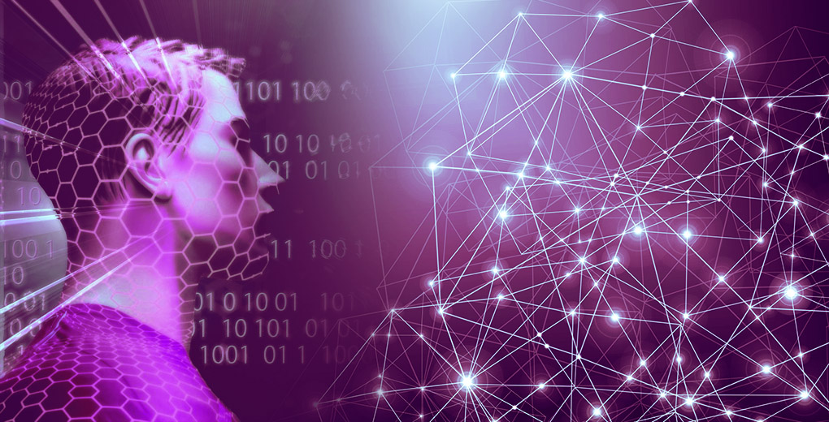
WHAT’S THE PROJECT?
One of the most debated topics in deep learning is how to interpret and understand a trained model – particularly in the context of high risk industries like healthcare.
How can we trust the results of a model if we can’t explain how it works?
Through this project, we have tried to create a toolkit in Python for visualizing various deep learning models particularly used in most state-of-the-art image based applications.
Notes:
Take the example of a deep learning model trained for detecting cancerous tumours. The model tells you that it is 99% sure that it has detected cancer – but it does not tell you why or how it made that decision. Did it find an important clue in the MRI scan? Or was it just a smudge on the scan that was incorrectly detected as a tumour? This is a matter of life and death for the patient and doctors cannot afford to be wrong.

Slide 3
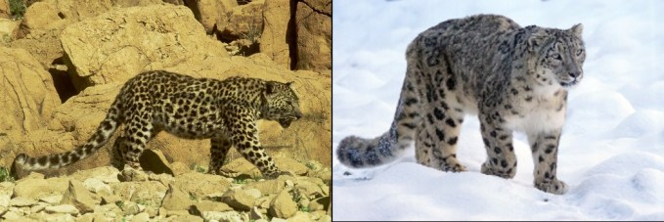
WHAT’S THE NEED?
Why turn to the off-beaten path of visualization?
Let’s consider a project where we need to classify images of animals, like snow leopards and Arabian leopards.
Intuitively, we can differentiate between these animals using the image background. Both animals live in starkly contrasting habitats. The majority of the snow leopard images will have snow in the background while most of the Arabian leopard images will have a sprawling desert.
Here is the problem - the model may start classifying snow versus desert images. So, how do we make sure our model has correctly learned the distinguishing features between these two leopard types? The answer lies in the form of visualization.

