Slide 1





Connected Cars
The future of mobility
FORTIFY
TEAM 27

Slide 2



Problem
Priority to Emergency Vehicles
According to Times of India, 1,46,133 were killed in road accidents and 30% of them were due traffic delays.
According to mygov.in, 25.8% of deaths could be avoided if there were no traffic delays.
This tells us that traffic is a major concern in general and also very dangerous for emergency vehicles.
FORTIFY
TEAM 27

Slide 3








Solution
Communicate to cars ahead about approaching ambulance & to clear out the right most lane.
The driver first enters the destination to get the best possible route.
The CCTV network of the route gets active and starts to collect data.
The vehicles are inspected
Our image processing algoritm now processes this videos and looks for numberplates.
Using R.T.O. database, phone numbers are extracted from the number plate values.
Drivers recive a notification on their phones.
RJ-XX-YYYY
FORTIFY
TEAM 27

Slide 4

Solution
Using an algorithm to predict traffic flow using the density of the cars and flucuate traffic lights accordingly.
The CCTV network of the route gets active and starts to collect video.
Switch the traffic light counter for the next 15 minutes
Count the density of cars for 15 minutes
FORTIFY
TEAM 27

Slide 5
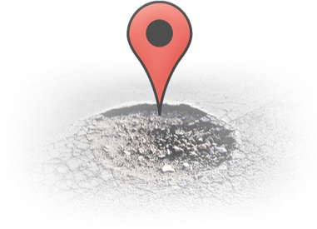




Solution
Detecting bad road condition (Potholes) and drowsiness detection for better and safe driving
Smartphone camera gets video feed from road
Sends log data
Model detects Potholes
Smartphone camera gets video feed of user
Analyzes face in real time
Alerts the driver if drowsiness is detected
FORTIFY
TEAM 27

Slide 6



Value Proposition
Extracting greater values from existing technologies
Our solution works on the existing technologies present i.e CCTVs on traffic lights and elsewhere in the city, we are only extracting more information from them for a better and safe road.
FORTIFY
TEAM 27

Slide 7
How it Works
1.
The CCTV network of the route gets active and starts to collect data.
The driver first enters the destination to get the best possible route.
The vehicles are inspected
Our image processing algoritm now processes this videos and looks for numberplates.
Using R.T.O. database, phone numbers are extracted from the number plate values.
Drivers recive a notification on their phones.
RJ-XX-YYYY
2.
The CCTV network of the route gets active and starts to collect video.
Switch the traffic light counter for the next 15 minutes
Count the density of cars for 15 minutes
FORTIFY
TEAM 27

Slide 8

Android App for ambulance location input
Number plate recognizer API for getting number plate from live video
Technologies Used
Way2Sms API for informing users to notify them
Firebase for database management
OpenCV vehicle counting method for density calculation
Yolov2 for Pothole detection
FORTIFY
TEAM 27

Slide 9




The Team
Akshita Mehta
Naman Bansal
Arjun Mohnot
Swapnil Panwala
Bennett University
FORTIFY
TEAM 27

